Slide 1

Backup workshop
Yi Shen
Mar 18th, 2014
Stanford Exploration Project

Slide 2
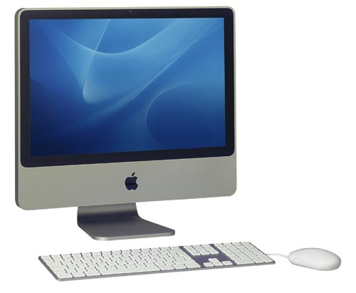
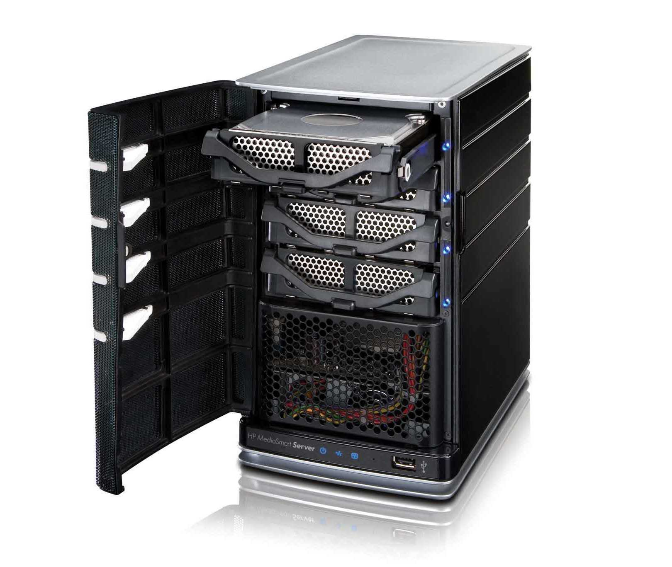
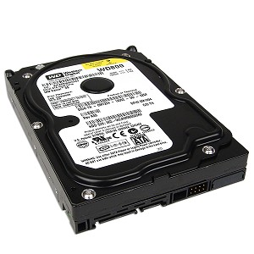
Two procedures

Slide 3
Two procedures

Slide 4
Two procedures
rsync & crontab

Slide 5
Two procedures
rsync & crontab

Slide 6
Two procedures
rsync & crontab
Time machine

Slide 7
The first procedure
rsync & crontab
Time machine

Slide 8
Introduction of rsync
Synchronize your files and directories from the server to your local computer;
Only back up the changes

Slide 9
Introduction of crontab
Allows tasks to automatically run in the background of the system at given intervals;
Helps you do the backup once a day without manual operation.

Slide 10
Procedure
Make a directory in your mac for backup
Copy the script to your backup directory
Change the script
Manually run the script
Create a cron schedule
Check the success of your crontab

Slide 11
Procedure
Make a directory in your mac for backup
e.g. mkdir ~/backup
Create a file on the server for monitor
e.g mkdir ~/backup/
Create a txt file like “I am doing backup”

Slide 12
Procedure
Make a directory in your mac for backup
Copy rsync script to your backup directory
Change the script
Manually run the script
Create a cron schedule
Check the success of your crontab

Slide 13
Procedure
Download it from
http://sepwww.stanford.edu/data/media/public/sep/yishen/backup/

Slide 14
Procedure
Make a directory in your mac for backup
Copy the rsync script to your backup directory
Change the script
Manually run the script
Create a cron schedule
Check the success of your crontab

Slide 15
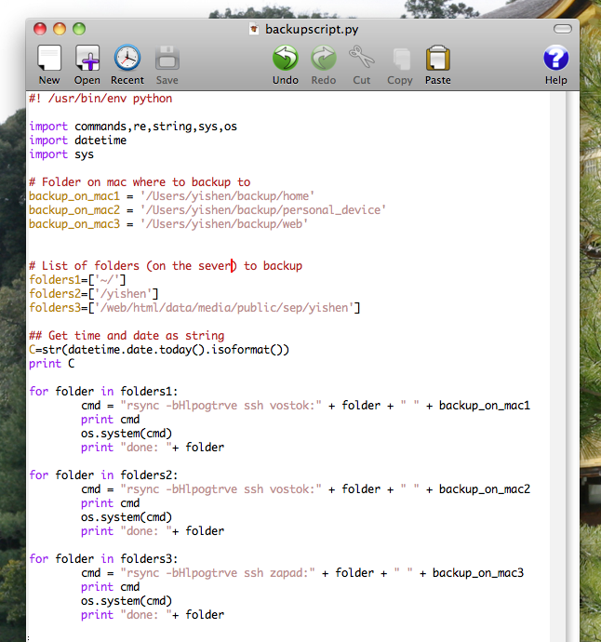

Slide 19
Procedure
Make a directory in your mac for backup
Copy the script to your backup directory
Change the script
Manually run the script
Create a cron schedule
Check the success of your crontab

Slide 20
Manually test
./backupscript.py
The first backup will take a while
Manually running the script for your first backup during the weekend or in the evening instead of using crontab is recommended.

Slide 21
Procedure
Make a directory in your mac for backup
Copy the script to your backup directory
Change the script
Manually run the script
Create a cron schedule
Check the success of your crontab

Slide 22
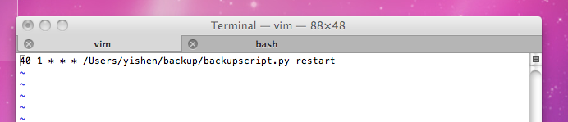
Create a cron schedule
Type “crontab –e” in the terminal window
The text editor will open a blank window for the “crontab entries” to be entered.
Each line presents a separate cron jobs.

Slide 23
Create a cron schedule
* * * * * /Users/yishen/backup/backupscript.py restart

Slide 24
Create a cron schedule
* * * * * /Users/yishen/backup/backupscript.py restart

Slide 25
Create a cron schedule
* * * * * /Users/yishen/backup/backupscript.py restart

Slide 26
Create a cron schedule
An asterisk (*) is used to indicate that every instance of the particular time period will be used.
* * * * *

Slide 27
Create a cron schedule
An asterisk (*) is used to indicate that every of the particular time period will be used.
* * * * *
Minute 0-59

Slide 28
Create a cron schedule
An asterisk (*) is used to indicate that every of the particular time period will be used.
* * * * *
Hour 0-23 (0 = midnight)

Slide 29
Create a cron schedule
An asterisk (*) is used to indicate that every of the particular time period will be used.
* * * * *
Day 1-31

Slide 30
Create a cron schedule
An asterisk (*) is used to indicate that every of the particular time period will be used.
* * * * *
Month 1-12

Slide 31
Create a cron schedule
An asterisk (*) is used to indicate that every of the particular time period will be used.
* * * * *
Weekday 0-6

Slide 32
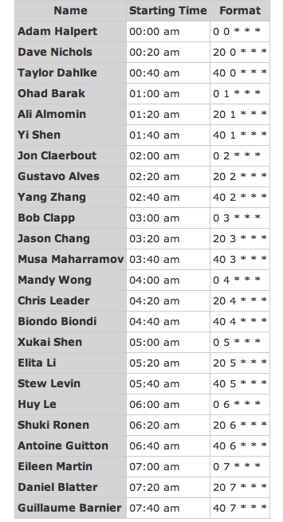
Change asterisks(*) accordingly

Slide 33
Change asterisks(*) accordingly

Slide 34
Change asterisks(*) accordingly
For example, Yi Shen’s command would look:
40 1 * * * /Users/yishen/backup/backupscript.py restart

Slide 35
Procedure
Make a directory in your mac for backup
Copy the script to your backup directory
Change the script
Manually run the script
Create a cron schedule
Check the success of your crontab

Slide 36
Check
Type “ls -ltr /var/mail”
Check the time shown in bold as follows
-rw------- 1 yishen mail 5559 Mar 16 1:40 yishen

Slide 37
Check
Type “ls -ltr /var/mail”
Check the time shown in bold as follows
-rw------- 1 yishen mail 5559 Mar 16 1:40 yishen

Slide 38

Check (2)
Growl

Slide 39
Notice
The first backup will take a while
Manually running the script for your first backup during the weekend or in the evening instead of using crontab is recommended.

Slide 40
The second procedure
rsync & crontab
Time machine

Slide 41
Procudures
Initialize your hard drive
Use time machine to back up your local computer

Slide 42
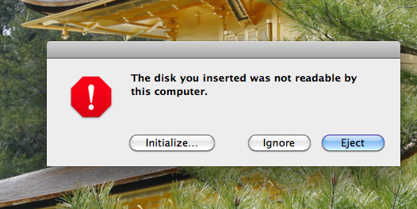
Initialize your hard drive

Slide 44
Procudures
Initialize your hard drive
Use time machine to back up your local computer

Slide 45
Introduction of time machine
The built-in backup that works with your Mac and an external drive;
Automatically backs up your entire Mac;
Remembers how your system looked on any given day;
Performs subsequent hourly backups of only the files that have changed on your Mac since the last backup

Slide 46
Change the backup interval
From the command line
Point-and-click

Slide 47
Change the backup interval
sudo defaults write
/System/Library/LaunchDaemons/com.apple.backupd-auto StartInterval -int 18000

Slide 48
Change the backup interval
sudo defaults write
/System/Library/LaunchDaemons/com.apple.backupd-auto StartInterval -int 18000
backup interval in seconds
— five hours

Slide 49
Change the backup interval
From the command line
Point-and-click
Time machine scheduler

Slide 50
Notice
The first backup may take a while;
Set up Time Machine in the evening so that the initial backup can be done overnight.

Slide 51
Acknowledgement
Thanks Sjoerd for helping with the rsync script
Thanks Bob for purchasing the cases
Thanks Ohad for providing the internal hard drives

Slide 52
Thank you
Yi Shen
Mar 18th, 2014
Stanford Exploration Project

