Slide 1

A new algorithm for bidirectional deconvolution
Yi Shen, Qiang Fu and Jon Claerbout
SEP143 P271-281
Stanford Exploration Project

Slide 2
Motivation
For mixed phase wavelet
Zhang, Y. and J. Claerbout, 2010, A new bidirectional deconvolution method that overcomes the minimum phase assumption: SEP-Report, 142, 93–103.

Slide 3
Motivation
Fitting goal:
Hyperbolic:
Claerbout, J. F., 2010, Image estimation by example.
Notes:
D a b first
Convolution
Find a and b to minimize
Hyper norm is introduced by Jon
R
We use this instead of a and b because use a smooth function to produce a sparse model

Slide 4
Motivation
Bidirectional deconvolution formulation
Notes:
Instead of solving the non-linear problem,
Alternatety
fix

Slide 5
Motivation
Bidirectional deconvolution formulation
Slalom

Slide 6
Problem of the slalom method
Battle between the causal and anti-causal filter
Low convergence rate
Unstable deconvolution result
Two different filters when dealing with the zero phase wavelet

Slide 7

Outline
Motivation
Theory
Data examples
1D synthetic data
2D synthetic data
2D field data
Conclusion

Slide 8
Theory
The fitting goal
Notes:
Lets introduce the new alg

Slide 9
Theory
The fitting goal
Consider perturbations of two filters
Notes:
Again overcome the minimum

Slide 10
Theory
The fitting goal
Consider perturbations of two filters
Neglect the non –linear term
Notes:
Linearized fitting function
Each iteration
New model

Slide 11
Theory
Fitting goal
Y and K are the mask matrix
Notes:
New model
Operator
Mask matrix

Slide 12
Theory
Fitting goal
Y and K are the mask matrix
Symmetric
Notes:
Regard this equally

Slide 13
Theory
Notes:
Simple sceoudo code
As the conventional inversion problem ,use cgstep
In the linear iteration we find the model
Update a and b in the non-linear iteration generates new operator

Slide 14
Outline
Motivation
Theory
Data examples
1D synthetic data
2D synthetic data
2D field data
Conclusion
Notes:
Compare the symmetric method with slalom method to look the advantage and dis of them

Slide 15
Outline
Motivation
Theory
Data examples
1D synthetic data
2D synthetic data
2D field data
Conclusion

Slide 16
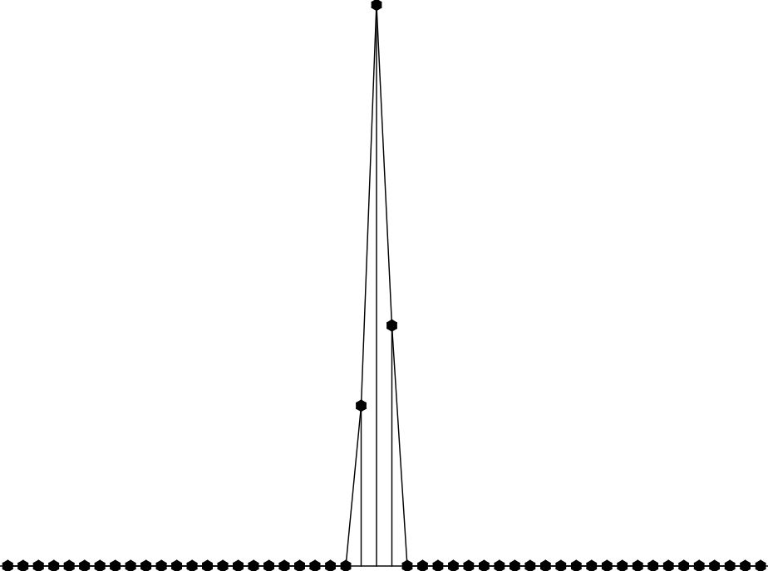
Three points data ［2，7，3］

Slide 17
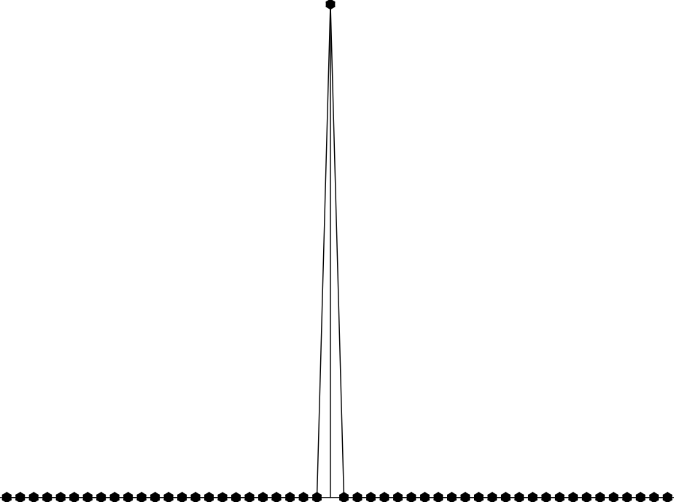
Result by symmetric method

Slide 18
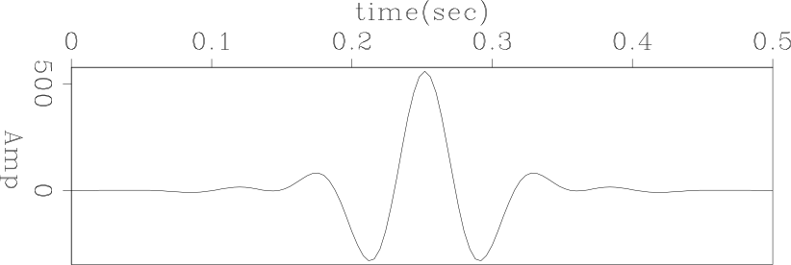
Zero-Phase wavelet

Slide 19
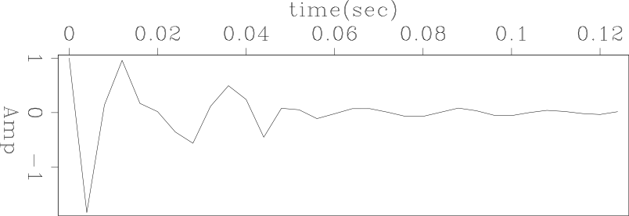
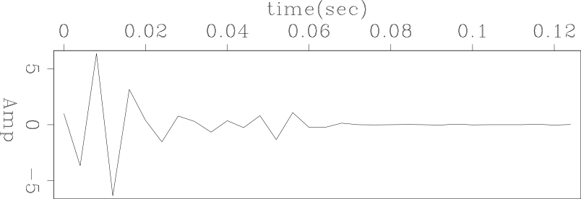
Filters by Slalom Method
Filter a
Filter b
Notes:
Estimate filters back and forth
Ideally identical

Slide 20
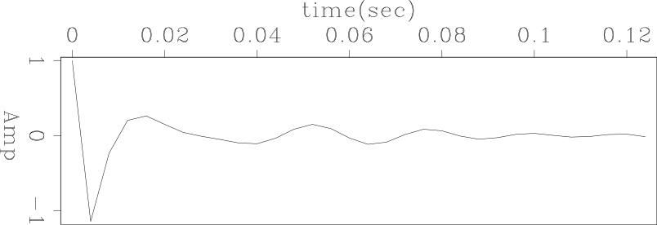

Filters by Symmetric Method
Filter a
Filter b
Notes:
Easy to understand gradients are the same

Slide 21
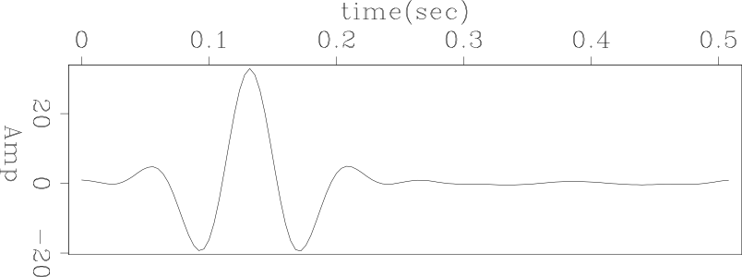
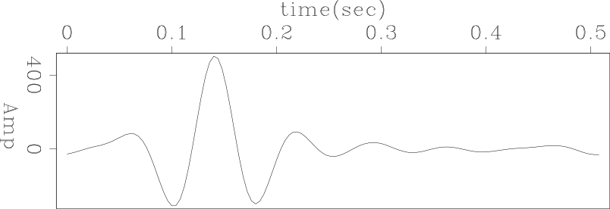
Estimated Wavelet after Decon
Symmetric
Slalom
Notes:
Symmetric
Less sidelopes

Slide 22
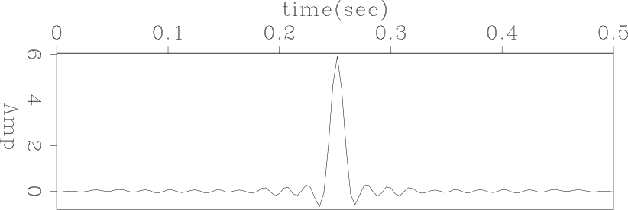
Result by Symmetric Method
Notes:
To our surprise

Slide 23
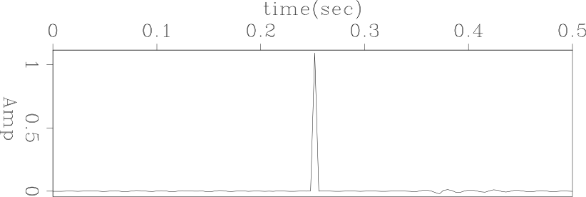
Result by Slalom Method

Slide 24
Analysis
Problem
Non–linear problem––multiple minima
Different initial guess
Additional constraint
Improvement
Good initial guess–– Ricker wavelet (Fu, Q., Y. Shen, and J. Claerbout, 2011, SEP-Report, 143, 283–296)
Preconditioning–– industry PEF
Notes:
Possible reason
important to the initial guess
After first estimating filter a
Different minimum and result

Slide 25
Outline
Motivation
Theory
Data examples
1D synthetic data
2D synthetic data
2D field data
Conclusion

Slide 26
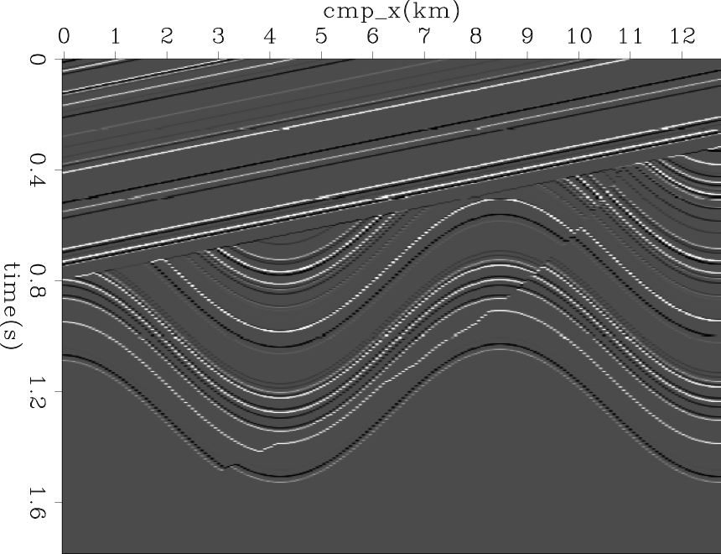
Synthetic 2D model

Slide 27
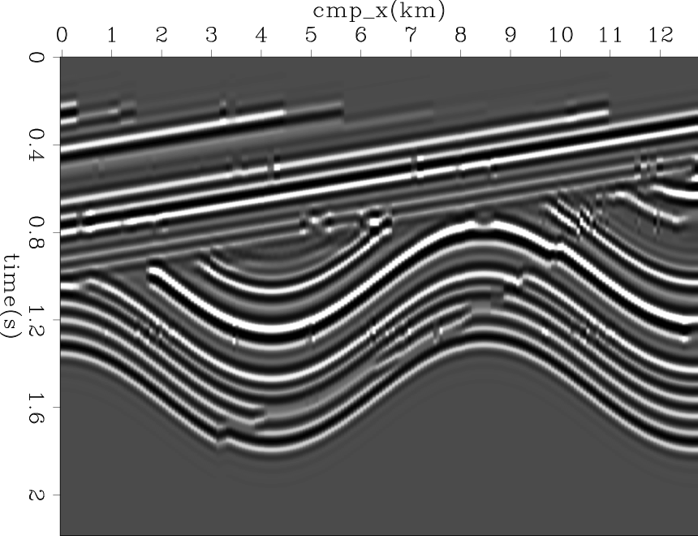
Synthetic 2D data

Slide 28
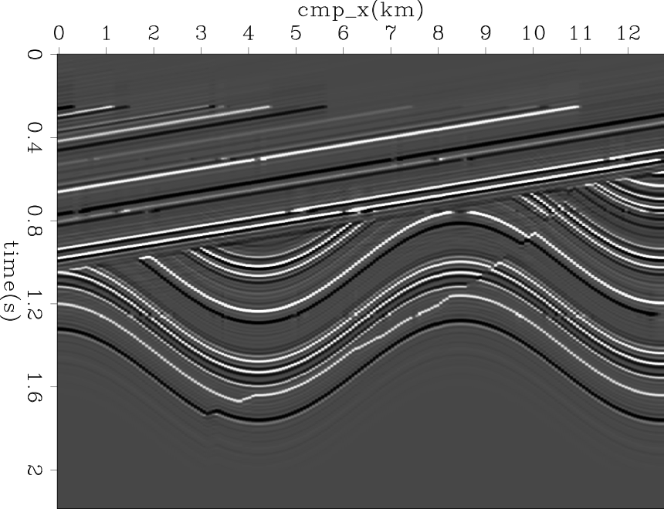
Result by Symmetric Method

Slide 29
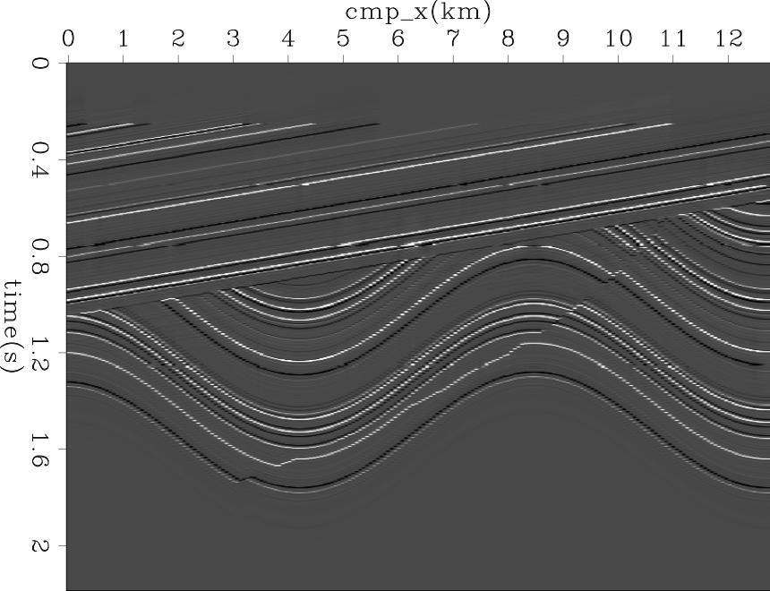
Result by Slalom Method
Notes:
Reasonable

Slide 30
Computational Cost
Symmetric method VS Slalom method
1min35 9min30
Notes:
but

Slide 31
Computational Cost
Symmetric method VS Slalom method
1min35 9min30
6 times faster

Slide 32
Outline
Motivation
Theory
Data examples
1D synthetic data
2D synthetic data
2D field data
Conclusion

Slide 33
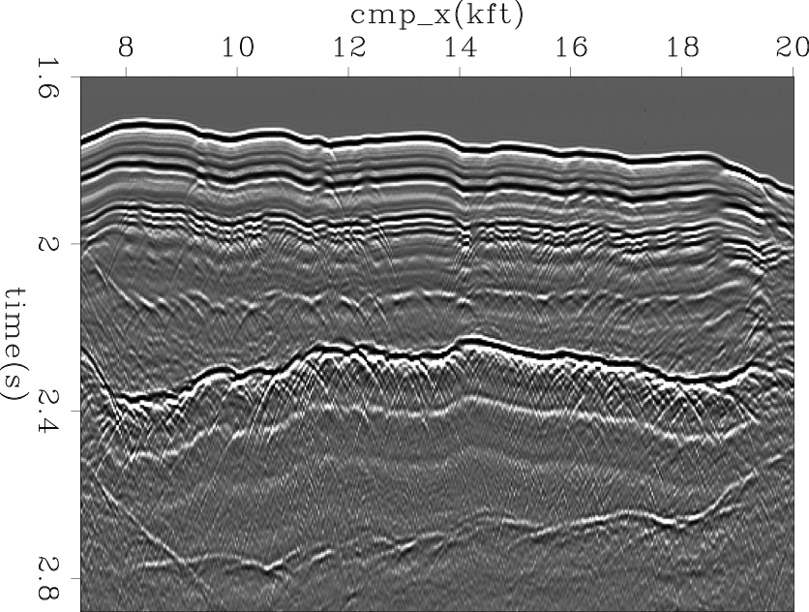
Common offset data
Notes:
Double ghost
bubble

Slide 34
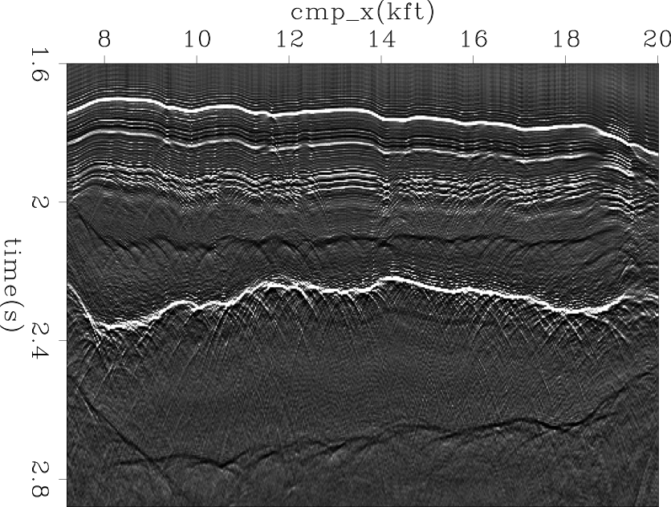
Result by Symmetric Method
Notes:
White
Bubbles are clear
Not the bubble

Slide 35
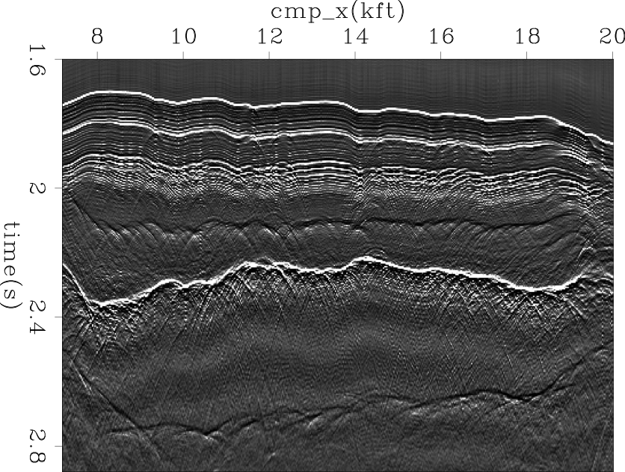
Result by Slalom Method
Notes:
Events same
Bubble and second
precorser

Slide 36
Computational Cost
Symmetric method VS Slalom method
50sec 3min28

Slide 37
Computational Cost
Symmetric method VS Slalom method
50sec 3min28
4 times faster

Slide 38
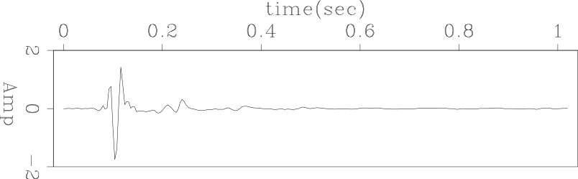
Wavelet
Symmetric
Notes:
Shown data has events look like ricker three bubble

Slide 39
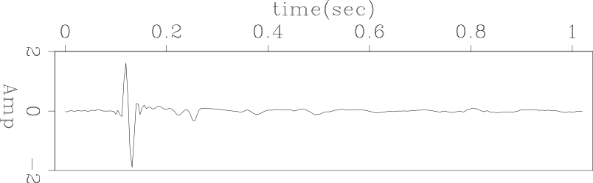
Wavelet
Slalom
Notes:
Because of filter

Slide 40
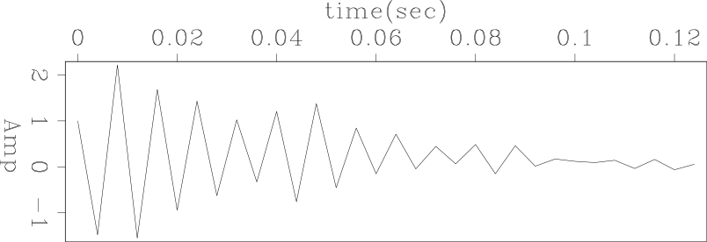
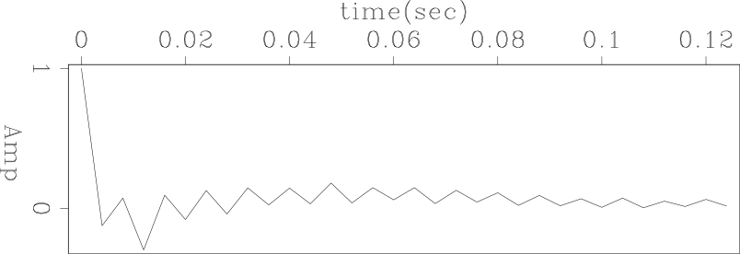
Filters by Slalom Method
Filter a
Filter b

Slide 41
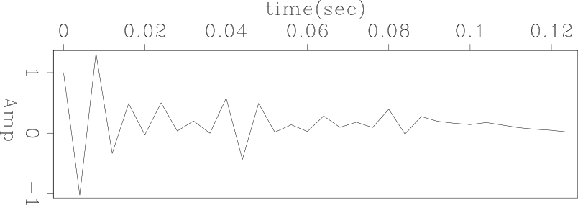
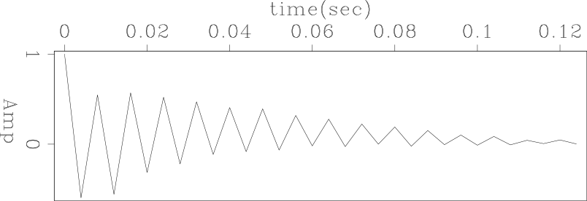
Filters by Symmetric Method
Filter a
Filter b
Notes:
Due to filters are estimated back forth

Slide 42
Outline
Motivation
Theory
Data examples
1D synthetic data
2D synthetic data
2D field data
Conclusion

Slide 43
Conclusion
Advantage
Filters can be inverted simultaneously, e.g. zero phase wavelet
Better estimated wavelet
Low computational cost
Disadvantage
In some cases results by symmetric method are not as spiky as ones by the slalom method
Notes:
Introduce and compare

Slide 44
Future Work
Good initial guess
Preconditioning ––Utilizes prior information
Fast convergence rate
Stable results
Gain function
Enhance the later events and focus on the area concerned area
Notes:
Thus a good initial guess
Another potential solution
Apply enhance the later events

Slide 45
Acknowledgement
Thanks Yang Zhang, Antoine Guitton, Shuki Ronen, Mandy Wong and Elita Li for their discussion.

Slide 46
Thank You
Stanford Exploration Project

