Slide 1


Anisotropic WEMVA with rock physics constraints
Yunyue (Elita) Li*
SEP Research Overview
10/29/2013

Slide 2
Agenda
Introduction to WEMVA
Examples for anisotropic WEMVA
Constraining WEMVA using rock physics information
Conclusion and discussion

Slide 3
Model building
Ray-based tomography
  Data space
  Image space

Slide 4
Model building
Ray-based tomography
  Data space
  Image space
Wave equation-based tomography
  Data space (FWI, WET, …)
  Image space (WEMVA, …)

Slide 5
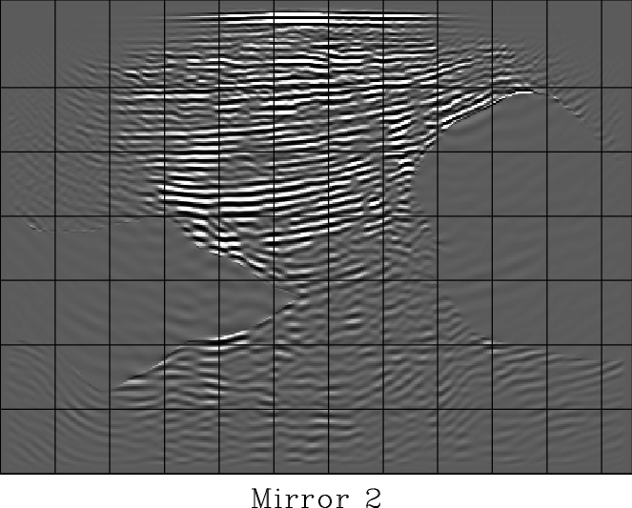
WEMVA
WEMVA: wave equation migration velocity analysis
If the earth model is correct, the images should resemble each other.
Coherence -> model correctness (eg, Sava and Biondo, 2004 )
Reflection angle
Courtesy of Mandy Wong

Slide 6
WEMVA
WEMVA: Stacked image
Negative v error
Correct v
Positive v error

Slide 7
WEMVA
WEMVA: Angle domain common image gathers
Angle (degree)
-50 -30 -10 10 30 50
Angle (degree)
-50 -30 -10 10 30 50
Angle (degree)
-50 -30 -10 10 30 50
Negative v error
Correct v
Positive v error

Slide 8
WEMVA
WEMVA:
  Global convergence: can handle large model errors
  Use of reflection events: update deep velocity anomalies
  High resolution results: combined with stacking power objective function

Slide 9
Anisotropy
Anisotropy is the property of being directionally dependent.
Seismic anisotropy is the variation of seismic wave speed with direction.

Slide 10
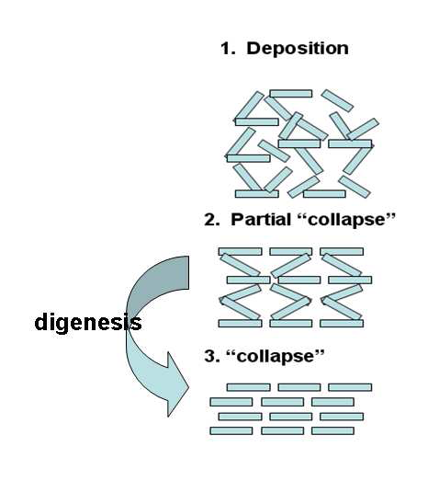
Anisotropy
Shale anisotropy
(after Avseth et al., 2008)

Slide 11
Anisotropy
Vertical transverse isotropy (VTI)
Vh
Vn
Vv

Slide 12
WEMVA for anisotropy
WEMVA: Angle domain common image gathers
Angle (degree)
-50 -30 -10 10 30 50
Angle (degree)
-50 -30 -10 10 30 50
Angle (degree)
-50 -30 -10 10 30 50
Negative ε error
Correct ε
Positive ε error

Slide 13
WEMVA for velocity
WEMVA: Angle domain common image gathers
Angle (degree)
-50 -30 -10 10 30 50
Angle (degree)
-50 -30 -10 10 30 50
Angle (degree)
-50 -30 -10 10 30 50
Negative v error
Correct v
Positive v error

Slide 14
Least-squares problem
Anisotropic WEMVA (Li and Biondi, SEP 143):
Notes:
In Anisotropic WEMVA, we look for an anisotropic Earth model which minimizes this objective function S.

Slide 15
Least-squares problem
Anisotropic WEMVA (Li and Biondi, SEP 143):
Differential
semblance
Model regularization
Stacking power
Notes:
In Anisotropic WEMVA, we look for an anisotropic Earth model which minimizes this objective function S.

Slide 16
Agenda
Introduction to WEMVA
Examples for anisotropic WEMVA
Constraining WEMVA using rock physics information
Conclusion and discussion

Slide 17
Synthetic example: BP2007
Initial Vn model
Inverted Vn model
True Vn model

Slide 18
Synthetic example: BP2007
Initial η model
Inverted η model
True η model

Slide 19
Synthetic example: BP2007
Inverted v anomaly
True v anomaly
Inverted η anomaly
True η anomaly

Slide 20
Synthetic example: BP2007
Initial image
Inverted image
True image

Slide 21
Synthetic example: BP2007
Initial gathers
Initial gathers
Inverted gathers

Slide 22
Synthetic example: BP2007
Final gathers

Slide 23
GOM field data example
Initial image

Slide 24
GOM field data example
Final image

Slide 25
GOM field data example
Location (km)
2 4 6 8 10 12 14 16 18 20
Depth (m)
0 80 160
0 1000 2000 3000
Velocity (m/s)
Updates in v model
Location (km)
2 4 6 8 10 12 14 16 18 20
Depth (m)
η
0 1000 2000 3000
0 0.04
Updates in η model

Slide 26
Agenda
Introduction to WEMVA
Examples for anisotropic WEMVA
Constraining WEMVA using rock physics information
Conclusion and discussion

Slide 27
Least-squares problem
Anisotropic WEMVA (Li and Biondi, SEP 143):
Data fitting goal
Model styling goal

Slide 28
Data fitting goal
ε-δ panel
Vv -ε panel
Vv -δ panel

Slide 29
Model styling goal
ε-δ panel
Vv -ε panel
Vv -δ panel

Slide 30
Rock Physics Modeling
Modeling results using lithological inversion
Epsilon model
Delta model

Slide 31
Rock Physics Modeling
Covariance model from stochastic rock physics modeling

Slide 32
Rock Physics Modeling
Covariance model from stochastic rock physics modeling

Slide 33
Agenda
Introduction to WEMVA
Examples for anisotropic WEMVA
Constraining WEMVA using rock physics information
Conclusions and future work

Slide 34
Conclusions
WEMVA can be extended to evaluate the accuracy of the anisotropic models.
Rock physics modeling is helpful in constraining seismic model building.

Slide 35
3D data
Well 6
Well 4
Well 5
Well 3
Well 2
Well 1
well logs
courtesy of WesternGeco

