Slide 1


Image-based Q tomography using wavefield-continuation
Yi Shen (Stanford University)
March 3, 2015
Stanford Exploration Project
Notes:
I am Yi Shen, from SEP

Slide 2
Outline
Introduction
Why Q estimation and Q compensation?
Method
Wave-equation migration Q analysis
Implementations and numerical examples
Q estimation using one-way wavefield-continuation
From stack image
From pre-stack image
Q estimation using two-way wavefield-continuation
Conclusions
Notes:
The methods can be implemented into different image domain and use different wavefield-continuation, I will talks about them later in details with the numerical examples.

Slide 3
Introduction
Attenuation results in
Significant loss of signal strength, bandwidth
Velocity dispersion
e.g., Gas trapped in sediments
Degrades image quality
Low resolution
Amplitude dimming
Makes identification and
interpretation inaccurate
Proper estimation and correction
to enhance image quality
(Zhou, 2011)
Notes:
The kind of gas anomaly is the issue tackle with in this presentation.

Slide 4
Method
Wave-equation migration Q analysis (WEMQA)
Image space
Suppresses the noise
Simplifies and focuses the events
Can be implemented in a target-oriented fashion
Wave-equation based tomography
Handle complex subsurface structure
Notes:
1. The pre-existed methods successfully do the job, but they fails in certain situation, such as there are high noise, events interference, diffraction and complex structure
2. In this talk, I develop a new method to tackle the above issues. This method has the ability to build a robust Q model with two features that are different from the conventional methods
3. I call it as WEMQA

Slide 5
Method
Wave-equation migration Q analysis (WEMQA)
Image space
Stack image
Pre-stack image
Wave-equation based tomography
One-way wavefield continuation
Two-way wavefield continuation
Notes:
In terms of image space, it is measuring Q after migration. The most morory and compuational efficient way is the stack image. Prestack migration but I take only one section at the zero-subsurface offset.it doesn’t gather the information
2. Therefore, we need to go to pre-stack image containing all the offset information for a better improvement.
3. one-way is cheap, but two-way complex model
4. This WEMQA methods has be implemented using all of these way, I will show you later along with the numerical examples.

Slide 6
Notes:
I will show you the general inversion workflow for this WEMQA methods.

Slide 7
True Q model
Q₀ model (Q=10,000)
Notes:
Say:
it does not have to be correct;
We usually use the constant value for the initial model; most of the real case, we assume the initial model is non-attenuating
Log display

Slide 8
data
Wavefield-continuation Q migration
Notes:
It compensate the Q effects on the image. If the current Q model is incorrect, the image will be either under or over compensation,

Slide 10
Back projection:
wave-equation tomographic operator
Where E is Q effects;
T* is the adjoint of the tomographic operator

Slide 12
Output Q model

Slide 13
Numerical example
Wave-equation migration Q analysis (WEMQA)
Image space
Stack image
Pre-stack image
Wave-equation based tomography
One-way wavefield continuation
Two-way wavefield continuation

Slide 14
Stack image
Notes:
Prestack migration and take one section at…let’s look at how to quantify it on the numerical example

Slide 15
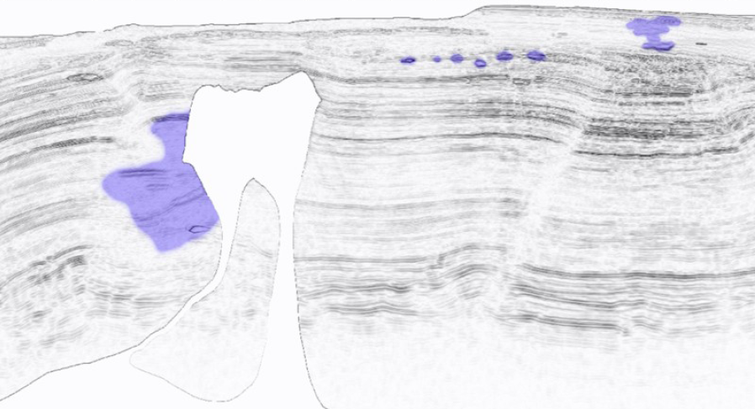
2D visco-acoustic version of the 2004 BP benchmark model (Billette and Brandsberg-Dahl, 2005), generated by Schlumberger (Cavalca et al., 2013)
Q model
Shallow gas; Q=10~200
Q=50
Background:
Q=5000
Courtesy of Cavalca et al, 2013 and Billette 2005
Notes:
Data generated by Sclumberger using a 2D visco-acoustic version of the 2004 BP benchmark model
The Q model is not released and has been added by Schlumberger to the original BP models.
The background is …; model contains
Two shallow gas like the one I show you in the introduction. One of them has big size, the other has five un-connected gas pockets.
Sal body beside complex structure that needs a proper wave propagation to handle
The initial Q model is the backgournd Q model

Slide 16
Attenuated image
Notes:
Say:
1. At the first iteration, attenuated image
Attenuated image without compensation
Three Q anomolies
the images are washed out; the frequency are degraded and the events are incoherent

Slide 17
Attenuated image
Notes:
Say:
1. We need the reference image to measure the attenuated image./Some other area; like the … has the least attenuation effects
We will use this as the reference image for the later spectral analysis
In the real life, we need the help from the interpretation to choose the reference area.

Slide 18
Attenuated image
Spectra
frequency
Notes:
Say:
We first compute the spectral
The spectra of the reflectivities are statistically the same, within each large window. Therefore, the spectral differences between these windows mainly come from attenuation.
In accordance with the Q properties, the high loss more
Measure how much more the higher frequencies are lost

Slide 19
Attenuated image
Log(Ratio)
Spectra
Slope ~ - Δ(1/Q)
frequency
frequency
Spectral ratio method (Tonn, 1991)
Notes:
Say:
The slope shows how this windows are attenuated; in other words, how much this image is far from the attenuation-free model
If the image is perfectly compensted with a correct Q model, the spectral closed, and the slope is flat
Goal or objectives is to flatten the slop

Slide 20
Notes:
Say
We sliding the windows over the depth, and ompute the windowed spectral trace by trace
The slope as the input to get the delta Q and update our current Q model
Compare those spectral with the reference at the same depth in the least attenuation area for slope.
4. Left shallow gas effect is hard to tell

Slide 21
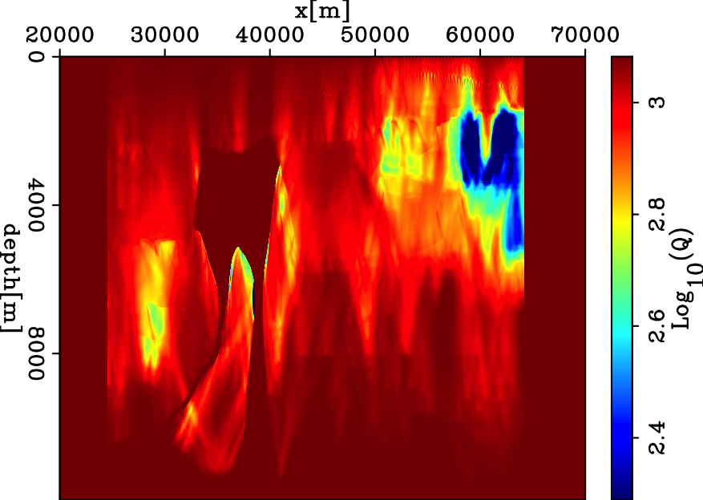
Inverted Q model from stack image
True Q
Notes:
Say:
Parts of the results look goo, they show the position of the anomoly and the value is closed; left is not good which is reasonable
However, In addition, because of we don’t use whole information, the results doesn’t work well. the vertival resolution and side lobes
%1. Low resolution and low location: large window, not precisely give the location
%2. Small: large window, not be solved, too small
%3. Salt one: poor image

Slide 22
Pre-stack image: angle domain common image gather (ADCIG)
Notes:
Say:
1. We achnoledge the whiteness of the subsurface within a large window

Slide 23
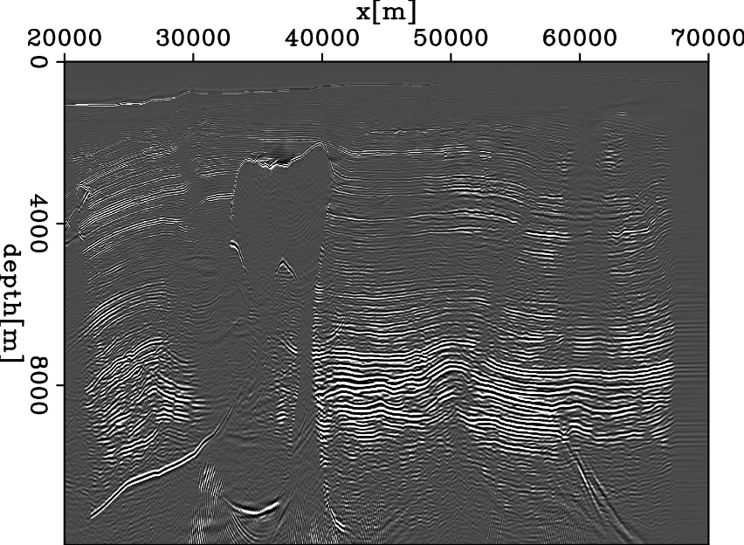

Slide 25
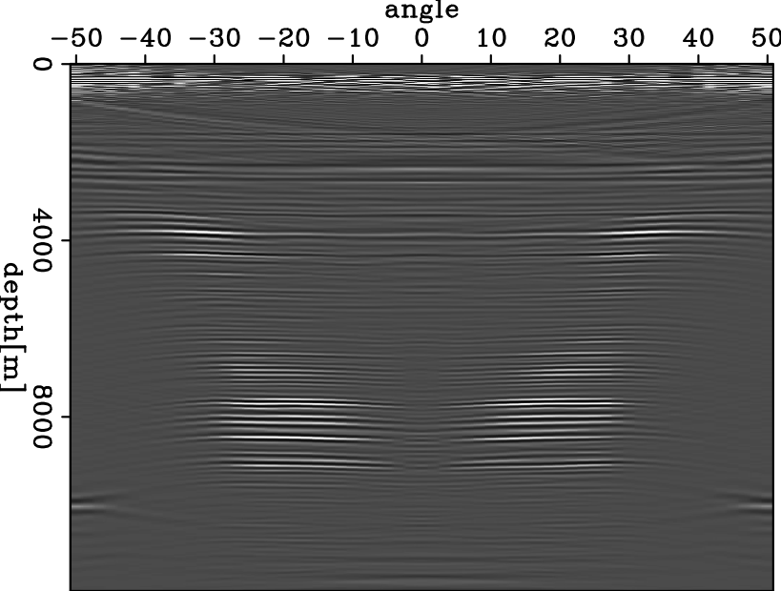
Angle domain common image gather

Slide 26
Angle domain common image gather
attenuated

Slide 28
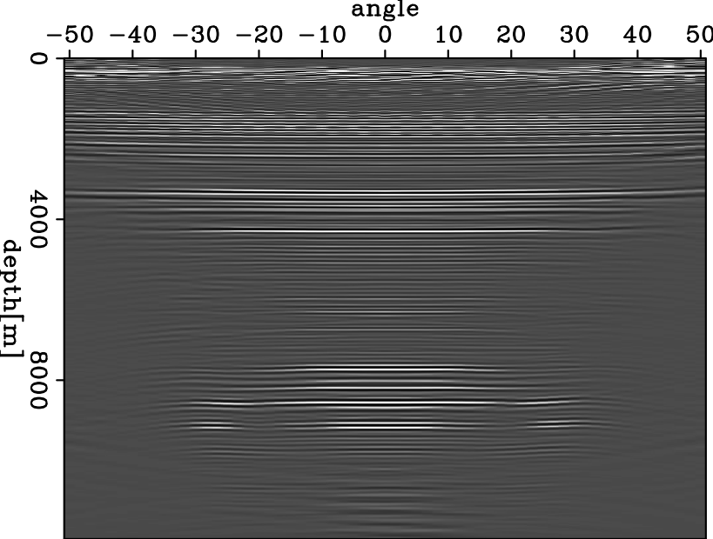
Angle domain common image gather

Slide 29
Angle domain common image gather
attenuated

Slide 30
Attenuated image

Slide 31
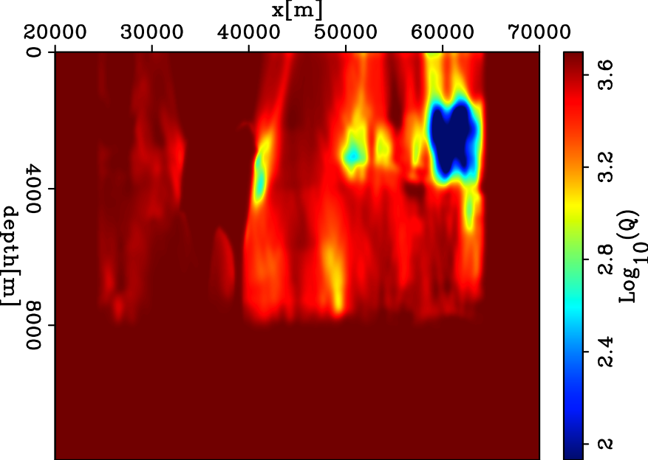
Inverted Q model from prestack image
True Q
Notes:
Vertical resolution gets a little bit improved. The side lobes disappear.
Salt is not obviouse

Slide 32
Inverted Q model from stack image
True Q

Slide 33
Migration with starting Q model
Notes:
1. the images are washed out; the frequency are degraded and the events are incoherent

Slide 34
Migration with estimated Q model

Slide 35
Migration with starting Q model
Notes:
1. the images are washed out; the frequency are degraded and the events are incoherent

Slide 36
Two-way wavefield continuation
(Zhu & Harris, 2013)

Slide 37
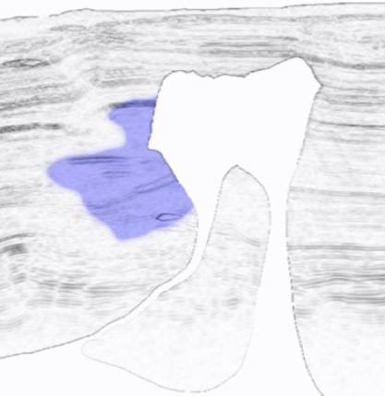
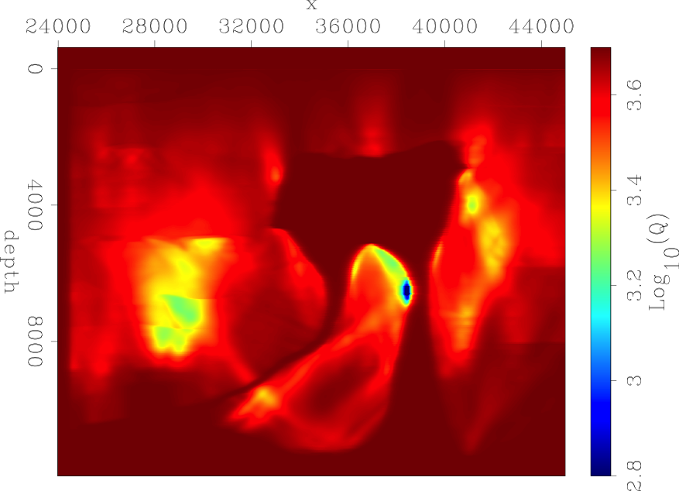
Inverted Q model using one-way
True Q

Slide 38
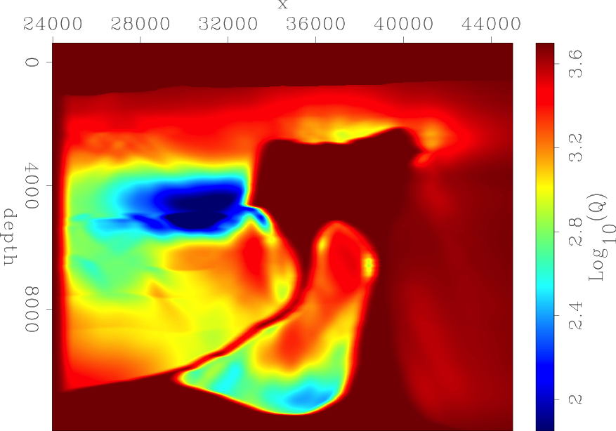
Inverted Q model using two-way
True Q
Notes:
Much improved
But not perfect
Diving wave creates the artifacts
Upper salt body

Slide 39
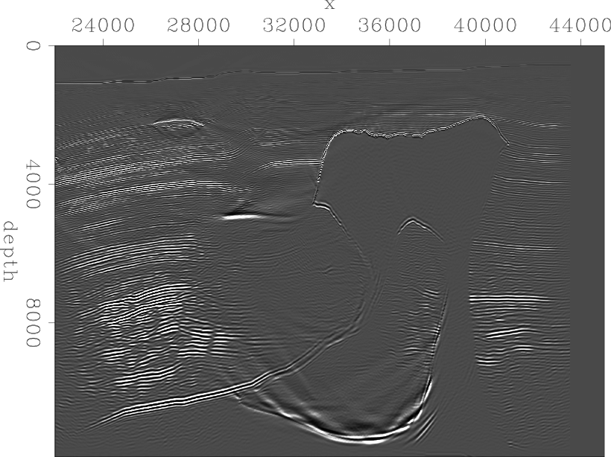
Migration with starting Q model

Slide 40
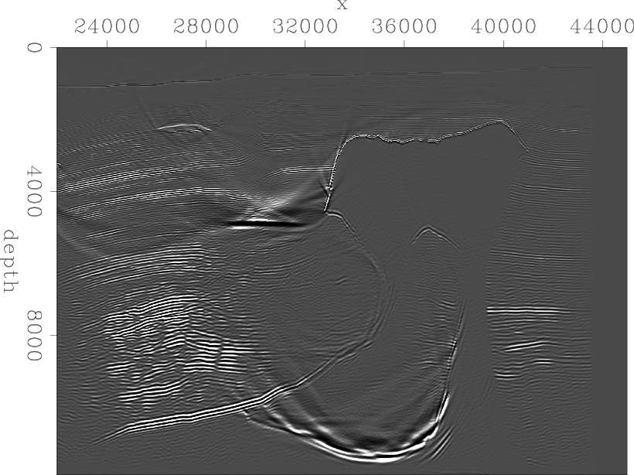
Migration with inverted Q model
Notes:
Artifacts;
You can also tell the weak updates from the artifacts here.
Other region is good

Slide 41
Migration with starting Q model

Slide 42
Conclusions
Develop a new technique: WEMQA
Results show the feasibility of WEMQA for a model with Q anomalies
Q anomalies are resolved by WEMQA
Migration with the estimated Q model improves the attenuated image
Q tomography from prestack image
Improves the resolution of the inverted Q model
Mitigates the side lobes problem from the stack image
Q tomography using two-way wavefield continuation
Better resolves the Q anomaly in the region with steep structures (e.g salt flank)
Needs filter to attenuate migration artifacts
Notes:
Mention real data?

Slide 43
Acknowledgement
Thanks to Schlumberger and BP for WG_BP2004Q visco-acoustic surface synthetic seismic data
Thanks to the sponsors of Stanford Exploration Project for financial supports
Thanks Biondo Biondi, Robert Clapp, Dave Nichols, Shuki Ronen and Stewart A. Levin for discussions and suggestions
Thanks Yaxun Tang, Ali Almomin and Tieyuan Zhu for their codes
Thanks all SEPers
Notes:
The first step is to get results as expected. Then I will move forward to complex structure. I will use ADCIG

Slide 44
ThanQ and Q?
Yi Shen
Notes:
Dgx=0.04
Ogx=0.5
Nwin=30
Lwin=0.3

