Slide 1
Issues on reproducibility test

Slide 2

SEPLIB 7.0 vs. 8.0, explicitly specify the variables in the Makefile

Slide 3
Applies to other env-variables you defined for yourself

Slide 4
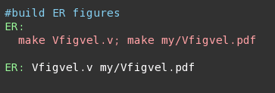
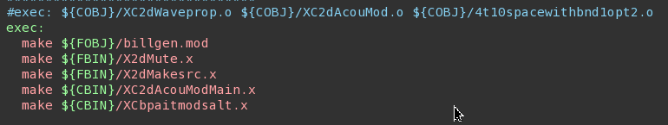
Put the targets in its dependency

Slide 5
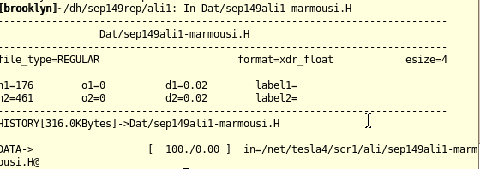
Have your raw data/model stored in a non-scratch folder

Slide 6
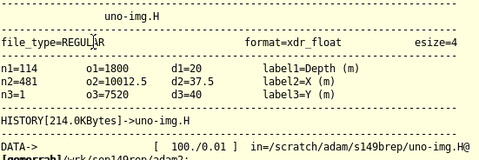
Have your raw data/model stored in a non-scratch folder

Slide 7
Have your raw data/model stored in a non-scratch folder
Cp data-scr.H data-perm.H out=stdout

Slide 8
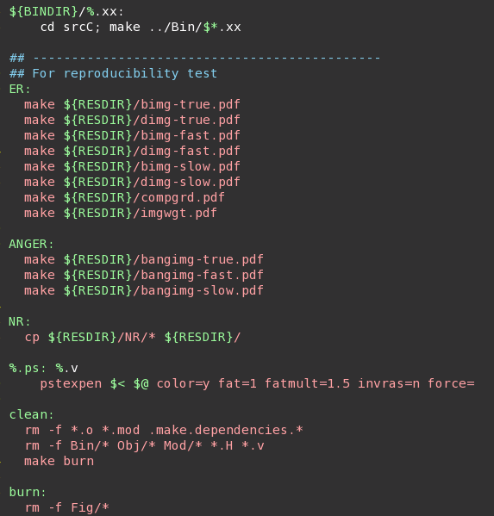
You can have different styles (I)

Slide 9
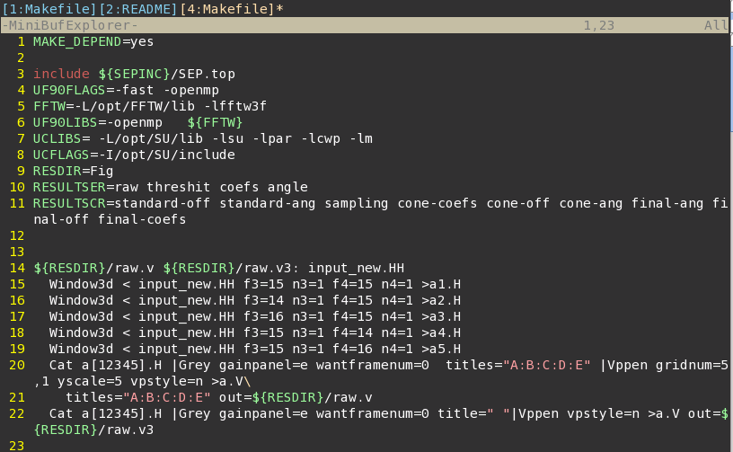
You can have different styles (II)

Slide 10
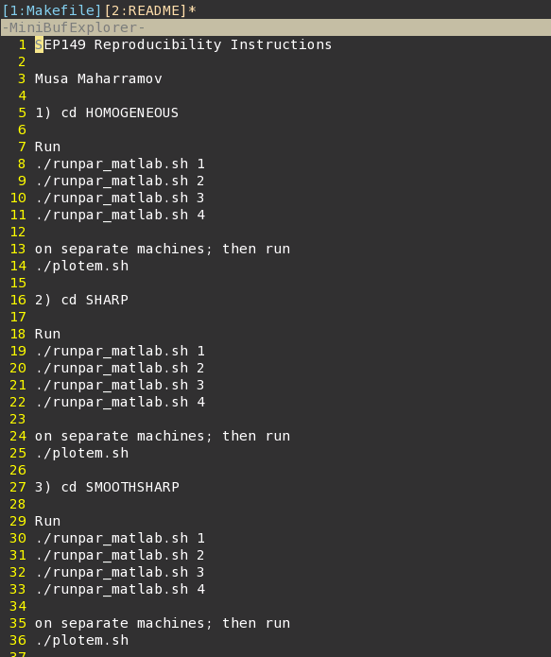
You can have different styles (III)

Slide 11
The requirement for CR results on CEES
Code compiles using provided makefile
Have a README, include the PBS script that generates the results
Anything other than the “qsub part” needs to be documented (preferably using Makefile)

Slide 12
Test the files yourself before sending them to me!

