Slide 1
SEP seminar 9 March 2020
Side lobes and blocky inversion
Fault cores—if there will be time to spare

Slide 2

Butterworth Vs Gaussian Wavelets
Blocky Wedge example

Slide 3
Outline
I notice that students use Ricker or Butterworth wavelets in synthetics
I propose an alternative: Gaussian-Diff wavelet
Minimal side lobes
I compare the two wavelets on a blocky wedge example to demonstrate an advantage of the Gaussian-Diff wavelet

Slide 4
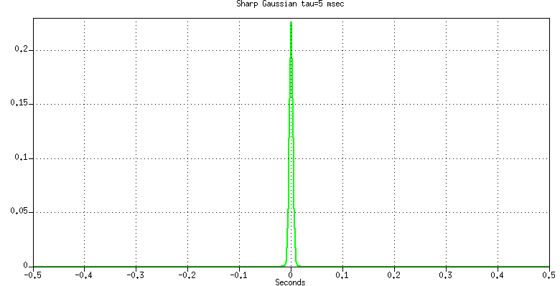
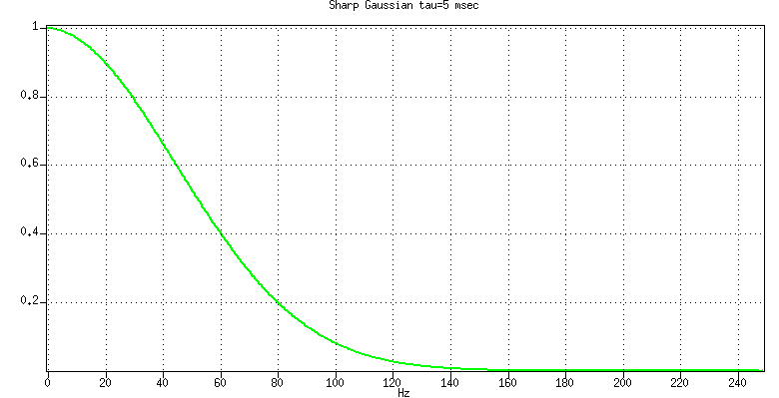
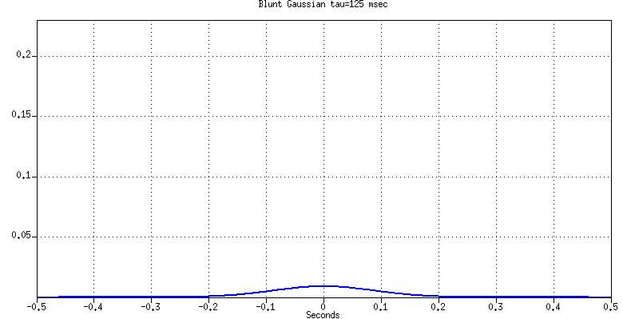
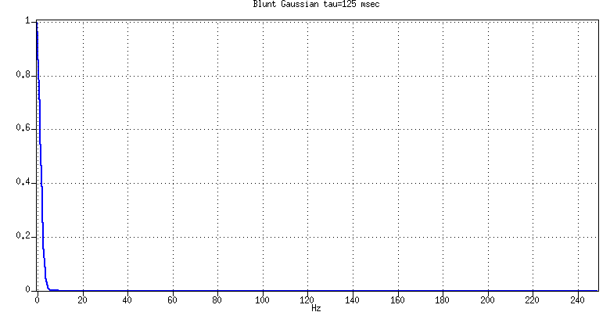
Gaussian wavelet: exp(-t/τ)² → exp(-fτ)²
Sharp in the time domain
Small
τ = 5 msec
Blunt in the frequency domain
Large 1/τ
→
Max (at zero) = 1
Blunt in the time domain
Large
τ = 125 msec
Scaled so that the areas are the same
Sharp in the frequency domain
Small 1/τ
→

Slide 5
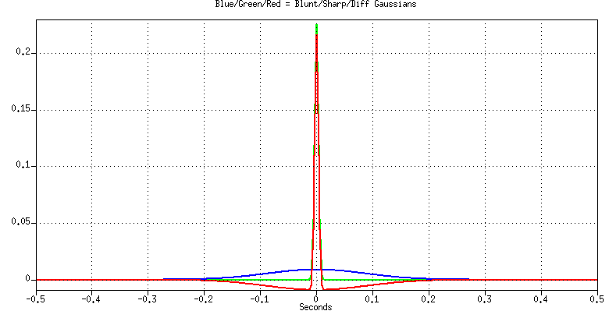
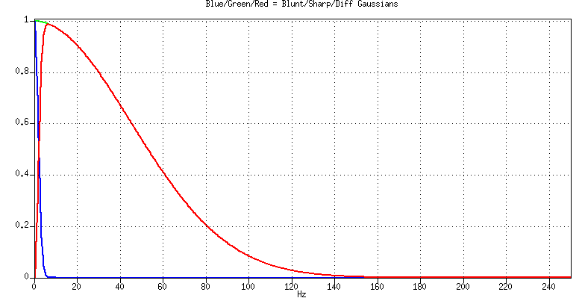
Gaussian-Diff wavelet
→
Gaussian-Diff = Sharp Gaussian - Blunt Gaussian

Slide 6
Butterworth and Ricker wavelets (on SU)
# GENERATE BFILT WAVELET
# Butterworth Wavelet from subfilt on a spike input
set BFILT = (subfilt verbose=1 fstoplo=1 fpasslo=5 fpasshi=60 fstophi=100)
suspike ntr=1 nspk=1 ix1=1 nt=1001 dt=0.002 it1=501 \
| sushw key=delrt a=-1000 | $BFILT …
subfilt: low-cut filter: npoles = 4, 3db point = 2.236304(Hz)
subfilt: high-cut filter: npoles = 10, 3db point = 78.350983(Hz)
#Generate Ricker Wavelet
suwaveform type=ricker1 dt=0.002 …

Slide 7
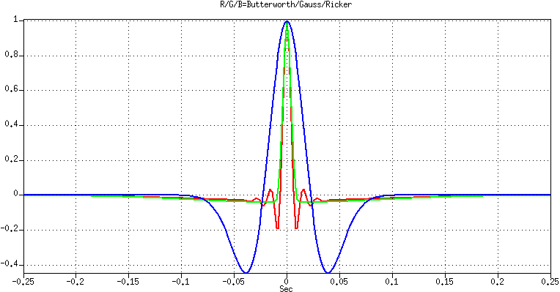
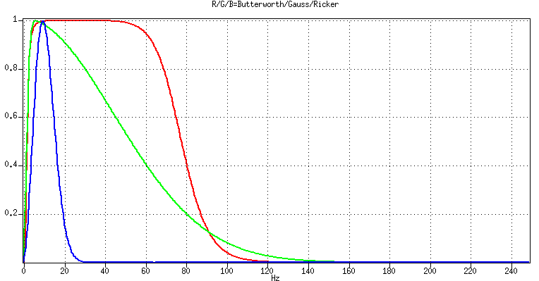
Wavelets: Butterworth, Gauss-Diff, Ricker
→

Slide 8
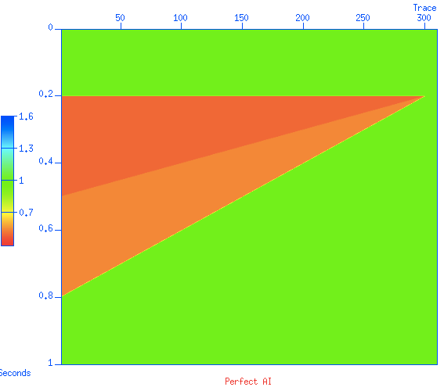
Blocky Wedge model: Acoustic Impedance

Slide 9
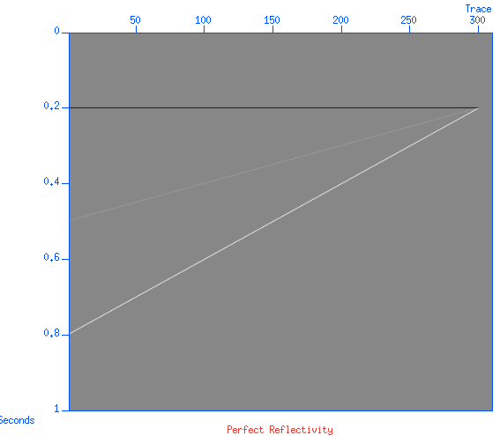
Blocky Wedge: AI and Perfect Reflectivity

Slide 10
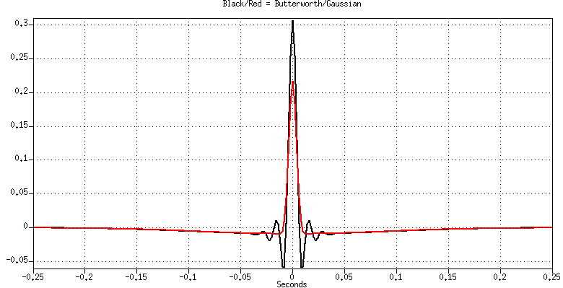
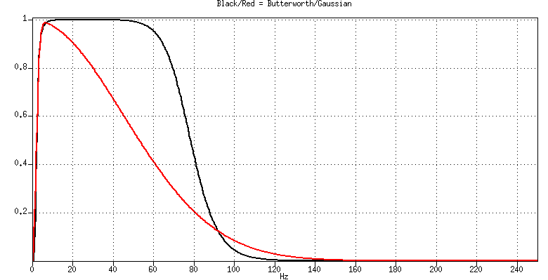
Wavelets Gaussian vs Butterworth
→
This Butterworth has a very nice spectrum
But the side lobes are deeper and more numerous

Slide 11
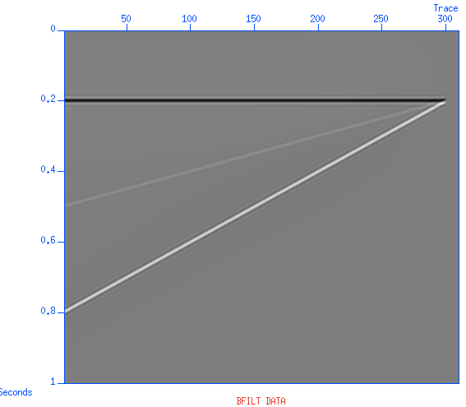
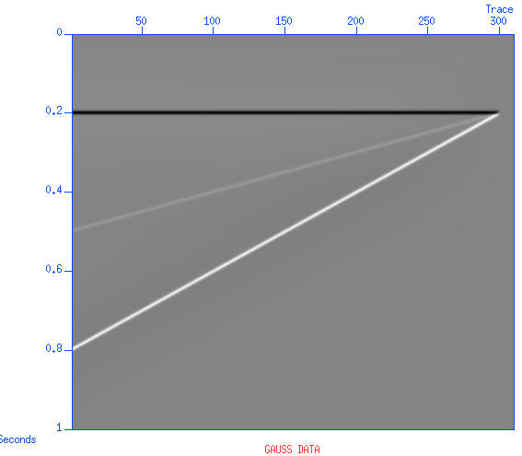
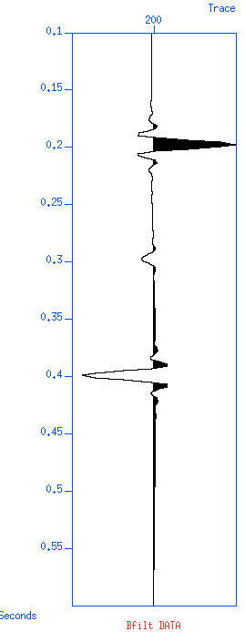
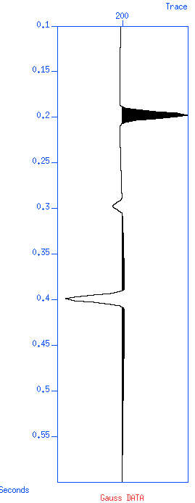
Data = Wavelet convolving Reflectivity

Slide 12
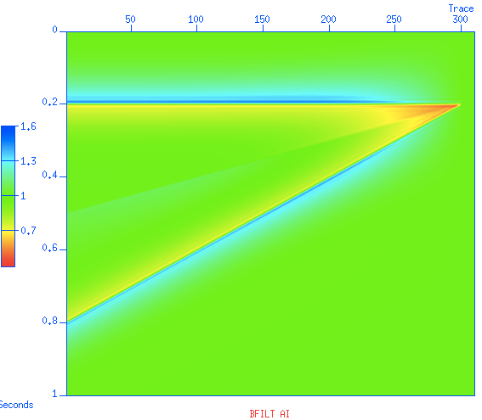
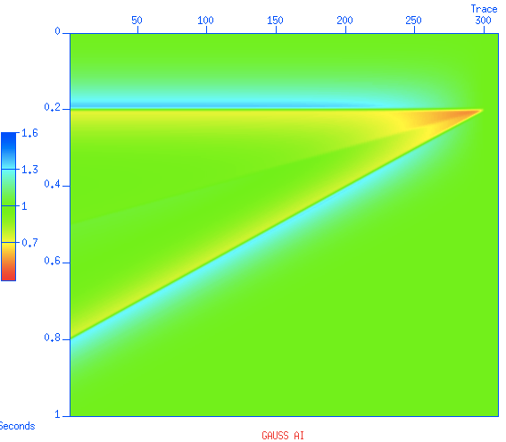
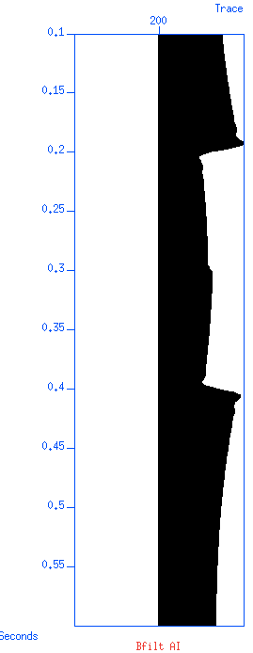
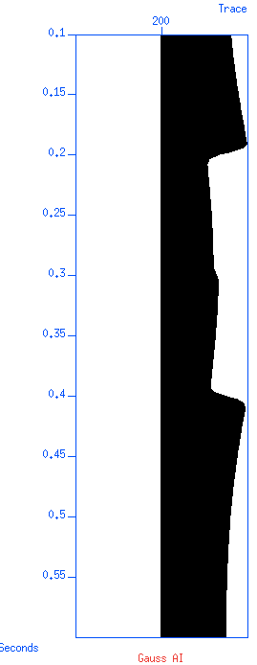
AI from data (not blocky, not so good)

Slide 13
Thresholding
A priori information (assumption)
The earth / the reservoir is blocky
Blocky acoustic impedance AI = ρ v
Spiky Reflectivity = (AI_{below} - AI_{above})/(AI_{below} + AI_{above})
The data are approximately the reflectivity
The data are not spiky because of the wavelet
Reflectivity = Spiky (Data)
Sophisticated: entropy, kurtosis, …
Simple (but essentially the same): Thresholding

Slide 14
Thresholding and clipping
Thresholding
If(Input > Threshold) then Output = Input
else Output = 0
Clipping
If(Input < Clip) then Output = Input
else Output = Clip
Approximately:
Thresheld part
Input
Clipped part
Thresheld part
Input
Clipped part

Slide 15
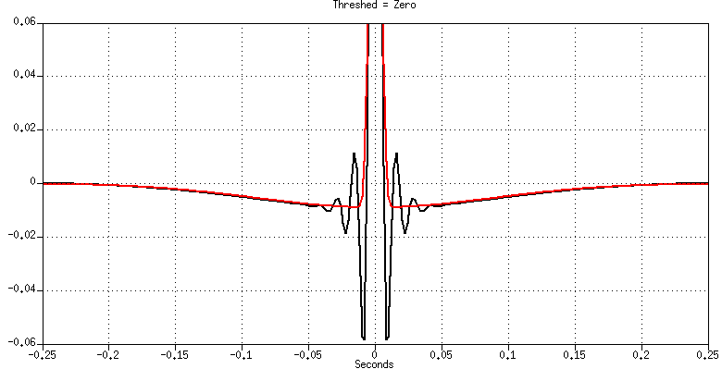

Threshold = Zero Clip = infinity (no-op)
If the Threshold is zero then everything is passed
(If the clip is zero then nothing is passed)
If the clip is infinity then everything is passed

Slide 16
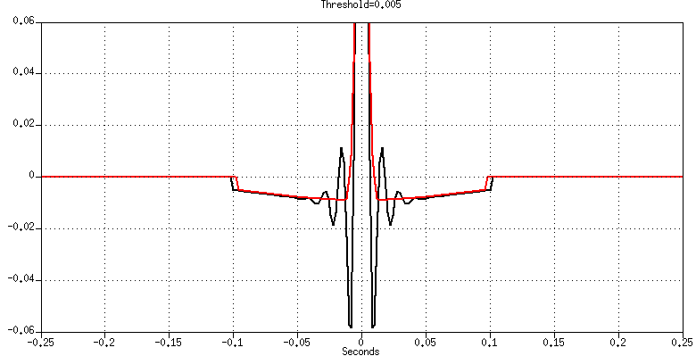
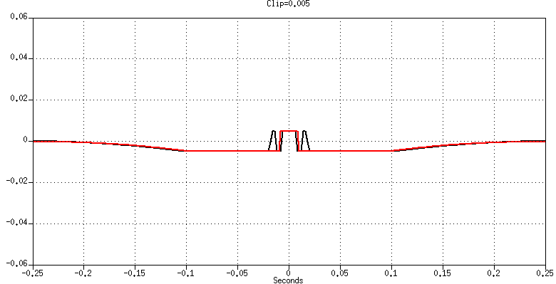
Threshold = Clip = 0.005
The threshold is too small to eliminate the sidelobes on the two wavelets

Slide 17
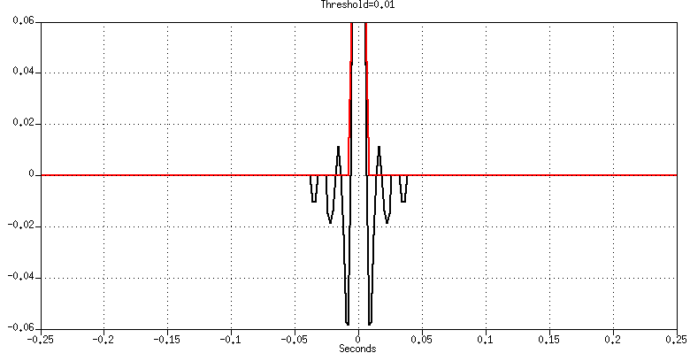
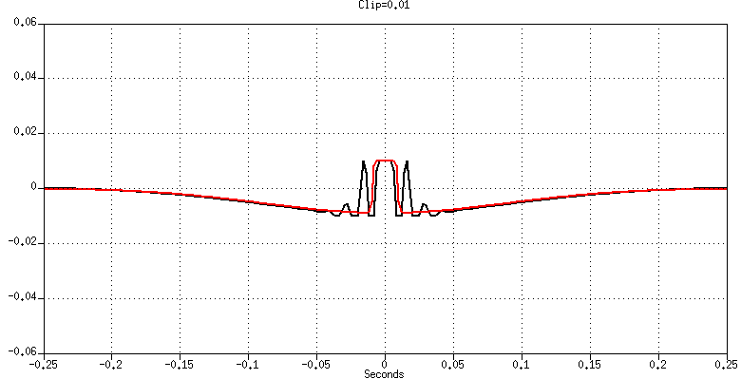
Threshold = Clip = 0.01
The threshold is too small to eliminate the sidelobes on the Butterworth wavelet
But it is large enough to eliminate the side lobes on the Gaussian wavelet

Slide 18
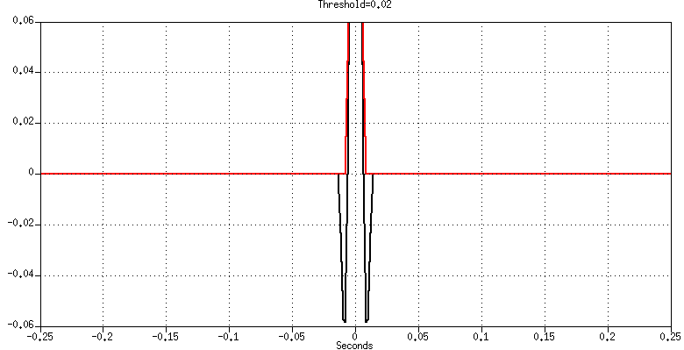
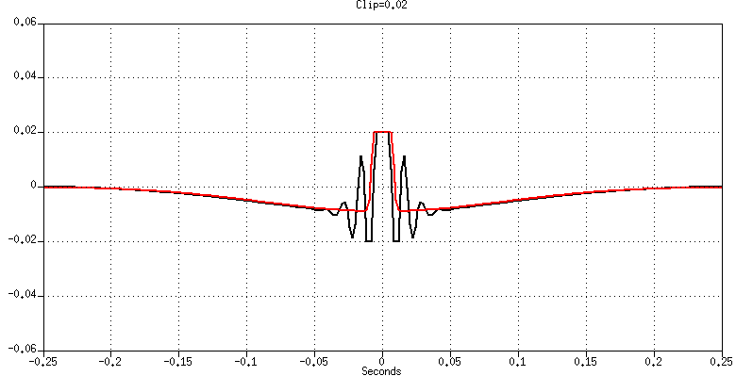
Threshold = Clip = 0.02
The threshold is still too small to eliminate the sidelobes on the Butterworth wavelet
But it is of course large enough to eliminate the side lobes on the Gaussian wavelet

Slide 19

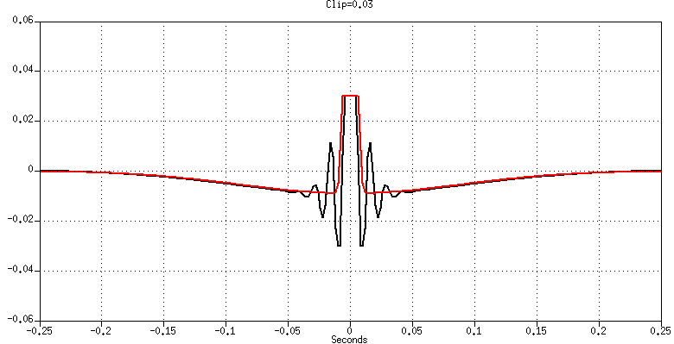
Threshold = Clip = 0.03
The threshold is still too small to eliminate the sidelobes on the Butterworth wavelet
But it is of course large enough to eliminate the side lobes on the Gaussian wavelet

Slide 20

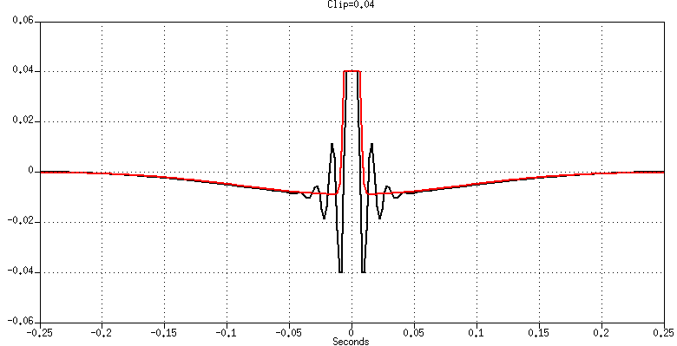
Threshold = Clip = 0.04
The threshold is still too small to eliminate the sidelobes on the Butterworth wavelet
But it is of course large enough to eliminate the side lobes on the Gaussian wavelet

Slide 21
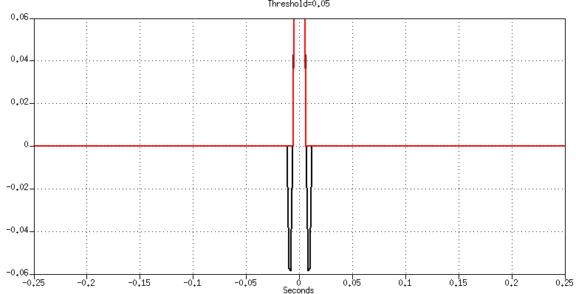
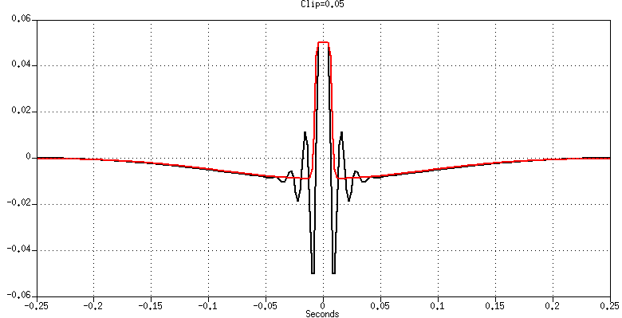
Threshold = Clip = 0.05
The threshold is still too small to eliminate the sidelobes on the Butterworth wavelet
But it is of course large enough to eliminate the side lobes on the Gaussian wavelet

Slide 22
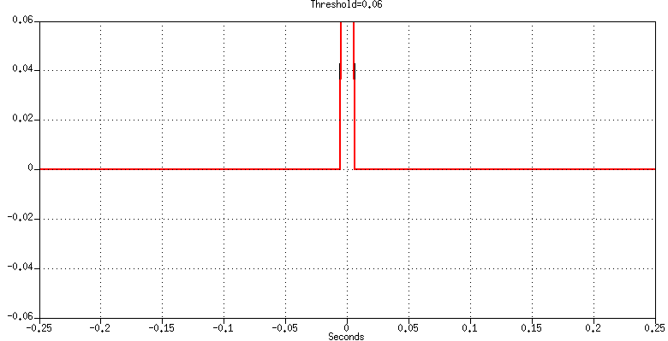
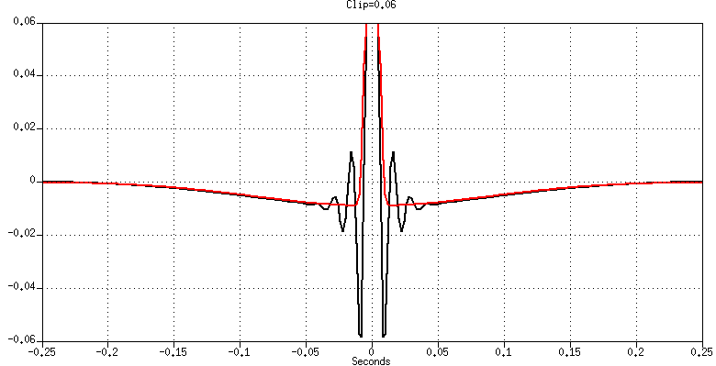
Threshold = Clip = 0.06
The threshold is large enough to eliminate the sidelobes on the Butterworth wavelet
But it is of course large enough to eliminate the side lobes on the Gaussian wavelet

Slide 23
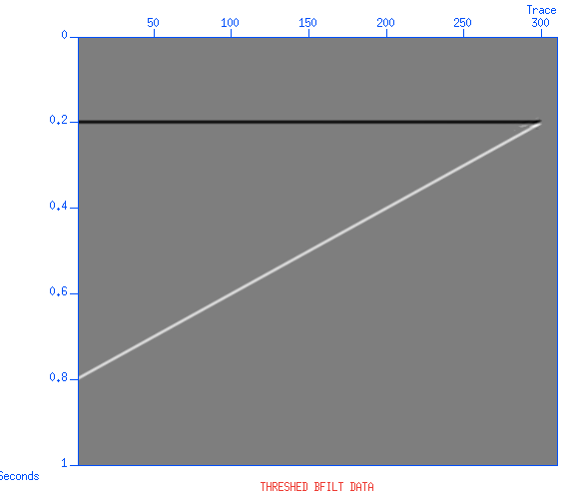
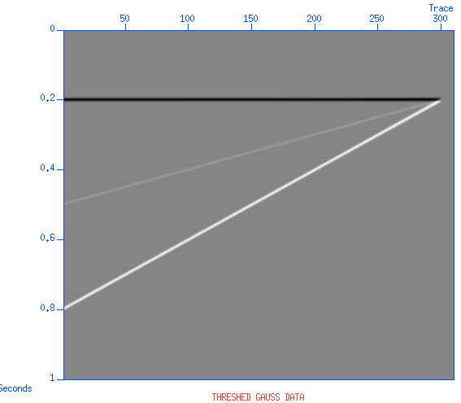
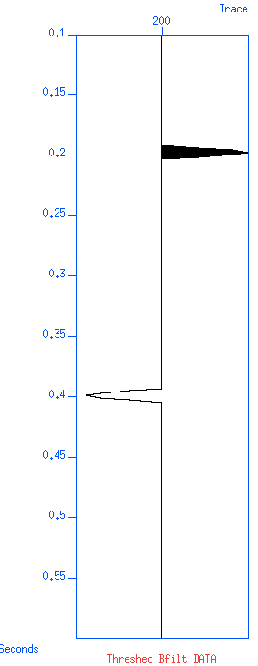
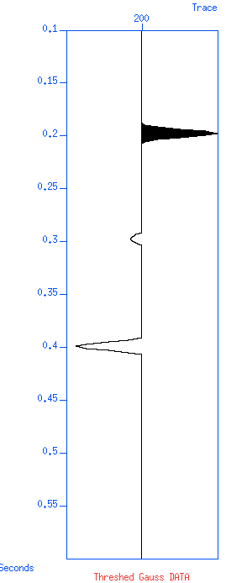
Thresheld data

Slide 24
Unthreshed Data

Slide 25
Thresheld data

Slide 26
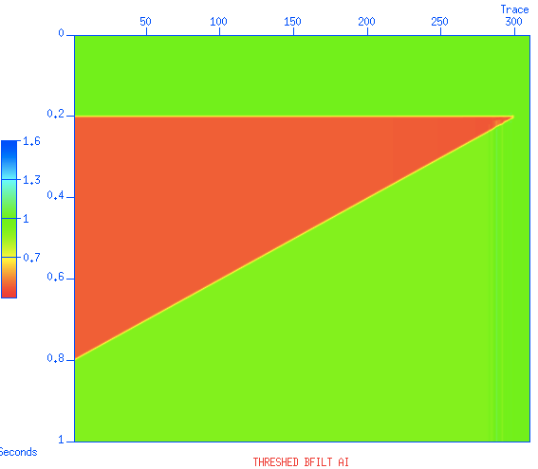
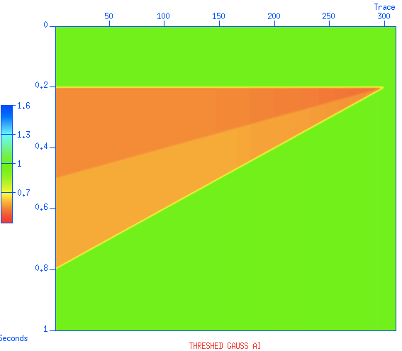
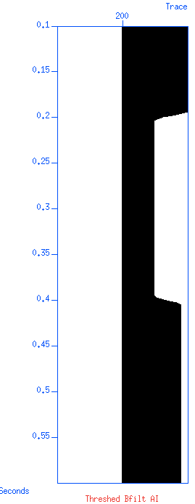
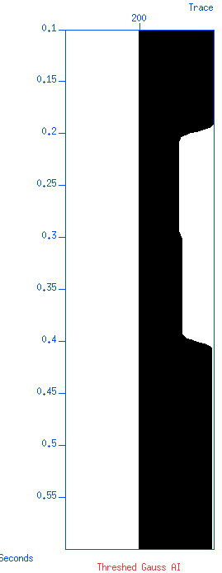
AI from thresheld data (blocky)

Slide 27
AI from thresheld data (blocky)

Slide 28
Summary
The Gaussian-Diff wavelets has less side-lobes
It does not matter much …
Until I try to impose blockiness by sparsity of reflectivity, using thresholding
The wavelet with less side lobes is easier to threshold

Slide 29
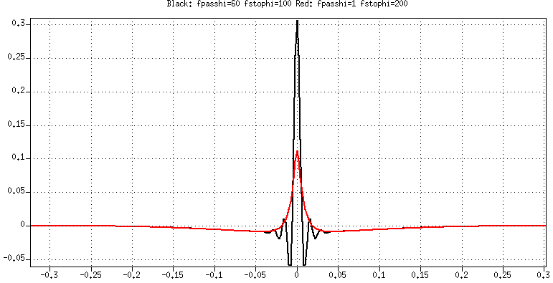
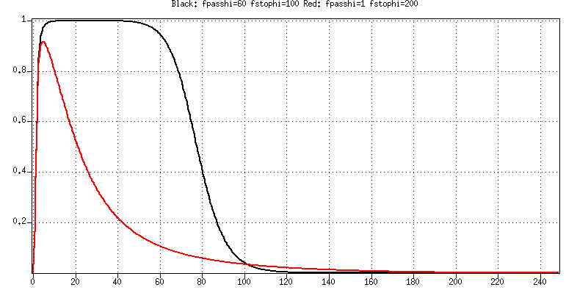
Post summary: try a softer butterworth?
Hard: low-cut: npoles = 4, high-cut: npoles = 10
Soft: low-cut: npoles = 4, high-cut: npoles = 2

Slide 30
Post Summary
Butterworth is minimum phase (although in subfilt the default is ‘zerophase=1’. You have to put zerophase=0 to get minimum phase)
If you want zero phase, which you do for inversion for acoustic impedance, then use gauss-diff
If you want minimum phase, then maybe butterworth, maybe leaky integration. Probably not Gauss-Diff taken via Kolmogoroff to make it minimum phase

Slide 31
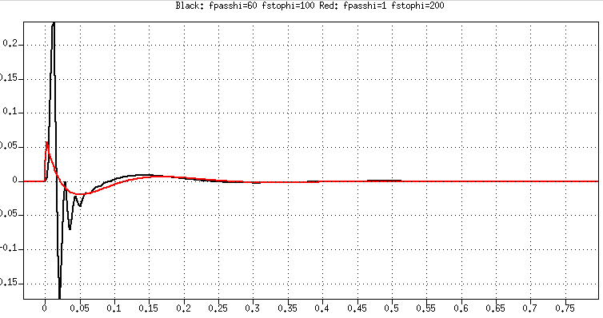
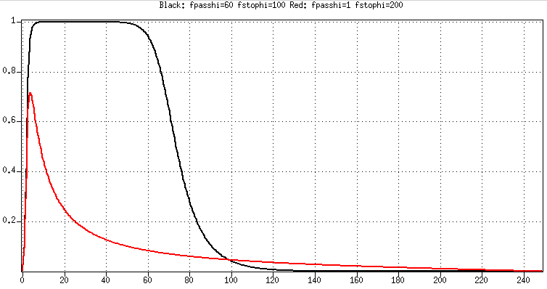
Minimum phase Butterworth

Slide 32
Soft Thresholding and Clipping?
Hard thresholding and hard clipping are not reversible
Soft clipping is
Soft thresholding?

Slide 33
Fault-cores
and
Fault plane reflections

Slide 34
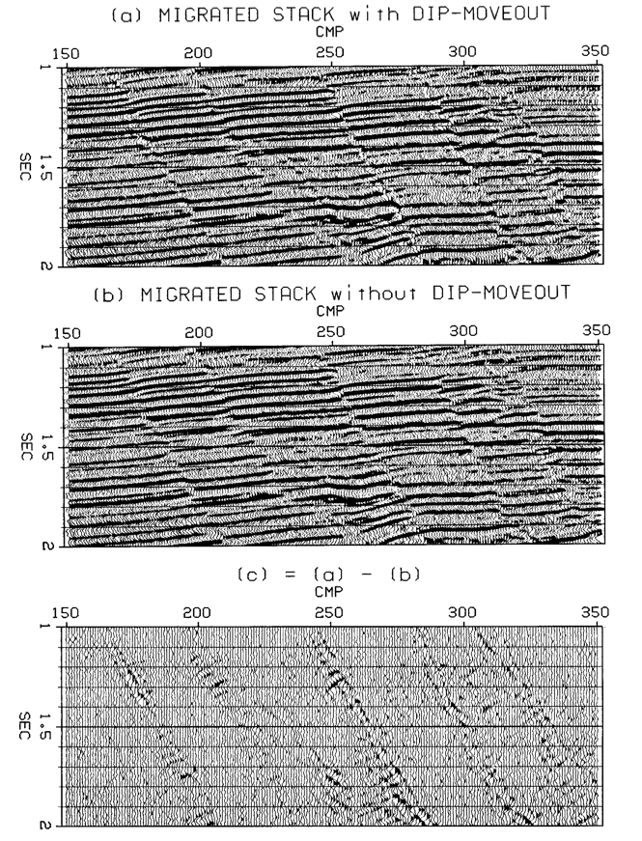
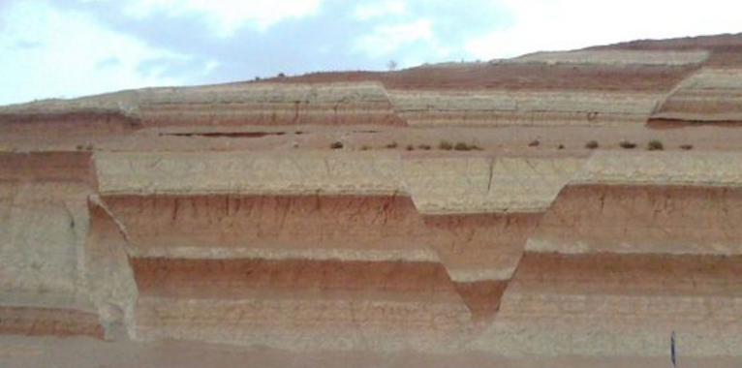
Do you see a problem here?

Slide 35
Fault core
Faults are not “clean cuts”
There are broken zones
I thanks Professor David Pollard for teaching me about them and for the picture

Slide 36
Small faults: thin cores
In large scale the fault core is thick enough to reflect seismic waves

Slide 37

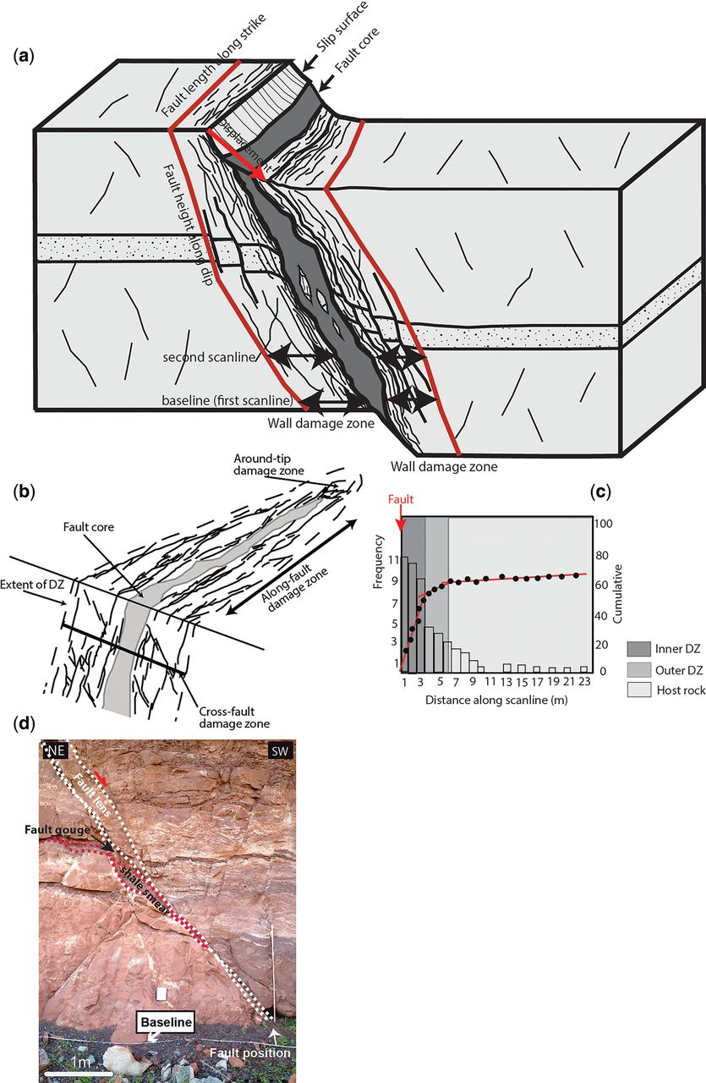
A. Torabi et al. Geological Society, London, Special Publications 2019;496:SP496-2018-151

Slide 38
From Dave Hale’s thesis
Fault plane reflections (?)
Negative polarity (?)
Softer (?)
Fault plane reflections and layer edges may not image at the same place because of
2D data
Isotropic processing

Slide 39
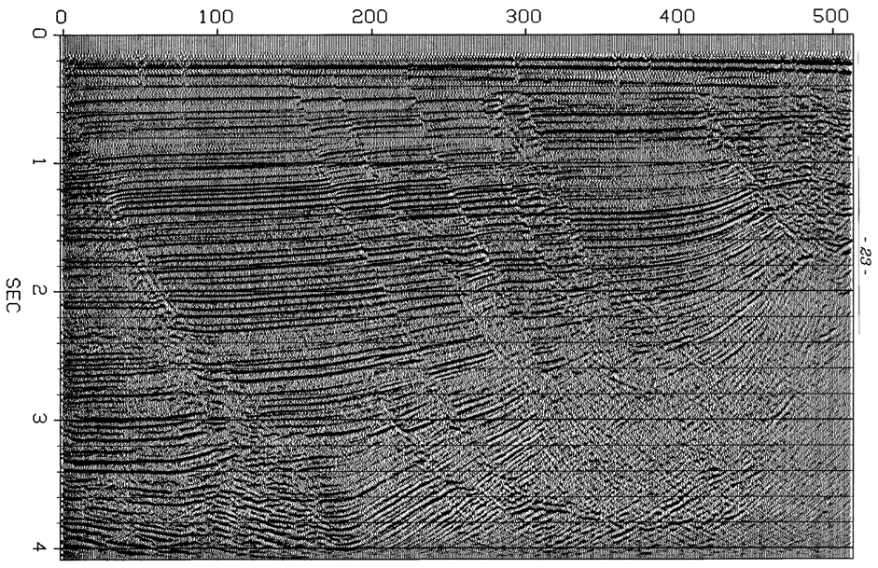
From Dave Hale’s thesis

Slide 40
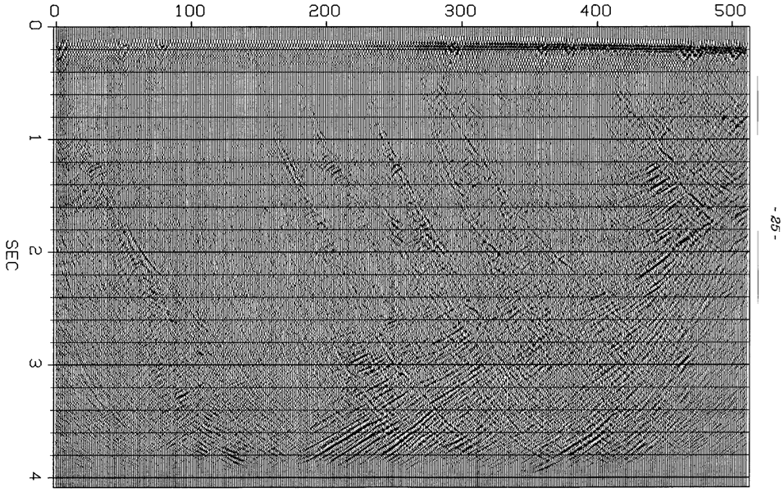
From Dave Hale’s thesis

Slide 41
From Dave Hale’s thesis

Slide 42
From Dave Hale’s thesis

Slide 43
From Dave Hale’s thesis

Slide 44
From Dave Hale’s thesis

Slide 45
Summary
Faults have cores
A zone that was changed and is different from the formations on either side of the fault
Small faults have thin or no cores
Large faults have cores that are thick enough to reflect seismic waves
Programs that generate reflectivity from geological scenarios need to take fault cores into account

