Slide 1
Nonlinear amplitude and frequency dependent reflections from source ghosting to amplitude dependent attenuation
Shuki Ronen
SEP seminar 10/25/2018
http://sepwww.stanford.edu/data/media/public/sep/shuki/sem1025/

Slide 2
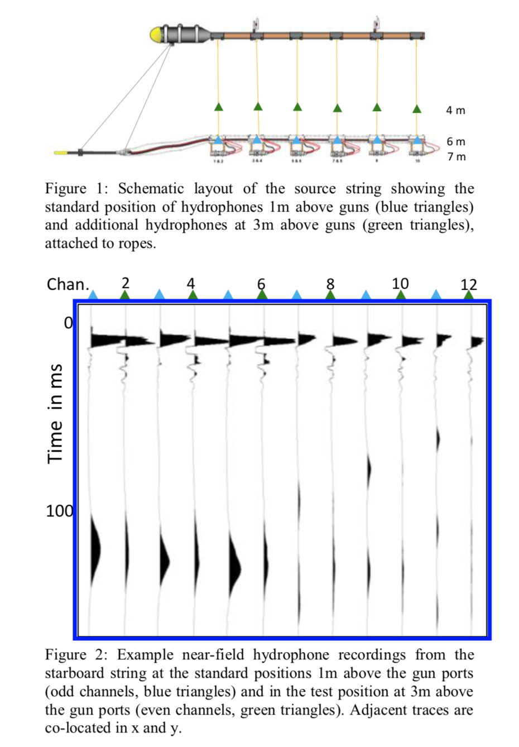
Telling et al “… source signature …”
Near Field Hydrophones (NFH)
Notional signatures (Ziolkowski, 1982): Inversion for N unknown notionals with data from N NFHs
Telling et al, 2018: N unknown notionals plus N more ghost notionals with 2N NFHs
  The ghost notionals are not simply a scalar reflection coefficient times the primary notionals
  The reflectivity of the sea surface is a big unknown. Not a single scalar. Not even a frequency dependent scalar.
  Paper went on to show results on field data

Slide 3
Simple physics (1D)
Reflection coefficient = (I₂-I₁) /(I₂+I₁)
I = ρv
  Water: ρ = 1000 kg/m³ ; v = 1500 m/sec; I = 1.5E6
  Air: ρ = 1.2 kg/m³ ; v = 343 m/sec; I = 412
  (412-1.5M)/(412+1.5M) = - 0.9994
1D to AVO is still too simple
Nature can be more complicated

Slide 4
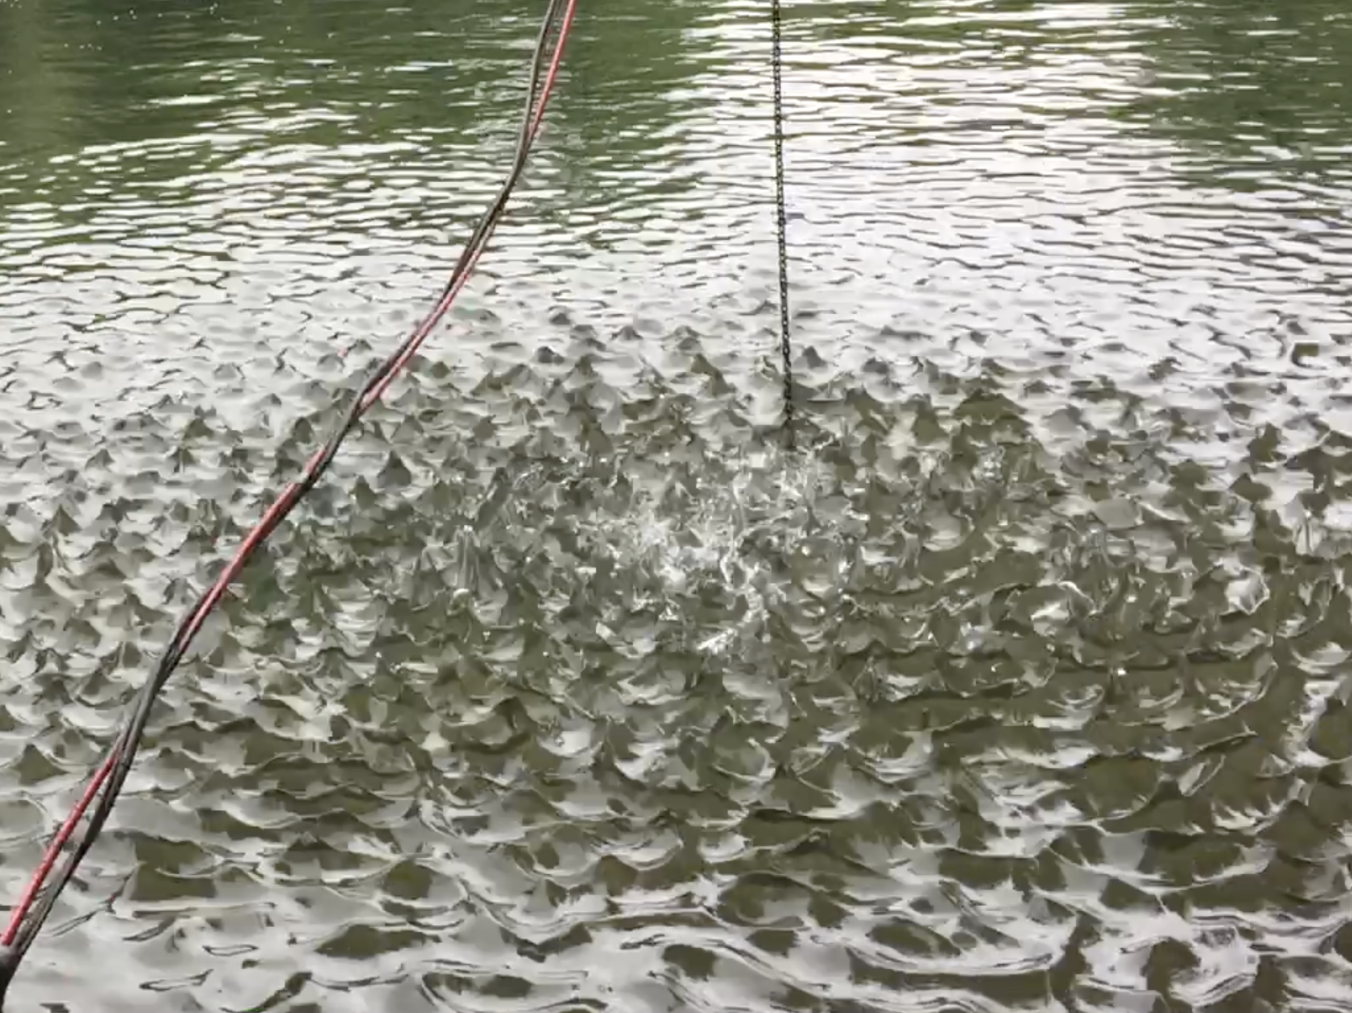
Chaotic reflection

Slide 5
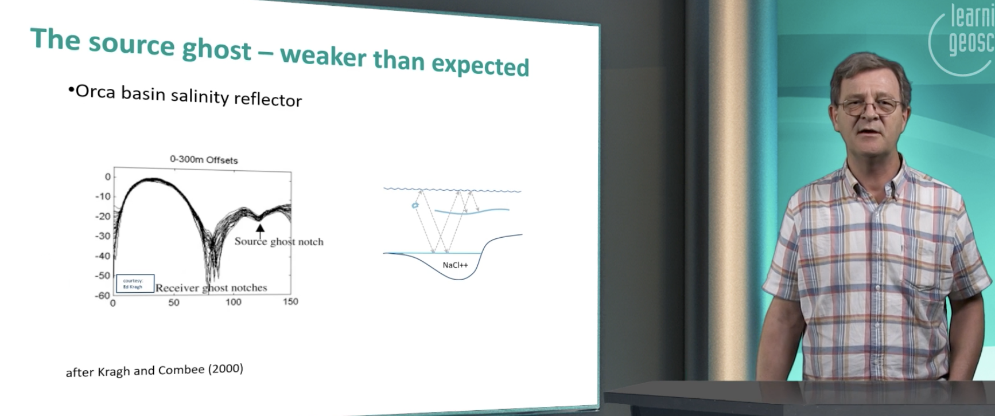
Hampson, 2018

Slide 6
Hampson, 2018
Question: Why is the source ghost weaker than the receiver ghost?
I thought: because the receiver is a point and the source is a 30x30m array
Hampson: because the high amplitude near the source causes anelastic reflectivity

Slide 7
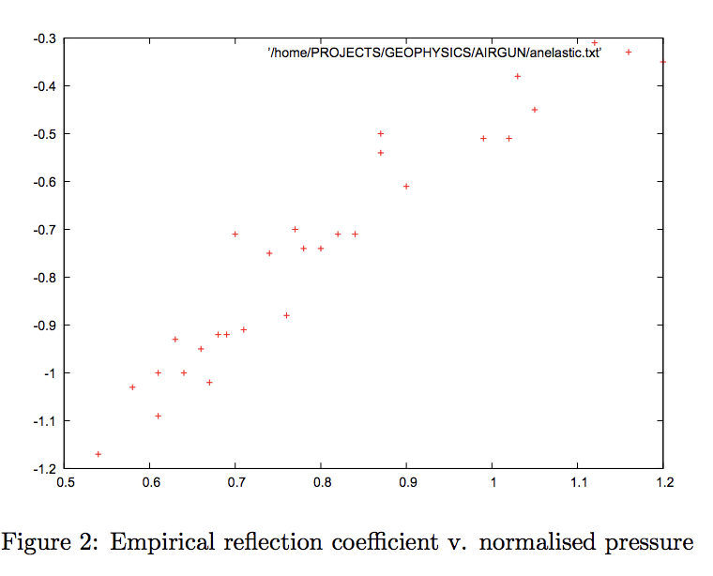
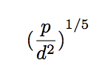
Hatton, 2007
Axis 2: “Empirical reflection coefficient” varies from -1.2 (not physical, focusing?) to -0.3
Axis 1is “normalized pressure”
  (Source strength in BarM / depth ²)^{1/5}
My movie: 4 BarM at 5m depth ~ 0.7 -> -0.95
There is also an energy loss !

Slide 8
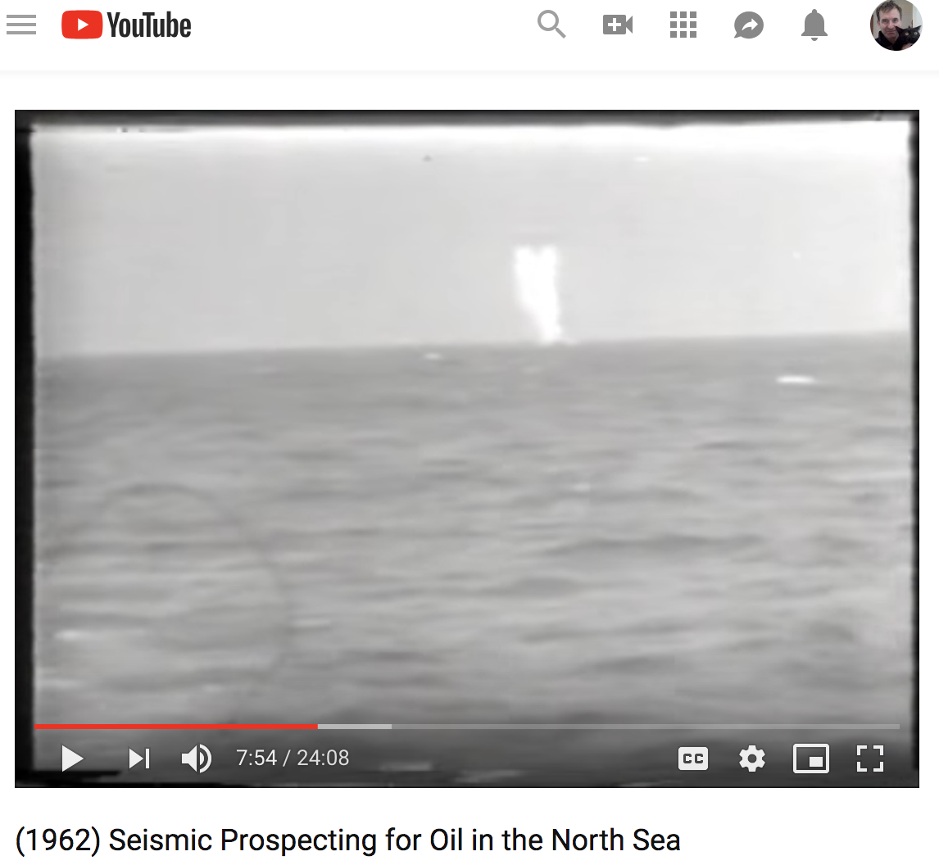
More significant energy loss (~0.5?)
Shallow explosives
The source in this 1962 ITN video
Probably half the energy is lost to the atmosphere
Data were good with 50 lbs of dynamite
… and no ghost

Slide 9
Why is this interesting
Source designature
  Debubble and deghosting are not two separate processes
Energy loss is not only frequency dependent (constant Q or whatever) but also amplitude dependent
There may be more loss going down than up, especially on land
What data can we use to study it?
What experiments can we do to study it?

Slide 10
Why is this interesting
Source designature
  Debubble and deghosting are not two separate processes
Energy loss is not only frequency dependent (constant Q or whatever) but also amplitude dependent
Energy loss on strong reflectors such as top salt / top basalt ?
There may be more loss going down than up, especially on land
What data can we use to study it?
What experiments can we do to study it?

