Slide 1
Numerical Modeling of Seismic Airguns
Leighton Watson Joseph Jennings Jonatan Werpers
Eric Dunham Shuki Ronen Ken Mattsson

Slide 2
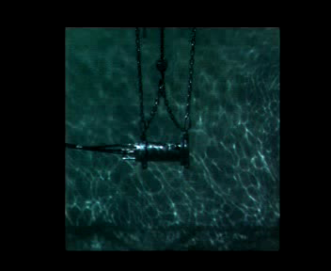
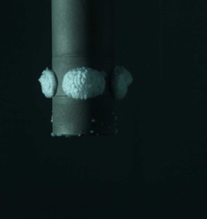
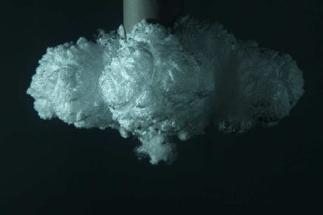
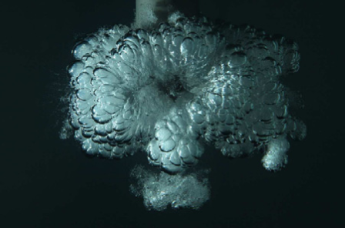
Seismic airguns are not an impulsive source
de Graaf et al. (2014)
Notes:
Motivation for studying seismic airguns. They are not an impulsive source. Highly pressurized air, bubble overshoots equilibrium position, contracts back. Generates an oscillating pressure signal. Would like a delta function. If we can model this we can deconvolve it from the data and have an ‘effective’ delta function/impulsive source. Designature the data.

Slide 3
Design a low pressure source
Strengthen low frequency signal
Reduce high frequency noise
High frequency noise
Notes:
Can use modeling to aid in designing a low pressure source. Strengthen low frequency signal, reduce high frequency noise that is useless and damaging to marine mammals

Slide 4
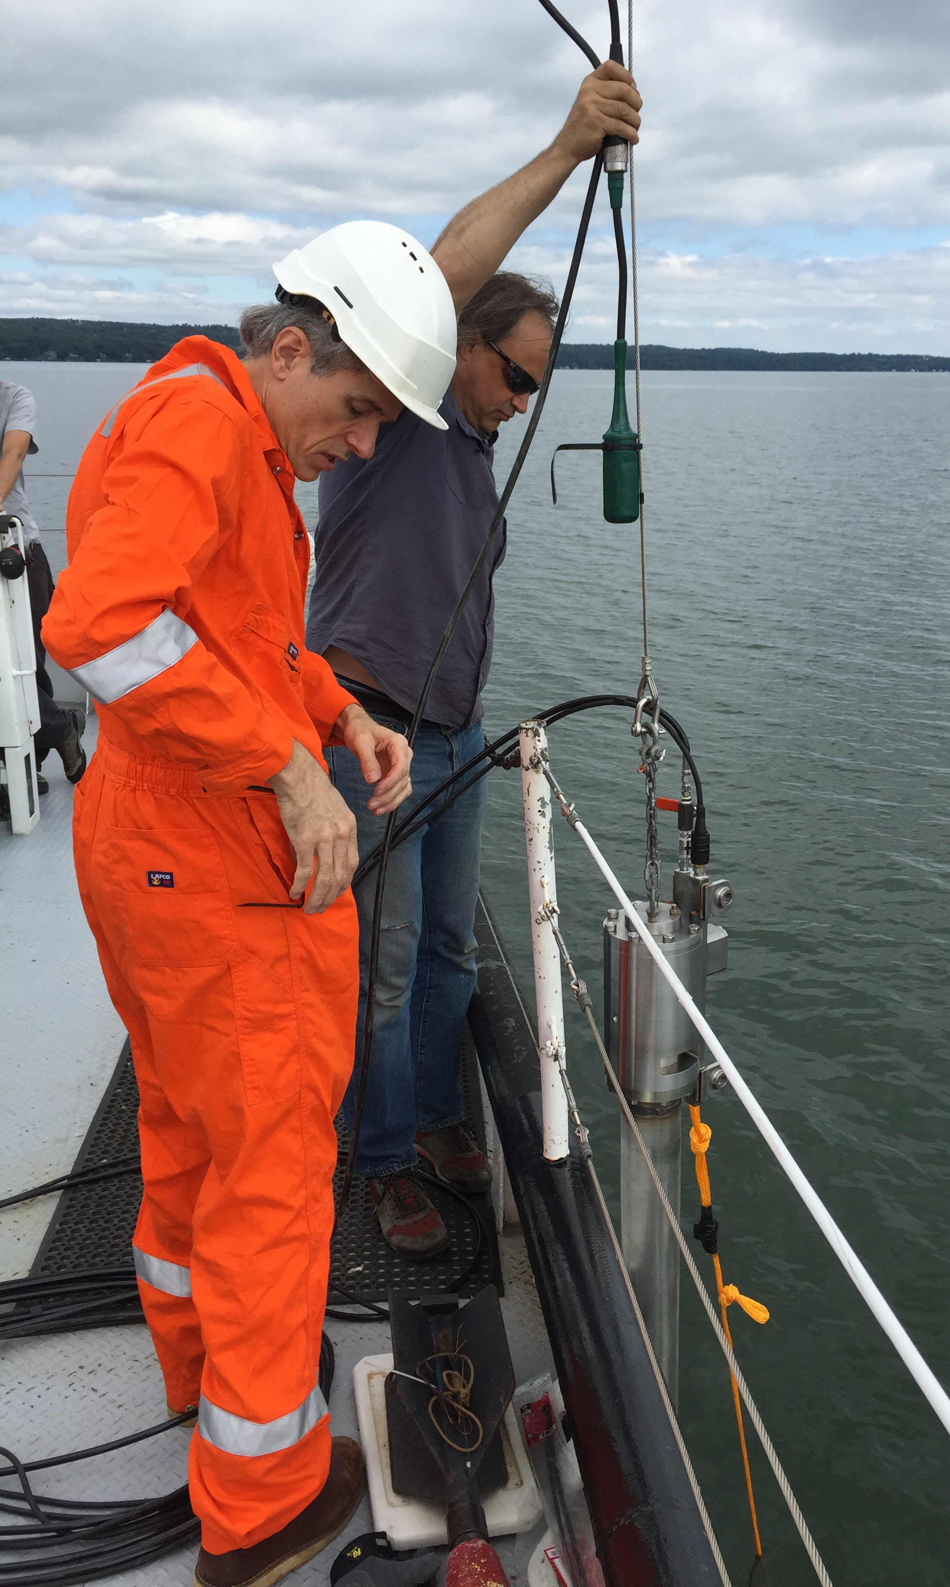
Field data from Lake Seneca
Near-field pressure signal
1m
75m
Far-field pressure signal
Notes:
Field tests at Lake Seneca. Acquisition geometry. Near field recording is rubbish – signal reaches recording limit of instrument. Far field recording is much better.

Slide 5
Field data from Lake Seneca
Far-field signal for a 598 in³ airgun at a measured depth of 7.5m for a range of pressures
Data
Notes:
Made measurements for a range of airgun firing pressure. Only limited range of volumes – hence where modeling is useful.

Slide 6
Field data from Lake Seneca
Far-field signal for a 598 in³ airgun at a measured depth of 7.5m for a range of pressures
Rise time of initial pulse is independent of airgun pressure
Amplitude of bubble peak is independent of airgun pressure
Data
Ghost
Notes:
Amplitude of initial pressure pulse is related to airgun pressure as expected. Interesting features in data. Would like to explain them and capture them in our modeling.

Slide 7
The same features are seen in other data sets
Laboratory measurements of a scaled down airgun by de Graaf et al. (2014)
Rise time of initial pulse is independent of airgun pressure
Amplitude of bubble peak is independent of airgun pressure
Ghost
Notes:
Similar features seen in different data sets.

Slide 8
Modeling approach
Solve the Euler equations governing the motion of the compressible fluid
Solution is evaluated on the bubble wall to give a nonlinear ODE for the bubble dynamics
Assume a spherical bubble and uniform internal properties of the bubble and airgun
Notes:
Spherical bubble – valid to approximate as a monopole as the wavelengths of the frequencies of interest are much larger than the bubble. 10Hz = wavelength of 150m. Bubble is ~1m.

Slide 9
Modeling approach
Solve the Euler equations governing the motion of the compressible fluid
Solution is evaluated on the bubble wall to give a nonlinear ODE for the bubble dynamics
Assume a spherical bubble and uniform internal properties of the bubble and airgun
The bubble dynamics are related to the observed pressure signal by
Notes:
This relationship simplifies in the far-field when the 1/r^4 term becomes negligible.

Slide 10
Match data for different firing configurations with no tuning of model parameters
598 in³ airgun fired with pressure of 1295 psi at measured depth of 5m
50 in³ airgun fired with pressure of 530 psi at measured depth of 25m
Near-field
Far-field
Near-field
Far-field
Notes:
Tune parameters for 598in^3 airgun near field. Only vary firing properties to match the other data. Should change tuning to match far field as near field data is not good quality. Other authors have used inverse procedure to get a better fit. Not the point. Change work flow to tune to far field. Measured depth vs true vertical depth. Controls ambient pressure which relates to bubble period.

Slide 11
Trends are similar between simulations and data for different firing configurations
Data
598 in³, 25 m measured depth
Model
598 in³, 25 m measured depth
Notes:
Needs additional work to choose correct tuning parameters initially. Trends in data are replicated in the model.

Slide 12
Simulated pressure signal
Rise time of the peak is independent of the airgun pressure. This is related to the port rapidly becoming choked
Amplitude of bubble peak depends on airgun pressure, unlike in the data
Model
Ghost
598 in³, 7.5 m measured depth
Notes:
Capture most of the interesting features. Can’t explain the amplitude of the bubble peak not depending on airgun pressure.

Slide 13
Model results agree with Rayleigh-Willis equation
Bubble frequency
Depth
Airgun pressure and volume
Model
Dominant frequency predicted by Rayleigh-Willis equation
598 in³, 7.5 m measured depth
Notes:
Model results agree with the Rayleigh-Willis equation. This gives the dominant bubble period/frequency but does not give how the power spectra varies with frequency. Model agrees with existing work but can also extend it.

Slide 14
Euler airgun
Describe the inside of the airgun using a system of PDE’s rather than ODE’s
Account for waves travelling inside the airgun
Solve the Euler equations inside the airgun
Work done with Jonatan Werpers and Ken Mattsson
Notes:
More sophisticated modeling using PDE’s inside the airgun rather than ODE’s

Slide 15
Conclusions
Developed a forward model of the airgun/bubble system that is able to match the data with limited tuning
Investigate design ideas for a low pressure source

Slide 16
Conclusions
Developed a forward model of the airgun/bubble system that is able to match the data with limited tuning
Investigate design ideas for a low pressure source
Increasing the quantity PV results in:
Shift to lower dominant frequency
Reduction of high frequency noise

Slide 17

Conclusions
Developed a forward model of the airgun/bubble system that is able to match the data with limited tuning
Investigate design ideas for a low pressure source
Increasing the quantity PV results in:
Shift to lower dominant frequency
Reduction of high frequency noise

Slide 18
Conclusions
Developed a forward model of the airgun/bubble system that is able to match the data with limited tuning
Investigate design ideas for a low pressure source
Increasing the quantity PV results in:
Shift to lower dominant frequency
Reduction of high frequency noise

