Slide 1

Fault-cores
and
Fault plane reflections

Slide 2
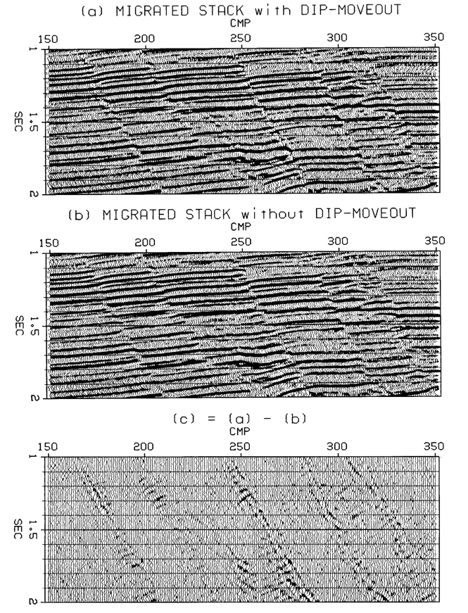
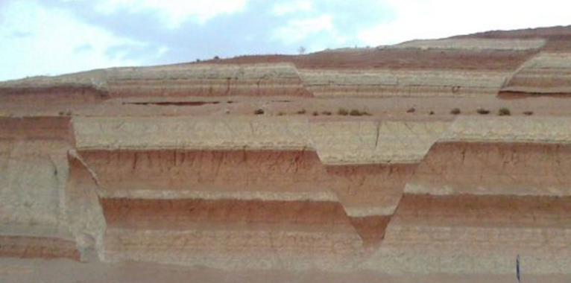
Is there a problem here?

Slide 3
Fault core
Faults are not “clean cuts”
There are broken zones
I thanks Professor David Pollard for teaching me about them and for the picture

Slide 4
This is rare
… happens only in very small scale.
In large scale the fault core is thick enough to reflect seismic waves

Slide 5

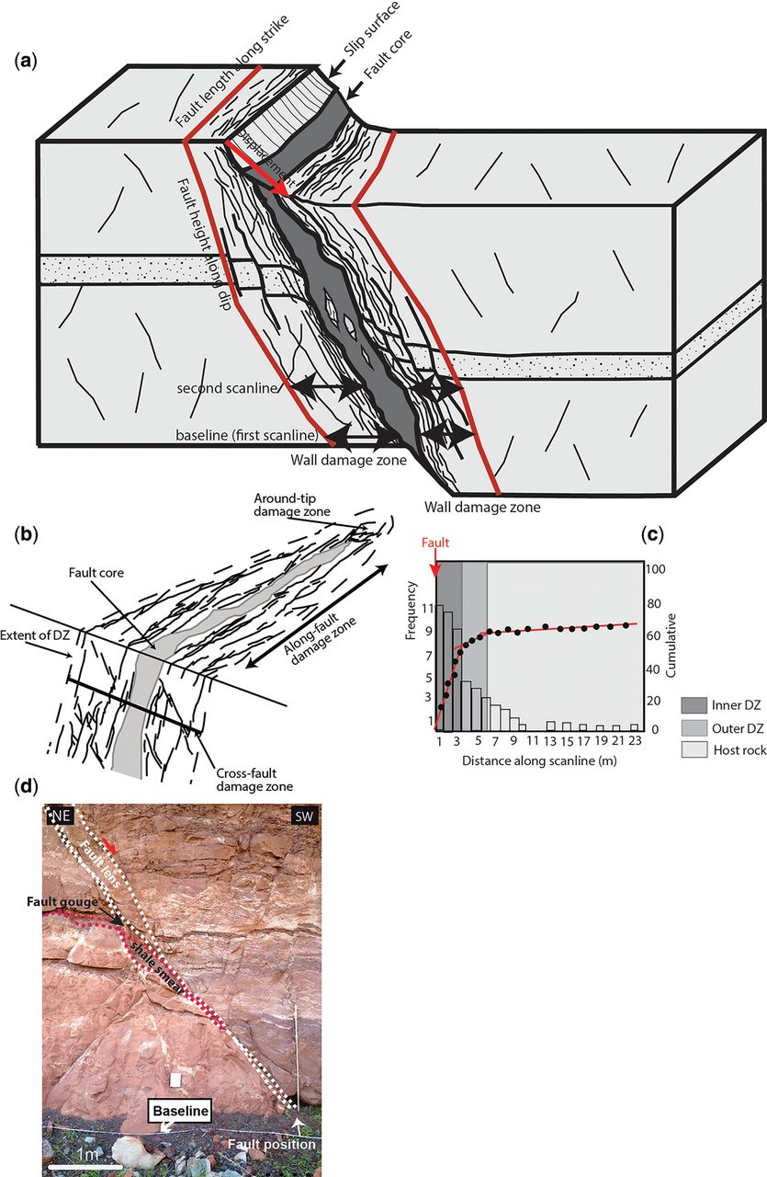
A. Torabi et al. Geological Society, London, Special Publications 2019;496:SP496-2018-151

Slide 6
From Dave Hale’s thesis
Fault plane reflections (?)
Negative polarity (?)
Softer (?)
Fault plane reflections and layer edges may not image at the same place because of
2D data
Isotropic processing

Slide 7
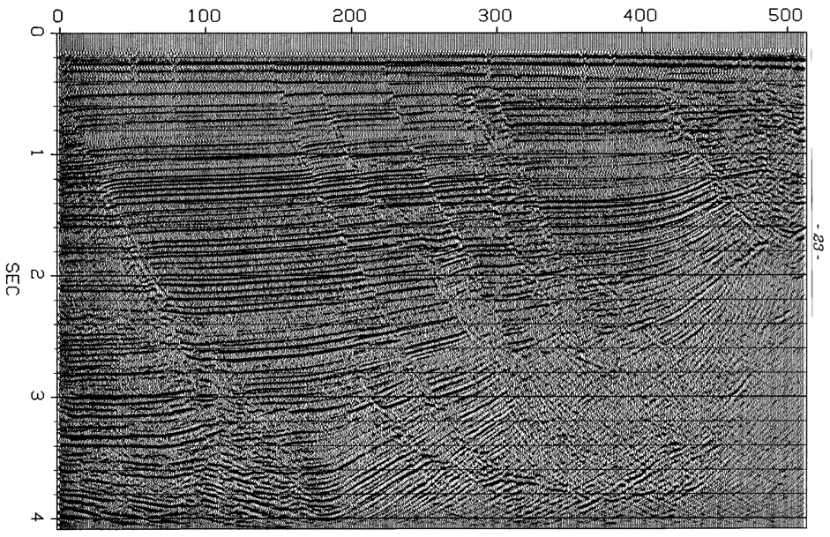
From Dave Hale’s thesis

Slide 8
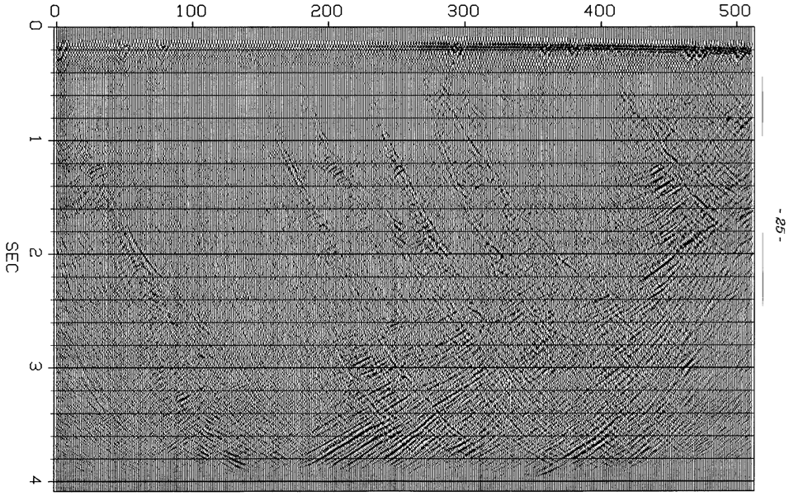
From Dave Hale’s thesis

Slide 9
From Dave Hale’s thesis

Slide 10
From Dave Hale’s thesis

Slide 11
From Dave Hale’s thesis

Slide 12
From Dave Hale’s thesis

Slide 13
Faults may or may not be flow barriers
Translate “Fault rock”/”Shale smear” to “Fault core”

Slide 14
Summary
Faults have cores
A zone that was changed and is different from the formations on either side of the fault
Small faults have thin or no cores
Large faults have cores that are thick enough to reflect seismic waves
Programs that generate reflectivity from geological scenarios need to take fault cores into account

