Slide 1

“Krisp” noise cancelation App
and speculation on
Deblending data acquired with simultaneous sources with different voices

Slide 2
Outline
Background noise is a problem with tele-conference calls
Dog barking
Coffee grinders
Traffic …
In a meeting, one dog owner suddenly asked everybody if they can hear his dog barking
Nobody (except the dog owner) heard any barking
The dog owner exclaimed “It’s working!”
“What is working?” … long answer … bottom line
https://krisp.ai/

Slide 3
I installed it and tested it
Two people (me and my wife) talking, so
Two voices (male/female)
Two languages (Hebrew/English)
Two noise tests
Hair dryer
Hand clapping

Slide 4
Test results
It Works!
Hair dryer was 100% perfect
No remnant of the hair dryer noise
No distortion on the signal. If anything it was cleaner and if I may say so, it was crisper
The hand clapping was (subjective) 80%
Some clapping got through, but very weak (-2 points)
The voice distorted when the hand clapping noise was removed (-18 points)

Slide 5
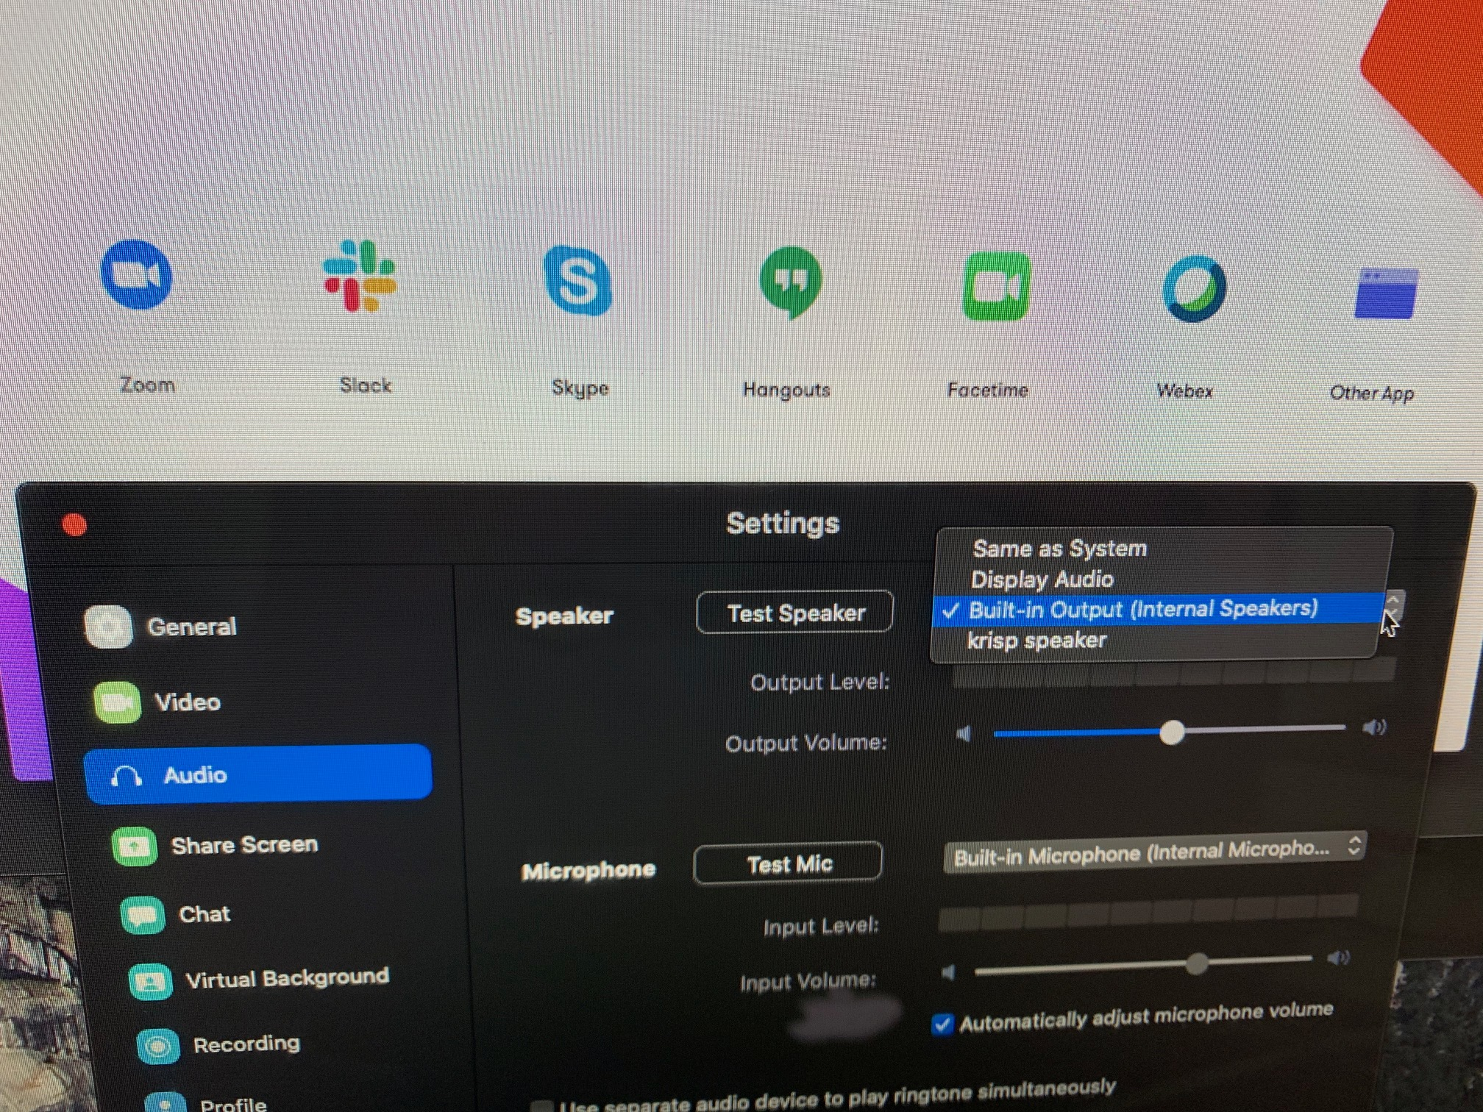
Set up after installation
There was no training
I did not have to say anything like “Hey Siri” to train it to recognize my voice
It told me there are a bunch of t-con apps that can use it

Slide 6
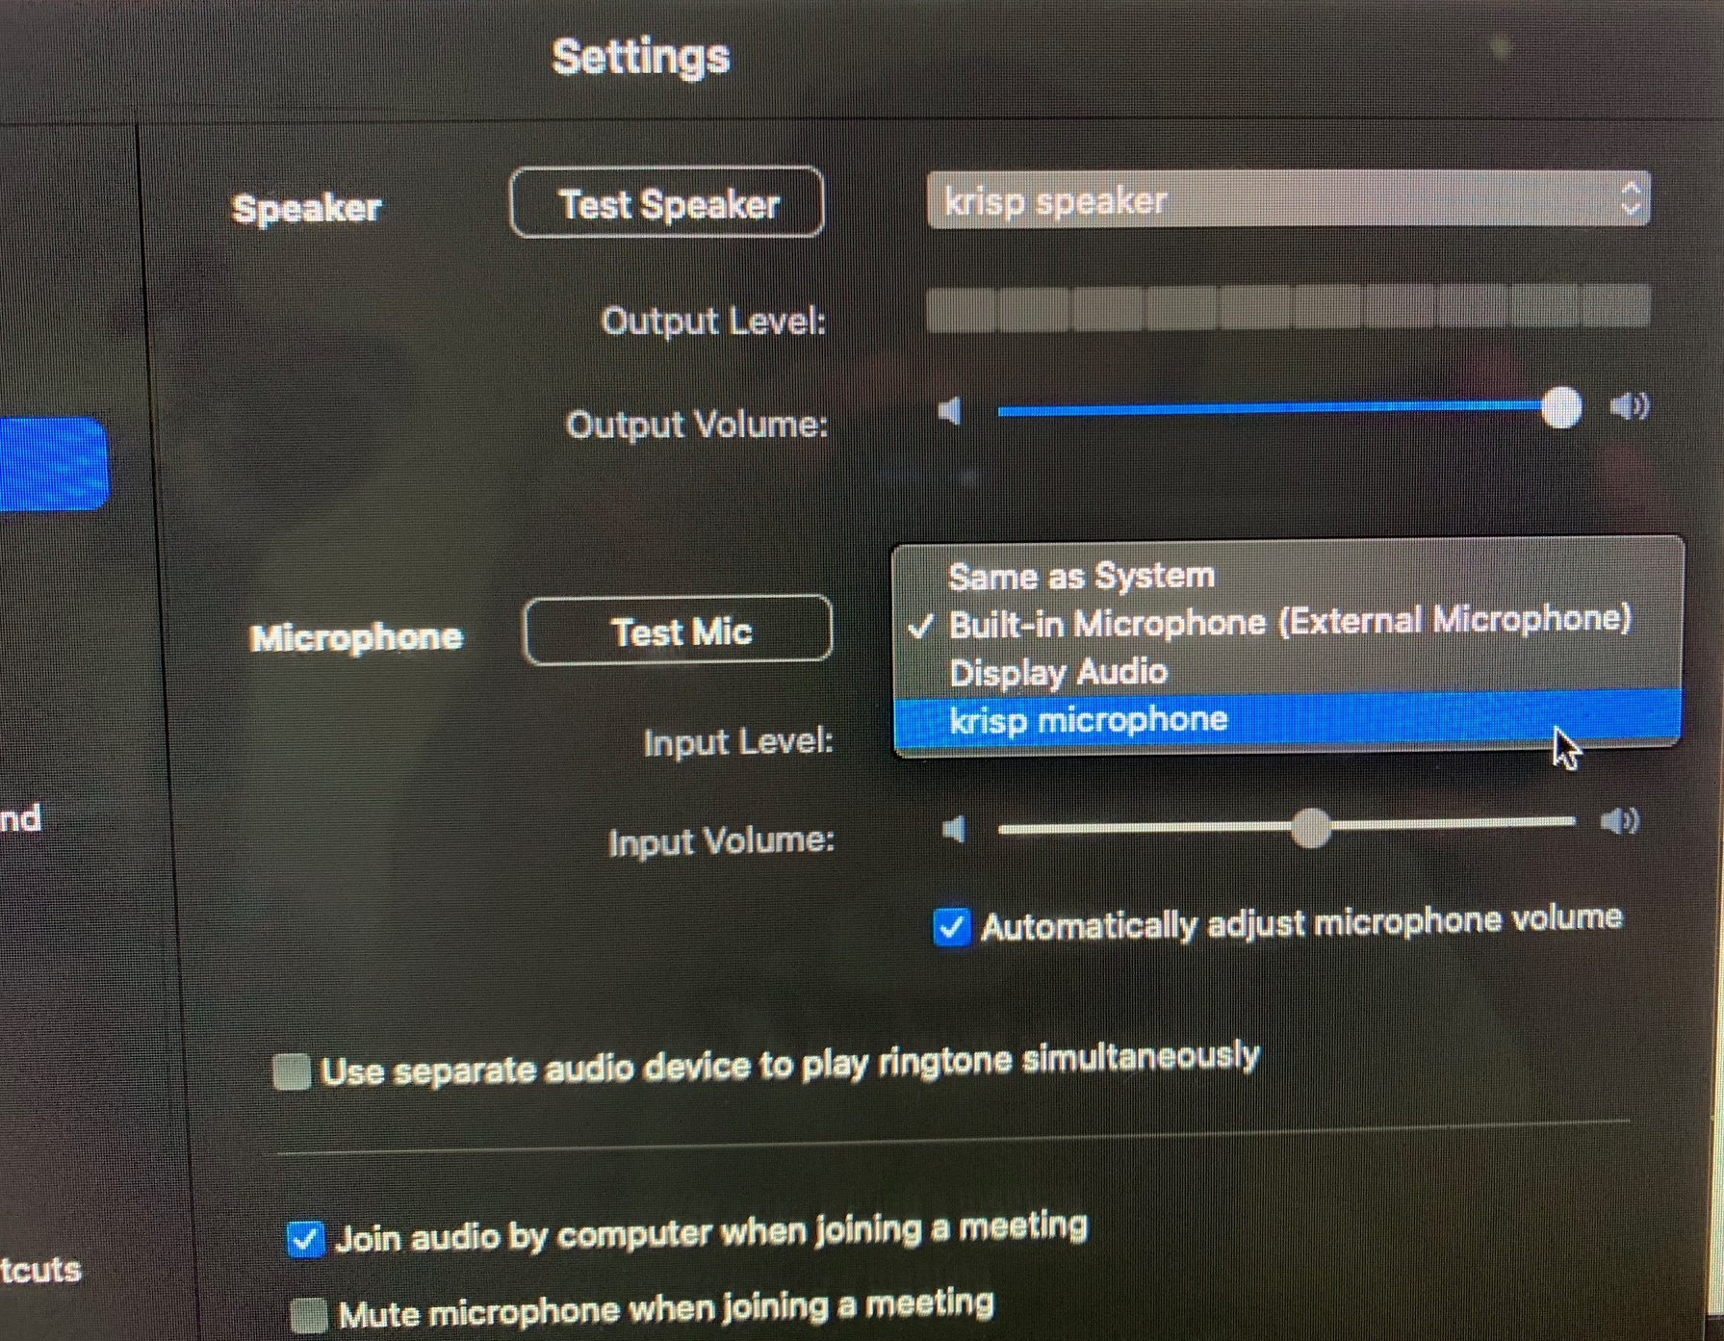
I chose to activate it on Zoom
In the Zoom → preferences → Audio
Activate
Either Speaker
And/or Microphone

Slide 7
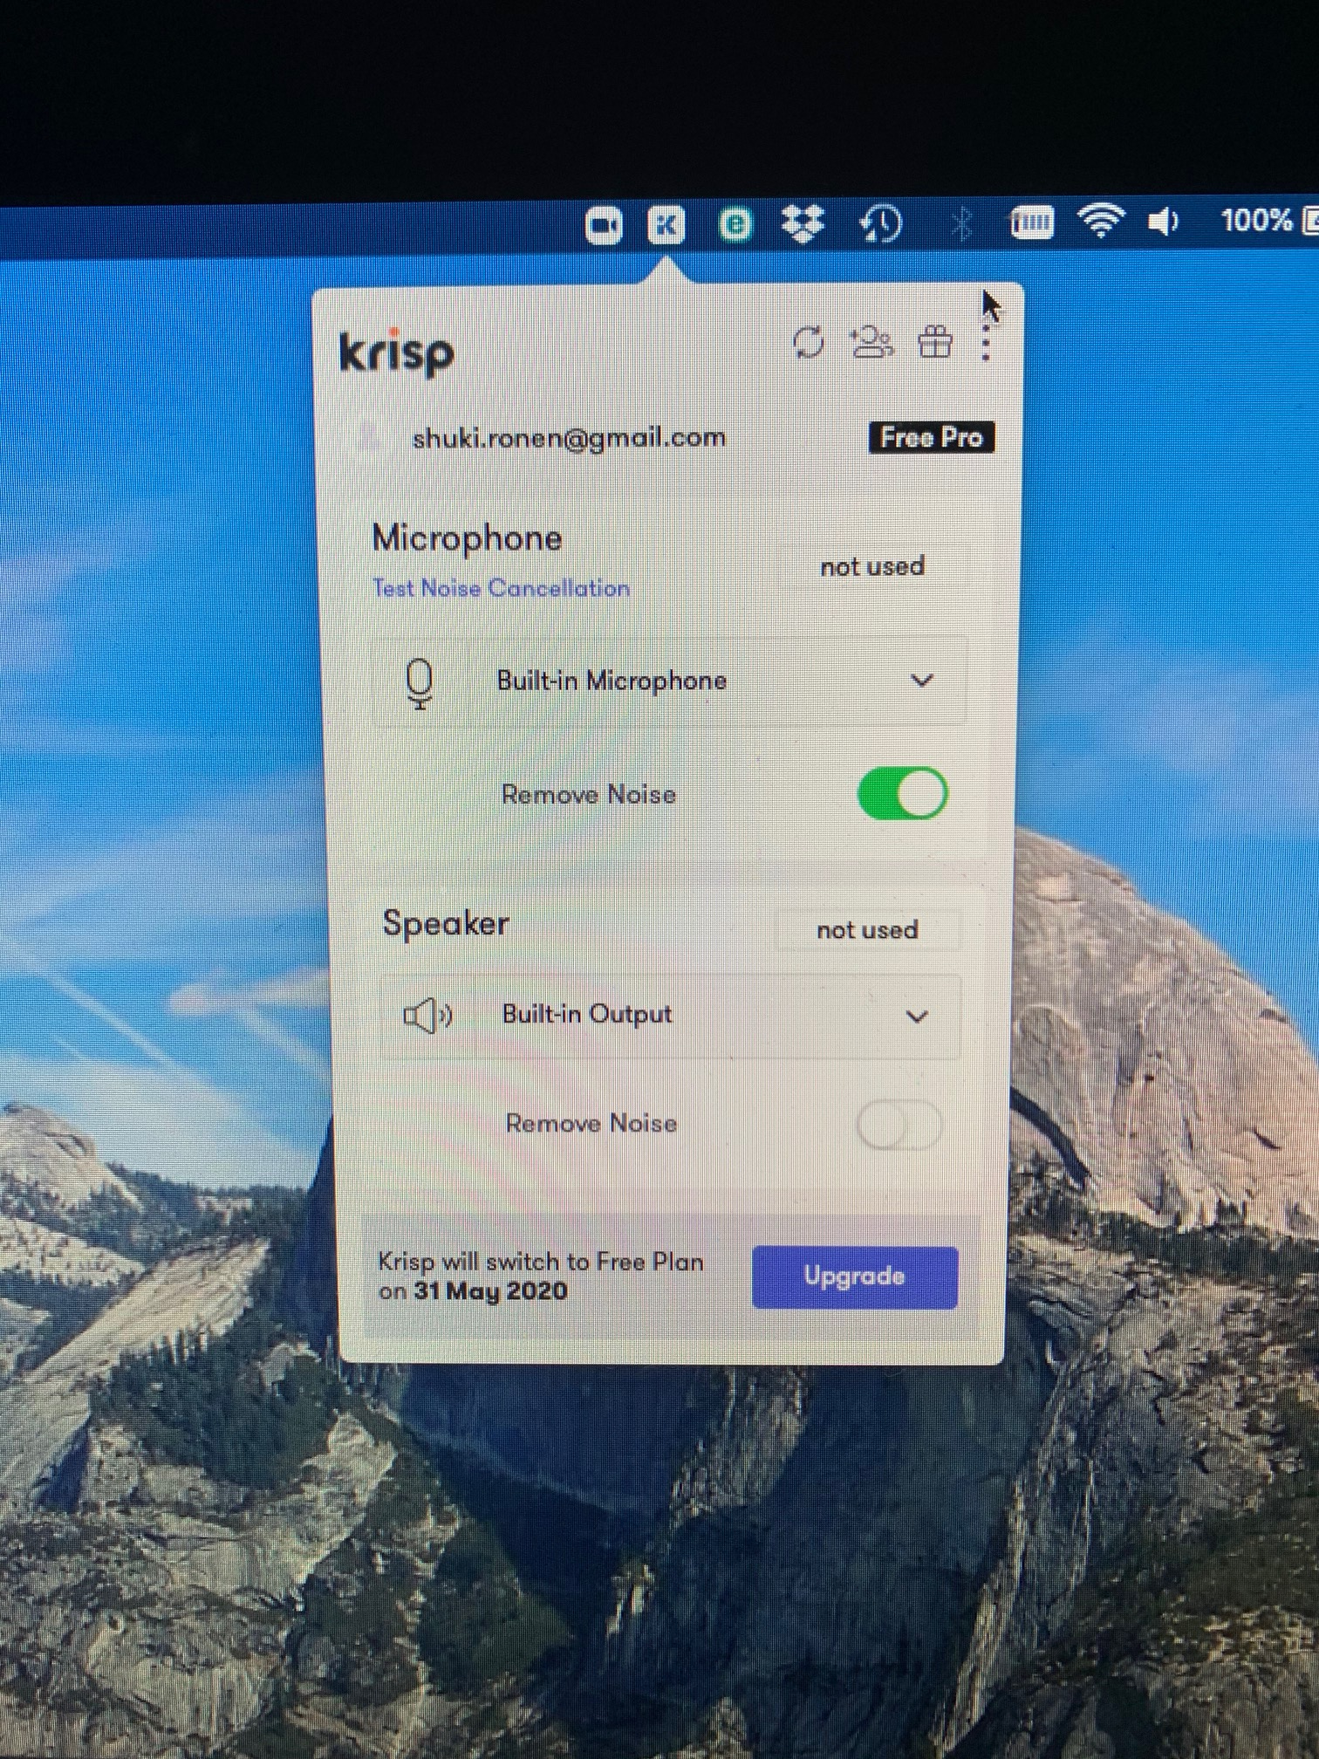
It also appears on the general app bar
I think (not sure) that I have it activated in general
for the Microphone
but not the Speaker

Slide 8
Why this may be interesting in seismic
I am not sure it can be (much?) better than conventional data processing system to filter out non shot generated noise such as shipping or traffic noise
If this can be developed to recognize and separate voices (cocktail party problem) then we can perhaps use it to deblend data from simultaneous sources with different voices

Slide 9
“Simultaneous sources with different voices”
(Everybody knows) … SimSrc Data
So far, the SimSrc surveys have been done with two or more sources that have the same frequency content—having the same voice
However, we may be going to source technology that will use sources with different voices

Slide 10
Sources with different voices
Geokinetics’ Marine Vibroseis Symphony
This idea can also be done with Air Guns (PGS eSeismic)
Small Guns: 20-100Hz, λ_{min} = 15m , shallow target, short listening time
Large Guns: 4-40Hz, λ_{min} = 37.5m , deep targets, long listening time
Huge Guns: 1-10 Hz, λ_{min} = 150m , long offsets, very long listening time
Conventionally, all guns in the array, big and small, shoot together, so same shot interval, usually 25-50m
The source interval is often too long for the small guns because the compressor capacity and the large guns limit the shot interval
Huge guns need a lot of air per shot
There is no ability (nor need) to shoot a 1-10 Hz source every 25m

Slide 11
Sources with different voices
Because the shot intervals are different
Limited compressor capacity
Different shot intervals
Different listening time
The data will be blended
But the sources will have different voices

Slide 12
Summary
Signal/noise separation methods that identify voice as signal and non-voice as noise
Seem to work well
Can we use voice recognition
not only for voice / non-voice separation
but for voice1 / voice 2 separation?

