Slide 1
SEP best of SEG seminar
Chose to cover one selected part of two workshops
  W9 Low-frequency FWI: how low do we need to go?
  W11 Promises and challenges with sparse node ultra-long offset acquisition in imaging and earth model building
The selected part
  Very and ultra low frequency sources: why and how
  I do not cover data processing and ocean bottom nodes

Slide 2
Summary
Low frequency content needed for
  Velocity model building
  Imaging under complex overburden (sub-salt, etc.)
  Building blocky earth models
  Resolution (side lobes)
What is needed
  Sources: new low frequency sources are coming
  Receivers: ocean bottom nodes are here
  Processing: including methods handling local minima

Slide 3
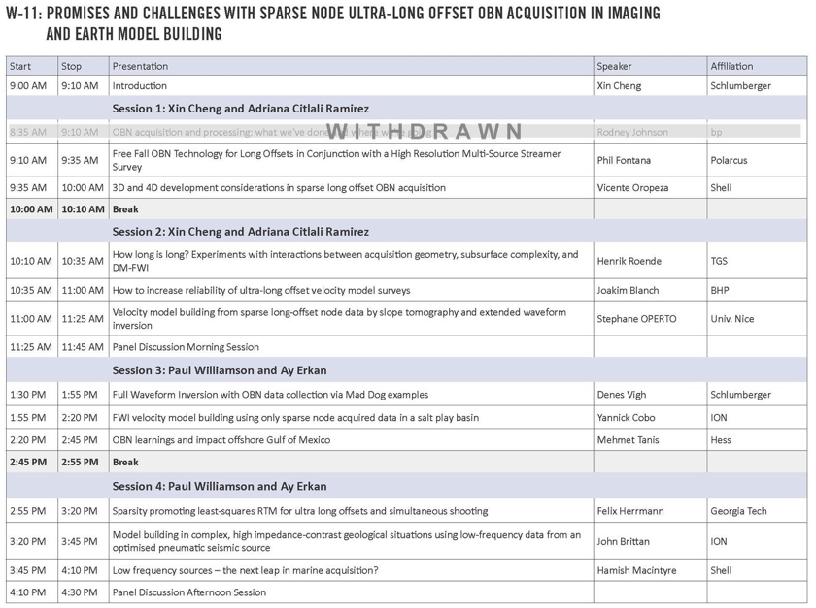

Slide 4
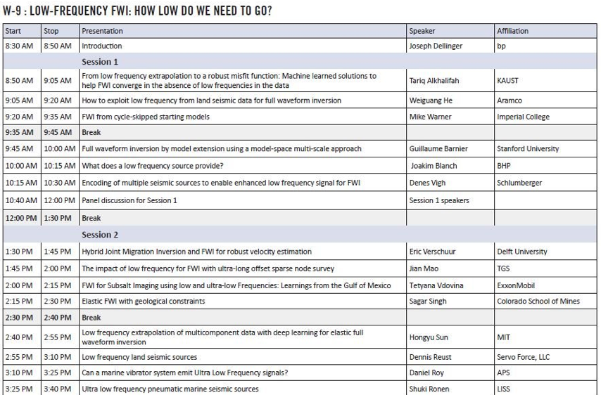

Slide 5
Joe Dellinger’s talk
Great improvement going
  From NATS to WATS
  From WATS to OBN
  BUT “There are still challenges to meet!”
Processing and/or acquisition solutions
Review of new low frequency sources
  Vibes: APS, PGS, SAE. ULF: T-ULF, Wolfspar
  Pneumatics: Breaching Airguns, ION EFS, LISS TPS

Slide 8
Joakim Blanch’s talks
Data from a BHP 2019 OBN survey
Compared EFS to the production Ags
  Spectra: Bubble frequency: 7.5Hz → 3.5Hz
  Bandpass common receiver gathers
    Dramatically improved 2-4 Hz signal over noise
  Small but significant improvement on final image

Slide 10
John Brittan’s talk
Same low frequency source EFS of Blanch’s talk
A pneumatic source. Showed no pictures.
Showed data from the 2020 Engagement OBN survey and from the 2019 BHP OBN survey
  Spectra: ion’s source a bubble frequency of 3.4Hz. Overlaid on conventional Airgun data with 7.8Hz.
  OBN data: better signal at 1.5-4 Hz
  Effect on velocity model: small but significant
  Effect on output image: small but significant

Slide 12
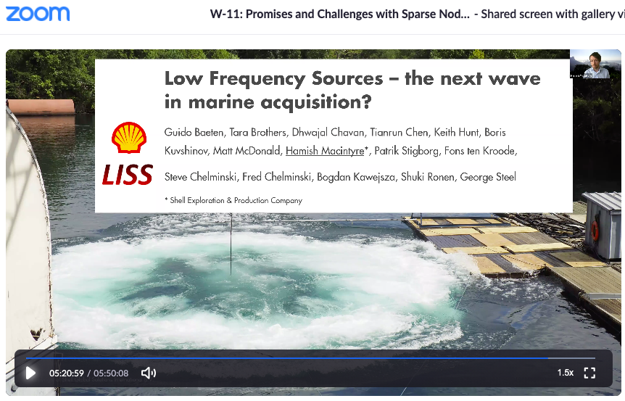

Slide 13
Hamish Macintyre’s talk
Nice introduction on a perspective of the added value of low frequency sources to other technologies including OBN, FWI, and LSRTM
A new source that Shell is developing together with a startup company called LISS
  Competitor to ion’s
  Spectra: 2.8 Hz resonance (ion’s is 3.4Hz)
  Added benefit: lower environmental impact

Slide 15
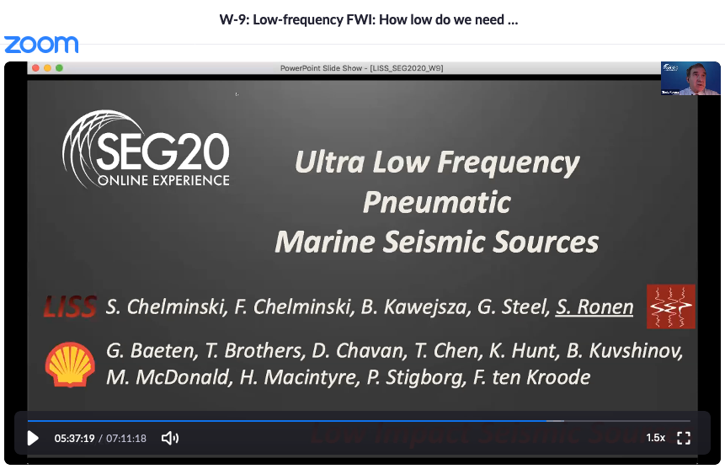

Slide 16
Shuki Ronen’s talk
Same source as in Hamish’ talk
Some stuff the same in the Shell and the LISS talks
LISS talk expanding on the environmental and safety advantages of the LISS source
  Environment: Reduces slope high frequency content
  Safety: Reduced risk of auto-fires
Made the point that the summer 2020 LISS source was “VLF” which means Very Low Frequency, but the LISS source is capable of future “ULF” (Ultra)

Slide 17
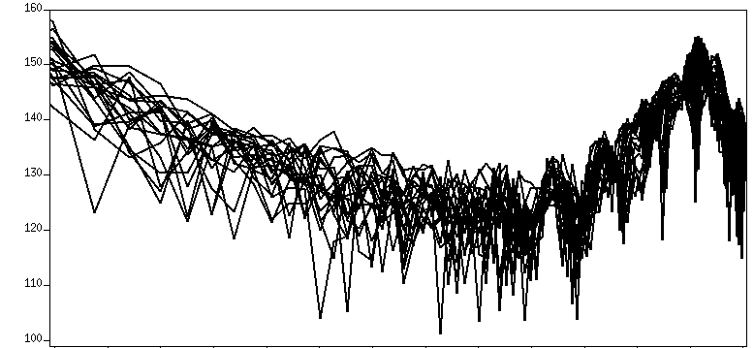
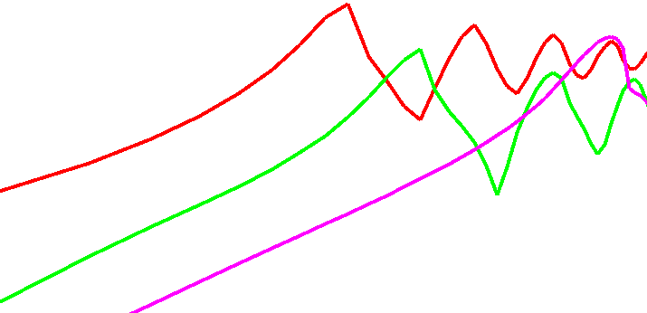
Very Low and Ultra Low Frequency sources
140K TPS
dB re uPa
Ambient noise
26K TPS
Airgun Array
0.5 1 Hz 2 Hz 4 Hz 7 Hz
Airgun data after RC designature (6dB/octave correction from 2 Hz down)
Ocean Bottom Node data courtesy of Seabed Geosolutions

Slide 18
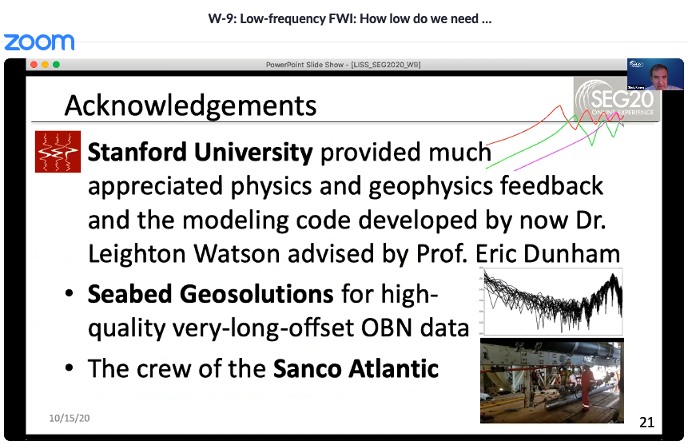

Slide 19
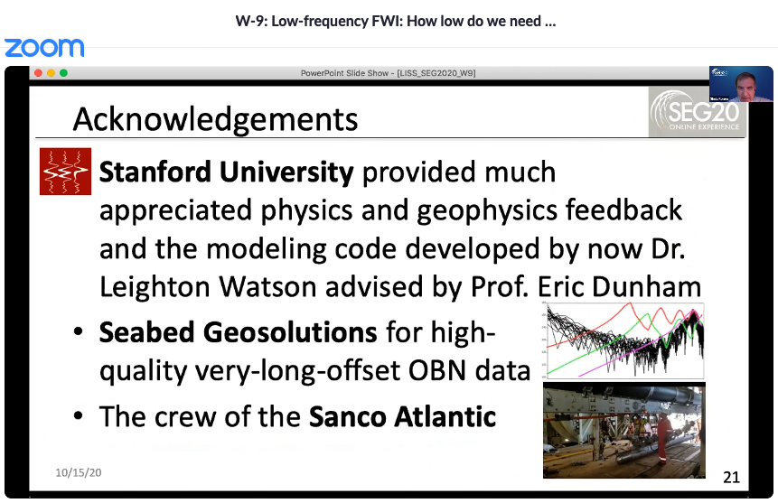

Slide 20
Summary
Low frequency content needed for
  Velocity model building
  Imaging under complex overburden (sub-salt, etc.)
  Building blocky earth models
  Resolution (side lobes)
What is needed
  Sources: new low frequency sources are coming
  Receivers: ocean bottom nodes are here
  Processing: including methods handling local minima

