Slide 1
Shuki Ronen
Adjunct Professor
Current Activities
Deblending with multi-component data
Deblending with with voice recognition
Continued interest in Ocean bottom Nodes
Low Frequency Sources

Slide 2
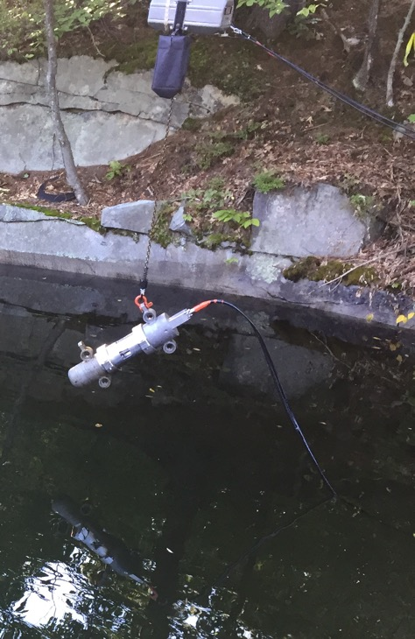
Quarry in NH, September 2018
Airgun Tuned Pulse Source
I thank Polarcus for the Airgun
I thank Shell for clear geophysical and environmental requirements and for their support in funding and data analysis

Slide 3
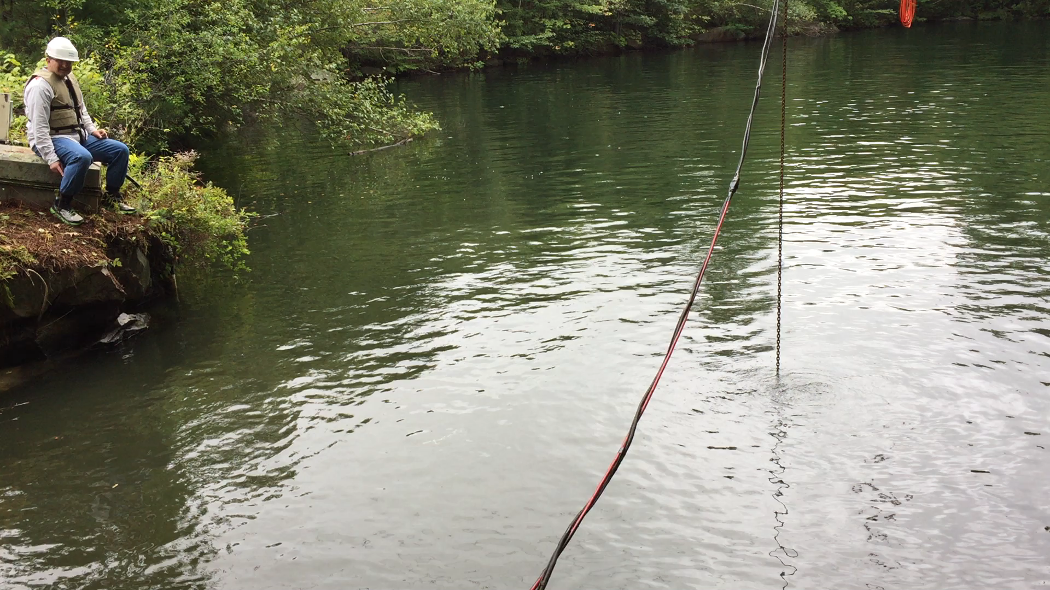
Watch: Particle acceleration ~> Earth Gravity
Listen: Water splashing and unheard infra-sound

Slide 4
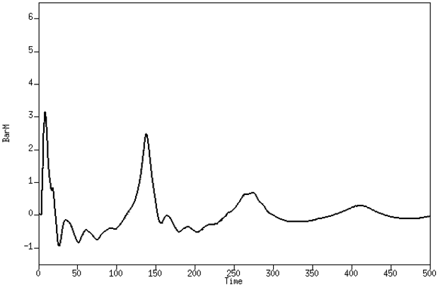
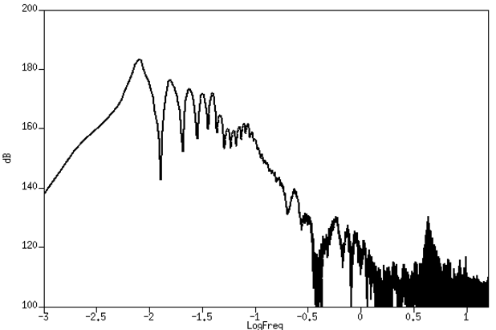
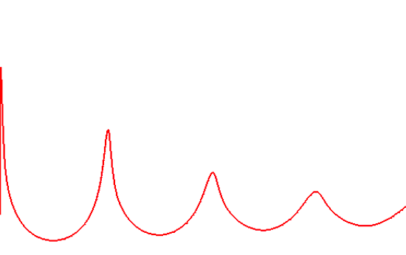
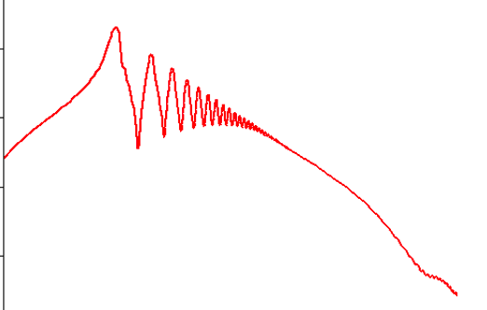
Comparison of quarry data to modeling 600 cui
Modeling program by Leighton Watson and Eric Dunham (Stanford … volcanology)
Now: Rayleigh-Plesset (bubble)
Soon: Euler (inside the firing chamber)
Difference between modeling and experimental data
1Hz 10Hz 100Hz 1kHz 10kHz

Slide 5
Environmental Impact (High Frequency content)
Difference between Airgun and Low frequency source

Slide 6
Low frequency signal
Source | Low Frequency Limit
Airgun | 4 Hz
VLF | 2 Hz
ULF | 1 Hz
I thank Seabed Geosolutions for the high quality node data that they released to Stanford

