Slide 1
Low Frequency Limit
Let’s look at available node data (conventional airguns)
Sub-basalt survey: high quality node data
Conventional array of 30 airguns
Low frequency provided by 3 clusters of 2x350 in³
Bubble frequency = 8 Hz
Run modeling
Model the airguns and the ULF
Same program to model conventional airguns
Overlay modeling results on the real data

Slide 2
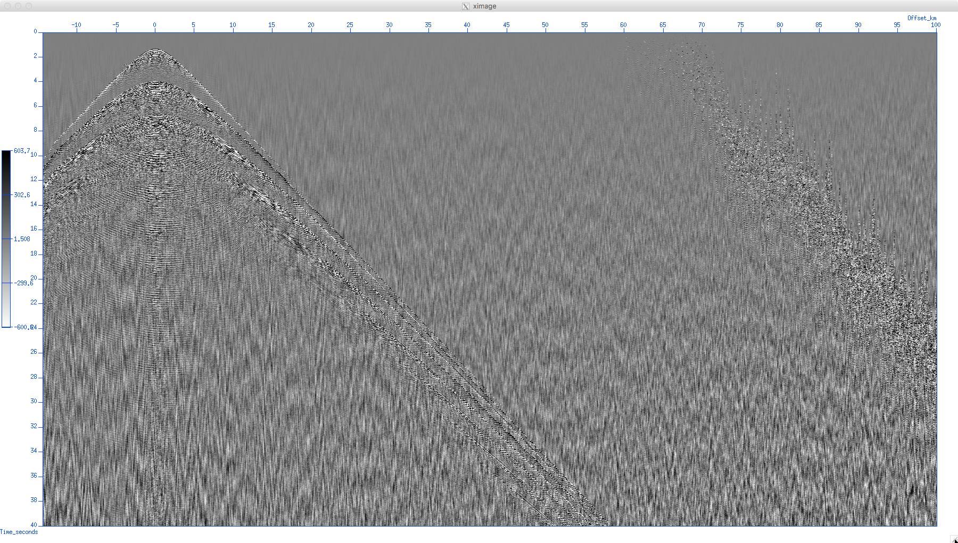
Common Receiver Gather, OBN, Hydrophone component
100km
Previous Shot 65-100 km away
40 seconds
Data courtesy of Seabed Geosolutions

Slide 3
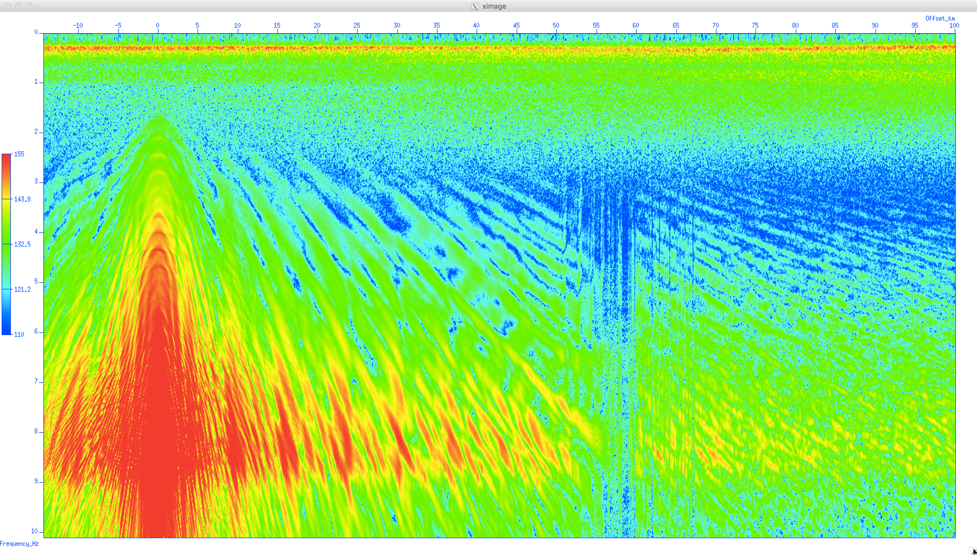
Common Receiver Gather, OBN, Hydrophone component
100km
10 Hz
Data courtesy of Seabed Geosolutions

Slide 4
Common Receiver Gather, OBN, Hydrophone component
Hydrophone analog RC low cut 6dB/octave winning <0.25Hz
Strong low frequency ambient ocean noise
100km
Near offset
signal down to 2 Hz
The Valley of lost opportunity: not much noise but no signal
30km offset
signal down to 4 Hz
Airgun bubble frequency at 8 Hz
10 Hz
Data courtesy of Seabed Geosolutions

Slide 5
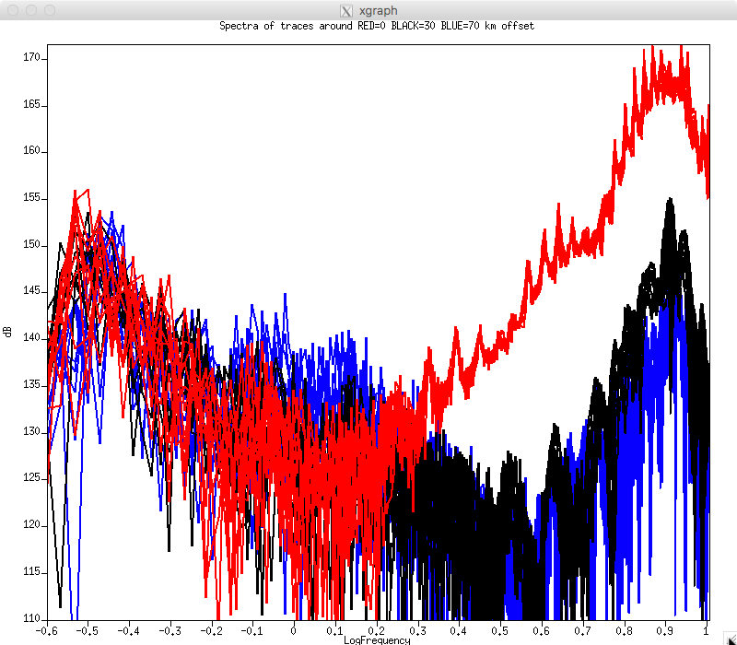
Common Receiver Gather, OBN, Hydrophone component
100km
Spectra of real data
10 Hz
0.25Hz 0.5Hz 1Hz 2Hz 4Hz 8Hz

Slide 6
Common Receiver Gather, OBN, Hydrophone component
100km
← 2Hz ← Near offset
←4Hz ← Far offset
10 Hz
0.25Hz 0.5Hz 1Hz 2Hz 4Hz 8Hz

Slide 7
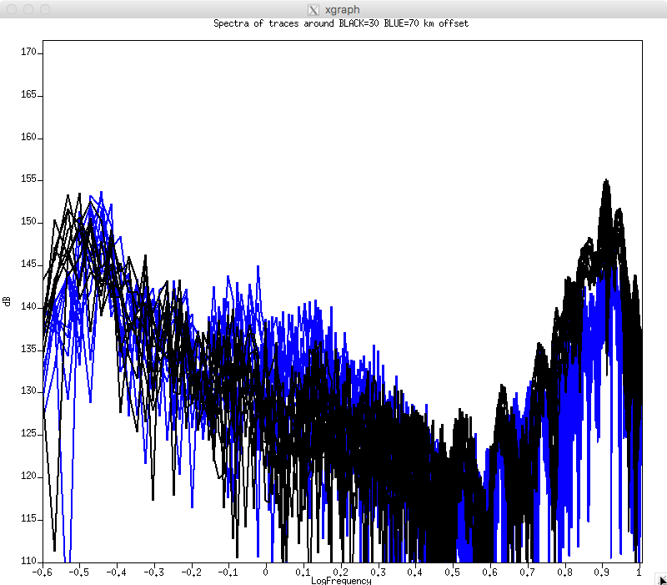
Common Receiver Gather, OBN, Hydrophone component
30 km offset
70 km offset
100km
4Hz ← Airguns
10 Hz
0.25Hz 0.5Hz 1Hz 2Hz 4Hz 8Hz

Slide 8
Common Receiver Gather, OBN, Hydrophone component
30 km offset
70 km offset
100km
Will it ?
4Hz ← Airguns
10 Hz
0.25Hz 0.5Hz 1Hz 2Hz 4Hz 8Hz

Slide 9
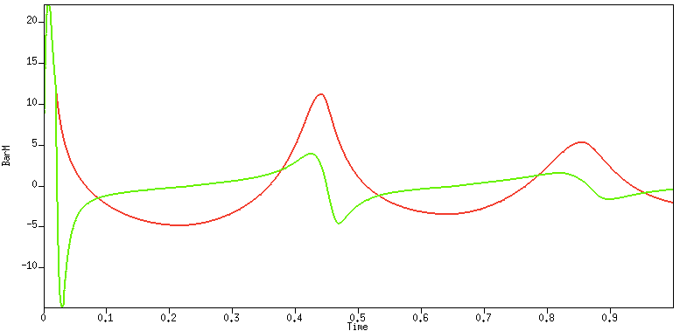
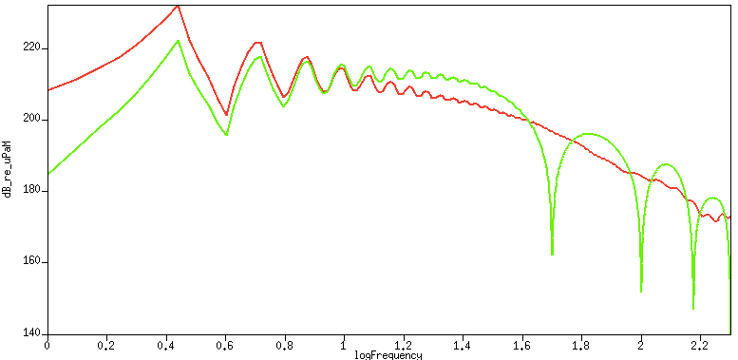
Modeling Ultra Low Frequency (ULF) Source
Modeling program by
Leighton Watson
advised by Prof. Eric Dunham
Without ghost
With ghost
0 0.5 second 1.0
1Hz 10Hz 100Hz

Slide 10
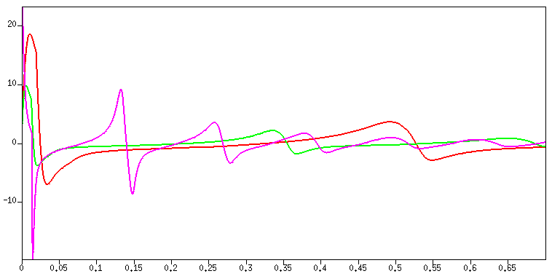
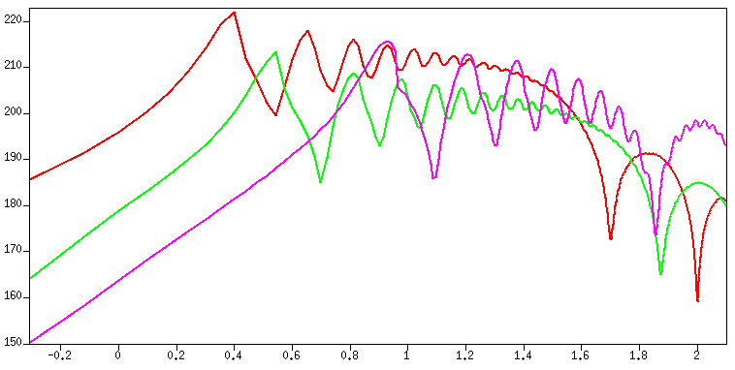
Modeling comparison to Airguns
Cluster7 X 20K in³ (ULF)
Max SPL 18 BarM
Bubble period 1/2 second
Cluster of 3x9600 in³ (VLF)
Max SPL 10 BarM
Bubble period 1/3 second
3 clusters of 2X350 airguns
Max SPL 23 BarM
Bubble period 1/8 second
Airgun Array: 3x 2x350ci @ 2000 psi
TPS cluster: 3x10kci @ 800 psi (VLF)
TPS cluster: 7x20kci @1000 psi (ULF)
BarM
Far Field Sound Pressure Level
Time
0 100 200 300 400 500 millisec
Frequency
Spectra
ULF
VLF
Airgun
dB
Airgun depth 10.5m
VLF depth 10m
ULF depth 15m
Frequency
6 April 2020
0.5 1 2 4 8 16 32 64 Hz
10

Slide 11
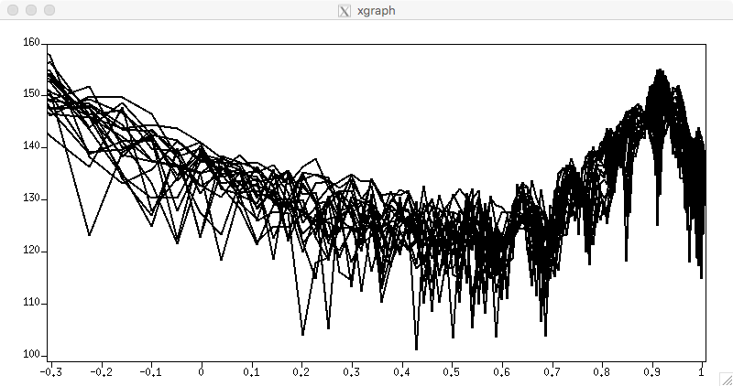
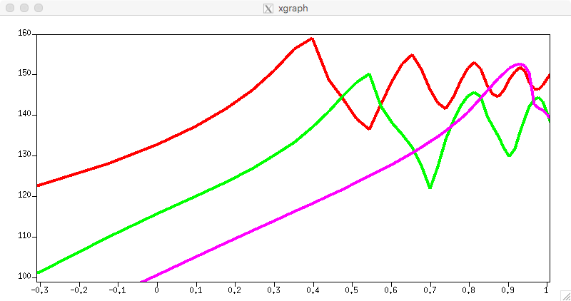
Now we can compare modeling to real data
Airgun data after RC designature
Real data
… to be compared to ...
Numerical modeling
ULF
VLF
Airgun
0.5 1 2 4 8 Hz
Airgun Data (raw)

Slide 12
Compare modeled data to real data
Airgun data after RC designature
0.5 1 2 4 8 Hz
Airgun Data (raw)

Slide 13
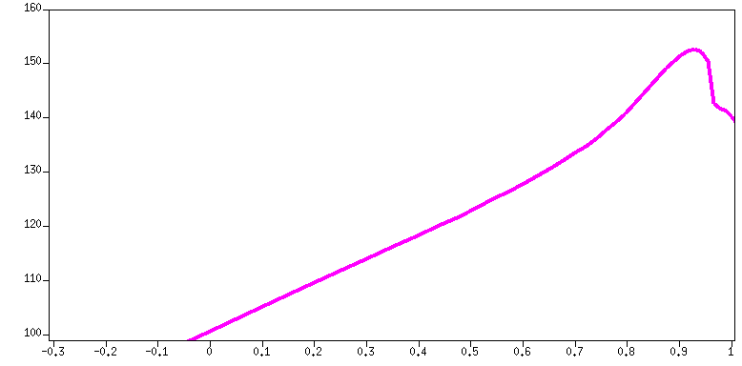
Compare modeled data to real data
Airgun data after RC designature
Airgun modeling
0.5 1 2 4 8 Hz
Airgun Data (raw)

Slide 14
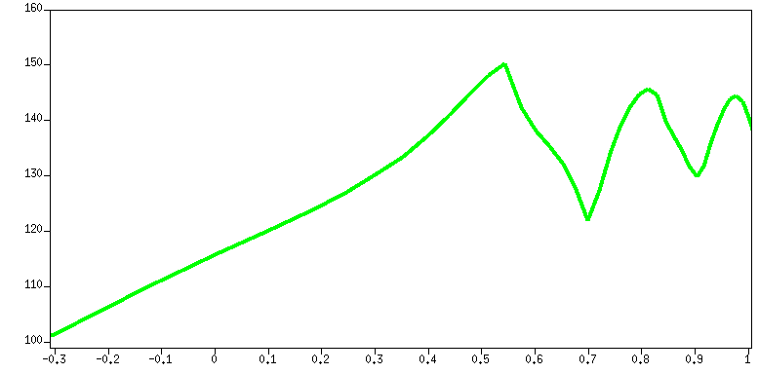
Compare modeled data to real data
Airgun data after RC designature
VLF modeling
Airgun modeling
0.5 1 2 4 8 Hz
Airgun Data (raw)

Slide 15
Compare modeled data to real data
Airgun data after RC designature
ULF modeling
VLF modeling
Airgun modeling
0.5 1 2 4 8 Hz

Slide 16
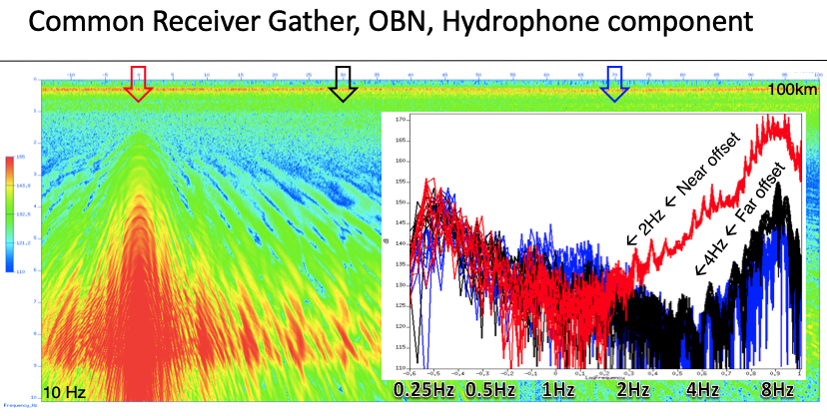
Summary
Low frequency limit
About half the bubble frequency at far offsets
About a quarter of the bubble frequency at near offset
To get 1 Hz signal at far offsets we need 2 Hz bubble frequency

Slide 17
2010 analysis (flawed)
Band pass filters
Frequency slices
Why do I think it is flawed?
Too good to be true
For example, 1 Hz signal on 14Hz geophones
Narrow band pass filters and Frequency slices
Time window edge effects
No distinction between waves that are water bound and waves that carry information (=signal) on the subsurface.

Slide 18
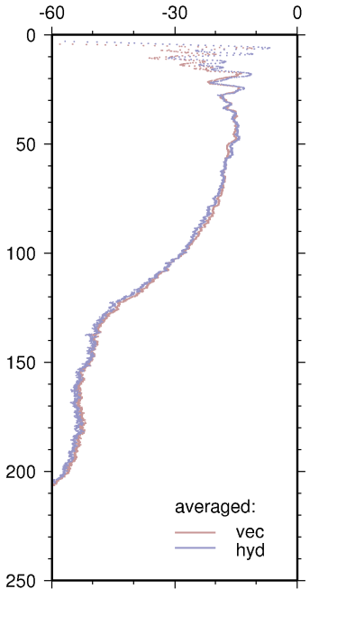
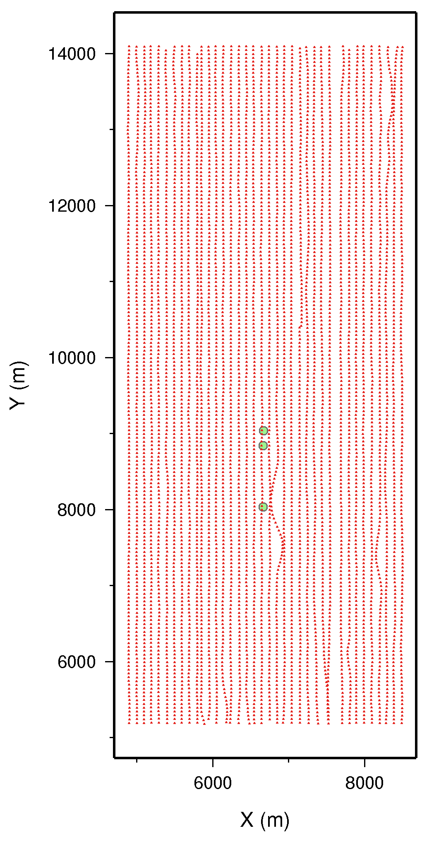
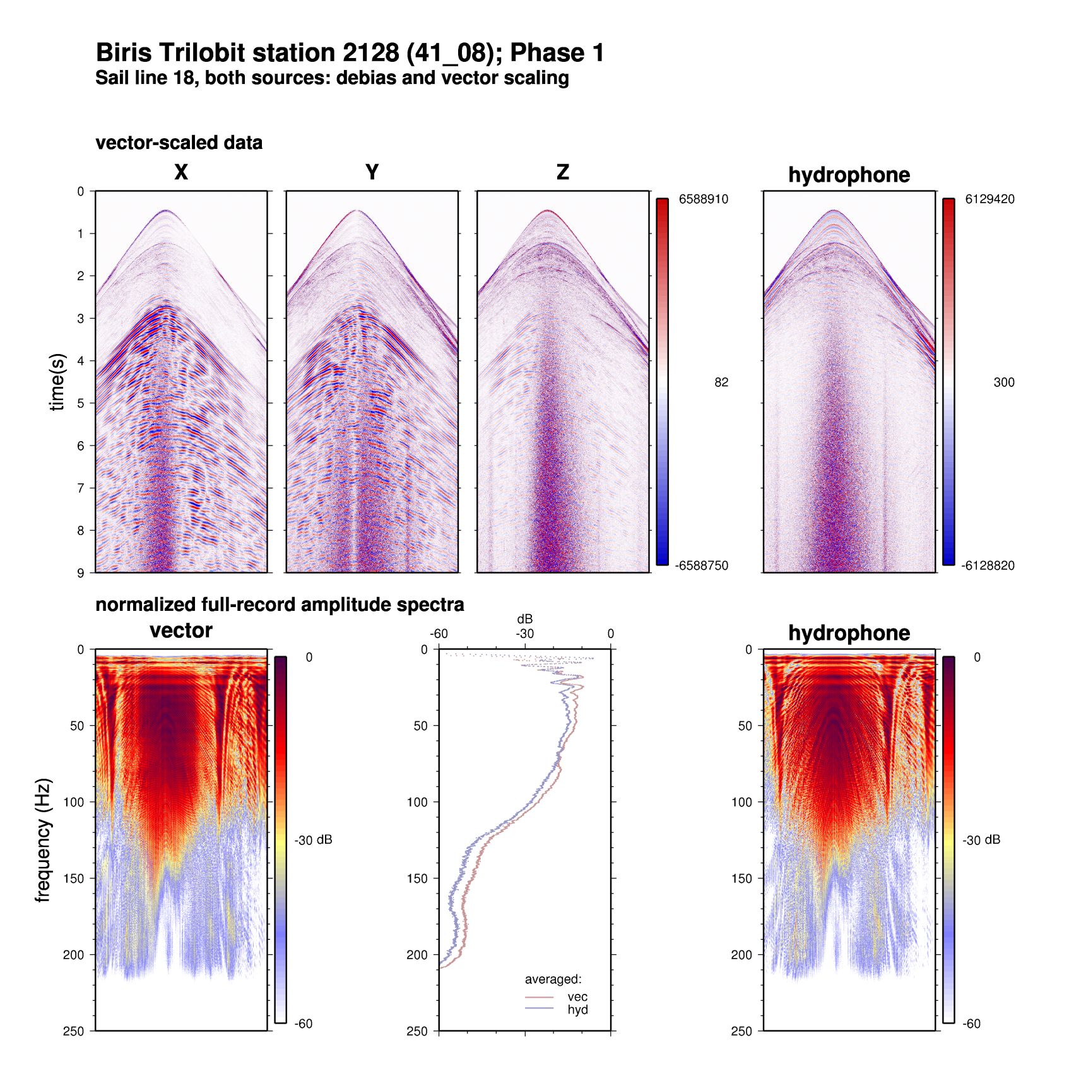
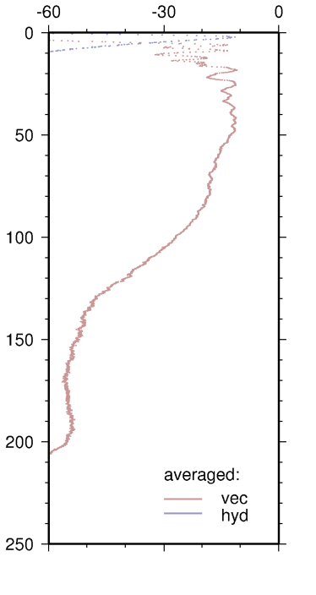
Spectra
Station 2144
Station 2128
Station 2064

Slide 19
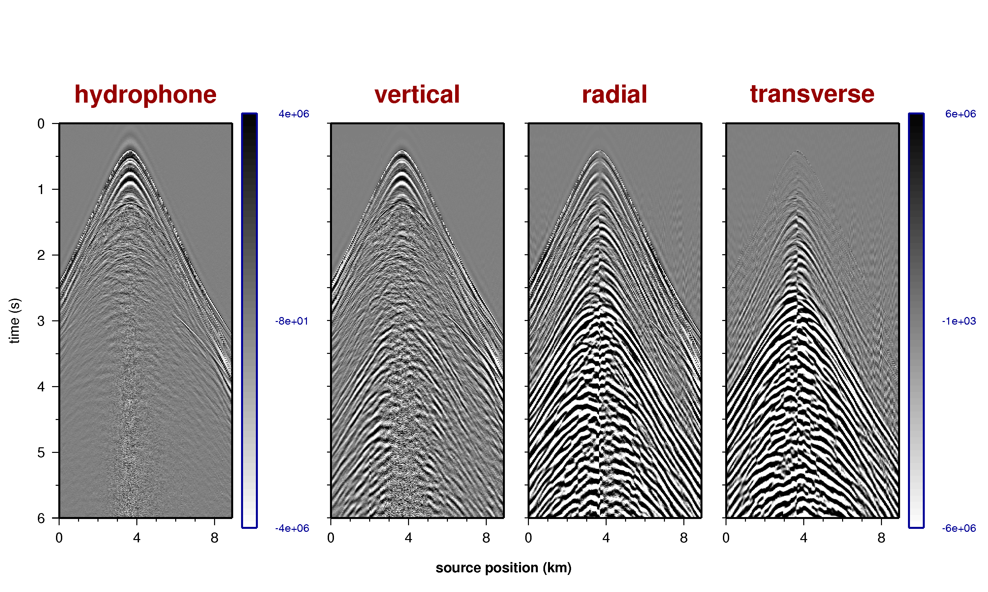
Field data in the TX domain 2128

Slide 20
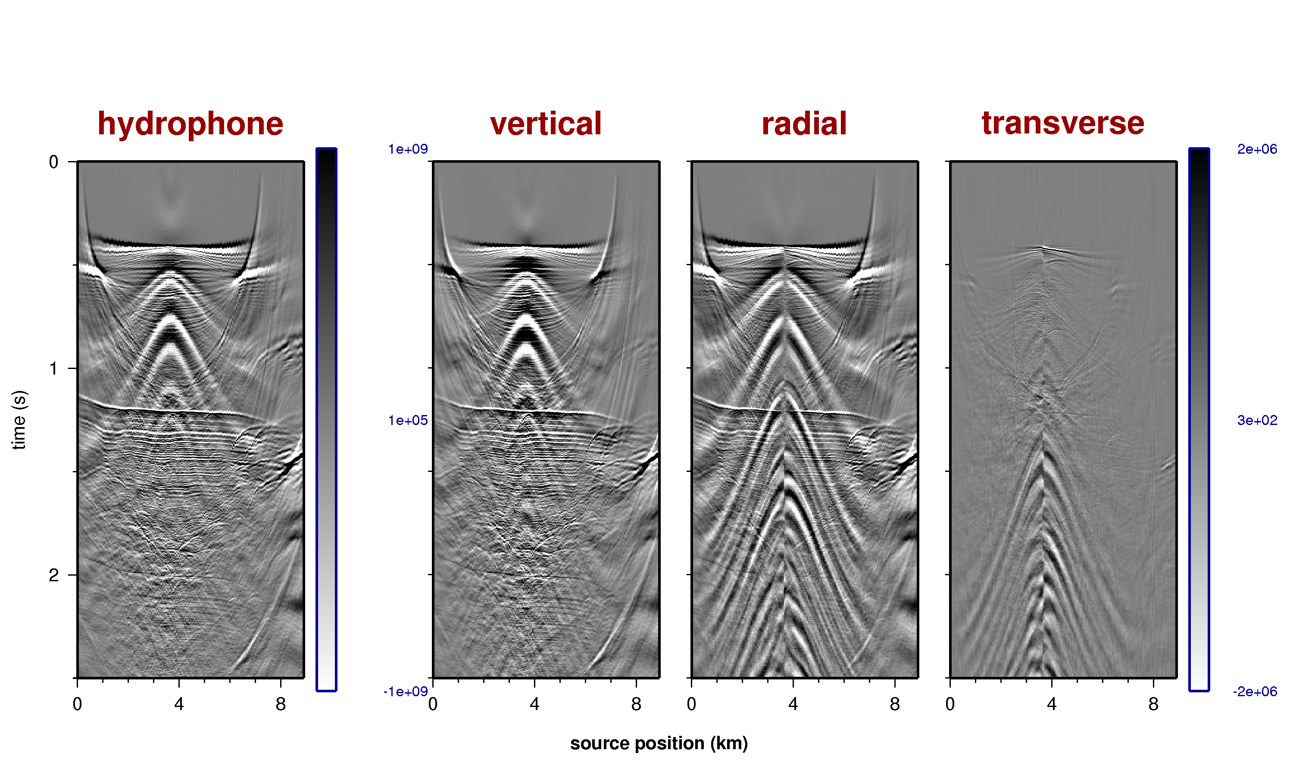
Field data after NMO 2128

Slide 21
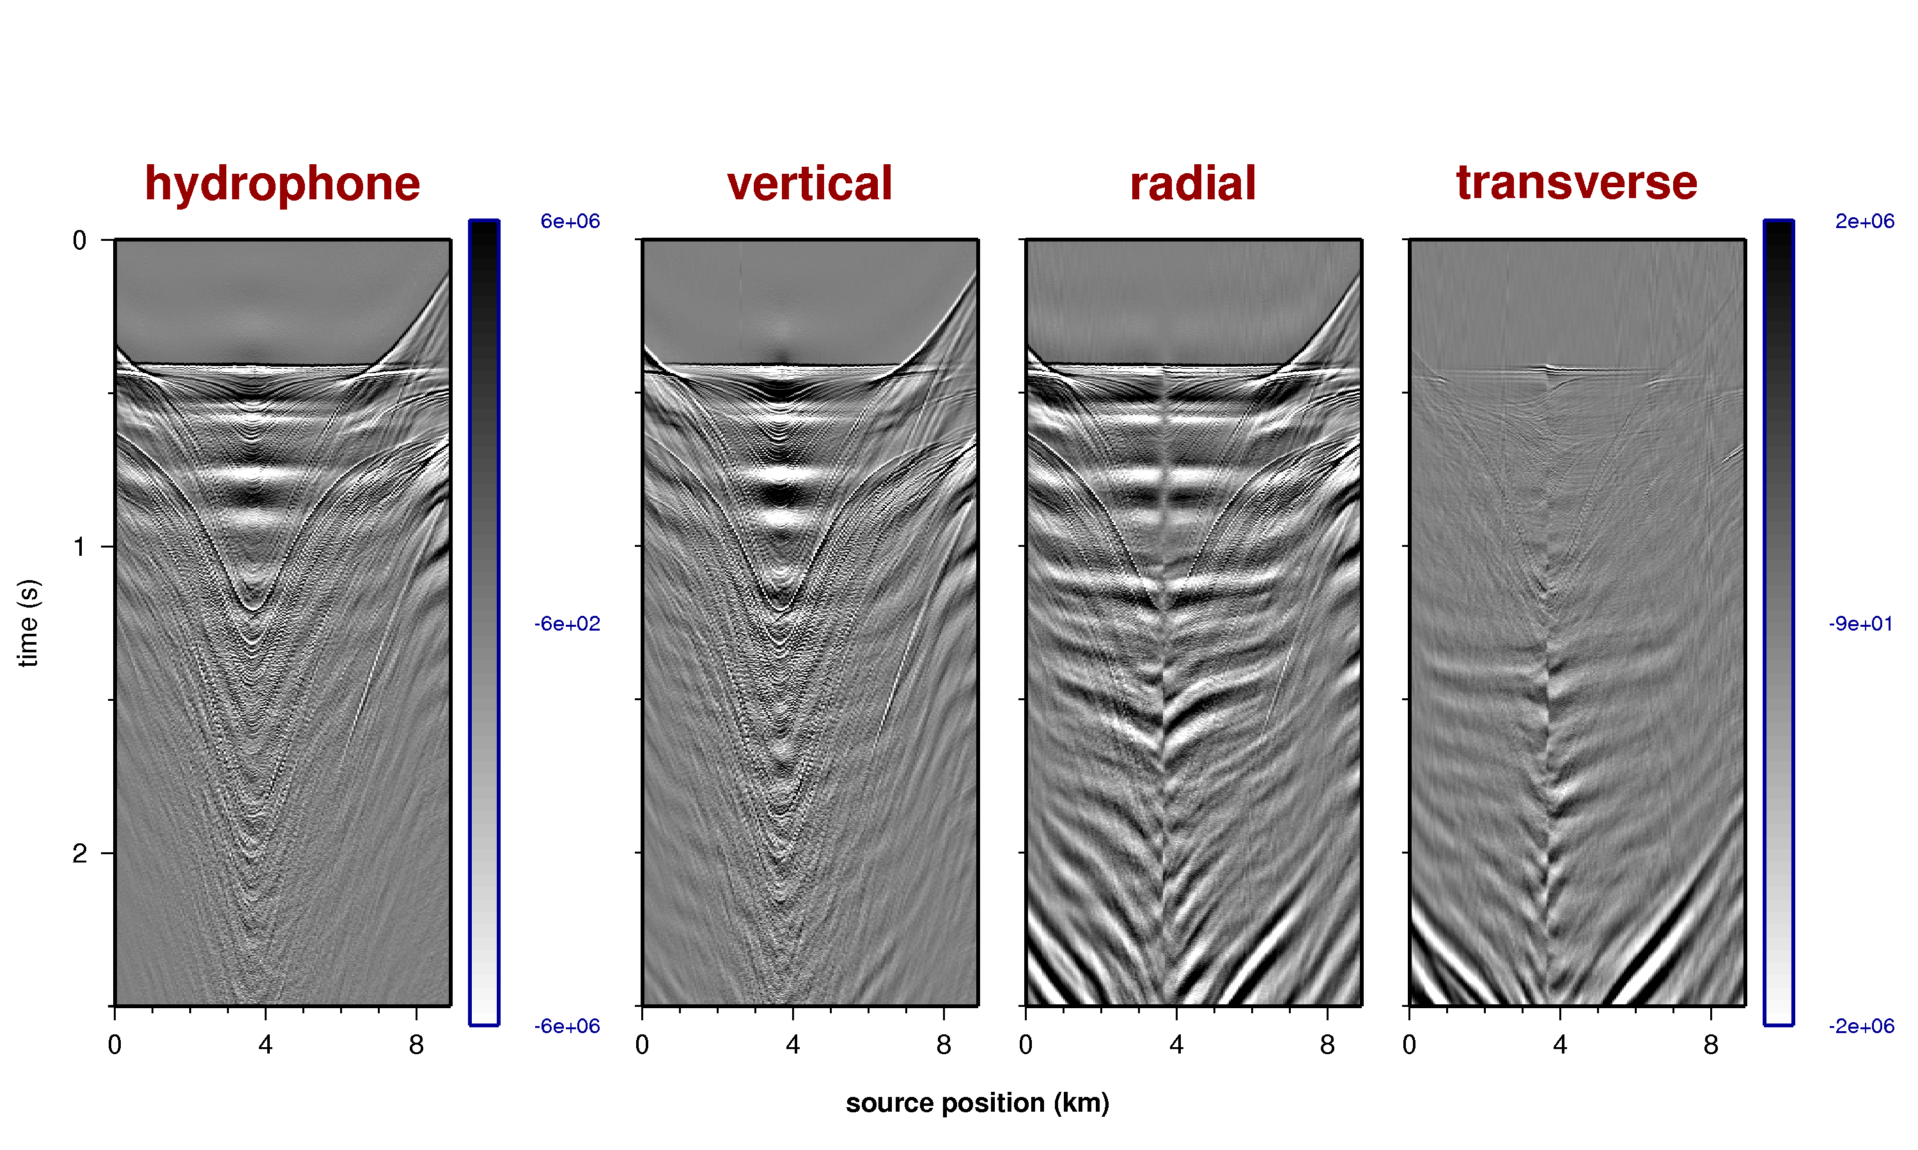
Field data after HMO 2128

Slide 22
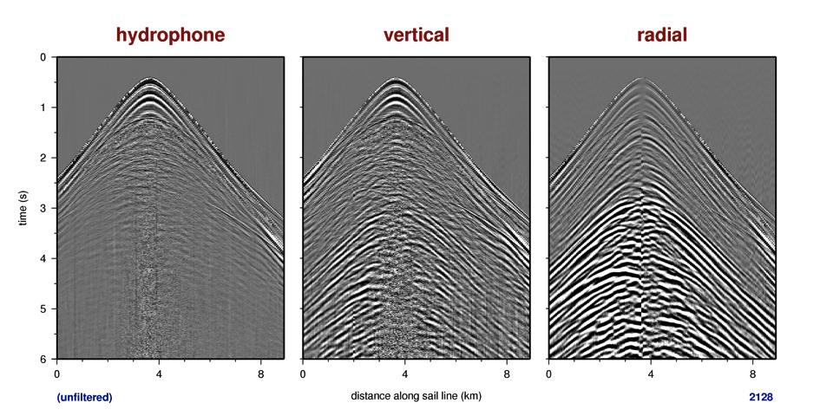
Node 2128 unfiltered

Slide 23
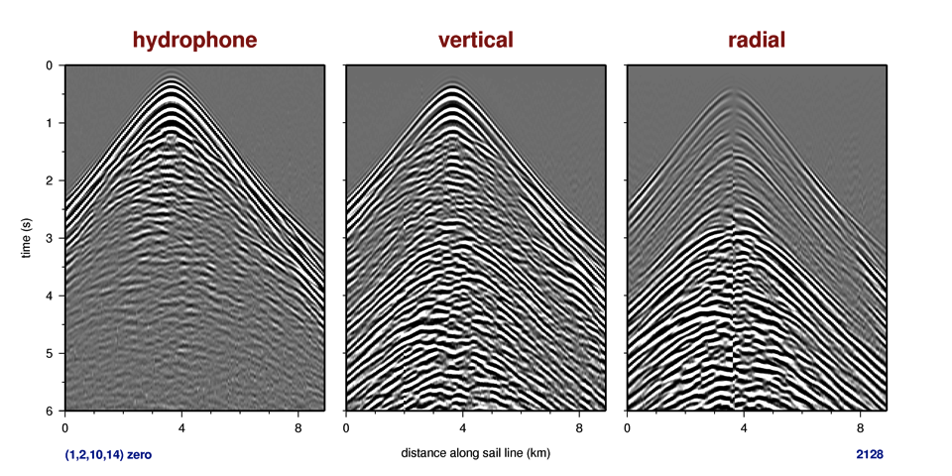
Node 2128 2-10 Hz

Slide 24
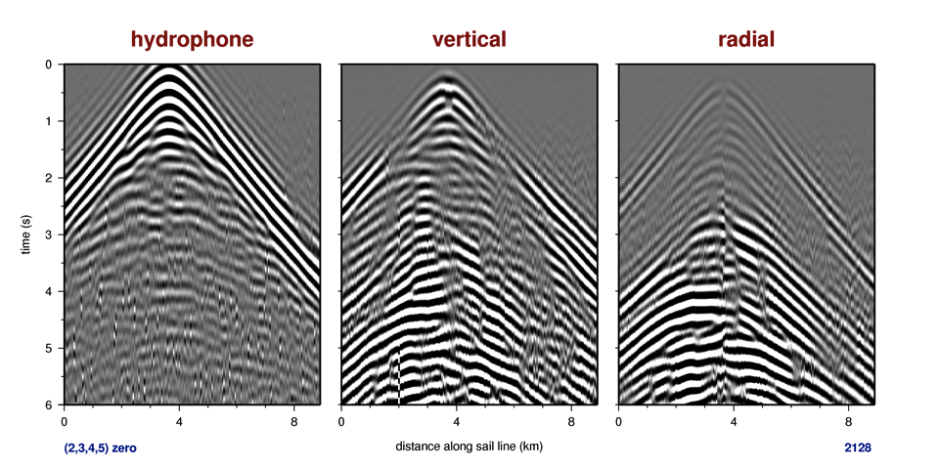
Node 2128 3-4 Hz

Slide 25
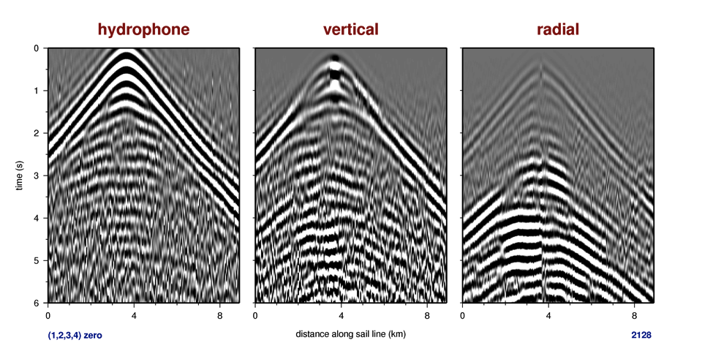
Node 2128 2-3 Hz

Slide 26
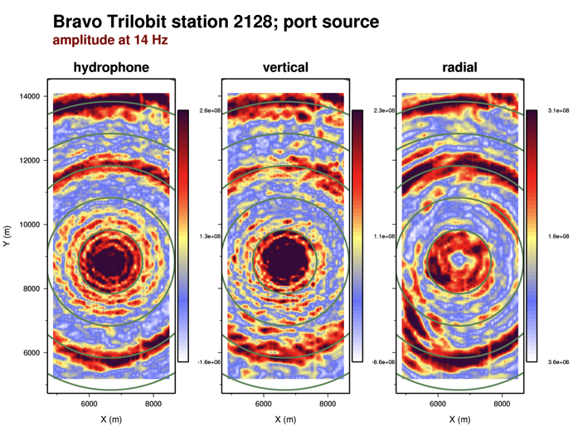
Trilobit 2128, Vertical, 14 Hz frequency slice

Slide 27
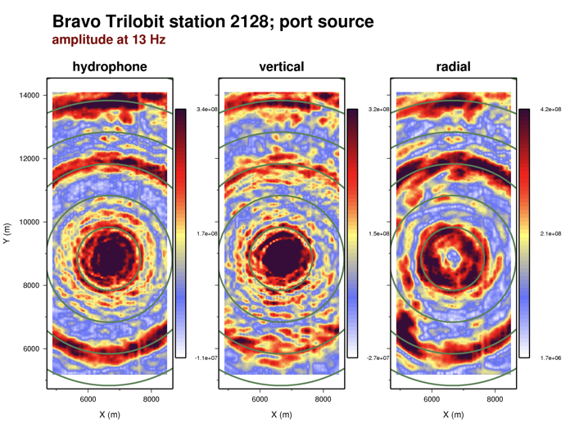
Trilobit 2128, Vertical, 13 Hz frequency slice

Slide 28
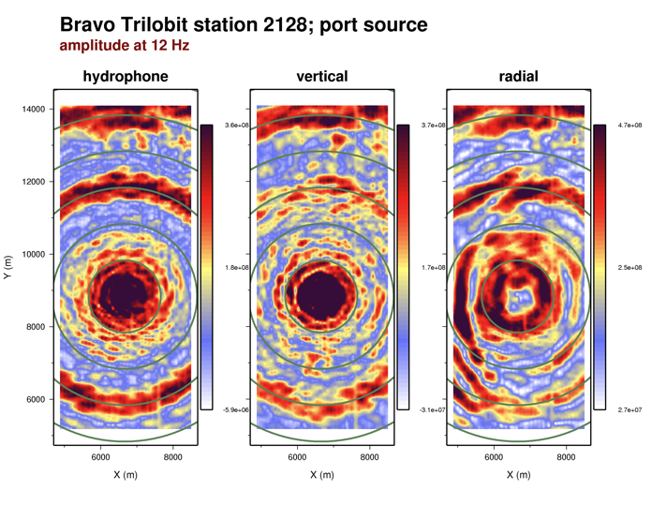
Trilobit 2128, Vertical, 12 Hz frequency slice

Slide 29
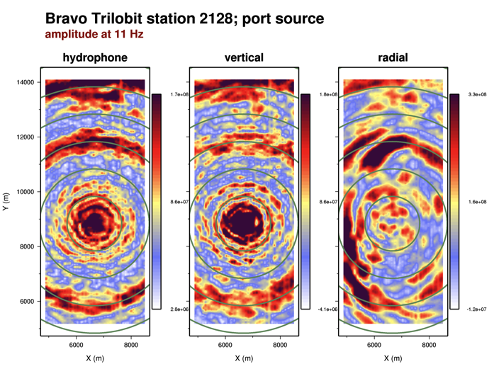
Trilobit 2128, Vertical, 11 Hz frequency slice

Slide 30
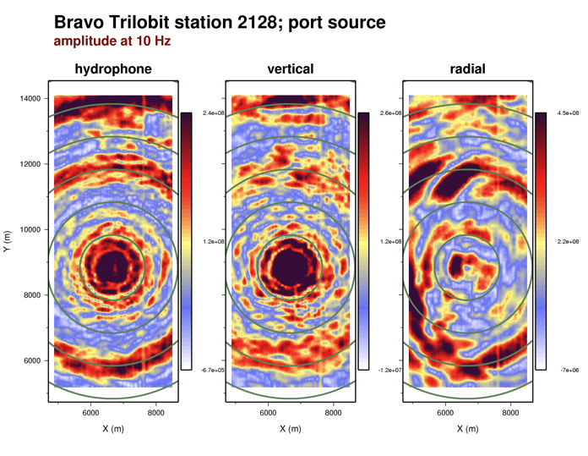
Trilobit 2128, Vertical, 10 Hz frequency slice

Slide 31
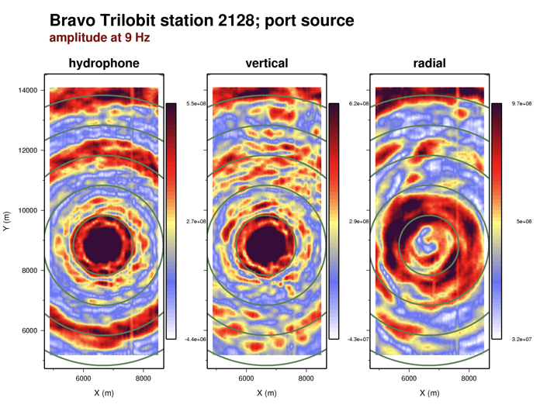
Trilobit 2128, Vertical, 9 Hz frequency slice

Slide 32
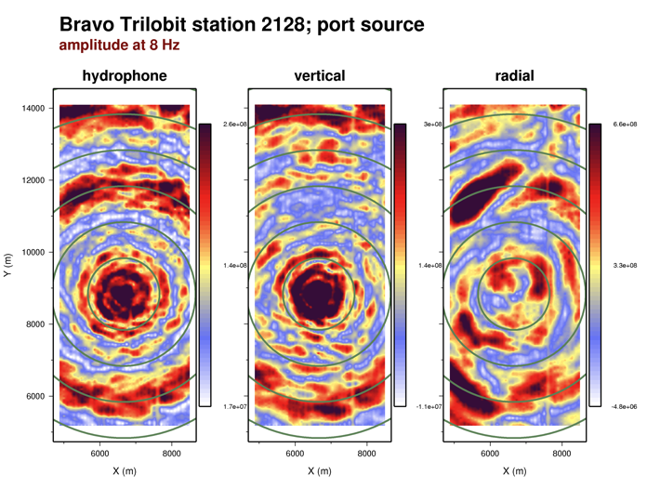
Trilobit 2128, Vertical, 8 Hz frequency slice

Slide 33
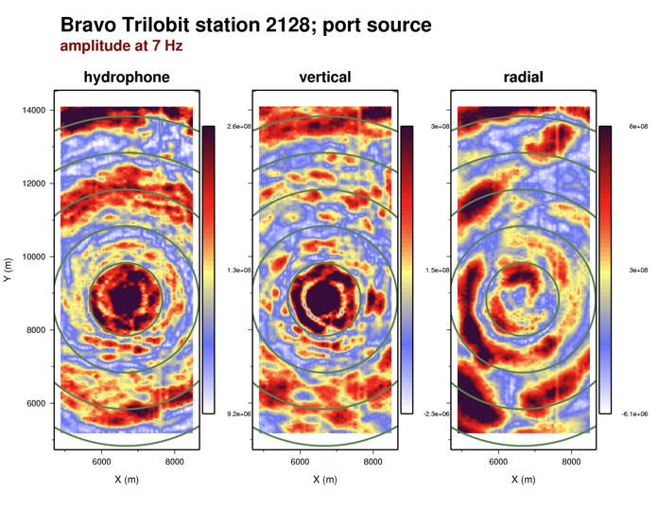
Trilobit 2128, Vertical, 7 Hz frequency slice

Slide 34
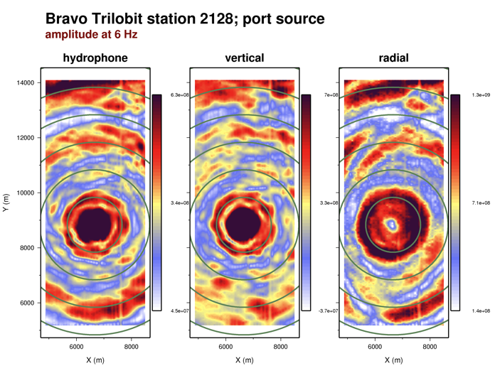
Trilobit 2128, Vertical, 6 Hz frequency slice

Slide 35
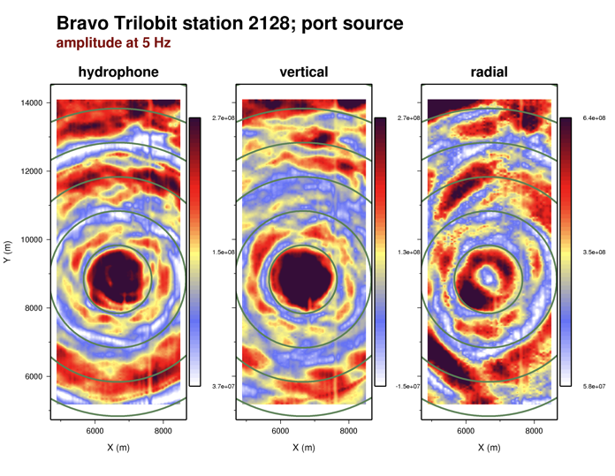
Trilobit 2128, Vertical, 5 Hz frequency slice

Slide 36
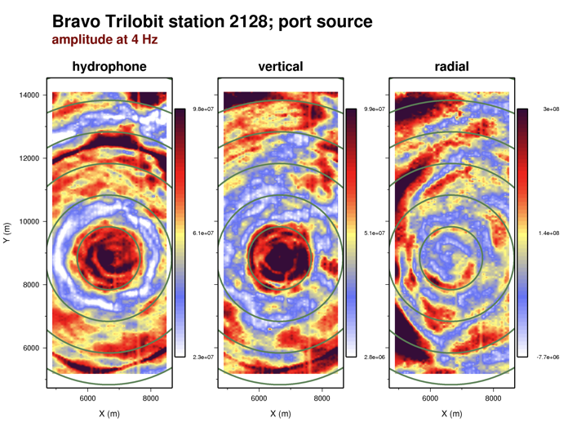
Trilobit 2128, Vertical, 4 Hz frequency slice

Slide 37
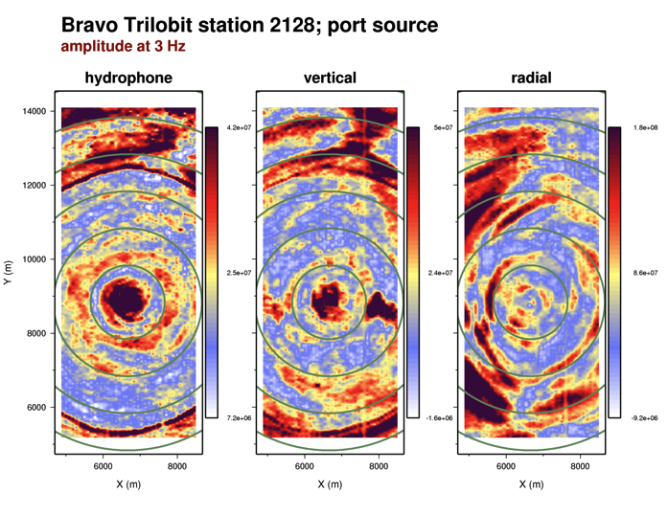
Trilobit 2128, Vertical, 3 Hz frequency slice

Slide 38
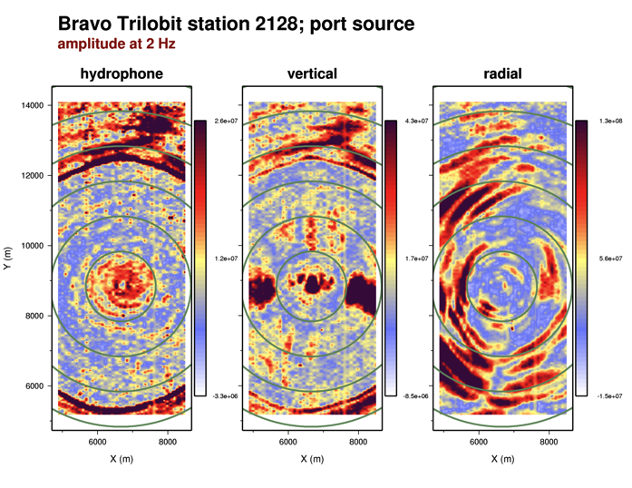
Trilobit 2128, Vertical, 2 Hz frequency slice

Slide 39
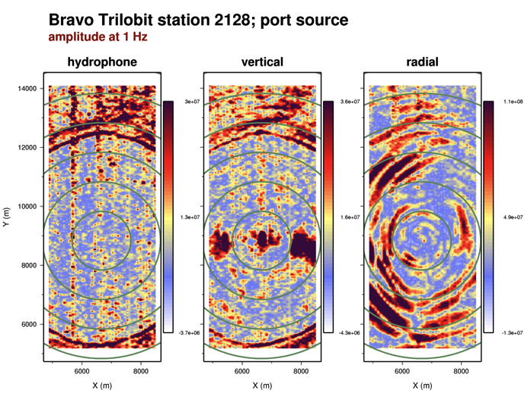
Trilobit 2128, Vertical, 1 Hz frequency slice

