Slide 1

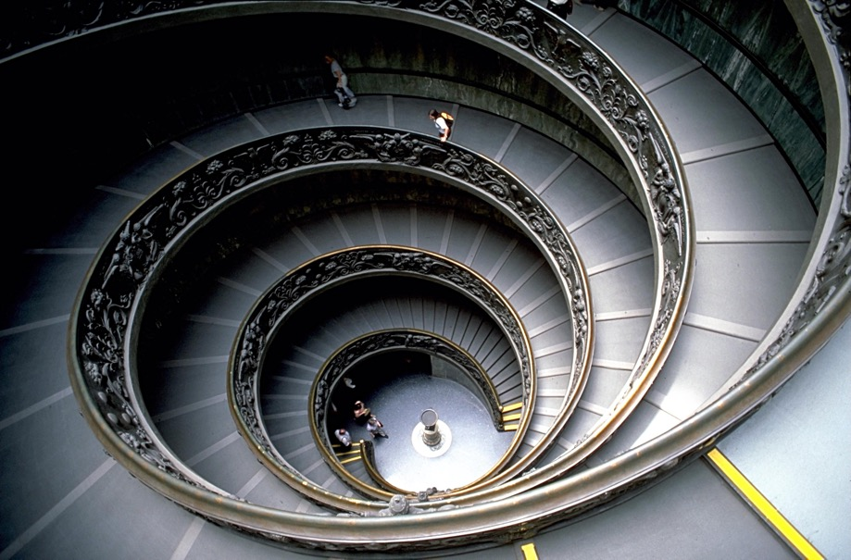
Bramante Staircase (double helix)

Slide 2
Bramante Staircase and DNA (double helix)

Slide 3
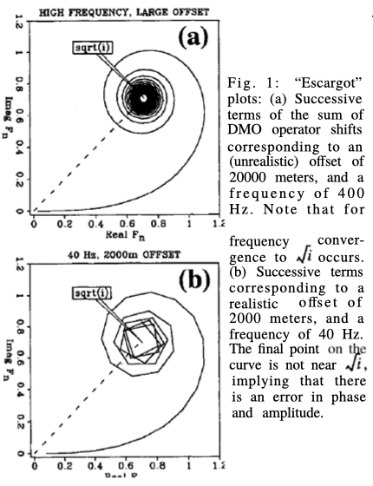
Flat event response
To calculate a flat event response of a Kirchhoff migration
Sum over x
Do it in the frequency domain
time shift operator δ(t+Δt)→ e ^{i ω Δt}
1996 paper
https://doi.org/10.1190/1.1887374

Slide 4
Kirchhoff PULL
Foreach image point (x,z)
Output(x,z) = SUM_{l} Input[l,t(x-l,z)]
(x,z) is the image point
SUM_{l} is summation over l
t() is the hyperbola
(vt/2)² = z² + (x-l)²
(l,z=0)
(x,z)

Slide 5
Code (reproduced 2020) —comments
/*
This programs follows this 1996 paper: Dealiasing DMO: Good‐pass, bad‐pass, and unconstrained. Ronen, Nichols, Bale, and Ferber
https://doi.org/10.1190/1.1887374
https://library.seg.org/doi/abs/10.1190/1.1887374
The 1996 paper did it for (Kirchhoff) DMO. This program is for (Kirchhoff) Migration. Post stack or Zero Offset Migration
The idea is to calculate a flat event response.
The program sums over a diffraction hyperbola from a point (x0,z0) to a surface point (x,z=0)
t(t0,x0,x) = sqrt (t0^2 + (2*(x-x0)/v)^2
where t0 = 2/v*z0
In General the Kirchhoff integral would be Image(z0,x0) = integral dx C(x) Data(t(t0,x-x0),x)
Because we calibrate a flat event, we can set x0=0 Image(z) = integral dx C(x) Data(t(t0),x)
t(t0,x) = sqrt (t0^2 + (2*x/v)^2
C() is a an operator which is expected to contain a scalar times a half derivative. What we know about C() is that it contains spherical spreading and a Jacobian because the integration is over the hyperbola and not over the horizontal x. For the Jacobian we need dt/dx
t^2 = t0^2 + (2/v)^2 * x^2
2*t*dt = (2/v)^2 * 2*x*dx
dt/dx = (x/t) * (2/v)^2
dl^2 = dt^2 + dx^2
Jacobian = dl/dx = sqrt(1+(x/t*(2/v)^2)^2)
We can do the above in the frequency domain
Image(kz) = integral dx C(x) exp(i*w*t(t0,x) * Data(w,x)
We expect that if we know C() the results would be
Image(z) = delta(z-z0)
Image(kz) = exp(i*kz*z0)
If we don't know C() then the output would be
Image(kz) = C(kz) * exp(i*kz*z0)
We are not interested in exp(i*kz*z0). Only in C() which is complex. We expect sqrt(iw)
*/

Slide 6
Code—before the integration
int main(int ac, char **av)
{
int i, verbose=1, nx=10001;
double f; FGETPAR(1,f,40.0);
double t0; FGETPAR(2,t0,1.0);
double xmax; FGETPAR(3,xmax,12000.0);
int halfdiff; IGETPAR(4,halfdiff,0);
double xmin = 0.0; double v = 1500.0; double dx = (xmax-xmin)/(nx-1);
double w = 2*M_PI*f; // M_PI is defined by <math.h>
double vh = v/2.0; double ovh = 1.0/vh; double z0 = t0*vh; double t0t0 = t0*t0;
if(verbose) {
if(ac==1) fprintf(stderr, "Example:\n%s [freq_in_Hz t0_in_secs xmax halfdiff]\n",av[0]); // Selfdoc
fprintf(stderr,"f=%g w=%g v=%g t0=%g z0=%g nx=%d xmin=%g xmax=%g dx=%g\n",
f,w,v,t0,z0,nx,xmin,xmax,dx);
}
double re = 0.0;
double im = 0.0;
printf("%g %g\n",re,im); // We want the starting point

Slide 7
Code—loop over x
82 for(i=0;i<nx;i++) {
83 double x = xmin + i*dx;
84 double xovh = x/vh;
85 double t = sqrt(t0t0 + xovh*xovh);
86 double jac = sqrt(1.0+xovh*xovh/t/t);
87 double dre = cos(w*(t-t0));
88 double dim = sin(w*(t-t0));
89 if(i==0) { dre *= 0.5; dim *= 0.5; } // We are summing only on positive x
90
91 // Jacobian: Integral dl = jac * dx
92 dre *= jac*dx;
93 dim *= jac*dx;
94
95 // Spherical spreading 1/sqrt(time) in 2D
96 dre /= sqrt(t);
97 dim /= sqrt(t);
98
99 re += dre;
100 im += dim;
101
102 if(halfdiff) printf("%g %g\n",(re+im)*sqrt(w/2),(im-re)*sqrt(w/2));
103 else printf("%g %g\n",re,im);
104 }

Slide 8
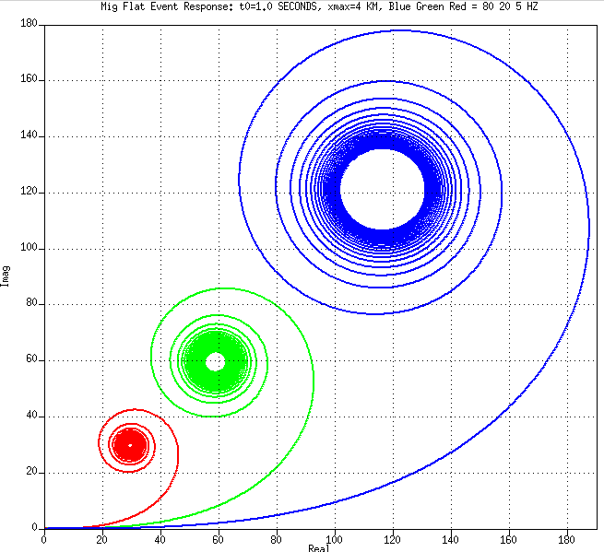
Results—4km aperture, t0=1 seconds
Observations
Low frequency: slow convergence
Half integral
Low frequencies scaled up
All frequencies converge to points almost exactly on the sqrt(i) line → 45 degree phase
There is a factor 2 scale in amplitude for every factor 4 in frequency → sqrt(ω)
Hence: 1/sqrt(iω) → half integral!
→we need a Half derivative to prevent the half integral
5 Hz
20 Hz
80 Hz

Slide 9
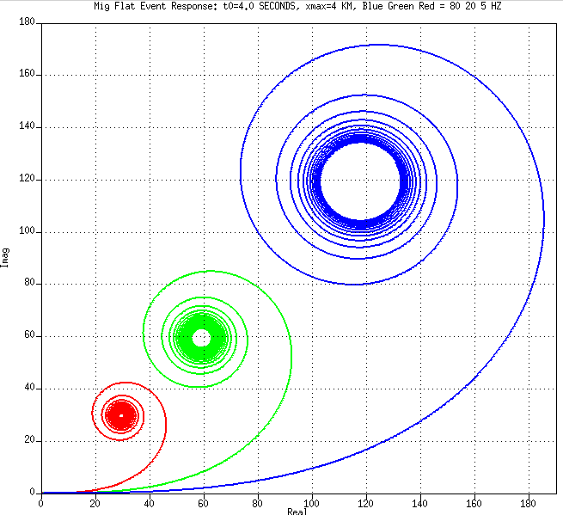
Results—4km aperture, t0=4 seconds
Observations
Almost exactly as t0=1
There is a dependency on frequency but not on t0
5 Hz
20 Hz
80 Hz

Slide 10
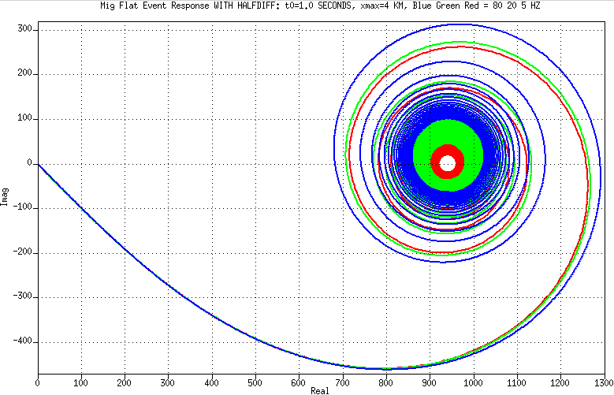
Results with half derivative option on, t0=1
Observations
They all converge to about the same point more or less on the real axis
Slightly off
It’s not roundoff errors because single precision and double precision give the same results
I don’t know why it’s slightly off
5 Hz
20 Hz
80 Hz

Slide 11
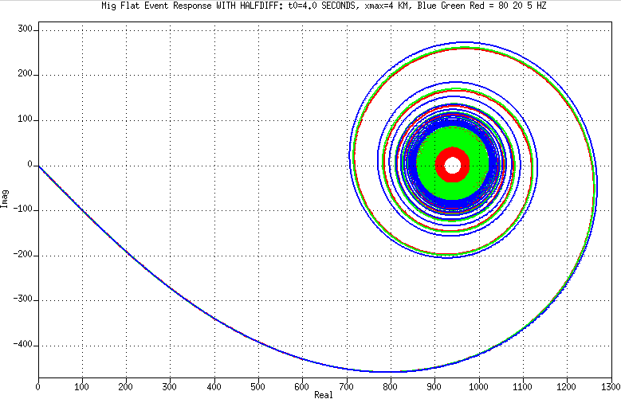
Results with half derivative option on, t0=4
Observations
They all converge to about the same point more or less on the real axis: (950,0)
Less off than t0=1 because of roundoff errors? (we did it in double)
I don’t know what to normalize by to make (950,0) to (1,0). nx=10001 in these runs
5 Hz
20 Hz
80 Hz

Slide 12
Low frequency imaging
Velocity model building such as FWI benefits from low frequencies signal
Avoiding local minima (“cycle skips”) in fitting the data
Imaging low frequencies should also benefit
Sub-salt/Sub-basalt/Blocky reservoir model building
But it seems like Imaging has a low frequency limitation
In Kirchhoff there is a stationary phase approximation and a zero divided by zero implied by correcting/pre-empting a half integral by a half derivative: sqrt(iω) / (1/sqrt(iω)
FK and FD migration methods may have a problem with very low frequencies for any reflector that is not flat ω/k>V_{min}

Slide 13
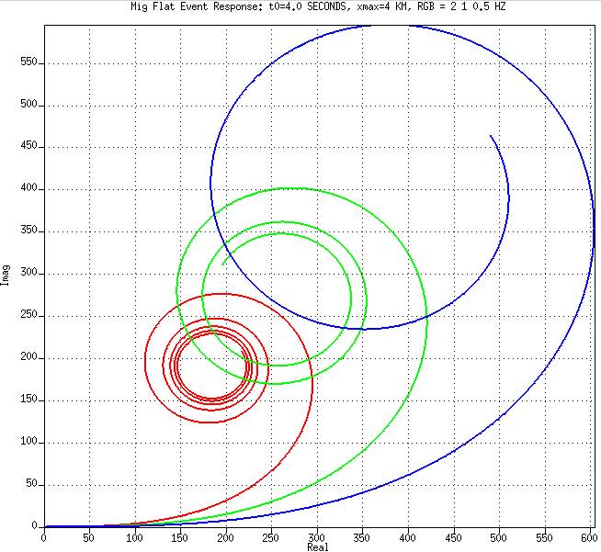
Spiral plots for Ultra Low Frequency
With maximal offset of 4km they do not converge at 0.5 Hz
With up to 4 km offset, we will not be able to image 1Hz and below even if we we have a 1Hz source

Slide 14
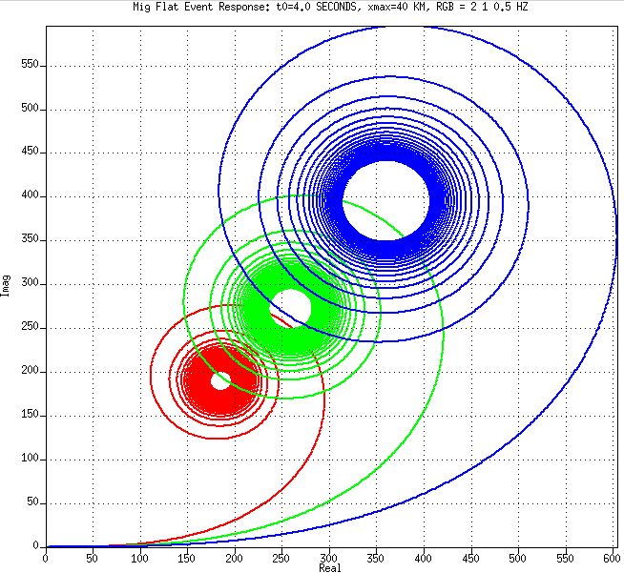
Spiral plots for Ultra Low Frequency
With maximal offset of 40km they converge
We can image 0.5 Hz signal if
we had 0.5 Hz sources and receivers
Ultra Long Offset

Slide 15
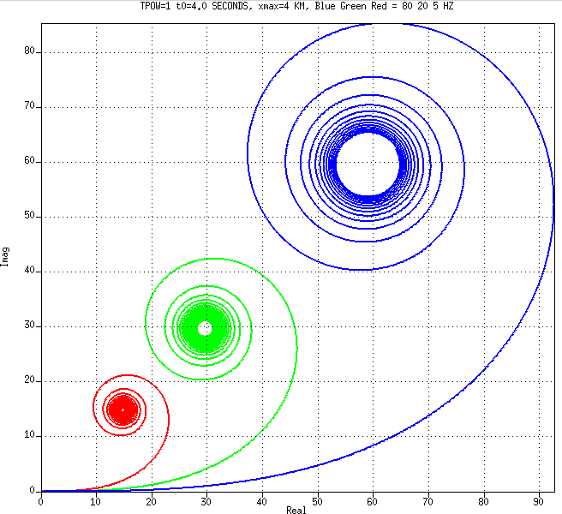
tpow=1
Observations
Slightly faster convergence
5 Hz
20 Hz
80 Hz

Slide 16
Default: tpow=0.5
Observations
This is the same as two of the previous slides
5 Hz
20 Hz
80 Hz

Slide 17
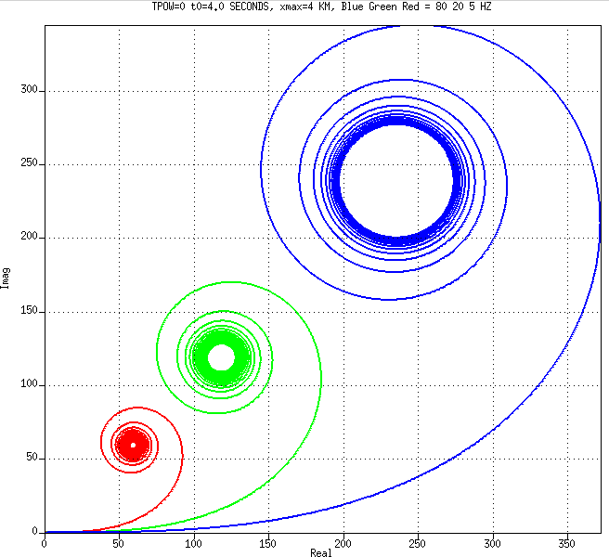
tpow=0
Observations
Slightly slower convergence
5 Hz
20 Hz
80 Hz

Slide 18
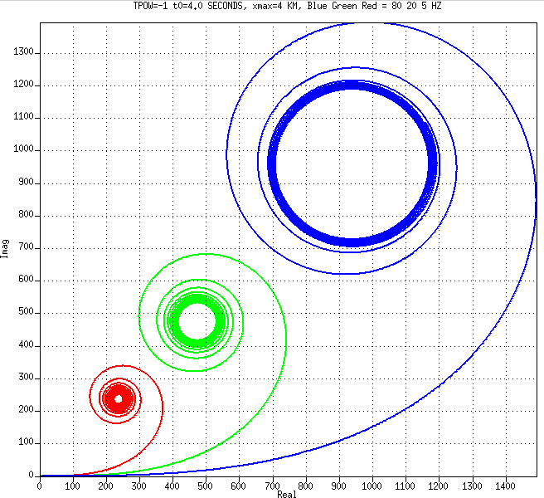
tpow=-1
Observations
Slower convergence
But it still converges—at least down to 5 Hz
5 Hz
20 Hz
80 Hz

Slide 19
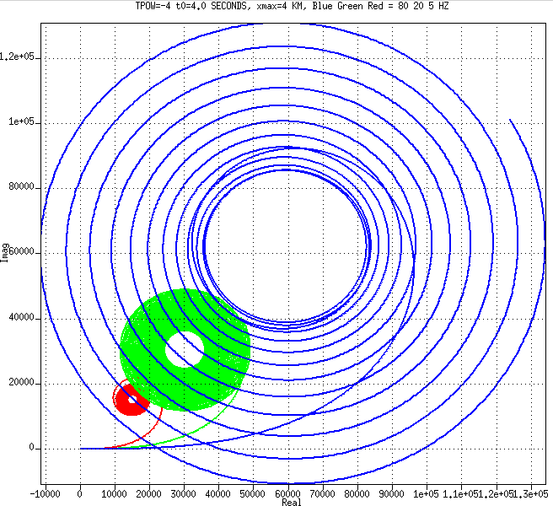
tpow=-4
Observations
Low frequency does not converge
High frequencies converge slower
5 Hz
20 Hz
80 Hz

Slide 20
Snails and Spirals
Other snails
Airgun signature and Mie scattering
Ghosting operator
Airgun energy cross-plot

Slide 21
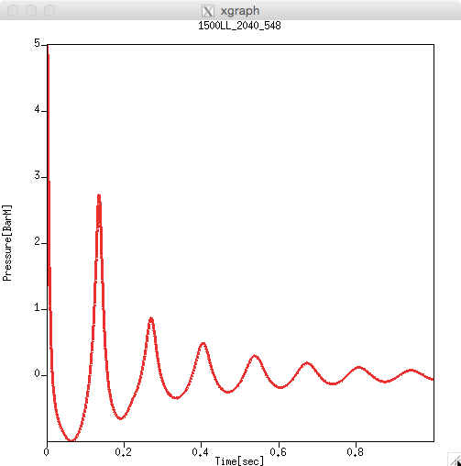
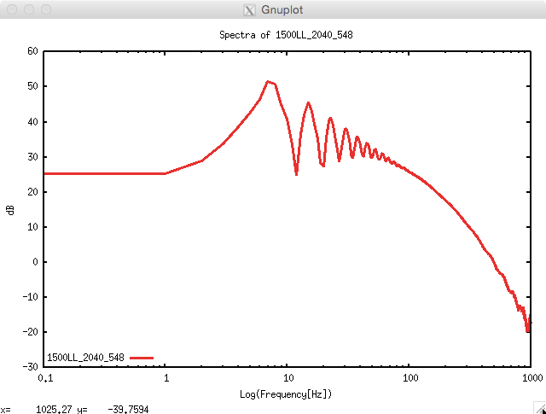
Airgun signature and spectrum
Time Domain Frequency Domain (log-log)

Slide 22
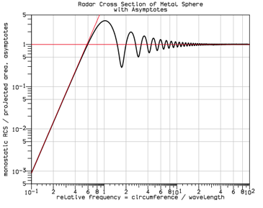
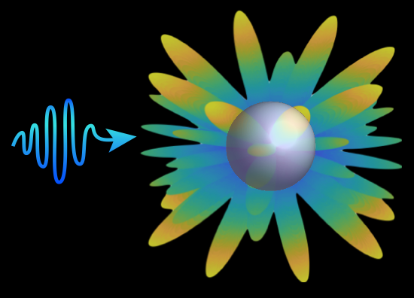
Mie scattering
Time Domain Frequency Domain (log-log)
http://en.wikipedia.org/wiki/Mie_scattering
The Mie solution toMaxwell’s equations describes the scattering of an EM wave by a homogeneous sphere.
It is named after Gustav Mie. (1868-1957)

Slide 23


Mie scattering (frequency domain log-log)
Radar Cross Section (RCS) is the ability of an airplane to reflect radar
Also reflection of light/IR from air molecule:
blue sky, red sunset
Very Low frequency: λ >> size: RCS = 0
Rayleigh scattering: λ > size: RCS ~ λ⁻⁴
Mie scattering: λ ≈ size: RCS = resonantive
High frequency: λ<<size : RCS = size²

Slide 24
Mie scattering (frequency domain log-log)
Radar Cross Section (RCS) is the ability of an airplane to reflect radar
Also reflection of light/IR from air molecule:
blue sky, red sunset
Very Low frequency: λ >> size: RCS = 0
Rayleigh scattering: λ > size: RCS ~ λ⁻⁴
Mie scattering: λ ≈ size: RCS = resonantive
High frequency: λ<<size : RCS = size²

Slide 25
Mie scattering (frequency domain log-log)
Radar Cross Section (RCS) is the ability of an airplane to reflect radar
Also reflection of light/IR from air molecule:
blue sky, red sunset
Very Low frequency: λ >> size: RCS = 0
Rayleigh scattering: λ > size: RCS ~ λ⁻⁴
Mie scattering: λ ≈ size: RCS = resonantive
High frequency: λ<<size : RCS = size²

Slide 26
Mie scattering (frequency domain log-log)
Radar Cross Section (RCS) is the ability of an airplane to reflect radar
Also reflection of light/IR from air molecule:
blue sky, red sunset
Very Low frequency: λ >> size: RCS = 0
Rayleigh scattering: λ > size: RCS ~ λ⁻⁴
Mie scattering: λ ≈ size: RCS = resonantive
High frequency: λ<<size : RCS = size²

Slide 27
Mie scattering (frequency domain log-log)
Radar Cross Section (RCS) is the ability of an airplane to reflect radar
Also reflection of light/IR from air molecule:
blue sky, red sunset
Very Low frequency: λ >> size: RCS = 0
Rayleigh scattering: λ > size: RCS ~ λ⁻⁴
Mie scattering: λ ≈ size: RCS = resonantive
High frequency: λ<<size : RCS = size²

Slide 28
Mie scattering (frequency domain log-log)
Radar Cross Section (RCS) is the ability of an airplane to reflect radar
Also reflection of light/IR from air molecule:
blue sky, red sunset
Very Low frequency: λ >> size: RCS = 0
Rayleigh scattering: λ > size: RCS ~ λ⁻⁴
Mie scattering: λ ≈ size: RCS = resonantive
High frequency: λ<<size : RCS = size²
Complex Hodogram
?
Imaginary
(0,0) (1,0)
Frequency = almost 0 (very small)
Frequency = almost Infinity (very high)
Real

Slide 29
Mie Scattering and Airgun signature spectra
Similar

Slide 30
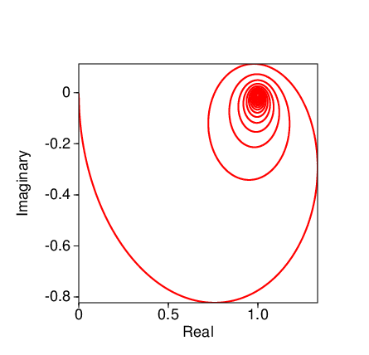
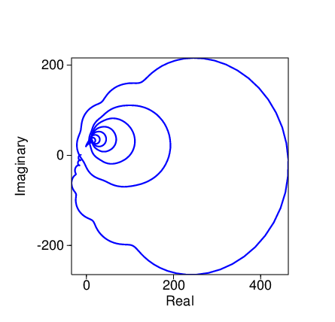
Mie spectra and Airgun spectra and hodograms
They spiral!

Slide 31
Mie spectra and Airgun spectra and hodograms
The difference in the high frequencies is because the force of the air coming out of an airgun is band-limited

Slide 32
Mie spectra and Airgun spectra and hodograms
They are not only minimum phase.
They are (pretty much) positive real!

Slide 33
Positive Real (PR) and Minimum Phase (MP)
Every Positive Real is also Minimum Phase
The convolution of any two MP’s is MP
The convolution of any two PR’s is MP, but (usually) not PR
because (x₁+iy₁)(x₂+iy₂)=(x₁x₂-y₁y₂) + i(x₁y₂+y₁x₂)
The sum of any PR’s is PR (and MP)
because (x₁+iy₁)+(x₂+iy₂) = (x₁+x₂) + i(y₁+y₂)
Σ Positive Real = Positive Real

Slide 34
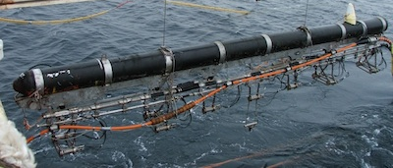
The Significance of ΣPR = Positive Real
The signature of an Airgun array is the sum of the signatures of each
If each gun is PR and if they all go off at the same time then the sum is PR
If they don’t go off at the same time then it will be neither PR nor even MP ! Not good (?)
If each gun is MP but not PR, then in general, their sum will not be MP

Slide 35
Airgun arrays, including their ghosts
Any PR wavelet is MP
The sum of PR wavelets is PR
So a heterogeneous Airgun array is PR (and MP)
The ghosts are like another array above the sea surface
So is a ghosted airgun array PR?
No, because the ghosts have a time delay
Ghosting is a convolution and not summing
Convolution of two positive real wavelets is not positive real
Convolution of two minimum phase wavelets is minimum phase
Let’s look at a ghosted airgun signature

Slide 36
The Ghosted airgun is not positive real
Airgun
Ghosted
Airgun

Slide 37
Snails and Spirals
Other snails
Airgun signature and Mie scattering
Ghosting operator
Airgun energy cross-plot

Slide 38
Focus on the source ghost
Ghost Source
Time domain
G(t) = δ(t) – R δ(t-τ_{g})
Frequency domain
G(ω) = 1 – R e^{iωτg}
Z Transform
Delay operator Z = e^{iω}
G(Z) = 1 – R Z^{τg}
Time delay τ_{g} = 2d cos θ / v
For example, if d=7.5m,
θ=0, and v=1500m/s
then τ_{g}= 10 msec
d
R
Source
θ
Ghost Rδ(t-τ_{g})
Primary δ(t)

Slide 39
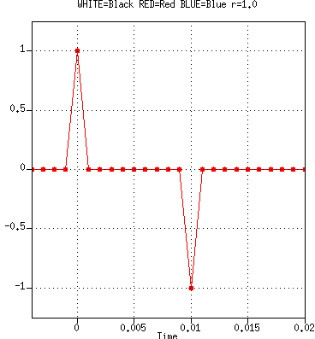
Ghosting operator: Primary + Ghost
Time domain
G(t) = δ(t) – R δ(t-τ_{g})
Frequency domain
G(ω) = 1 – R e ^{iωτg}
Z Transform Z = e^{iω}
G(Z) = 1 – R Z ^{τg}
R=1

Slide 40
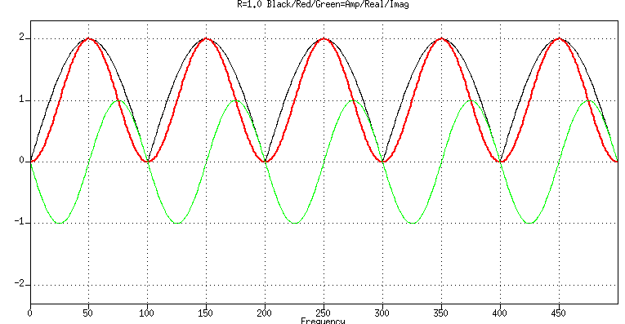
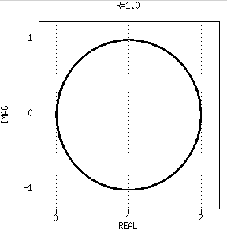
Ghosting operator: Primary + Ghost
Abs
Real
Imag
Time domain
G(t) = δ(t) – R δ(t-τ_{g})
Frequency domain
G(ω) = 1 – R e ^{iωτg}
Z Transform Z = e^{iω}
G(Z) = 1 – R Z ^{τg}
R=1
0 1 2
1-R e ^{i(ω+δω)τg}
Cross plot of Real vs Imag
(Complex plane)
1-R e ^{iωτg}
1

Slide 41
Ghosting operator: Primary + Ghost
-1 0 1
Time domain
G(t) = δ(t) – R δ(t-τ_{g})
Frequency domain
G(ω) = 1 – R e ^{iωτg}
Z Transform Z = e^{iω}
G(Z) = 1 – R Z ^{τg}
Unit circle in the Z complex plane
0
0
0
0
0
R=1
0
0
0
No Poles
τ_{g} zeroes
Whenever 1 = R Z ^{τg}
On the unit circle with R = 1
Outside the circle when R<1 (much nicer)
0
0

Slide 42
Frequency dependent R(ω) or R(Z) < 1
Acoustics: 0.9994
Spherical spreading
Swell
Visco-acoustics
Two different things
Both frequency dependent
Swell factor is weather dependent
Visco-acoustic depends on source depth
R➔R(Z)
Air
Water
Source
Seabed
R
Target Reflectors

Slide 43
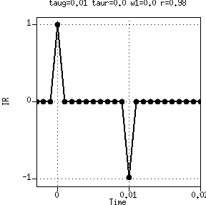
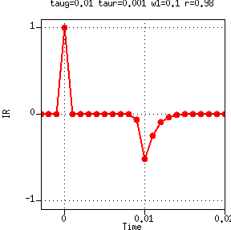
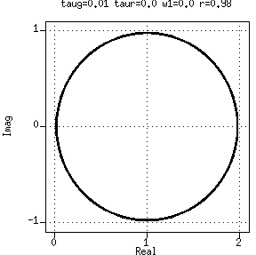
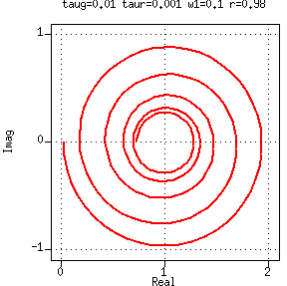
G(Z) = 1 – R(Z) Z ^{τg} ; R(Z) = Red Ghost
R(Z)
Time domain Impulse Responses
R = 1
Causal
Frequency domain Real-Imaginary cross plots
Positive Real hence Minimum Phase

Slide 44
Snails and Spirals
Other snails
Airgun signature and Mie scattering
Ghosting operator
Airgun energy cross-plot

Slide 45
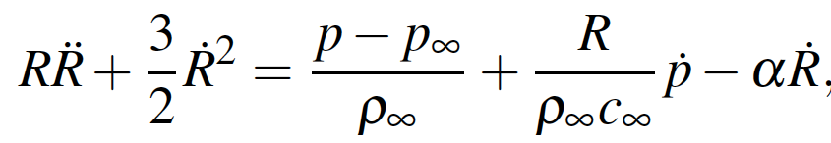
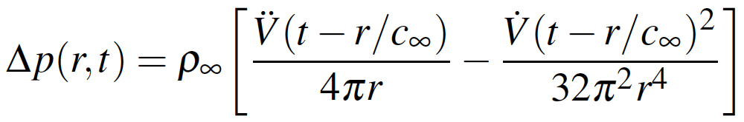
Physics of Air Guns and Sources in general
Radiating oscillators (Rayleigh’s equation)
Far field. Applies to sources in general (not only air guns but also vibes)
R = bubble radius; V = source volume; p = pressure; r = distance to receiver; ∞ = water
Rayleigh-Willis formula
k (PV)^{1/3}
(10+Depth) ^{5/6}
T_{b} =
Ideal Gas equation
PV = nRT
Adiabata equation
PV^{γ} = Constant
γ = 1.4
Temperature changes

Slide 46
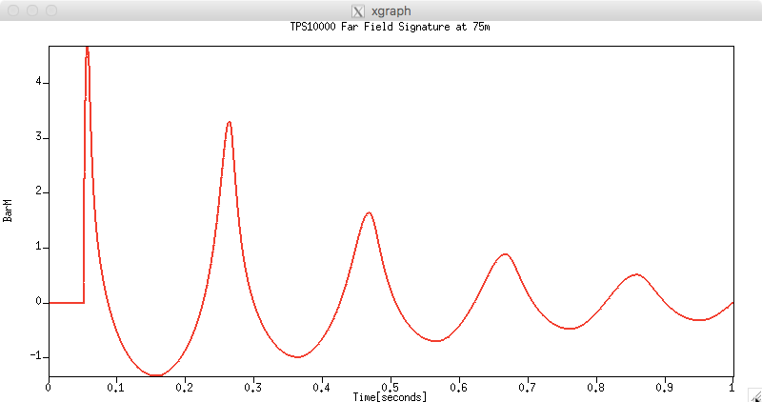
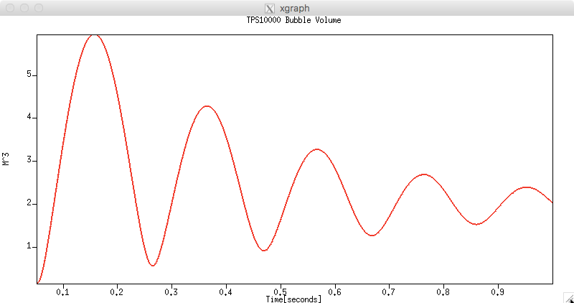

Integrate the far field signature twice
Far field Pressure
1/Frequency²
Bubble Volume
Frequency²
d²/dt²
Integrate twice
SSdt²

Slide 47
Integrate the far field signature twice
◉
Far field Pressure
Bubble Volume
Very soon (<miliscond) after the shot is triggered the ports are open and a small high pressure bubble is formed
◉

Slide 48
Integrate the far field signature twice
Far field Pressure
◉
Bubble Volume
The bubble is expanding, the pressure inside it is dropping and soon (10-20 milisconds) it reaches ambient pessure
◉

Slide 49
Integrate the far field signature twice
Far field Pressure
◉
◉
Bubble Volume
The bubble continues to expand but slowing. 60 milisconds later it reaches maximal volume and minimal pressure

Slide 50
Integrate the far field signature twice
Far field Pressure
◉
◉
Bubble Volume
6 m³ are displaced when the bubble is at maximal size and the pressure inside it is minimal

Slide 51
Integrate the far field signature twice
Far field Pressure
◉
Bubble Volume
Ambient pressure again
◉

Slide 52
Integrate the far field signature twice
◉
Far field Pressure
Bubble Volume
First bubble collapse (here 220 msec bubble period
… etc.
◉

Slide 53
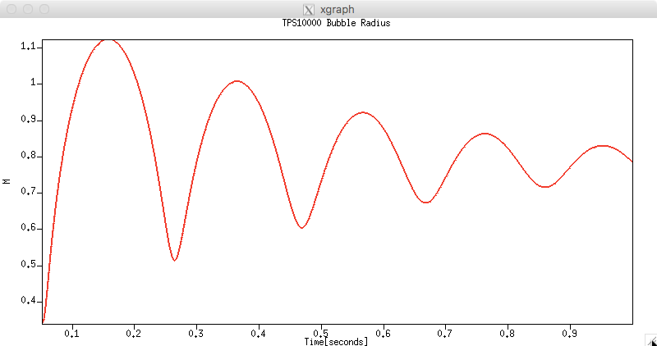
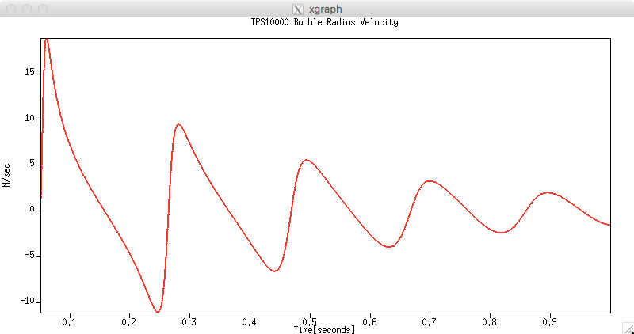
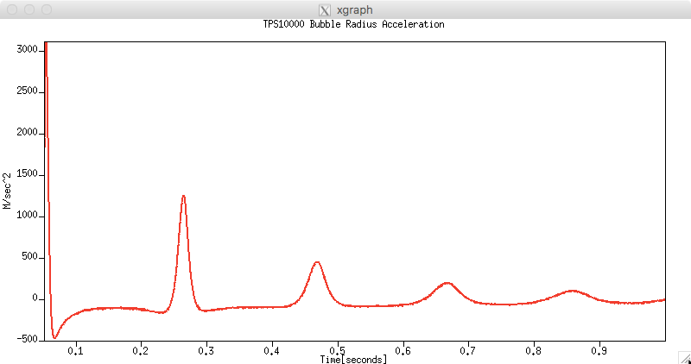
Bubble radius calculated from the volume
Bubble Radius
Volume = 4π/3 R³
Bubble Radius Velocity
Bubble Radius Acceleration

Slide 54
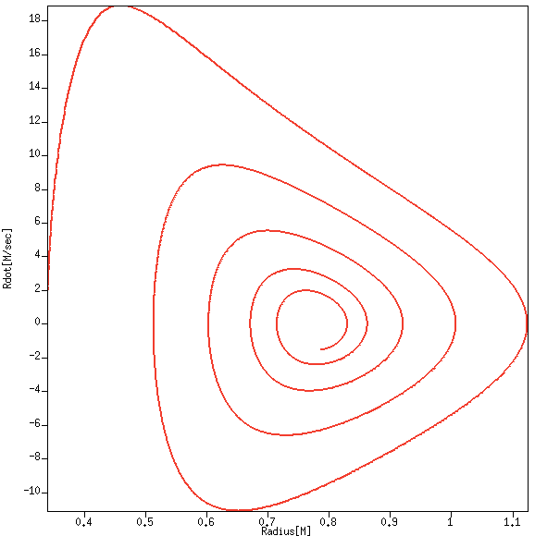
Cross-plot Radius and velocity
Bubble Radius
Bubble Radius Velocity
Notes:
Harmonic oscillator constant energy = ½ kx^2 + ½ mv^2

Slide 55
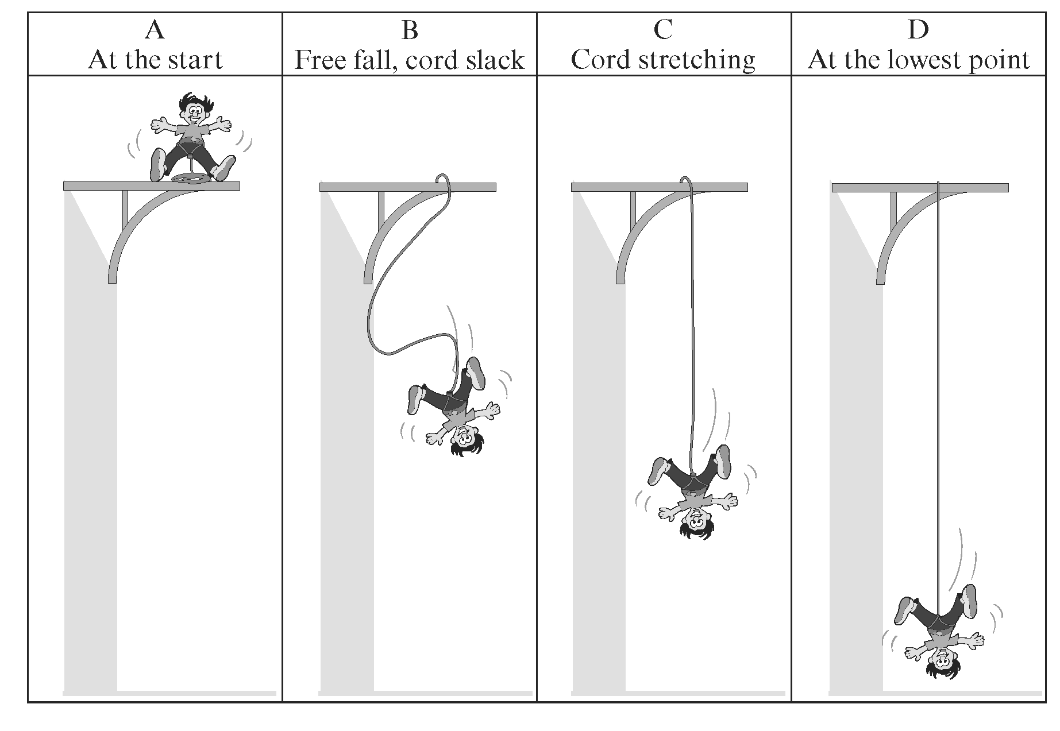
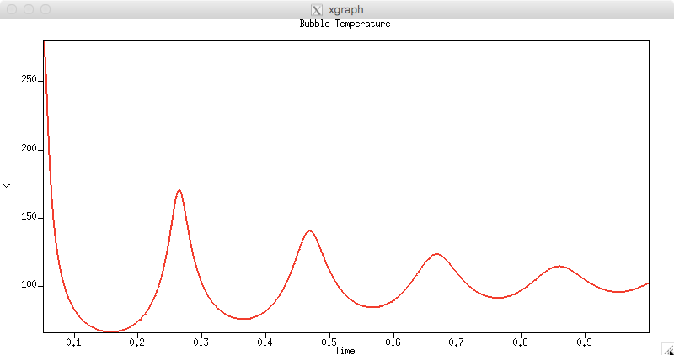
Energy crossplot
Potential Energy (gravity)
Bubble Temperature

Slide 56
Energy crossplot
Potential Energy (gravity)
Kinetic Energy
Bubble Temperature

Slide 57
Energy crossplot
Potential Energy (gravity)
Kinetic Energy
Potential Energy (elastic)
Bubble Temperature

Slide 58
Energy crossplot
Potential Energy (gravity)
Kinetic Energy
Potential Energy (elastic)
Bubble Temperature

Slide 59
Radiating adiabatic oscillator
Energy:
Kinetic proportional to Velocity²
Potential proportional to (R-R∞) ²
Thermal proportional to Temperature
Radiated acoustic wave Energy
Some wasted on turbulence
Bubble Temperature

Slide 60
Radiating adiabatic oscillator
Energy:
Kinetic proportional to Velocity²
Potential proportional to (R-R∞) ²
Thermal proportional to Temperature
Radiated acoustic wave Energy
Some wasted on turbulence
Kinetic Energy
Mechanical Energy
Velocity dR/dt
Bubble Temperature
R-R∞
Potential Energy

Slide 61
Zero velocity so zero Kinetic Energy
Energy:
Kinetic proportional to Velocity²
Potential proportional to (R-R∞) ²
Thermal proportional to Temperature
Radiated as acoustic wave
0
◉
Bubble Temperature maxima
0
1
2
3
4
◉
◉
◉
◉
◉
1
◉
2
◉
3
4
◉
◉

Slide 62
Zero Kinetic Energy
Energy:
Kinetic proportional to Velocity²
Potential proportional to (R-R∞) ²
Thermal proportional to Temperature
Radiated as acoustic wave
Bubble Temperature minima
5
4
3
2
1
◉
◉
◉
◉
◉
3
4
5
1
2
◉
◉
◉
◉
◉

Slide 63
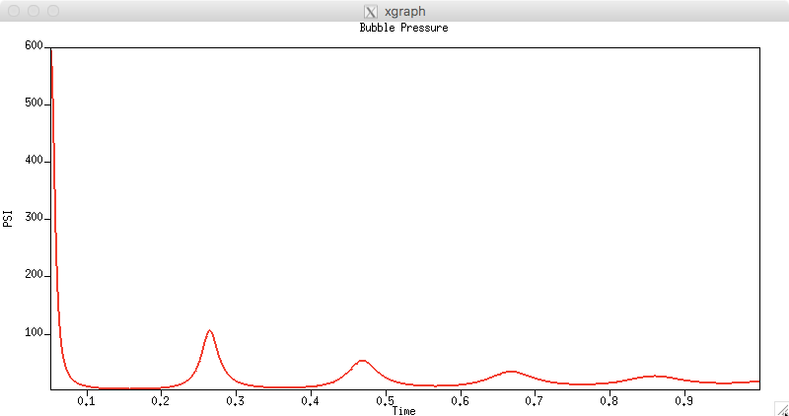
R=R∞ Zero Potential Energy
Bubble Pressure = ambient pressure
1
◉
1
5
◉
◉
◉
◉
◉
◉
◉
◉
Bubble Temperature
◉
5

Slide 64
Zero Potential Energy
Bubble Pressure
1
5
◉
◉
◉
◉
◉
Bubble Temperature
5
◉
◉
◉
◉
◉
1

