Slide 1
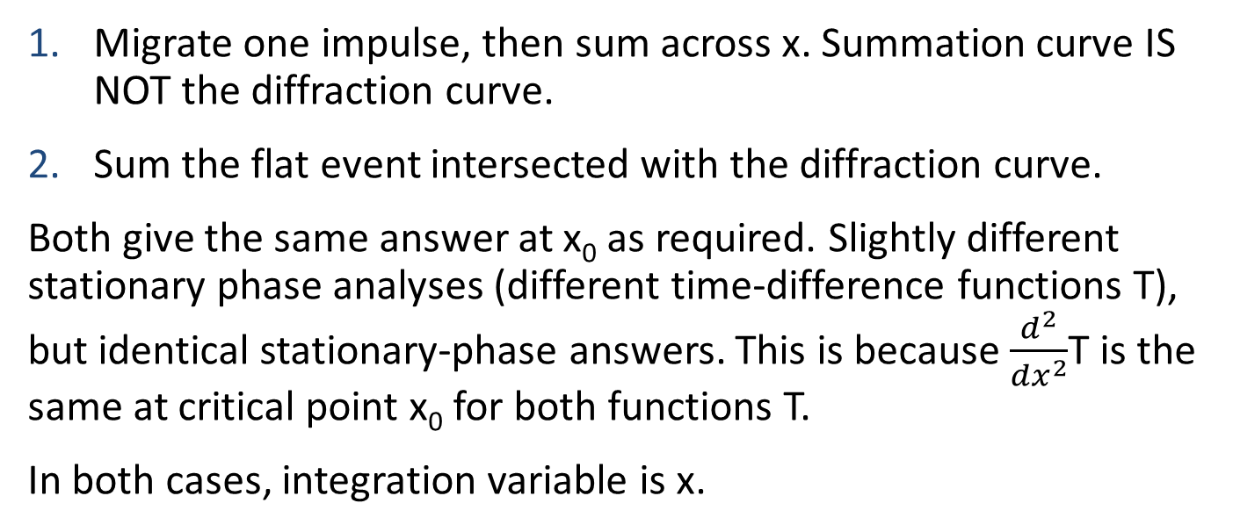
Two ways to get the response of a flat-event migration
Migrate one impulse, then sum across x. Summation curve IS NOT the diffraction curve.
Sum the flat event intersected with the diffraction curve.
Both give the same answer at x₀ as required. Slightly different stationary phase analyses (different time-difference functions T), but identical stationary-phase answers. This is because $\frac{d^{2}}{{dx}^{2}}$T is the same at critical point x₀ for both functions T.
In both cases, integration variable is x.

Slide 2
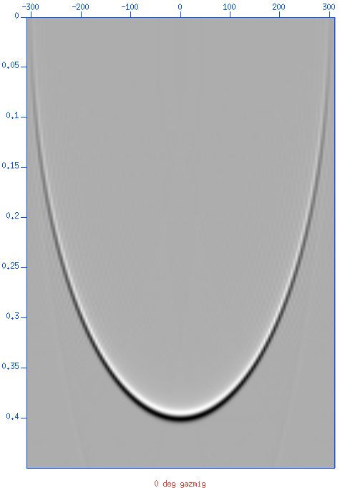
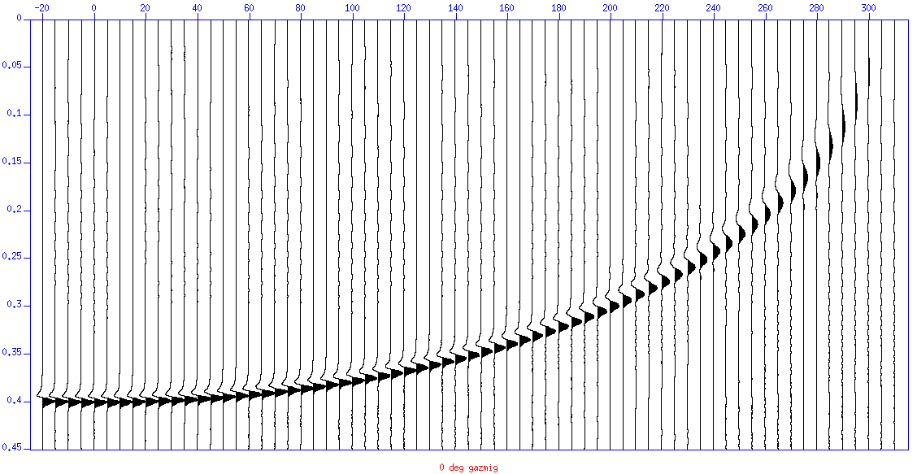
Output impulse response
Summation curve (red) IS NOT the diffraction curve. Summing over x produces a half-integral which exactly compensates the half-derivative of the downward continuation.
The impulse response is not zero phase

Slide 3
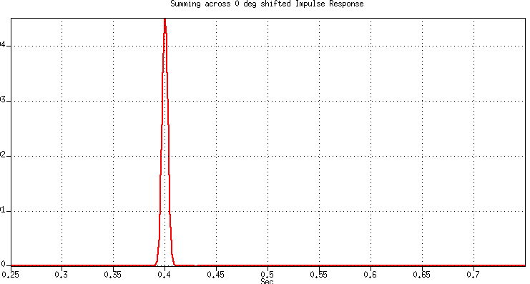
Impulse response and flat event response
Summing across: Perfect zero-phase
Flat event response
The impulse response is not zero phase

Slide 4
Summing over the diffraction curve
Summation curve (red) IS the diffraction curve. Summing over x produces a half-integral which exactly compensates the half-derivative applied to the data.

