Slide 1

Bending the rules: Least-squares migration (LSM)
Standard migration is a combination of
Superposition of wave propagation (correct)
Huygens’ principle, forward and backward in time
Single scatter (superposition of diffraction: Born approximation)
Imaging condition
R = U / D R = U D*
R = U D* / D D*
D
Theoretically better
U
U = R D
R = U / D

Slide 2
Bending the rules: Least-squares migration (LSM)
Standard migration is a combination of
Superposition of wave propagation (correct)
Huygens’ principle, forward and backward in time
Single scatter (superposition of diffraction: Born approximation)
Imaging condition
R = U / D R = U D*
R = U D* / D D*

Slide 3
Standard migration rules
LSM starts with linearized modeling:
Superposition of wave propagation (correct)
Huygens’ principle, forward and backward in time
Single scatter (superposition of diffraction: Born approximation)
d = L m
Recorded data
“Reflectivity” or perturbation model
Linearized wave operator

Slide 4
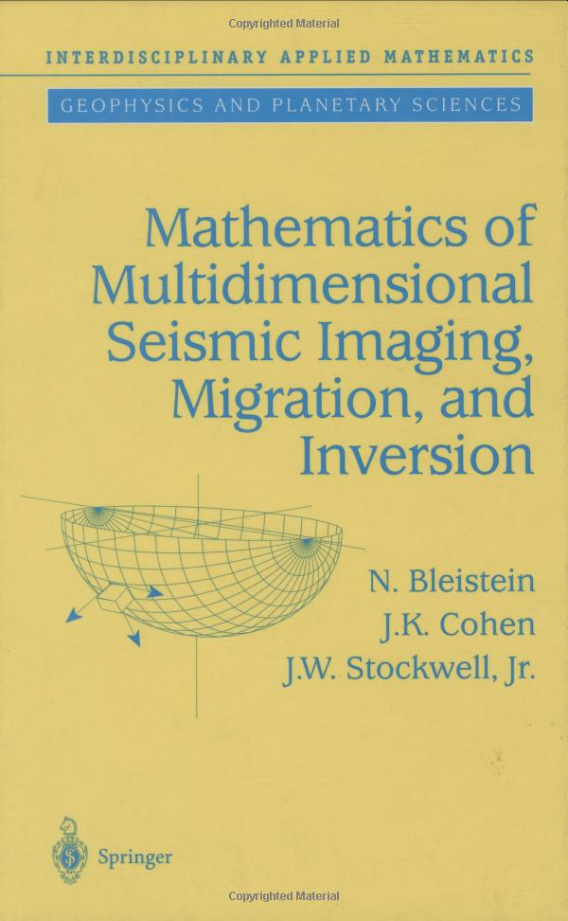
Least-squares migration
LSM starts with linearized modeling:
Superposition of wave propagation (correct)
Huygens’ principle, forward and backward in time
Single scatter (superposition of diffraction: Born approximation):
d = L m
Simply invert for m?
m = L⁻¹ d (e.g., Bleistein et al., 2000)

Slide 5
Least-squares migration
Two purposes of LSM:
Compensate for acquisition deficiencies
Compensate for subsurface illumination deficiencies

Slide 6
Least-squares migration
LSM starts with linearized modeling:
Superposition of wave propagation (correct)
Huygens’ principle, forward and backward in time
Single scatter (superposition of diffraction: Born approximation)
d = L m
Simply invert for m?
m = L⁻¹ d
Not so fast! Does L⁻¹ exist? Remember
surround the obstacle
continuous time measurements
continuous spatial grid
full time / space bandwidth
perfect subsurface illumination

Slide 7
Least-squares migration
m = L⁻¹ d
is too ambitious because L⁻¹ does not exist given finite acquisition.
Claerbout recognized that conjugate transpose L^{H} does exist, and that
m = L^{H} d
is the same as imaging condition
R = U D*.

Slide 8
Least-squares migration
In general, we can’t invert
d = L m.
But we can pseudo-invert (maybe):
L^{H} d = L^{H} L m
m = (L^{H}L)⁻¹ L^{H} d
(if (L^{H}L)⁻¹ exists), which is closer to imaging condition
R = U / D.
We call m = (L^{H}L)⁻¹ L^{H} d least-squares migration.

Slide 9
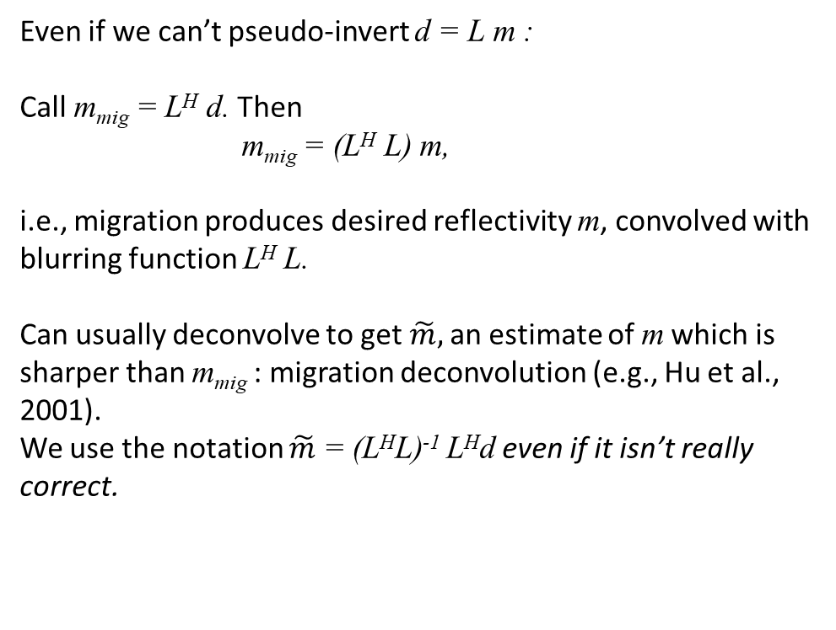
Least-squares migration
Even if we can’t pseudo-invert d = L m :
Call m_{mig} = L^{H} d. Then
m_{mig} = (L^{H} L) m,
i.e., migration produces desired reflectivity m, convolved with blurring function L^{H} L.
Can usually deconvolve to get $\tilde{m},$an estimate of m which is sharper than m_{mig} : migration deconvolution (e.g., Hu et al., 2001).
We use the notation $\tilde{m}$ = (L^{H}L)⁻¹ L^{H}d even if it isn’t really correct.

