Slide 1
Wavefield continuation theory, Born approximation, imaging principles Migration methods: WEM, RTM, Kirchhoff High-resolution acquisition, including: broadband sources and receivers, dense time and space sampling, source and receiver designature, deghosting, and examples of how shear waves may and may not improve resolution Practical problems in imaging, including: angle control, anisotropy, land, and many more Velocity estimation, shallow and deep OBN hardware, acquisition geometries, operations, and processing Towards high-resolution imaging: least-squares migration, imaging multiples, broadband imaging Towards unconventional high-resolution imaging: magical thinking? (Sparsity, diffraction imaging, superresolution)

Slide 2
Seismic imaging Principles and practice
Sam Gray – modified and expanded from CGG training
Includes RTM synthetic example from James Sun

Slide 3
Wavefield Extrapolation

Slide 4
Superposition principle
depth
When energy hits a diffracting point it re-emits energy in all directions. The diffracting point is like a point source for a new wavefront.

Slide 5
Superposition principle
depth
When energy hits a diffracting point it re-emits energy in all directions. The diffracting point is like a point source for a new wavefront.

Slide 6
Superposition principle
depth
When energy hits a diffracting point it re-emits energy in all directions. The diffracting point is like a point source for a new wavefront.

Slide 7
Superposition principle
depth
When energy hits a diffracting point it re-emits energy in all directions. The diffracting point is like a point source for a new wavefront.

Slide 8
Superposition principle
depth
When energy hits a diffracting point it re-emits energy in all directions. The diffracting point is like a point source for a new wavefront.
A similar experiment: a seismic source emits energy in all directions.

Slide 9
Superposition principle
depth
When energy hits a diffracting point it re-emits energy in all directions. The diffracting point is like a point source for a new wavefront.
A similar experiment: a seismic source emits energy in all directions.

Slide 10
Superposition principle
depth
When energy hits a diffracting point it re-emits energy in all directions. The diffracting point is like a point source for a new wavefront.
A similar experiment: a seismic source emits energy in all directions.

Slide 11
Superposition principle
depth
We can add more and more diffractors or point sources emitting energy at the same time and show the wavefronts spreading out with time. Linear superposition of wavefields from multiple sources.

Slide 12
Superposition principle
depth
The wavefronts emitted from these diffractors or point sources will superimpose on each other, constructively interfering in some places and destructively interfering in others.

Slide 13
Superposition principle
depth
As we add more and more diffractors or point sources we start to approximate a continuous reflection event, or wavefront.

Slide 14
Superposition principle
depth
As we add more and more diffractors or point sources we start to approximate a continuous reflection event, or wavefront.

Slide 15
Superposition principle
depth
As we add more and more diffractors or point sources we start to approximate a continuous reflection event.
What’s missing in this picture?

Slide 16
Superposition principle
depth
As we add more and more diffractors or point sources we start to approximate a continuous reflection event.
What’s missing in this picture?

Slide 17
Superposition principle holds for sources, not diffractors
But we will usually pretend that superposition holds for diffractors too.
depth
As we add more and more diffractors or point sources we start to approximate a continuous reflection event.
What’s missing in this picture? Assumes all diffractors are independent of each other. In reality, diffractors interact: Multiple diffractions.

Slide 18
Superposition principle holds for sources, not diffractors
But we will usually pretend that superposition holds for diffractors too.
depth
The individual diffracted wavefronts superimpose to form the wavefront that we would get from a continuous reflector.

Slide 19
Superposition principle holds for sources, not diffractors
But we will usually pretend that superposition holds for diffractors too.
depth
“Common tangents”: constructive and destructive interference.

Slide 20
Superposition principle
depth
The resulting wavefield has plane wavefronts created from the continuous part of the event and the diffracted wavefronts from the discontinuous edges.

Slide 21
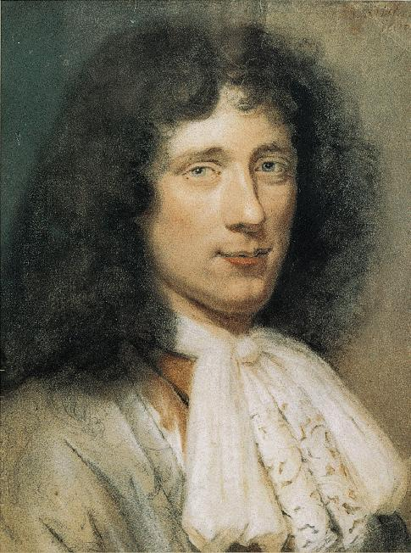
Huygens’ principle
depth
Christiaan Huygens
1629-1695
Huygens’ principle states that each point on the wavefront at a specific time can be regarded as the source of a subsequent wave. Destructive interference destroys the subsequent waves except along the common tangent producing a new wavefront.

Slide 22
Huygens’ principle
depth
We can plot the wavefront at time T + dT from each new point source along the original wavefront.

Slide 23
Huygens’ principle
depth
That is, the wavefront at time T + dT is built from each new point source along the original wavefront.

Slide 24
Huygens’ principle
Keep this part.
depth
Discard this part.
Huygens waves propagate forward in time, and outward from the source.

Slide 25
Huygens’ principle
depth
Huygens waves propagate forward in time, and outward from the source.

Slide 26
Huygens’ principle
depth
Huygens waves propagate forward in time, and outward from the source.

Slide 27
Huygens’ principle
depth
Huygens waves propagate forward in time, and outward from the source.

Slide 28
Huygens’ principle
depth
Huygens waves propagate forward in time, and outward from the source.

Slide 29
Huygens’ principle
depth
Huygens waves propagate forward in time, and outward from the source.
But they could propagate backward in time, or inward to the source.

Slide 30
Huygens’ principle
depth
Repeating for all the new point sources we can see the wavefront built up at time T + dT or indeed T - dT. Therefore if we know the wavefield at a snapshot time T and we know the velocity field, then we can predict the wavefield at time T + dT or indeed T - dT. This is the basis behind forward and reverse wavefield extrapolation techniques.

Slide 31
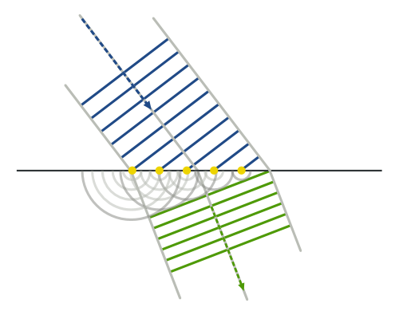
Huygens’ principle is incomplete
As stated, Huygens’ principle allows waves to travel forward in space/time, but not backward in space/time.
Huygens’ principle is stated for waves traveling without obstruction, i.e., no barriers.
Wave refraction in the manner of Huygens.
From Wikipedia,
“Huygens – Fresnel Principle”.

Slide 32
Huygens’ principle is incomplete
As stated, Huygens’ principle allows waves to travel forward in space/time, but not backward in space/time.
Huygens’ principle is stated for waves traveling without obstruction, i.e., no barriers.
Wave refraction in the manner of Huygens.
From Wikipedia,
“Huygens – Fresnel Principle”.

Slide 33
Huygens’ principle is incomplete
As stated, Huygens’ principle allows waves to travel forward in space/time, but not backward in space/time.
Huygens’ principle is stated for waves traveling without obstruction, i.e., no barriers.
Wave refraction in the manner of Huygens.
From Wikipedia,
“Huygens – Fresnel Principle”.

Slide 34
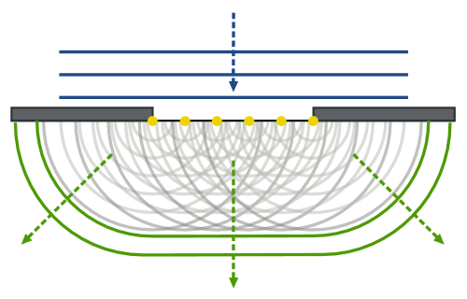
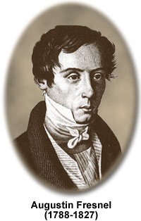
Huygens’ principle is incomplete
As noted, Huygens’ principle provides for waves traveling forward in space/time, but not backward in space/time.
Huygens’ principle is stated for waves traveling without obstruction, i.e., no barriers.
Wave diffraction in the manner of Huygens and Fresnel.
From Wikipedia,
“Huygens – Fresnel Principle”.

Slide 35
Huygens’ principle applied to migration
As stated, Huygens’ principle allows waves to travel forward in space, but not backward in space.
Most migration methods use Huygens’ principle, both forward and backward in time.
Does RTM use Huygens’ principle?

Slide 36
Theory of standard migration*
Standard migration is a combination of
Superposition
Huygens’ principle, forward and backward in time
Imaging condition (coming soon)
*What is “standard migration”?

Slide 37
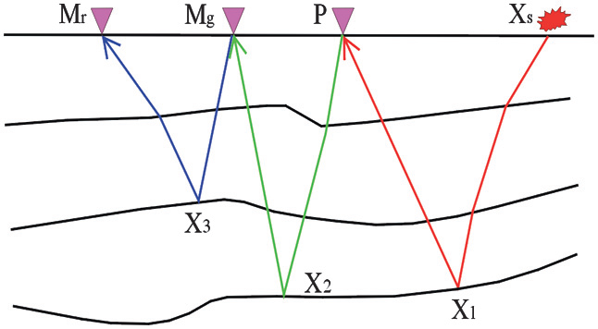
What is “standard migration”?
Standard migration
Single scatter

Slide 38
What is “standard migration”?
NOT standard migration
Refraction
Liu et al., 2011
Multiple scatter

Slide 39
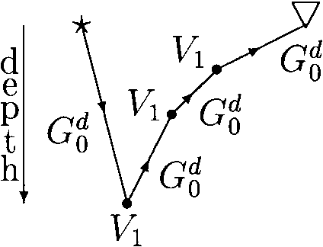
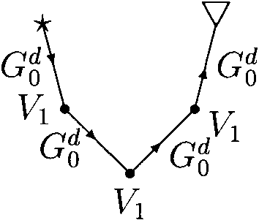
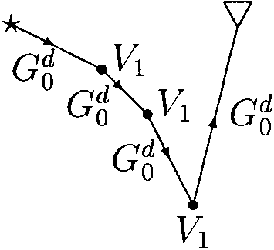
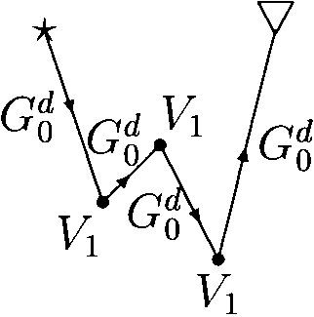
Off on a tangent: Are these “single scatter?”
Weglein et al. (1997)

Slide 40
Off on a tangent: Are these “single scatter?”
Weglein et al. (1997)

Slide 41
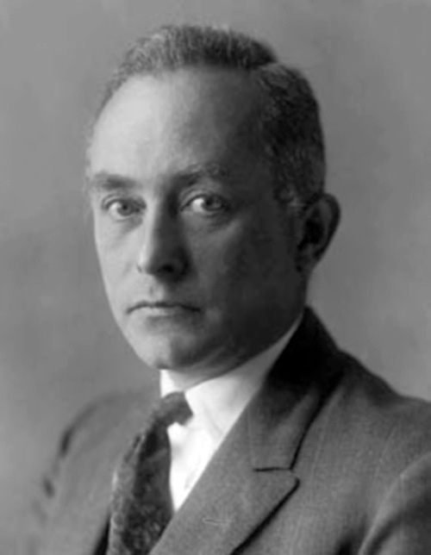
Theory of standard migration
Standard migration is a combination of
Superposition of wave propagation (correct)
Huygens’ principle, forward and backward in time
Single scatter (superposition of diffraction: Born approximation)
Imaging condition (coming soon)
Max Born
1882-1970

Slide 42
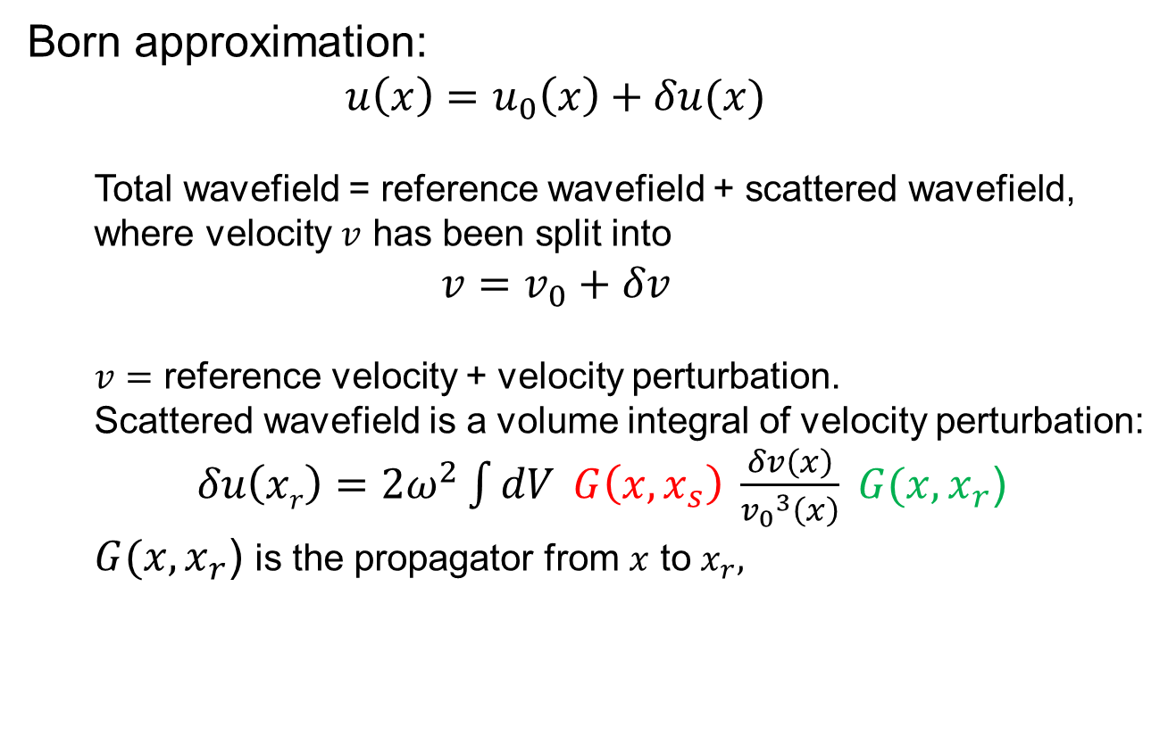
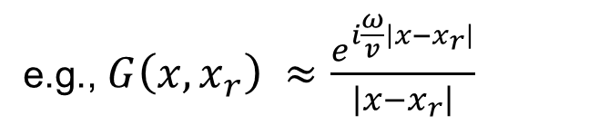
Theory of standard migration
Born approximation:
$$u\left(x\right)=u_{0}\left(x\right)+δu(x)$$
Total wavefield = reference wavefield + scattered wavefield,
where velocity $v$ has been split into
$$v=v_{0}+δv$$
$v=$ reference velocity + velocity perturbation.
Scattered wavefield is a volume integral of velocity perturbation:
$δu\left(xr\right)=2ω^{2}\int{dV }G\left(x,x_{s}\right) \frac{δv\left(x\right)}{{v_{0}}^{3}\left(x\right)} G(x, x_{r}$)
$G(x, x_{r}$) is the propagator from $x$ to $x_{r},$
x_{r}
e.g., $G\left(x,x_{r}\right) ≈\frac{e^{i\frac{ω}{v}\left|x−x_{r}\right|}}{\left|x−x_{r}\right|}$
z
x

Slide 43

Theory of standard migration
Born approximation:
$$u\left(x\right)=u_{0}\left(x\right)+δu(x)$$
Total wavefield = reference wavefield + scattered wavefield,
where velocity $v$ has been split into
$$v=v_{0}+δv$$
$v=$ reference velocity + velocity perturbation.
Scattered wavefield is a volume integral of velocity perturbation:
$δu\left(xr\right)=2ω^{2}\int{dV} G\left(x,x_{s}\right) \frac{δv\left(x\right)}{{v_{0}}^{3}\left(x\right)} G(x, x_{r}$)
$G(x, x_{r}$) is the propagator from $x$ to $x_{r},$
x_{r}
e.g., $G\left(x,x_{r}\right) ≈\frac{e^{i\frac{ω}{v}\left|x−x_{r}\right|}}{\left|x−x_{r}\right|}$
z
x

Slide 44
Theory of standard migration
Born approximation:
$$u\left(x\right)=u_{0}\left(x\right)+δu(x)$$
Total wavefield = reference wavefield + scattered wavefield,
where velocity $v$ has been split into
$$v=v_{0}+δv$$
$v=$ reference velocity + velocity perturbation.
Scattered wavefield is a volume integral of velocity perturbation:
$δu\left(xr\right)=2ω^{2}\int{dV} G\left(x,x_{s}\right) \frac{δv\left(x\right)}{{v_{0}}^{3}\left(x\right)} G(x, x_{r}$)
$G(x, x_{r}$) is the propagator from $x$ to $x_{r},$
x_{r}
e.g., $G\left(x,x_{r}\right) ≈\frac{e^{i\frac{ω}{v}\left|x−x_{r}\right|}}{\left|x−x_{r}\right|}$
z
x₁
x₂
Not allowed!

Slide 45
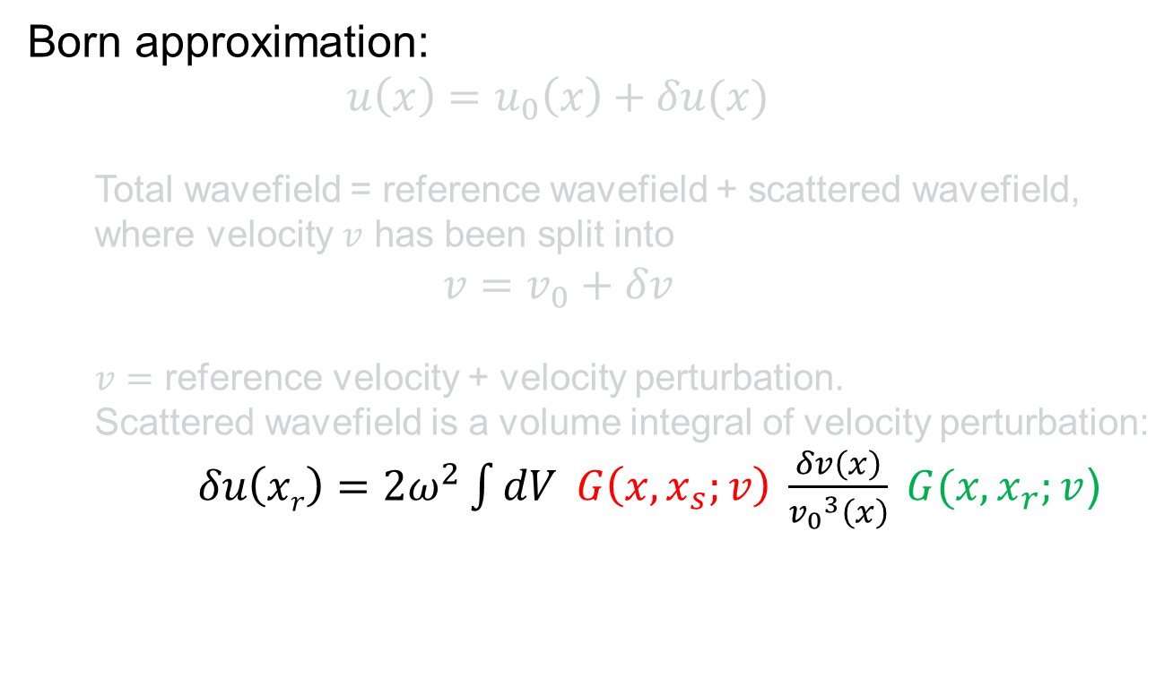
Theory of standard migration
Born approximation:
$$u\left(x\right)=u_{0}\left(x\right)+δu(x)$$
Total wavefield = reference wavefield + scattered wavefield,
where velocity $v$ has been split into
$$v=v_{0}+δv$$
$v=$ reference velocity + velocity perturbation.
Scattered wavefield is a volume integral of velocity perturbation:
$δu\left(xr\right)=2ω^{2}\int{dV} G\left(x,x_{s};v\right) \frac{δv\left(x\right)}{{v_{0}}^{3}\left(x\right)} G(x, x_{r};v$)
Recorded data
Unknown (“image”)
Unknown “propagators”

Slide 46
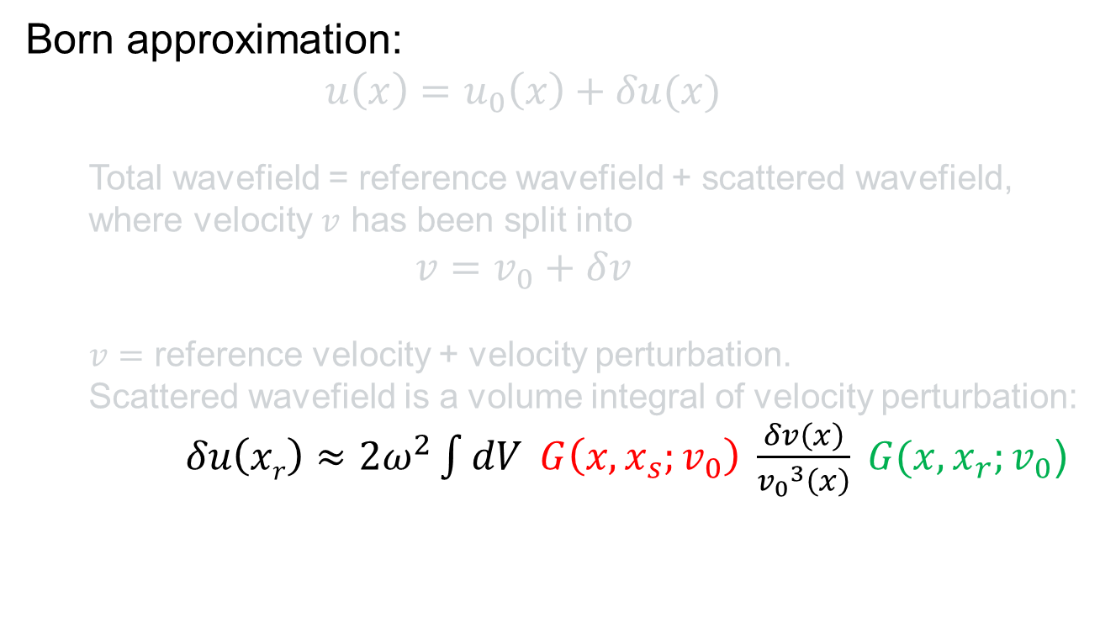
Theory of standard migration
Born approximation:
$$u\left(x\right)=u_{0}\left(x\right)+δu(x)$$
Total wavefield = reference wavefield + scattered wavefield,
where velocity $v$ has been split into
$$v=v_{0}+δv$$
$v=$ reference velocity + velocity perturbation.
Scattered wavefield is a volume integral of velocity perturbation:
$δu\left(xr\right)≈2ω^{2}\int{dV} G\left(x,x_{s};v_{0}\right) \frac{δv\left(x\right)}{{v_{0}}^{3}\left(x\right)} G(x, x_{r};v_{0}$)
Recorded data
Unknown (“image”)
Known “reference propagators”

Slide 47
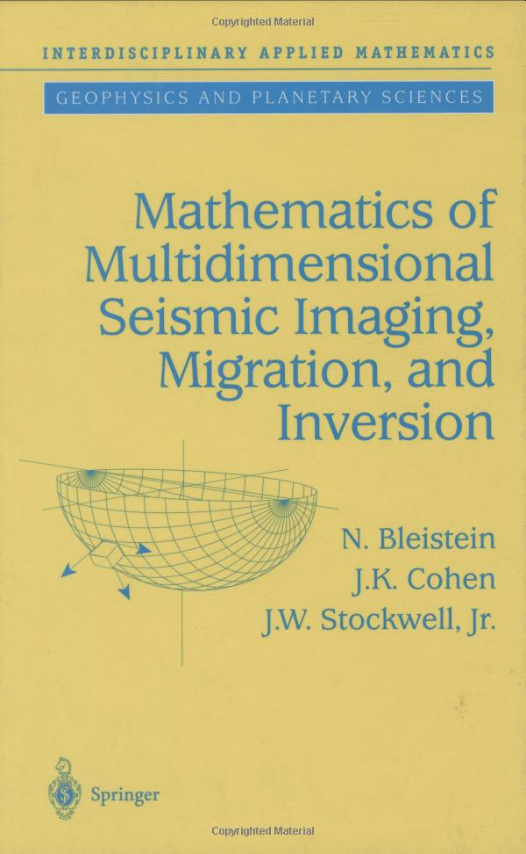
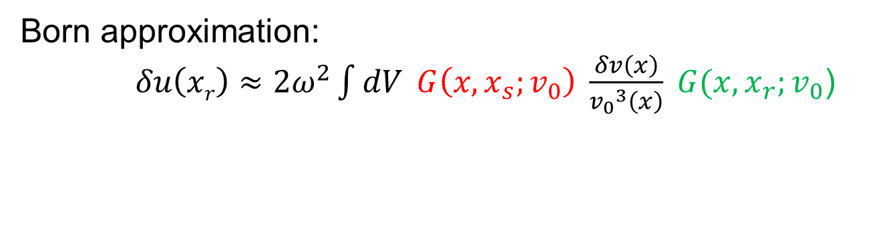
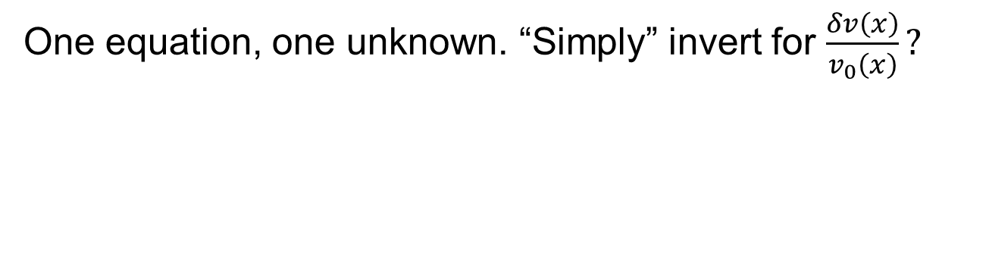
Theory of standard migration
Born approximation:
$δu\left(xr\right)≈2ω^{2}\int{dV} G\left(x,x_{s};v_{0}\right) \frac{δv\left(x\right)}{{v_{0}}^{3}\left(x\right)} G(x, x_{r};v_{0}$)
Recorded data
Unknown (“image”)
Known “reference propagators”
One equation, one unknown. “Simply” invert for $\frac{δv\left(x\right)}{v_{0}\left(x\right)}?$

Slide 48
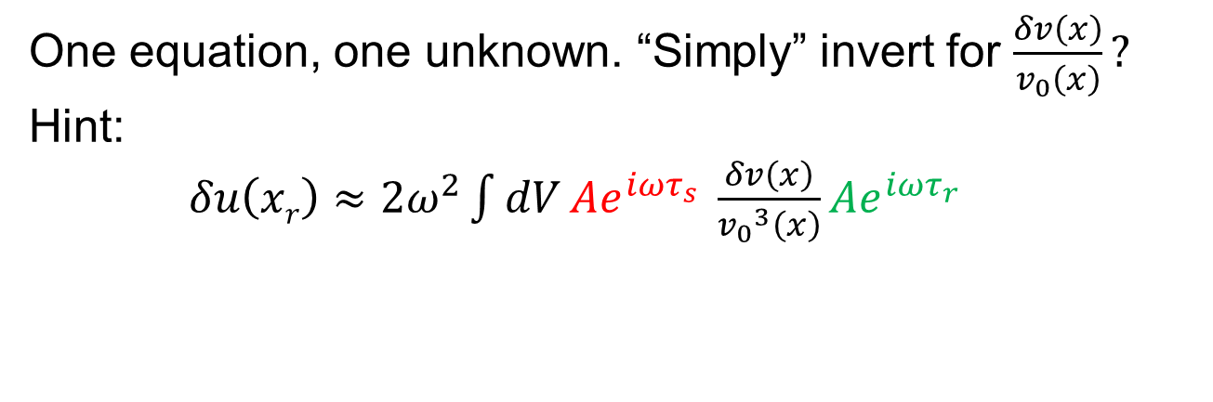
Theory of standard migration
Born approximation:
$δu\left(xr\right)≈2ω^{2}\int{dV} G\left(x,x_{s};v_{0}\right) \frac{δv\left(x\right)}{{v_{0}}^{3}\left(x\right)} G(x, x_{r};v_{0}$)
One equation, one unknown. “Simply” invert for $\frac{δv\left(x\right)}{v_{0}\left(x\right)}?$
Hint:
$δu\left(xr\right)≈2ω^{2}\int{dV}Ae^{iωτ_{s}} \frac{δv\left(x\right)}{{v_{0}}^{3}\left(x\right)}Ae^{iωτ_{r}}$

Slide 49
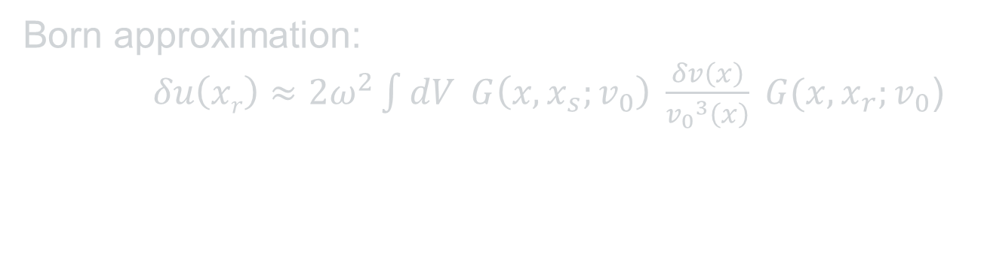
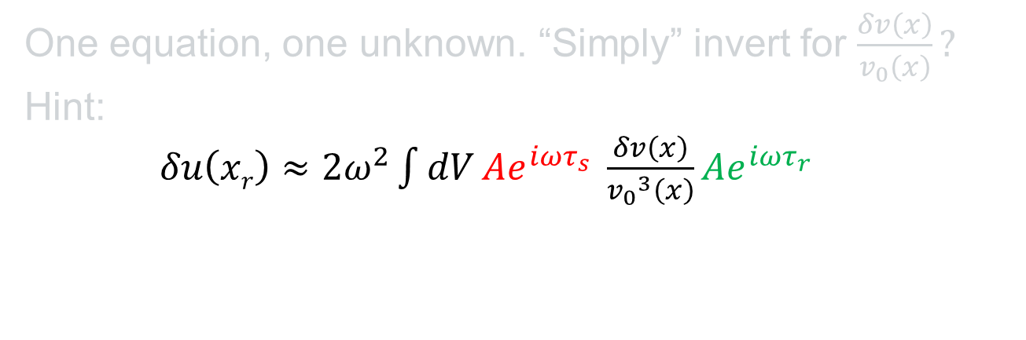
Theory of standard migration
Born approximation:
$δu\left(xr\right)≈2ω^{2}\int{dV} G\left(x,x_{s};v_{0}\right) \frac{δv\left(x\right)}{{v_{0}}^{3}\left(x\right)} G(x, x_{r};v_{0}$)
One equation, one unknown. “Simply” invert for $\frac{δv\left(x\right)}{v_{0}\left(x\right)}?$
Hint:
$δu\left(xr\right)≈2ω^{2}\int{dV}Ae^{iωτ_{s}} \frac{δv\left(x\right)}{{v_{0}}^{3}\left(x\right)}Ae^{iωτ_{r}}$
What are the mathematical units?

Slide 50
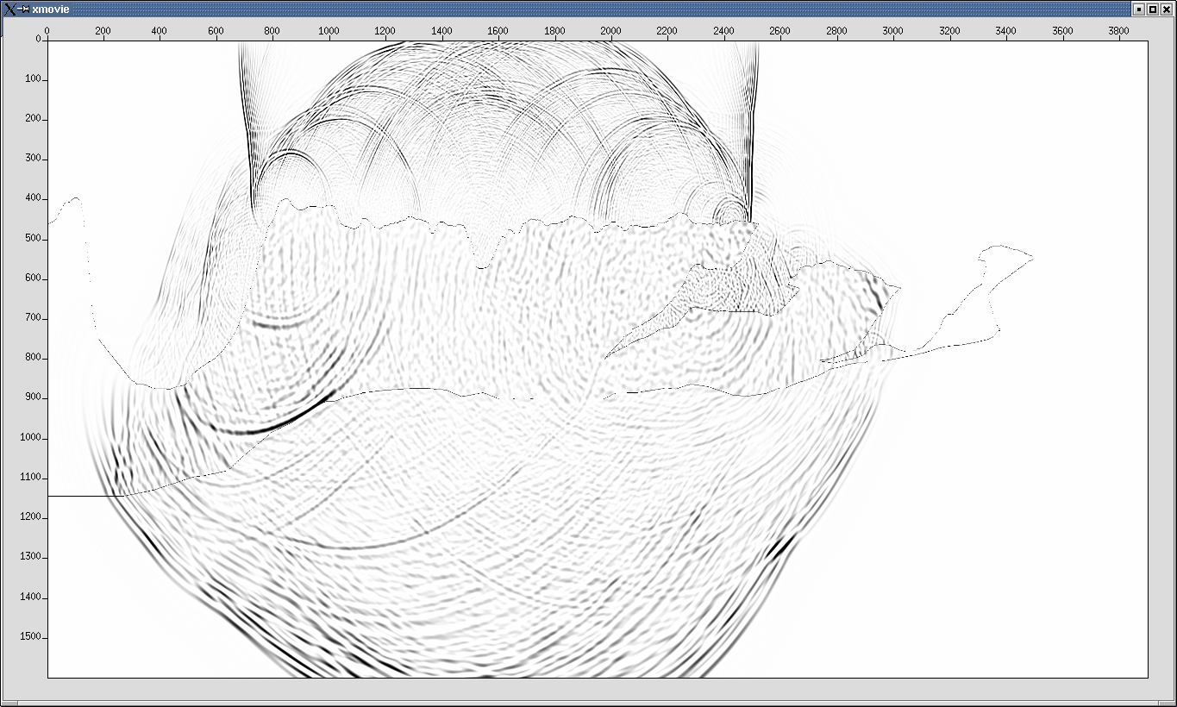
Total wavefield = reference wavefield + scattered wavefield

Slide 51
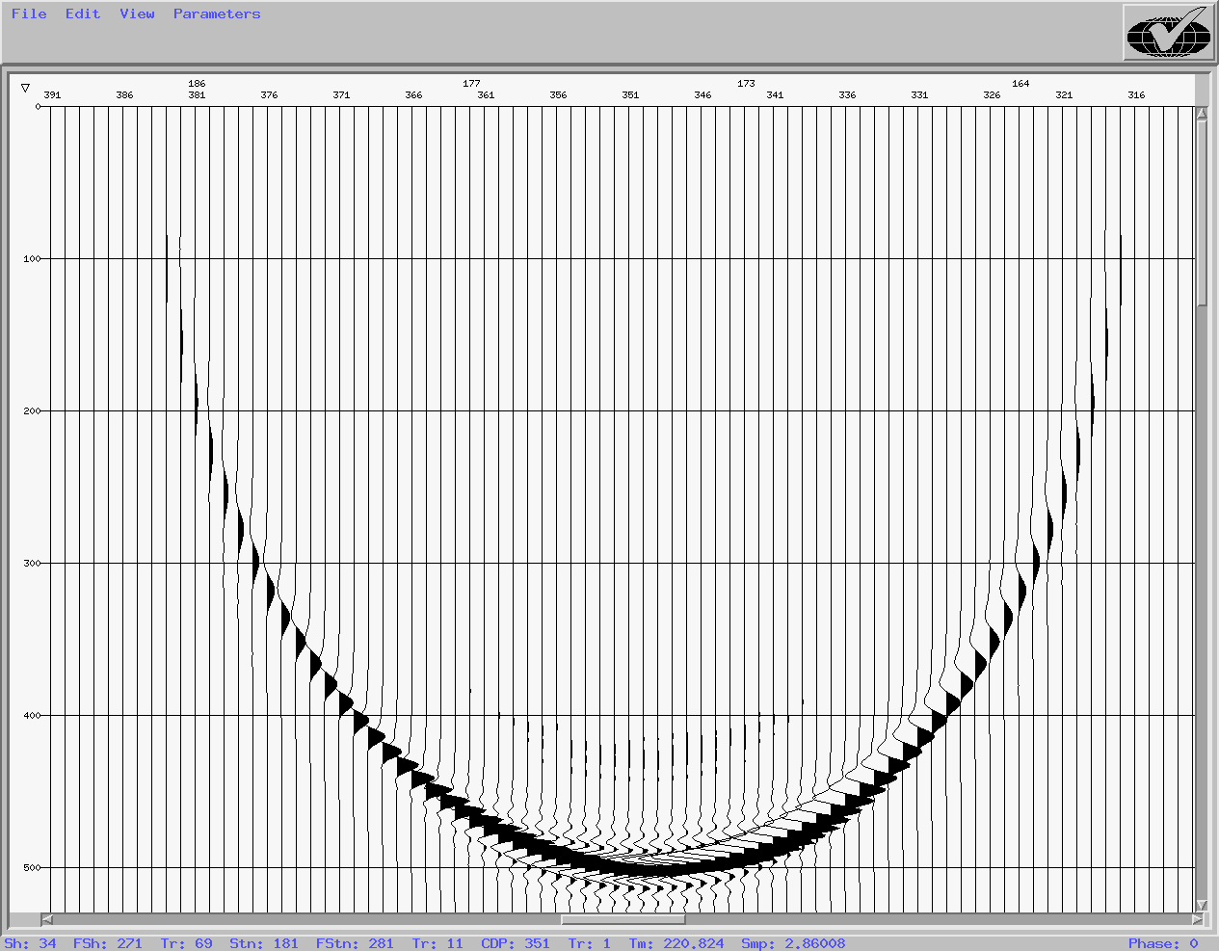
Total wavefield = reference wavefield + scattered wavefield
Bad choice of reference velocity:
Too slow!

Slide 52
Total wavefield = reference wavefield + scattered wavefield
Scattered wavefield =
(Total wavefield – reference wavefield) is large. Born approximation is bad for this reference velocity.

Slide 53
Total wavefield = reference wavefield + scattered wavefield

Slide 54
Total wavefield = reference wavefield + scattered wavefield
Bad choice of reference velocity:
Too slow!

Slide 55
Total wavefield = reference wavefield + scattered wavefield
Better choice of reference velocity

Slide 56
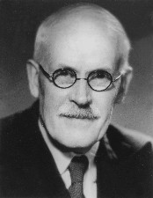
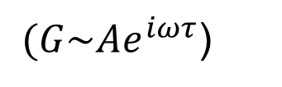
Theory of standard migration
Standard migration is a combination of
Superposition of wave propagation (correct)
Huygens principle, forward and backward in time
Imaging condition (coming soon)
Single scatter (Born approximation) :
Superposition of response (approximate) :
Adding one more scatterer / diffractor adds one more diffraction response to the recorded wavefield : Single scatter happens when either :
Applying WKBJ to the source and receiver propagators ; or
Smoothing the velocity field.
Both rely on high-frequency asymptotics (next).
$(G\sim Ae^{iωτ}$)
WKBJ: “J” = Sir Harold Jeffreys 1891-1989

Slide 57
Theory of standard migration
Velocity smoothing and high-frequency asymptotics:
No smoothing : waves of all frequencies WILL reflect. BAD.
Short-wavelength smoothing :
low-frequency waves WILL reflect. BAD.
Long-wavelength smoothing : waves of all frequencies WILL NOT reflect. GOOD.

Slide 58
Theory of standard migration
Velocity smoothing and high-frequency asymptotics:
No smoothing : waves of all frequencies WILL reflect. BAD.
Short-wavelength smoothing :
high-frequency waves WILL NOT reflect. GOOD.
Long-wavelength smoothing : waves of all frequencies WILL NOT reflect. GOOD.

Slide 59
Theory of standard migration
Velocity smoothing and high-frequency asymptotics:
No smoothing : waves of all frequencies WILL reflect. BAD.
Short-wavelength smoothing :
high-frequency waves WILL NOT reflect. GOOD.
Long-wavelength smoothing : waves of all frequencies WILL NOT reflect. GOOD.
“Good”, but not always accurate!

Slide 60
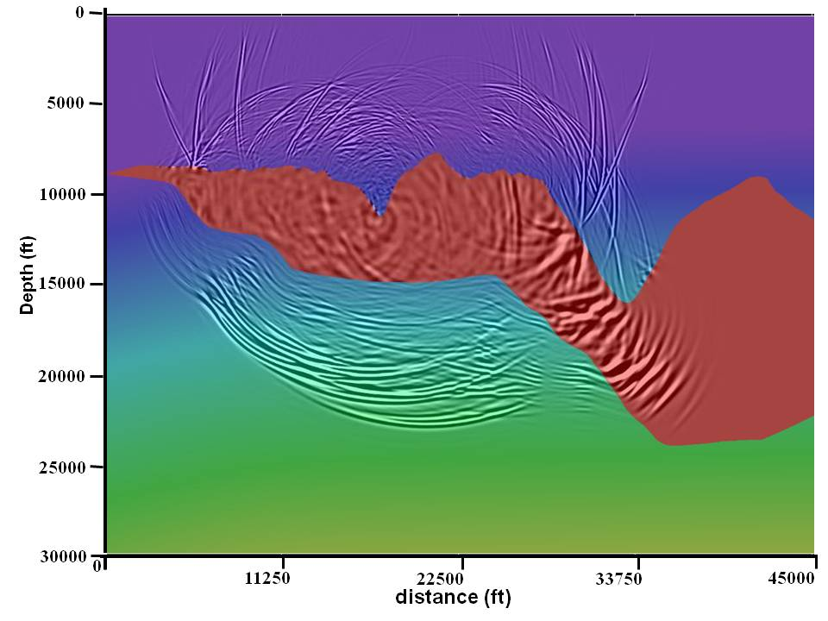
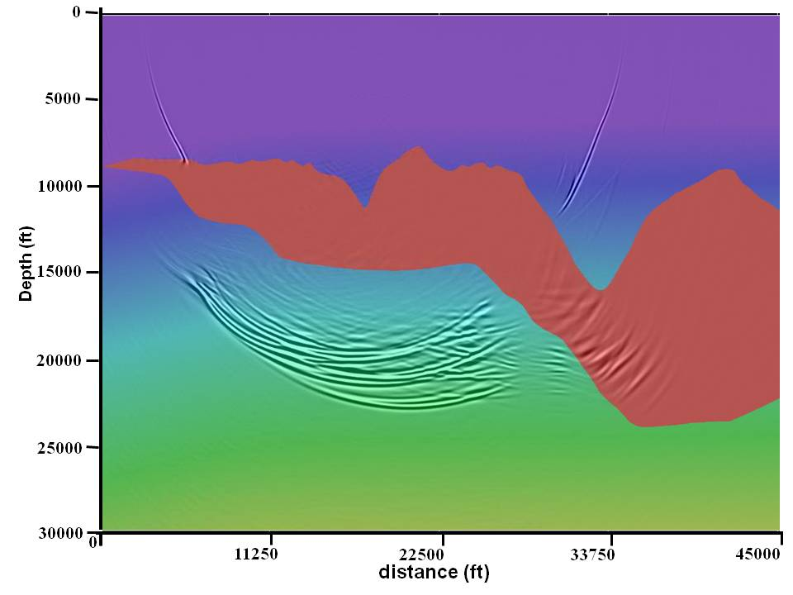
Theory of standard migration
Velocity smoothing and high-frequency asymptotics:
RTM crosstalk from not enough smoothing
OWEM : asymptotics honored automatically

Slide 61
Theory of standard migration
Velocity smoothing and high-frequency asymptotics:
No smoothing : waves of all frequencies WILL reflect. BAD.
Short-wavelength smoothing :
high-frequency waves WILL NOT reflect. GOOD.
Long-wavelength smoothing : waves of all frequencies WILL NOT reflect. GOOD.
What frequencies are“high”?

Slide 62
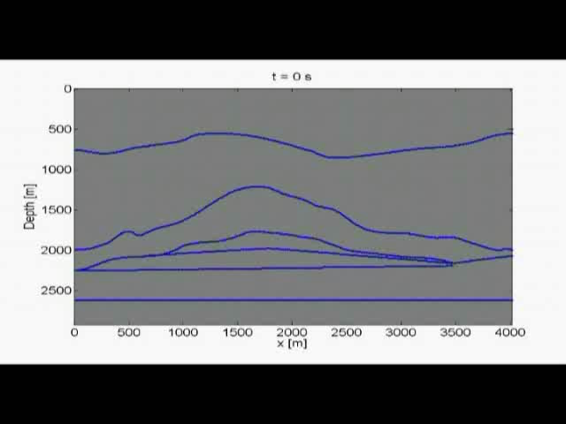
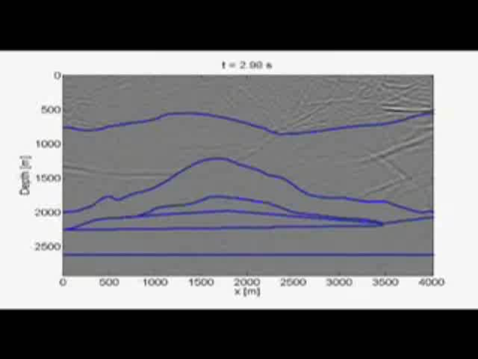
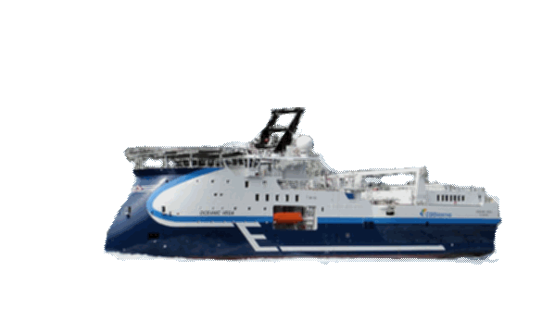
The source wavefield, plus unwanted receiver wavefield
We can use wavefield extrapolation to forward propagate a source wavelet through a velocity model and record the resultant wavefield at the surface to form a gather.
And if we know the wavefield and its time derivative at a specific time t we can also extrapolate the wavefield in reverse.
Acknowledgement to SINTEF, Rita Streich

Slide 63
The receiver wavefield, plus unwanted source wavefield
We can use wavefield extrapolation to forward propagate a source wavelet through a velocity model and record the resultant wavefield at the surface to form a gather.
And if we know the wavefield and its time derivative at a specific time t we can also extrapolate the wavefield in reverse.
Acknowledgement to SINTEF, Rita Streich

Slide 64
The imaging condition uses source and receiver wavefields
We can use wavefield extrapolation to forward propagate a source wavelet through a velocity model and record the resultant wavefield at the surface to form a gather.
And if we know the wavefield and its time derivative at a specific time t we can also extrapolate the wavefield in reverse.
Is that the same as migration?

Slide 65

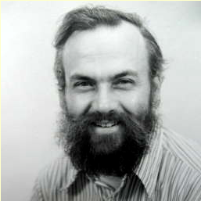
Wave equation migration (Claerbout, 1970-1971)
The imaging principle:
“Reflectors exist in the earth at places where the onset of the downgoing wave is time coincident with an upgoing wave.” – Claerbout (1971)

Slide 66
Wave equation migration (Claerbout, 1970-1971)
The imaging principle:
“Reflectors exist in the earth at places where the onset of the downgoing wave is time coincident with an upgoing wave.” – Claerbout (1971)
D

Slide 67
Wave equation migration (Claerbout, 1970-1971)
The imaging principle:
“Reflectors exist in the earth at places where the onset of the downgoing wave is time coincident with an upgoing wave.” – Claerbout (1971)
D

Slide 68
Wave equation migration (Claerbout, 1970-1971)
The imaging principle:
“Reflectors exist in the earth at places where the onset of the downgoing wave is time coincident with an upgoing wave.” – Claerbout (1971)
D
U
U = R D
R = U / D

Slide 69
Wave equation migration (Claerbout, 1970-1971)
The imaging principle:
“Reflectors exist in the earth at places where the onset of the downgoing wave is time coincident with an upgoing wave.” – Claerbout (1971)

Slide 70
Wave equation migration (Claerbout, 1970-1971)
The imaging principle:
“Reflectors exist in the earth at places where the onset of the downgoing wave is time coincident with an upgoing wave.” – Claerbout (1971)
How are these two related?

Slide 71
Wave equation migration (Claerbout, 1970-1971)
The imaging principle:
“Reflectors exist in the earth at places where the onset of the downgoing wave is time coincident with an upgoing wave.” – Claerbout (1971)
R = ∫ U / D dω
R = ∫ U D* dω

Slide 72
Wave equation migration (Claerbout, 1970-1971)
The imaging principle:
“Reflectors exist in the earth at places where the onset of the downgoing wave is time coincident with an upgoing wave.” – Claerbout (1971)
R = ∫ U / D dω
R = ∫ U D* dω
What are the mathematical units?

Slide 73
Wave equation migration (Claerbout, 1970-1971)
The imaging principle:
“Reflectors exist in the earth at places where the onset of the downgoing wave is time coincident with an upgoing wave.” – Claerbout (1971)
R = ∫ U / D dω
R = ∫ U D* dω
What are the mathematical units?
What are the best mathematical units for a migrated image?

Slide 74


Wave equation migration (Claerbout, 1970-1971)
The imaging principle:
“Reflectors exist in the earth at places where the onset of the downgoing wave is time coincident with an upgoing wave.” – Claerbout (1971)
The acoustic wave equation
Very slow to compute in 1970
Two-way (no “downgoing” and “upgoing”)
A new (“parabolic”, low-dip) wave equation (Claerbout and Johnson, 1971)
Much faster to compute
One-way

Slide 75
Parabolic wave equation
M. Leontovich and V. Fock, Solution of the problem of propagation of electromagnetic waves along the earth’s surface by the method of parabolic equation, Acad. Sci.
USSR. J. Phys. 10 (1946), 13–24.
USSR: Laser optics, late 1960’s
Geophysics: Claerbout, c. 1969
Necessity is the mother of invention
Underwater acoustics, early 1970’s

Slide 76
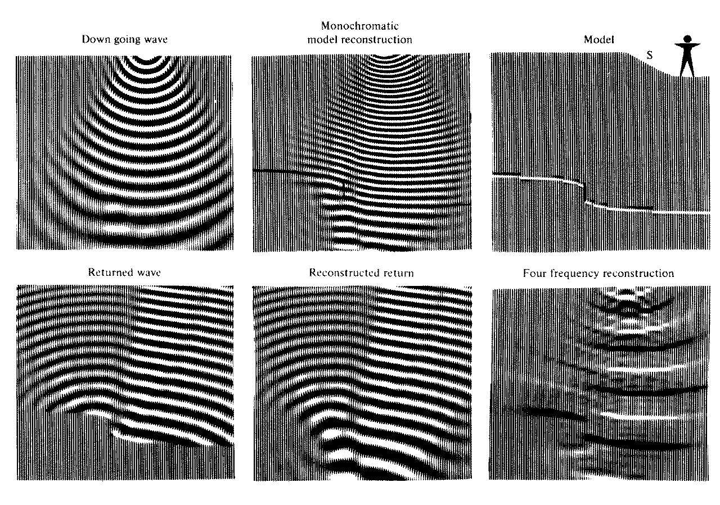

The invention of wave-equation migration
Claerbout, 1971

Slide 77
The invention of wave-equation migration

Slide 78
The invention of wave-equation migration

Slide 79
The invention of wave-equation migration

Slide 80
The invention of wave-equation migration

Slide 81
The invention of wave-equation migration

Slide 82
The invention of wave-equation migration

Slide 83
The invention of wave-equation migration

Slide 84
The invention of wave-equation migration

Slide 85
The invention of wave-equation migration
Claerbout, 1971

Slide 86
Wavefield propagation forwards in time

Slide 87
Wave propagation and the imaging condition
Here we see a shot point illuminating some reflection points on the sea floor

Slide 88
Wave propagation and the imaging condition
Rather than imagining this as rays, we can look at the actual wavefield propagating in time.

Slide 89
Wave propagation and the imaging condition
Is it OK to imagine this as rays?

Slide 90
Wave propagation and the imaging condition
The shot fires at time zero…

Slide 91
Wave propagation and the imaging condition
..and we see the Source wavefield forward propagating into the Earth

Slide 92
Wave propagation and the imaging condition
..and we see the Source wavefield forward propagating into the Earth

Slide 93
Wave propagation and the imaging condition
The red cone highlights the portion of the Source Wavefield that will be recorded by our receivers.

Slide 94
Wave propagation and the imaging condition
Raypaths in the red cone: Do they form the wavefield?

Slide 95
Wave propagation and the imaging condition
As the wavefield hits the seafloor we see some of the wavefield transmitted and some reflected.

Slide 96
Wave propagation and the imaging condition
As the wavefield hits the seafloor we see some of the wavefield transmitted and some reflected.

Slide 97
Wave propagation and the imaging condition
As the wavefield hits the seafloor we see some of the wavefield transmitted and some reflected.

Slide 98
Wave propagation and the imaging condition
As the wavefield hits the seafloor we see some of the wavefield transmitted and some reflected.

Slide 99
Wave propagation and the imaging condition
This red line shows where the Source wavefield would be if there were no velocity change at the seafloor

Slide 100
Wave propagation and the imaging condition
This red line shows the portion of the wavefield that will be recorded at our receivers.

Slide 101
Wave propagation and the imaging condition
We call this upcoming wavefield, which will be recorded at the receivers, the Receiver wavefield.

Slide 102
Wave propagation and the imaging condition
This location on the seafloor is where the Source Wavefield and the Receiver Wavefield are coincident.

Slide 103
Wave propagation and the imaging condition
This location on the seafloor is where the Source Wavefield and the Receiver Wavefield are coincident.

Slide 104
Wave propagation and the imaging condition
This location on the seafloor is where the Source Wavefield and the Receiver Wavefield are coincident.

Slide 105
Wave propagation and the imaging condition
This location on the seafloor is where the Source Wavefield and the Receiver Wavefield are coincident.

Slide 106
Wave propagation and the imaging condition
The Source Wavefield and the Receiver Wavefield being coincident is the Imaging condition.

Slide 107
Wave propagation and the imaging condition
The Source Wavefield and the Receiver Wavefield being coincident is the Imaging condition.

Slide 108
Wave propagation and the imaging condition
The Source Wavefield and the Receiver Wavefield being coincident is the Imaging condition.

Slide 109
Wave propagation and the imaging condition
The Source Wavefield and the Receiver Wavefield being coincident is the Imaging condition.

Slide 110
Wave propagation and the imaging condition
The Source Wavefield and the Receiver Wavefield being coincident is the Imaging condition.

Slide 111
Wave propagation and the imaging condition
The Source Wavefield and the Receiver Wavefield being coincident is the Imaging condition.

Slide 112
Wave propagation and the imaging condition
The Source Wavefield and the Receiver Wavefield being coincident is the Imaging condition.

Slide 113
Wave propagation and the imaging condition
The Source Wavefield and the Receiver Wavefield being coincident is the Imaging condition.

Slide 114
Wave propagation and the imaging condition
The Source Wavefield and the Receiver Wavefield being coincident is the Imaging condition.

Slide 115
Wave propagation and the imaging condition
The Source Wavefield and the Receiver Wavefield being coincident is the Imaging condition.

Slide 116
Wave propagation and the imaging condition
The upcoming Receiver wavefield is now being recorded at the first receiver

Slide 117
Wave propagation and the imaging condition
We can sometimes (always?) plot the source-reflector-receiver raypath.

Slide 118
Wave propagation and the imaging condition
t=0.8s-
We can plot the Receiver wavefield on our shot gather as it is recorded.

Slide 119
Wave propagation and the imaging condition
t=0.8s-
We can plot the Receiver wavefield on our shot gather as it is recorded.

Slide 120
Wave propagation and the imaging condition
t=0.8s-
t=0.9s-
We can plot the Receiver wavefield on our shot gather as it is recorded.

Slide 121
Wave propagation and the imaging condition
t=0.8s-
t=0.9s-
We can plot the Receiver wavefield on our shot gather as it is recorded.

Slide 122
Wave propagation and the imaging condition
t=0.8s-
t=0.9s-
We can plot the Receiver wavefield on our shot gather as it is recorded.

Slide 123
Wave propagation and the imaging condition
t=0.8s-
t=0.9s-
We can plot the Receiver wavefield on our shot gather as it is recorded.

Slide 124
Wave propagation and the imaging condition
t=0.8s-
t=0.9s-
We can plot the Receiver wavefield on our shot gather as it is recorded.

Slide 125
Wave propagation and the imaging condition
t=0.8s-
t=0.9s-
t=1.0s-
We can plot the Receiver wavefield on our shot gather as it is recorded.

Slide 126
Wave propagation and the imaging condition
t=0.8s-
t=0.9s-
t=1.0s-
We can plot the Receiver wavefield on our shot gather as it is recorded.

Slide 127
Wave propagation and the imaging condition
t=0.8s-
t=0.9s-
t=1.0s-
We can plot the Receiver wavefield on our shot gather as it is recorded.

Slide 128
Wave propagation and the imaging condition
t=0.8s-
t=0.9s-
t=1.0s-
We can plot the Receiver wavefield on our shot gather as it is recorded.

Slide 129
Wave propagation and the imaging condition
t=0.8s-
t=0.9s-
t=1.0s-
We can plot the Receiver wavefield on our shot gather as it is recorded.

Slide 130
Wave propagation and the imaging condition
t=0.8s-
t=0.9s-
t=1.0s-
t=1.1s-
We can plot the Receiver wavefield on our shot gather as it is recorded.

Slide 131
Wave propagation and the imaging condition
t=0.8s-
t=0.9s-
t=1.0s-
t=1.1s-
We can plot the Receiver wavefield on our shot gather as it is recorded.

Slide 132
Wave propagation and the imaging condition
t=0.8s-
t=0.9s-
t=1.0s-
t=1.1s-
We can plot the Receiver wavefield on our shot gather as it is recorded.

Slide 133
Wave propagation and the imaging condition
t=0.8s-
t=0.9s-
t=1.0s-
t=1.1s-
We can plot the Receiver wavefield on our shot gather as it is recorded.

Slide 134
Wave propagation and the imaging condition
t=0.8s-
t=0.9s-
t=1.0s-
t=1.1s-
We can plot the Receiver wavefield on our shot gather as it is recorded.

Slide 135
Wave propagation and the imaging condition
t=0.8s-
t=0.9s-
t=1.0s-
t=1.1s-
t=1.2s-
We can plot the Receiver wavefield on our shot gather as it is recorded.

Slide 136
Wave propagation and the imaging condition
t=0.8s-
t=0.9s-
t=1.0s-
t=1.1s-
t=1.2s-
We can plot the Receiver wavefield on our shot gather as it is recorded.

Slide 137
Wave propagation and the imaging condition
t=0.8s-
t=0.9s-
t=1.0s-
t=1.1s-
t=1.2s-
We can plot the Receiver wavefield on our shot gather as it is recorded.

Slide 138
Wave propagation and the imaging condition
t=0.8s-
t=0.9s-
t=1.0s-
t=1.1s-
t=1.2s-
We can plot the Receiver wavefield on our shot gather as it is recorded.

Slide 139
Wave propagation and the imaging condition
t=0.8s-
t=0.9s-
t=1.0s-
t=1.1s-
t=1.2s-
We can plot the Receiver wavefield on our shot gather as it is recorded.

Slide 140
Wave propagation and the imaging condition
t=0.8s-
t=0.9s-
t=1.0s-
t=1.1s-
t=1.2s-
t=1.3s-
We can plot the Receiver wavefield on our shot gather as it is recorded.

Slide 141
Wave propagation and the imaging condition
t=0.8s-
t=0.9s-
t=1.0s-
t=1.1s-
t=1.2s-
t=1.3s-
We can plot the Receiver wavefield on our shot gather as it is recorded.

Slide 142
Wave propagation and the imaging condition
t=0.8s-
t=0.9s-
t=1.0s-
t=1.1s-
t=1.2s-
t=1.3s-
We can plot the Receiver wavefield on our shot gather as it is recorded.

Slide 143
Wave propagation and the imaging condition
t=0.8s-
t=0.9s-
t=1.0s-
t=1.1s-
t=1.2s-
t=1.3s-
We can plot the Receiver wavefield on our shot gather as it is recorded.

Slide 144
Wave propagation and the imaging condition
t=0.8s-
t=0.9s-
t=1.0s-
t=1.1s-
t=1.2s-
t=1.3s-
We can plot the Receiver wavefield on our shot gather as it is recorded.

Slide 145
Wave propagation and the imaging condition
t=0.8s-
t=0.9s-
t=1.0s-
t=1.1s-
t=1.2s-
t=1.3s-
t=1.4s-
We can plot the Receiver wavefield on our shot gather as it is recorded.

Slide 146
Wave propagation and the imaging condition
t=0.8s-
t=0.9s-
t=1.0s-
t=1.1s-
t=1.2s-
t=1.3s-
t=1.4s-
We can plot the Receiver wavefield on our shot gather as it is recorded.

Slide 147
Wave propagation and the imaging condition
t=0.8s-
t=0.9s-
t=1.0s-
t=1.1s-
t=1.2s-
t=1.3s-
t=1.4s-
We can plot the Receiver wavefield on our shot gather as it is recorded.

Slide 148
Wave propagation and the imaging condition
t=0.9s-
t=1.0s-
t=1.1s-
t=1.2s-
t=1.3s-
t=1.4s-
We can plot the Receiver wavefield on our shot gather as it is recorded.

Slide 149
Wave propagation and the imaging condition
t=0.9s-
t=1.0s-
t=1.1s-
t=1.2s-
t=1.3s-
t=1.4s-
We can plot the Receiver wavefield on our shot gather as it is recorded.

Slide 150
Wave propagation and the imaging condition
t=0.9s-
t=1.0s-
t=1.1s-
t=1.2s-
t=1.3s-
t=1.4s-
t=1.5s-
Here is the complete seafloor event recorded on our shot gather

Slide 151
To be continued…

