Slide 1
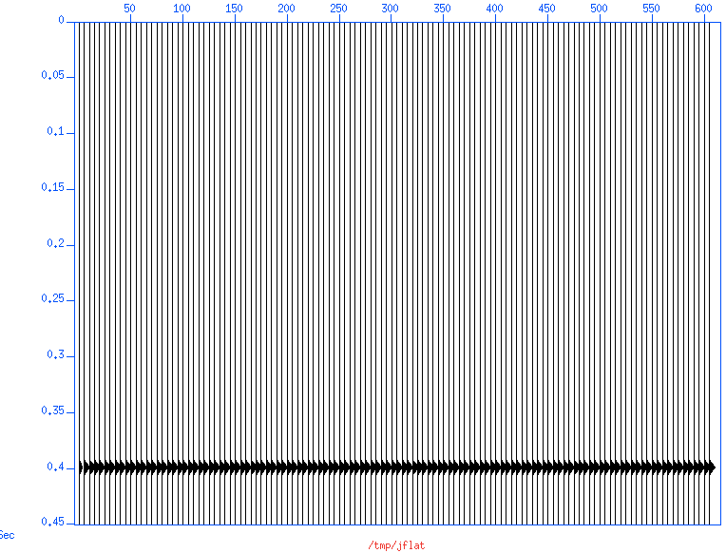
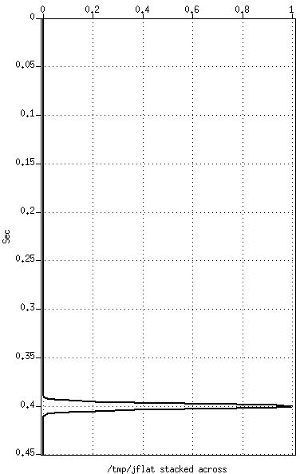
Flat event and its stack—Time Domain

Slide 2
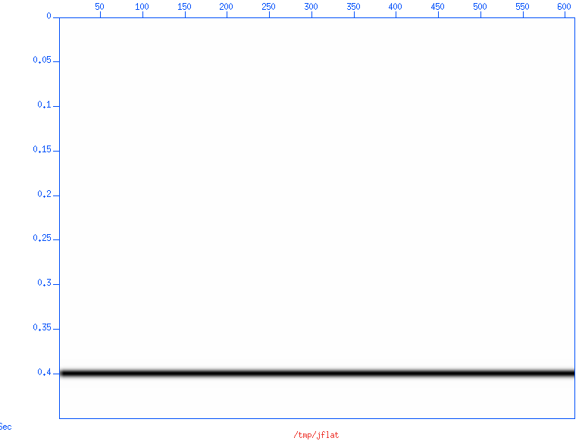
Flat event and its stack—Time Domain

Slide 3
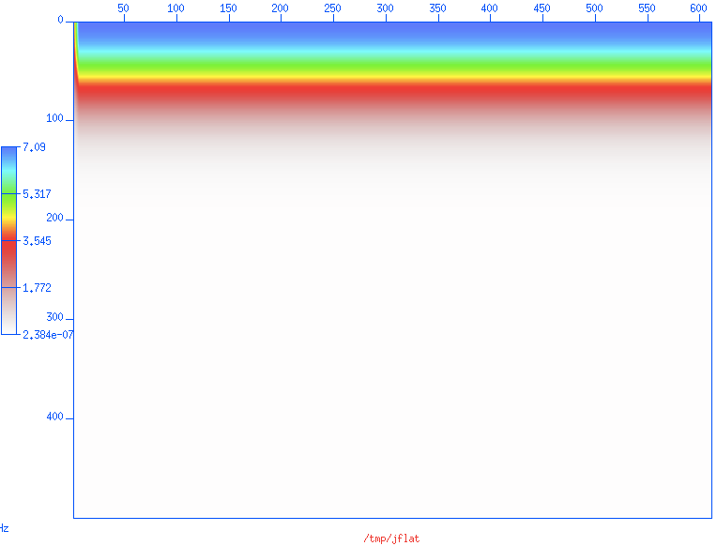
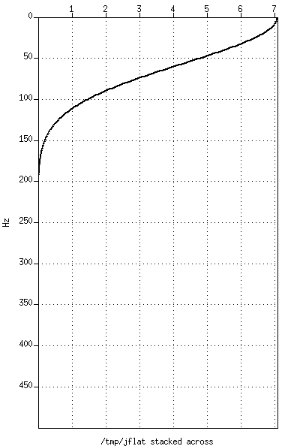
Flat event and its stack—Spectra

Slide 4
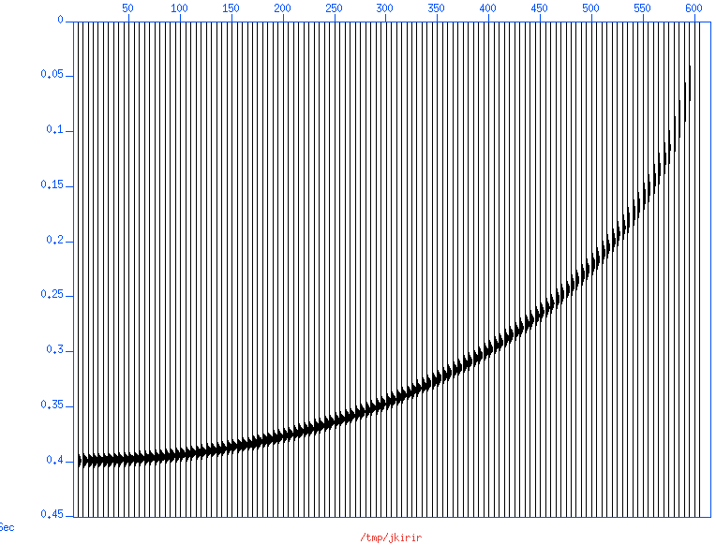
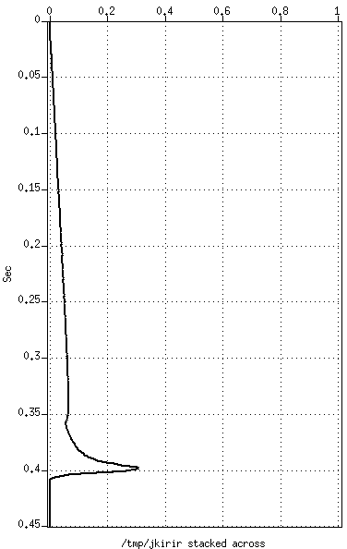
Flat event NMO-ed and stacked—Time Domain
Sunmo default sscale=1

Slide 5
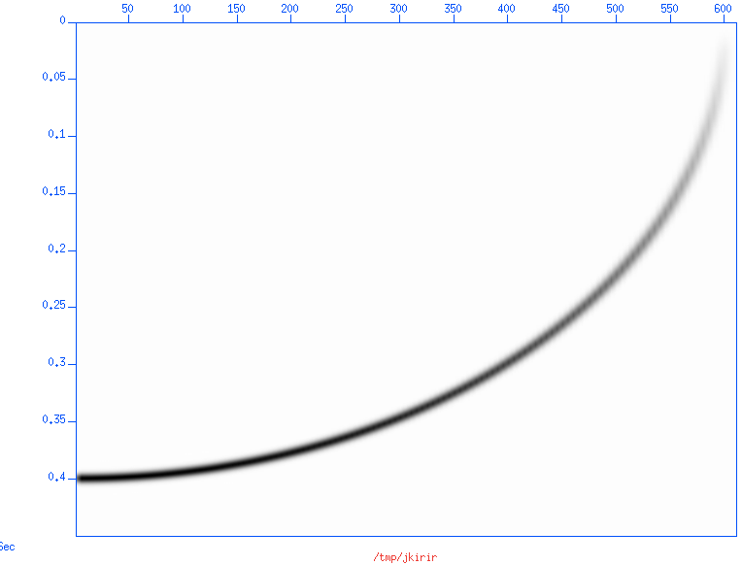
Flat event NMO-ed and stacked—Time Domain
Sunmo default sscale=1

Slide 6
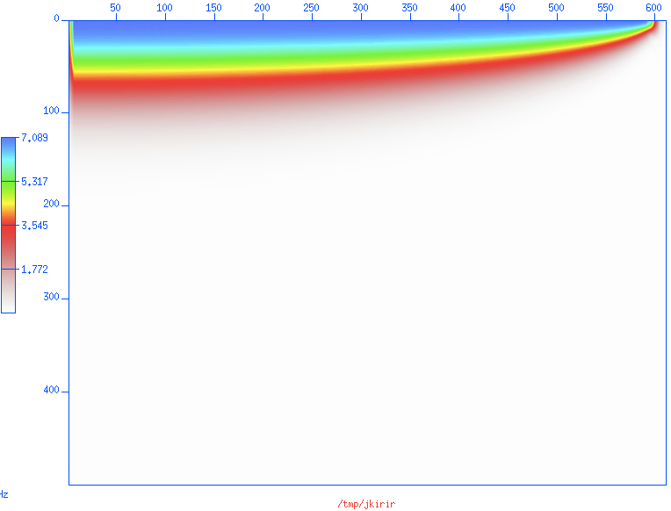
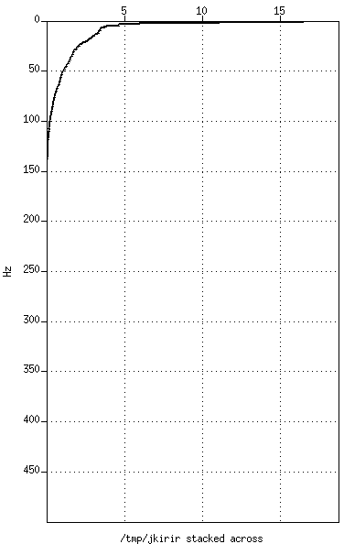
Flat event NMO-ed and stacked—Spectra
Sunmo default sscale=1

Slide 7
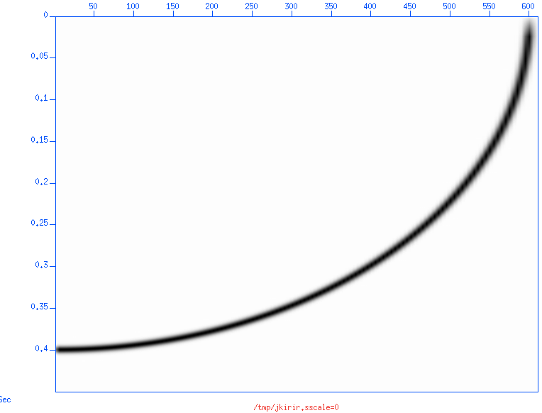
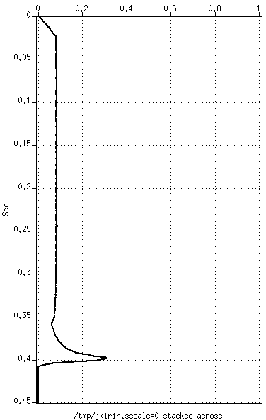
Flat event NMO-ed and stacked—Time Domain
Sunmo sscale=0

Slide 8
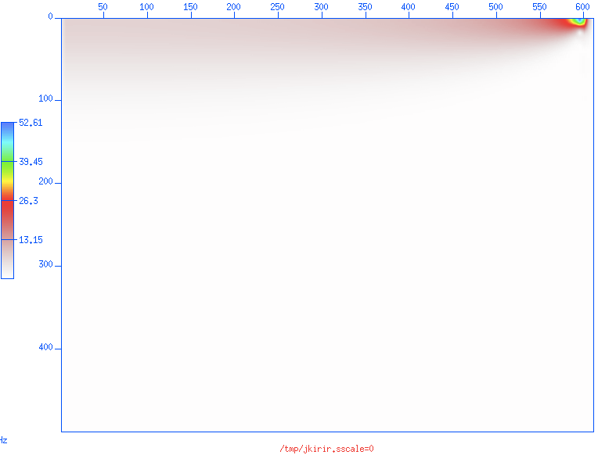
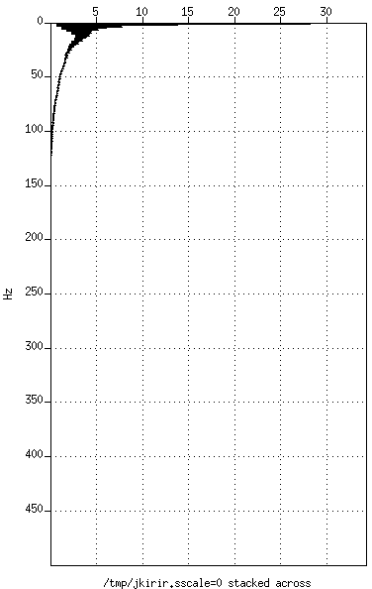
Flat event NMO-ed and stacked—Spectra
Sunmo sscale=0

Slide 9
Kirchhoff methods
Kirchhoff summation migration may have a difficulty with broadband wavelets that are not bandlimited on the low side—that is DC content
  This is because summation through an event that contains DC will give a non zero result even when the summation curve is not tangent to the event
Norm Bleistein (personal communication. 1987):
  The solution is a derivative (in 3D) or a half-derivative (in 2D) as part of the Kirchhoff summation operator

Slide 10
Does FK migration have the same problem?
It is certainly true that in practice seismic data is always bandlimited and never has a DC component
However, inability to migrate (synthetic) data with DC seems to be a Kirchhoff problem
FK methods such as Gazdag’s phase shift seem to be okay with DC, at least in theory

Slide 11
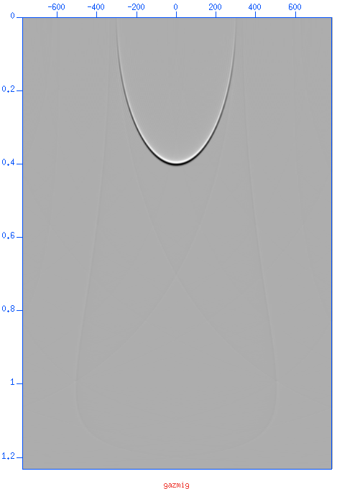
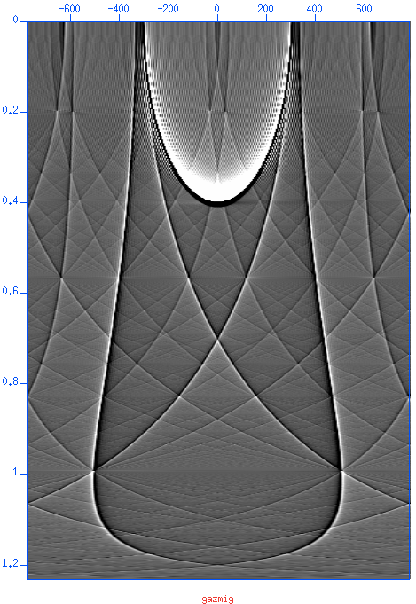
Output impulse response: artifacts
The same impulse response plotted (by suximage) with perc=98 shows interesting artifacts that are low amplitude

Slide 12
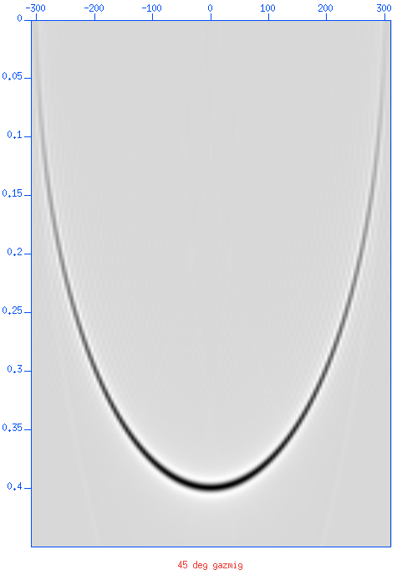
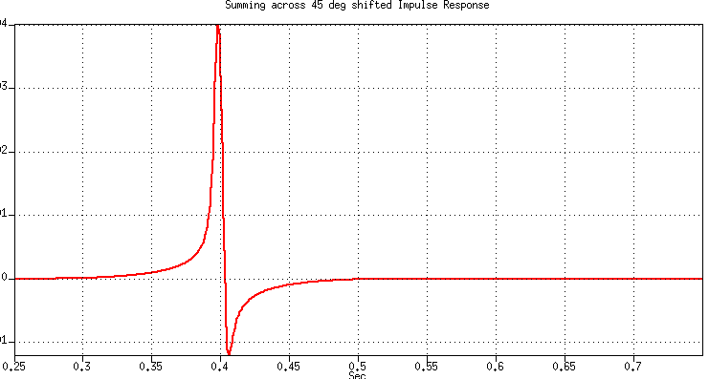
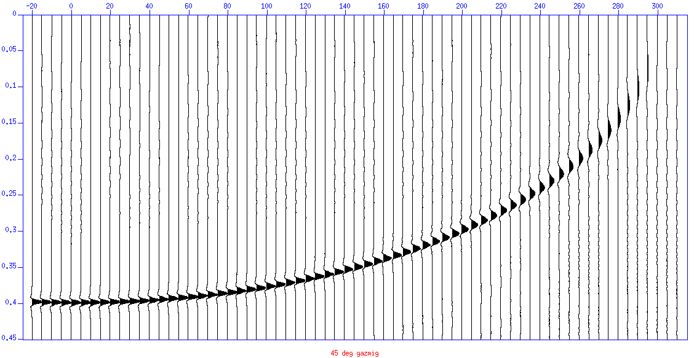
Impulse & flat responses—45º phase rotation
But now the flat event response has 45º phase!
After 45º phase rotation, the impulse response is zero phase

Slide 13
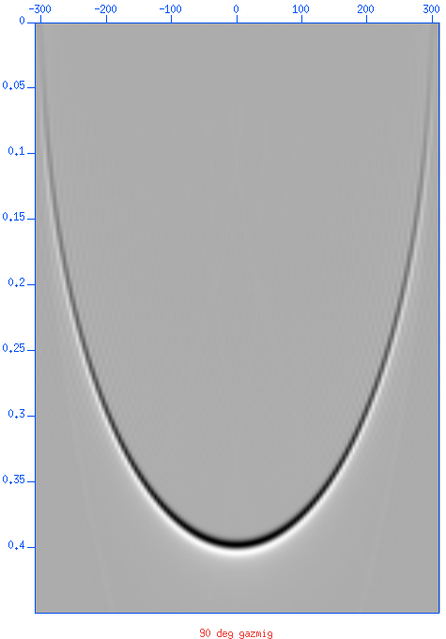
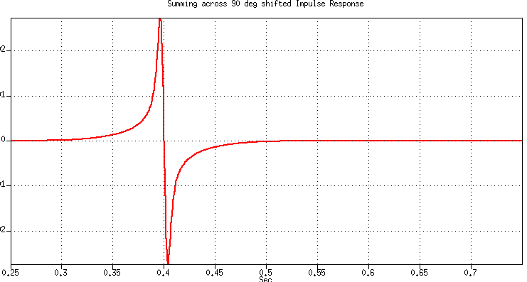

Impulse/flat responses—90º phase rotation
Now they are 45º and 90º off

Slide 14
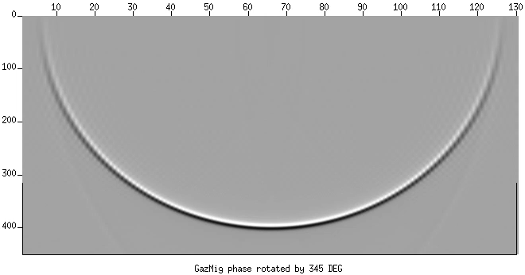
Phase rotation movie

Slide 15
Summary of the Gazdag tests
Curiously the impulse response has more artefacts
  Maybe FFT wrap-around?
The impulse response has have a 45º phase!
Flat event response:
  Zero-phase Full-band spikes
  If we rotate the phase of the IR, then the flat event response’s phase is off (of course)
Bottom line
  The Kirchhoff operator should have 45º phase

