Slide 1
Broadband Processing and Imaging:
Retaining low frequencies in migration

Slide 2
Low frequency signal is a challenge
Sources that produce low frequency waves are larger and require more energy than high frequency sources
Receivers have evolved to record what sources produce
  Receivers are not the limiting factor. However, low frequency receiver challenges: instrument noise, omni-tilt
Source and receiver ghosts reduce low frequency signal
Ambient ocean noise is “red” (low frequency)
Retaining low frequency signal in broadband processing and imaging is a challenge

Slide 3
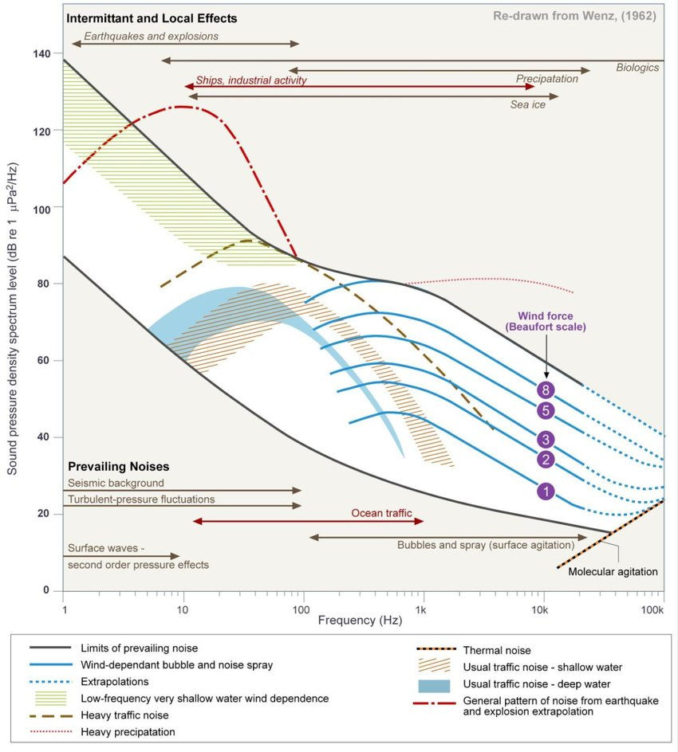
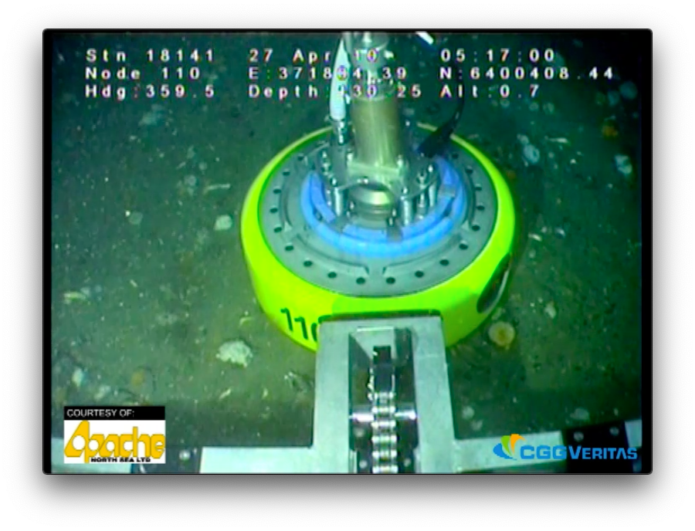
Low frequency challenges and solutions
Low frequency sources
Multi-component receivers
Ambient Ocean noise

Slide 4
Broadband processing and imaging
Low-frequency sources (big and expensive)
  And their designature
Low-frequency receivers (expensive)
  And their designature: 6-12 dB/octave and 90º-180ºphase
Deghosting is more important and can be tricky
  Surface reflection coefficient is stronger at lower frequency
  Multi-component helps
Imaging: must not lose or damage the low frequency signal when we migrate

Slide 5
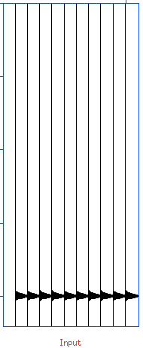
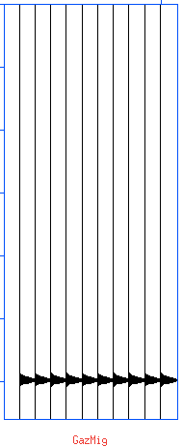
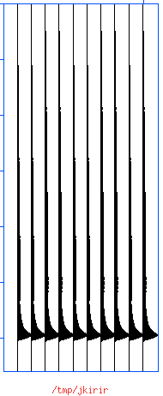
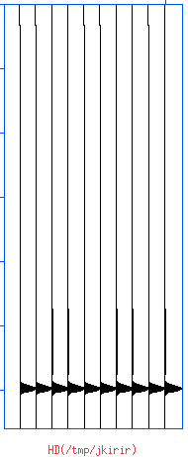
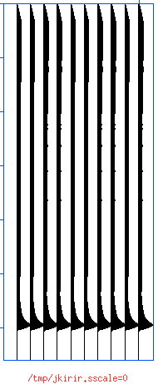
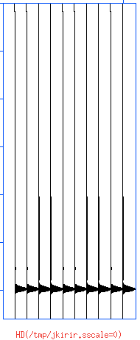
Spoiler Alert
Input Flat Event | Fourier Migration | 2D Kirchhoff Migration
 |  |  |  | No Half-diff | Half-Diff
Kirchhoff migration programs have problems in imaging low frequency signal without artifacts
Why it is important
How these problems can be solved
Explore the low frequency limits of migration
Signal down to 0 Hz
No Problems
Yes Problem
Problem solved

Slide 6
History of Migration
Kirchhoff methods (late 1960s... CSM, 1978-80s)
  NMO-Stacking had been in use as summation over hyperbolas in the offset direction
  In the mid-point direction it became Kirchhoff Migration
Finite Differencing methods: Claerbout (early 1970s)
Fourier Transform methods: Gazdag, Stolt (late 1970s)
Reverse Time Migration (early 1980s)
Least Squares Migration (Theory: late 1980s)
Joint primary and multiple imaging (2000s)
In practice High Performance Parallel Computing

Slide 7
Do we care about Kirchhoff?
For some time (2D) we did not care because Finite-Differencing and Fourier methods do not have this problem
However, when we started doing 3D, Kirchhoff methods came back in great force
Even now, with WEM, Reverse Time, FWI, and LSMig, Kirchhoff is important, because
  “Fast track” processing (next iteration after “brute-stack”)
  Iterative velocity model building
  LSMig can be done well with Kirchhoff (not exclusive)
  Irregular acquisition geometry

Slide 8
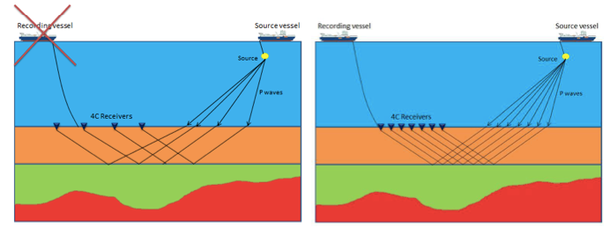
2D: approximately regular surveys
Marine (streamers)
Land
Data(Sht,Rcv,Time)
3D
Migration
&
Stacking
Ocean Bottom (also Marine)
OBN (nodes)
OBC (cables)
Image(x,z)
2D

Slide 9
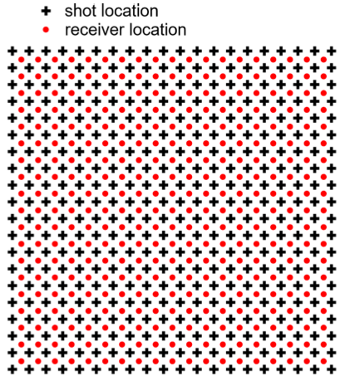
Ideal 3D seismic survey
3D seismic survey is 5D data
3D Image(x,y,z)
5D Data(Shot, Receiver, Time)
  Shot(x,y) and Receiver(x,y)
  For VSP and Cross well, the data are 7D with Shot(x,y,z) and Receiver(x,y,z)
We can’t have fully sampled 5D data. At best 3D subsets.
Long, PGS

Slide 10
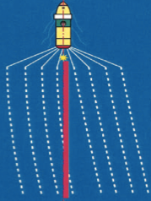
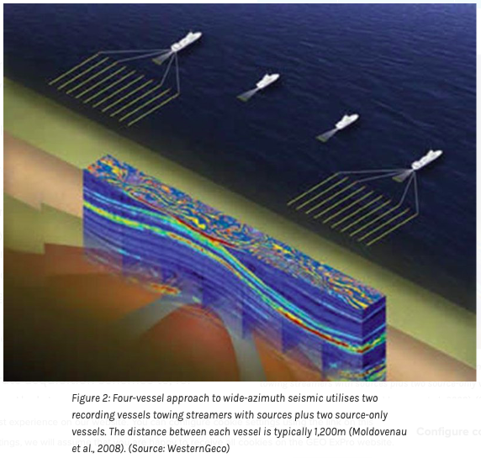
Towed Streamers
The 5D data are a collection of 3D gathers
Very well sampled in Time
Very well sampled in the Receiver_{x} direction
Well sampled in the Shot_{x} direction
Poorly sampled in the Receiver_{y} direction
Very Poorly sampled in the Shot_{y} direction
And there is feathering which is a nuisance but it helps with the poor cross-line Y coverage
Fontana, Polarcus
Robertson et al, 2016. GeoExPro

Slide 11
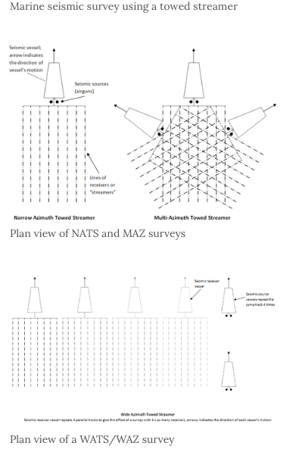
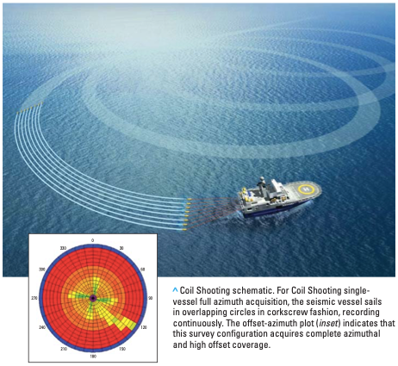
Wide Azimuth Towed Streamers
Narrow Azimuth (NATS)
Multi Azimuth (MAZ)
Wide Azimuth (WATS)
Full Azimuth (FAZ)
− Pretentious
These help with wide azimuth for better sub-surface coverage under salt, but do not provide regular geometry
Robertson et al, 2016. GeoExPro
Coil (Western Geco)

Slide 12
Land surveys are irregular (“brick” shown here)
G. Vermeer, 2004. CSEG Recorder

Slide 13
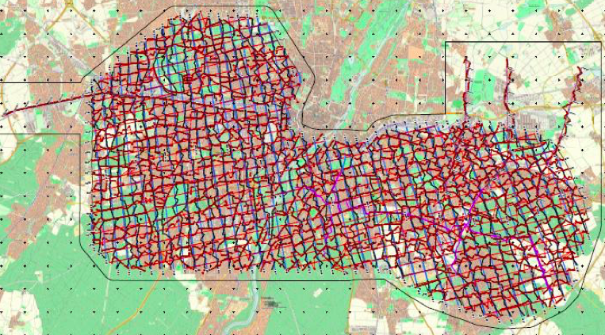
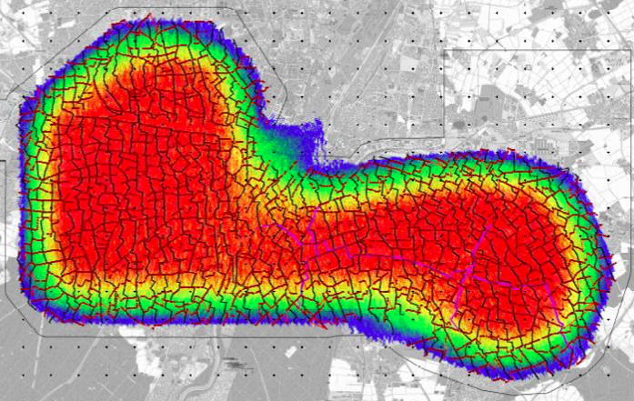
Land surveys are irregular
Dombrowski et al, 2017. EBN Utrecht

Slide 14
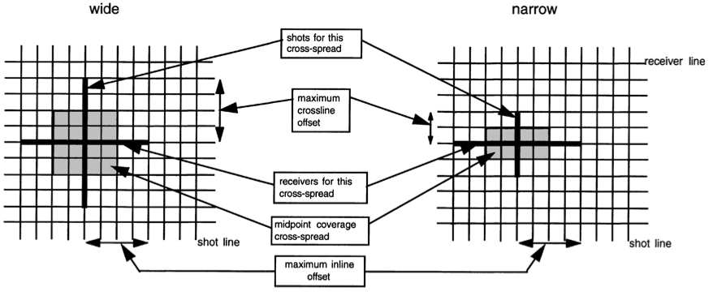
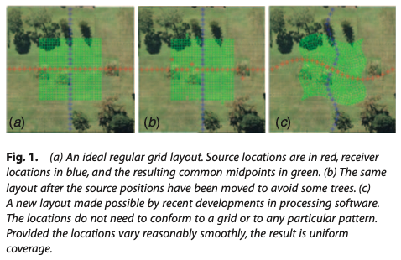
Cross-spread geometry (Time, Rcv_{x} ,Sht_{y})
The 5D data are a collection of 3D gathers
Very well sampled in Time
Very well sampled in the Receiver_{x} direction
Well sampled in the Shot_{y} direction
Poorly sampled in the Receiver_{y} direction
Very Poorly sampled in the Shot_{x} direction
There are
Irregularities on Land
Less irregularities with OBC
However, keep in mind that Cross-Spread Data(Receiver_{x},Shot_{y} ,Time) is not a wavefield from a physical experiment
Vermeer, 1998. Geophysics
Tim Dean, 2012. Preview

Slide 15
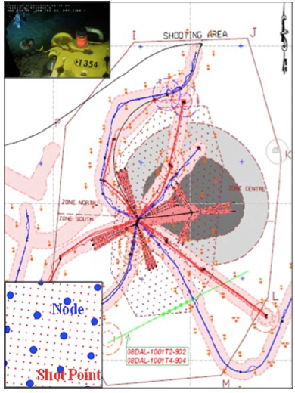
Ocean Bottom Nodes (Time, Shot_{x} ,Shot_{y})
Dense shot carpet
Sparse nodes
Common Receiver Gather (3D subset)
  Well sampled in Time
  Well sampled in Shot_{x}
  Well sampled in Shot_{y}
  Poorly sampled in Receiver_{x}
  Poorly sampled in Receiver_{y}
  Slightly randomized shot X and Y
  Obstructions: holes in the shot carpet
  Using reciprocity the CRGs are a wavefield from a physical experiment!
Hardouin et al, EAGE 2011

Slide 16
Compressive sensing
Intentional random geometry
Less sampling (spatial aliasing) artifacts
To understand why we need to go through LSM (=Least Square Migration, but it could be L1M, etc.)
And keep in mind that matrices with random numbers are “well conditioned”. They are often invertible. Moreover, their transpose is often a good approximation to their inverse.

Slide 17
Do we care about Kirchhoff? YES
Irregular geometry motivating Kirchhoff
Streamer data: feathering
Land data: irregular (brick worse than cross-spread)
OBC: regular cross spread data but not a wavefield
OBN: holes in the shot carpet due to obstructions and slight irregularities in shot post-plot positions
Compressive sensing: intentional irregularities

Slide 18
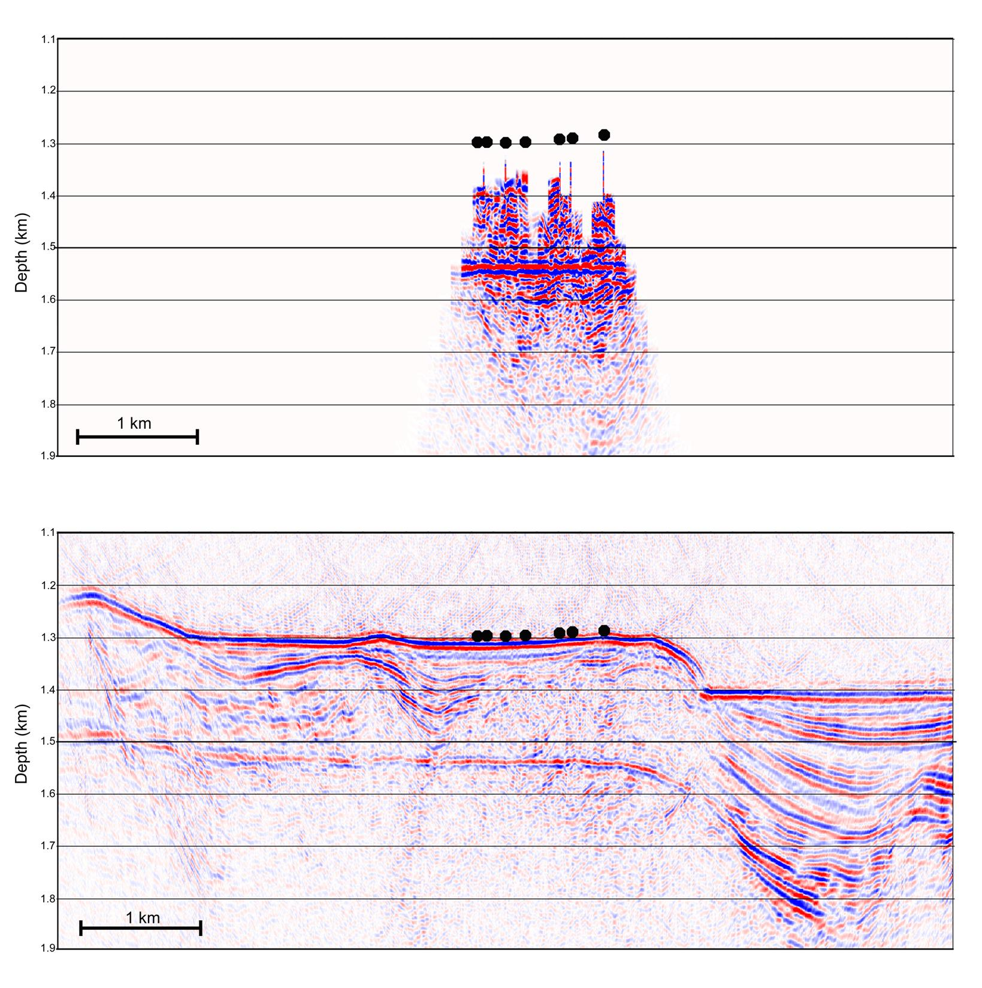
Cascadia data example
Up Kirchhoff
Up LSRTM
Down Kirchhoff
Down LSRTM
Thanks to University of Victoria and VeritasDGC
Joint LSRTM

Slide 19
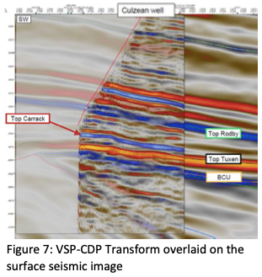
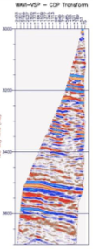
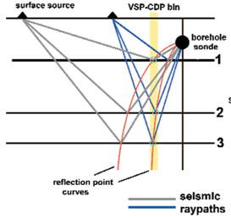
VSP imaging is almost always Kirchhoff
Far offset
Near offset
https://csegrecorder.com/articles/view/vsp-for-the-interpreter-processor-for-2001-and-beyond-part-1
https://www.sercel.com/products/Lists/ProductPublication/Reducing%20Drilling%20Risk%20on%20Culzean%20using%20WAVI-VSP_Oct2019.pdf

Slide 20
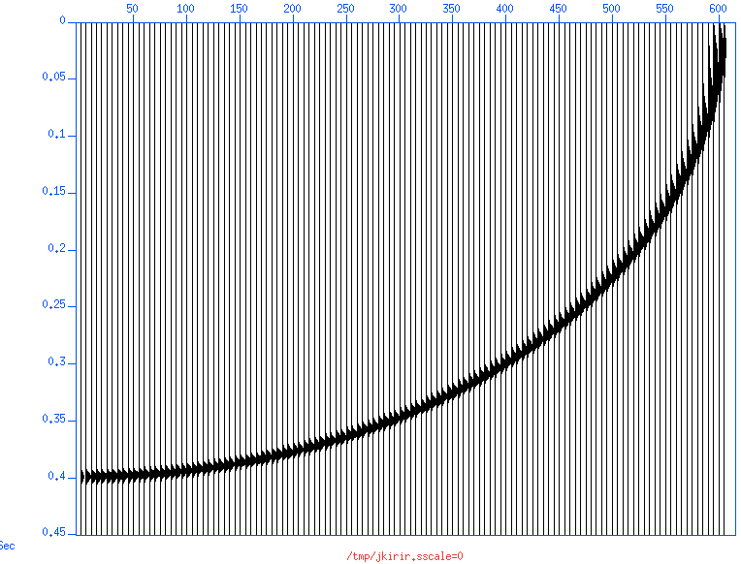
Impulse response of simple Kirchhoff

Slide 21
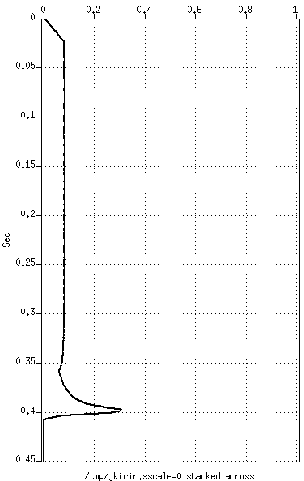
Flat event response of simple Kirchhoff
This precursor is not good
This is good
Sum across to calculate the flat event response

Slide 22
Retaining low frequency in migration
Kirchhoff methods produced a low frequency precursor
  It can be attenuated by low-cut filtering. BUT …
  Broadband processing: stay away from low-cut filters!
Questions:
  Is this an inherent problem for all migration methods?
  Do we care (about Kirchhoff)?
  What is the best solution?

Slide 23
1. Gazdag method: DC okay in theory
No problem at ω=0
  Downward continuation step
  When ω is zero, so are k_{x} and k_{z}
  (When ω=0, k_{z} is imaginary if k_{x} is not zero and real)

Slide 24
1. Gazdag method: in practice
Let’s migrate some synthetic data with DC
We looked at migration impulse responses
Used the Gazdag method implemented on SU
  http://sepwww.stanford.edu/oldsep/cliner/files/suhelp/sugazmig.txt
Following slides
  I show the impulses and their responses
  And I summed across to get flat event responses

Slide 25
Bandlimited wavelet: High-cut but no low-cut
Chose to generate a Gaussian wavelet
  No low-cut, only hi-cut
Sampling interval Δt = 1 millisecond
Gaussian width = 4 milliseconds
  High cut approximately at 125 Hz

Slide 26
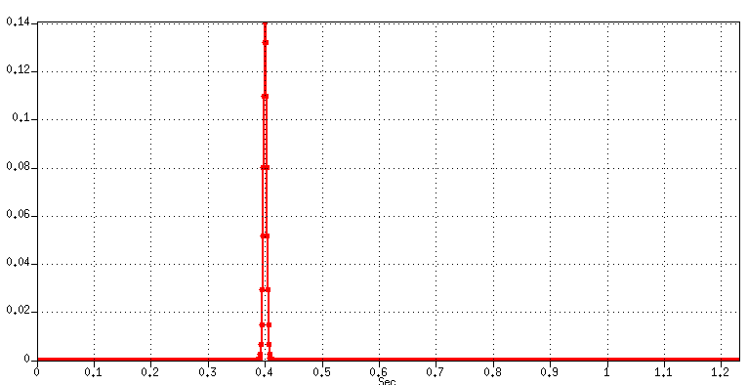
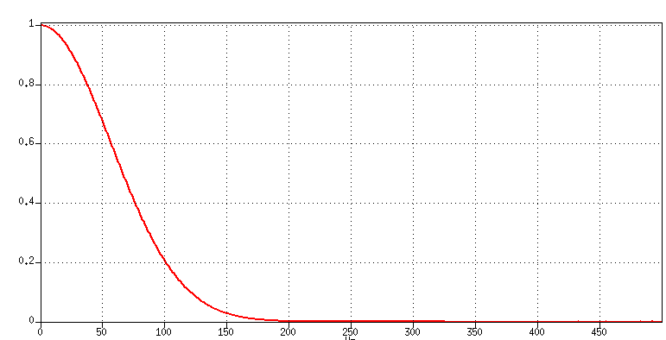
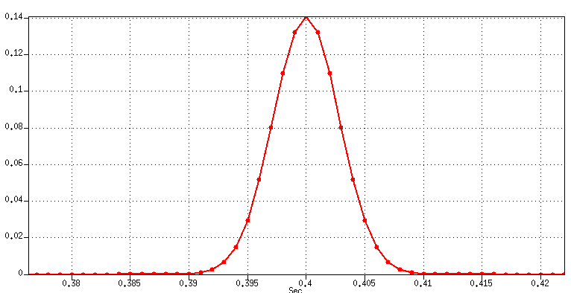
Gaussian wavelet
Frequency domain spectrum
Time domain
Time domain
No low frequency limit!

Slide 27
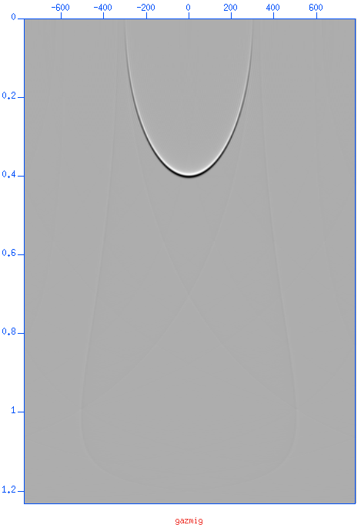
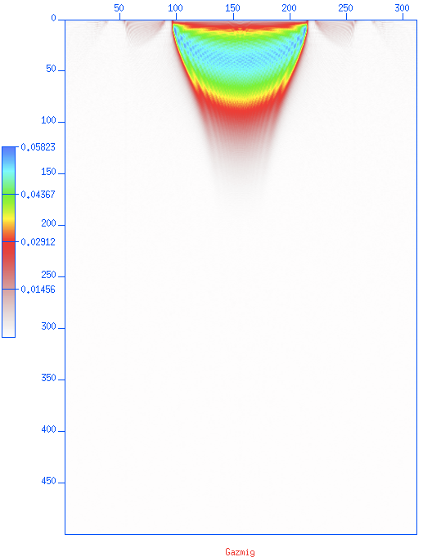
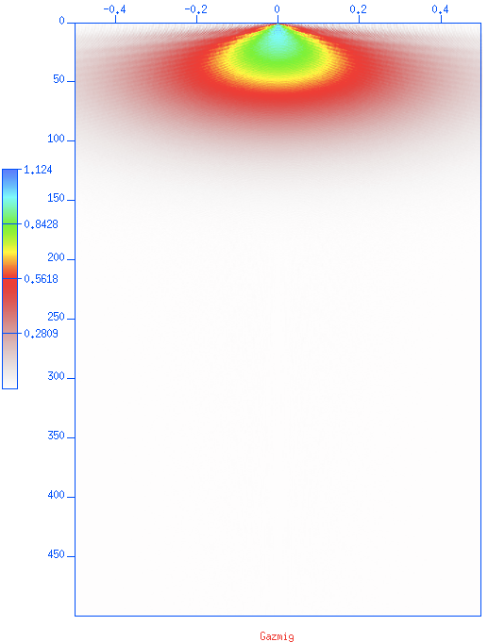
Migration impulse response
T-X
F-X
F-K

Slide 28
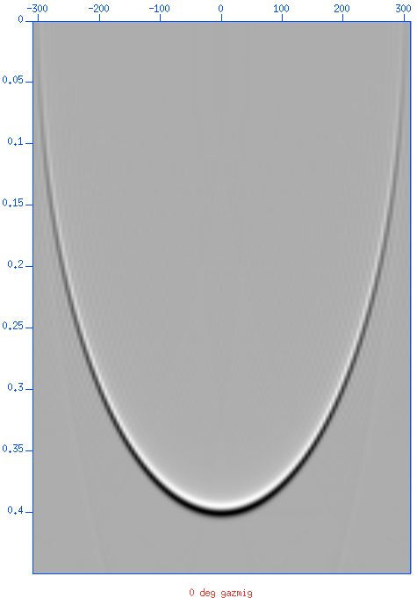
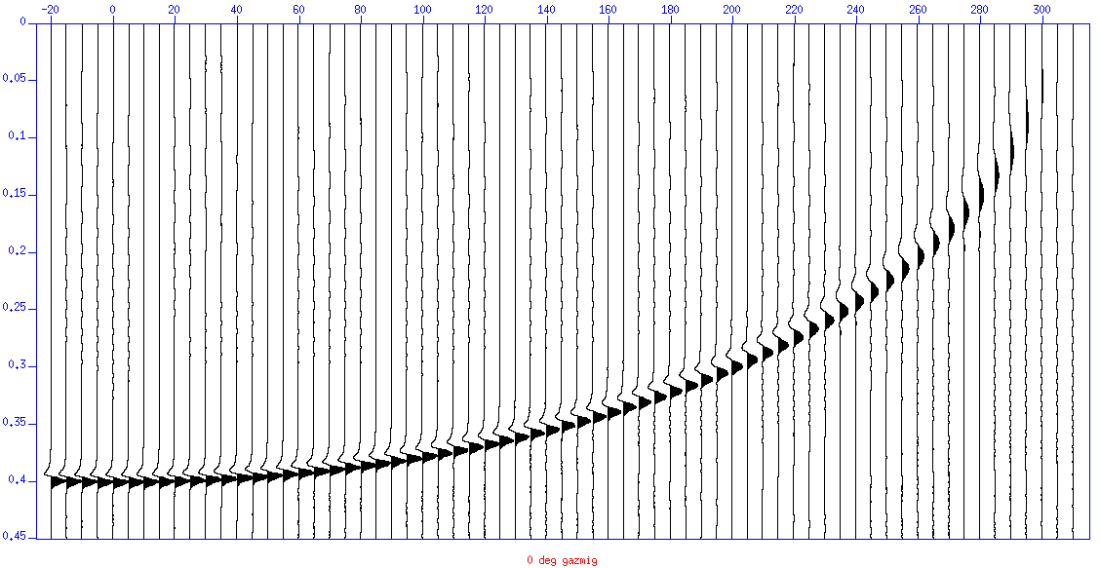
Migration impulse response
Migration impulse response is not zero phase!

Slide 29
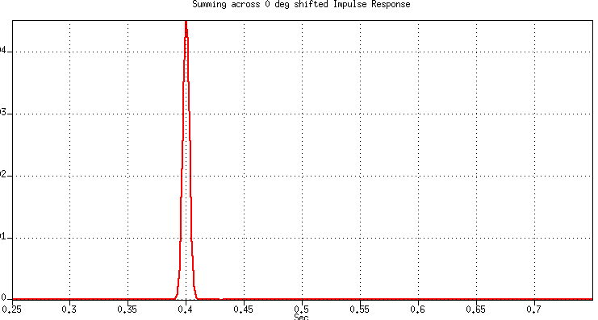
Impulse response → flat event response
Perfect zero-phase
Flat event response
Sum across to calculate the flat event response
zero

Slide 30
Summary so far
Gazdag’s phase shift does not have any problem with low frequency signal
  Down to zero frequency!
Simple Kirchhoff does have a problem
  (Without following Bleistein’s advice)
Two remaining questions
  Do we care?
  Better solution than low-cut?
Gazdag
Kirchhoff

Slide 31
2. Better solution than arbitrary low cut?
Norm Bleistein (1987 and before): “You need a derivative (in 3D Kichhoff) or a half-derivative (in 2D Kirchhoff)”
We could calculate the Green function of Gazdag (stationary phase)
Alternative method for the analysis
  Numerically calculate a flat even response of simple Kirchhoff, without any low-cut, and then with half/full diff
  We’ll do it for 3 frequencies
  Limit the migration aperture
  2D and 3D

Slide 32
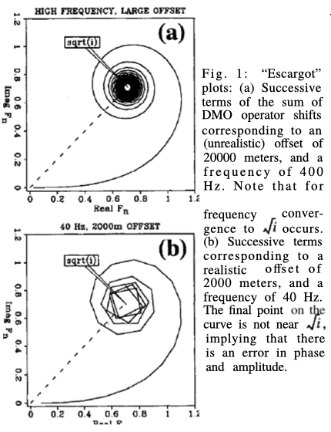
Flat event response
To calculate a flat event response of a Kirchhoff migration
  Sum migration impulse response over x, just like we did for Gazdag
  But this time: frequency domain Kirchhoff. That is (ω,x) domain
  1996 paper https://doi.org/10.1190/1.1887374 (which was for Kirchhoff DMO)

Slide 33
Kirchhoff PULL
Foreach image point (x,z)
Output(x,z) = SUM_{l} Input[l,t(x-l,z)]
(x,z) is the image point
SUM_{l} is summation over l
t() is the hyperbola
(vt()/2)² = z² + (x-l)²
(l,z=0)
(x,z)

Slide 34
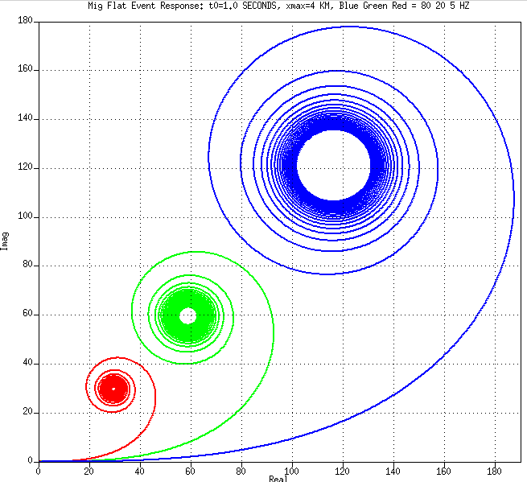
Results—4km aperture, t₀=1 seconds
Observations
Low frequency: no convergence
Half integral
  Low frequencies scaled up
  “High” frequencies converge to points almost exactly on the sqrt(i) line → 45 degree phase
  There is a factor 2 scale in amplitude for every factor 4 in frequency → 1/sqrt(ω)
  Hence: 1/sqrt(iω) → half integral!
  →we need a Half derivative to prevent the half integral
5 Hz
20 Hz
80 Hz

Slide 35
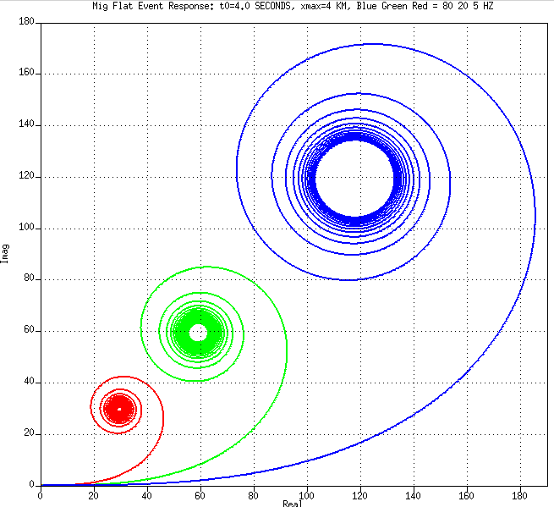
Results—4km aperture, t₀=4 seconds
Observations
Almost exactly as t₀=1
There is a dependency on frequency but less so on t₀−convergence depends on wt₀ >>1)
5 Hz
20 Hz
80 Hz

Slide 36
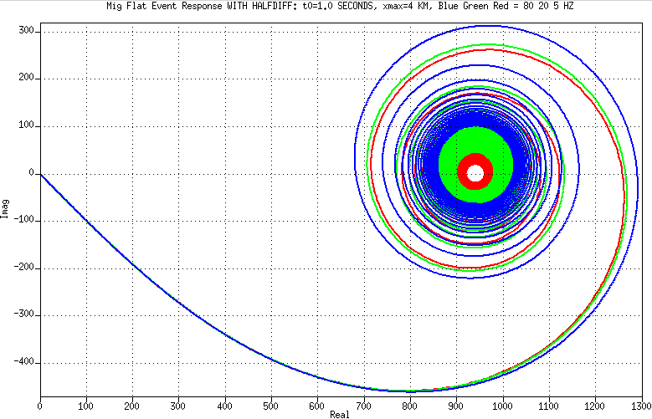
Results with half derivative option on, t₀=1
Observations
20Hz and 80Hz converge to about the same point very near the real axis
Slightly off
Why? Bug? Or high frequency approximation? because 80Hz is better than 20 Hz
Low frequencies need long aperture and time to converge
5 Hz
20 Hz
80 Hz

Slide 37
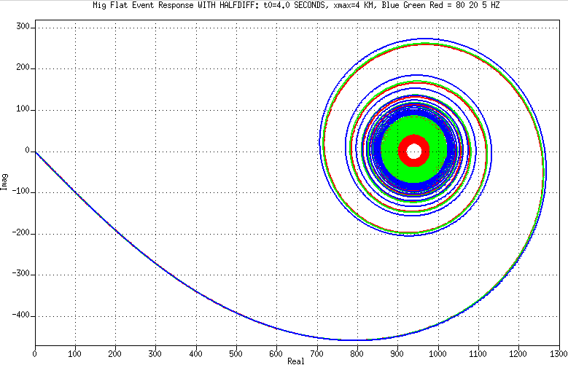
Results with half derivative option on, t₀=4
Observations
20Hz and 80Hz converge to about the same point very near the real axis)
Less error than t0=1 because wt₀ is four times larger, so high frequency approximation is better
Low frequencies need long aperture and time to converge
5 Hz
20 Hz
80 Hz

Slide 38
Summary of the last bit (the spirals)
Putting a half derivative term in a Kirchhoff migration is needed (Norm Bleistein was right)
Without a half derivative term, the results have a half-integral error
  Which can be corrected by half derivative post migration
In 3D it would be a full derivative because 3D can be done by two orthogonal passes of 2D
  The post 3D Kirchhoff migration correction would be a full derivative
Not sure about the following minor issues
  The Jacobian: dropping it does not make a substantial difference except that without it convergence is a bit faster (minor effect, bumped to “spare-slides”)
  Converging to (950, almost 0) instead of converging to (1,0) because I didn’t normalize by the number of traces in the aperture

Slide 39
Now let’s try to apply half derivative
Half derivative is simple in the frequency domain but tricky in the time domain
Implemented a finite differencing half-diff based on Taylor series of sqrt(1-Z)
Found that we need an anti-causal half derivative.
  Causal half-derivative made things worse

Slide 40
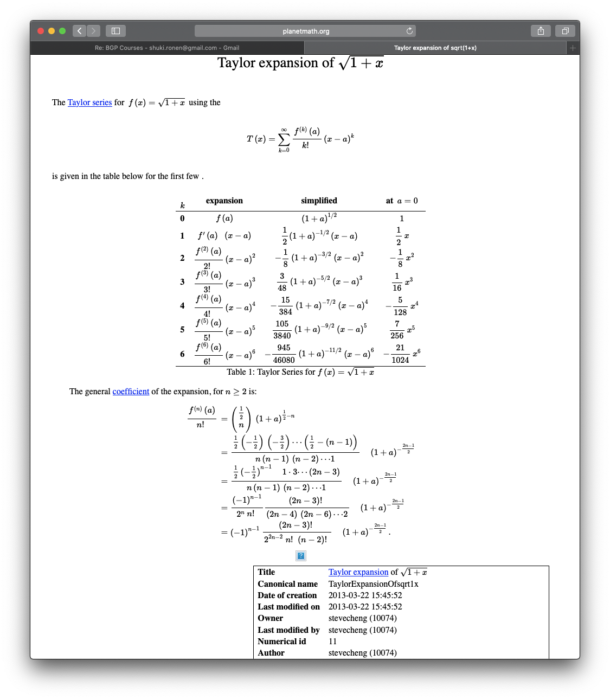
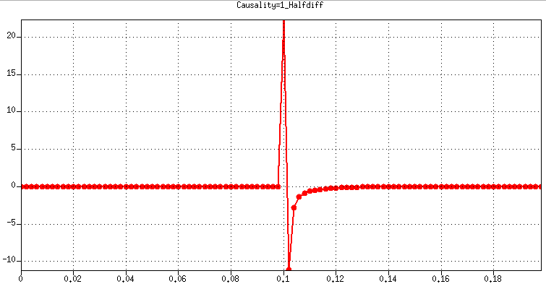
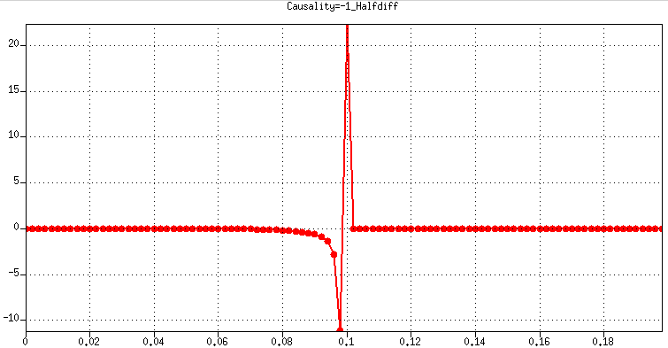
Taylor series: sqrt(1-Z) = sqrt(1+x) (x=-Z)
Causal
Minimum-phase
Anti-Causal
Maximum-phase
https://planetmath.org/TaylorExpansionOfsqrt1x

Slide 41
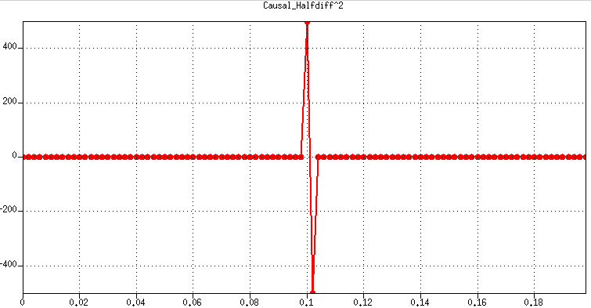
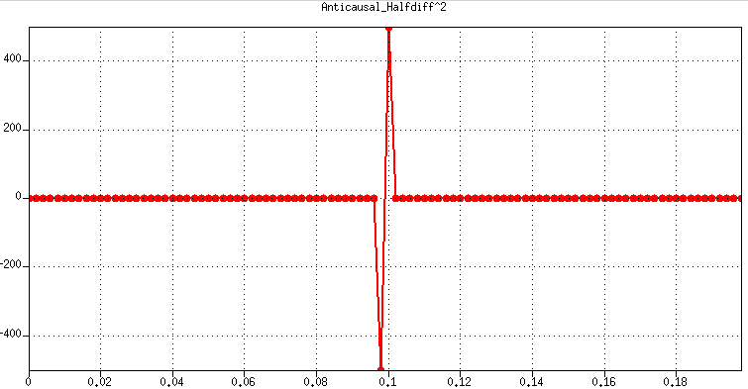
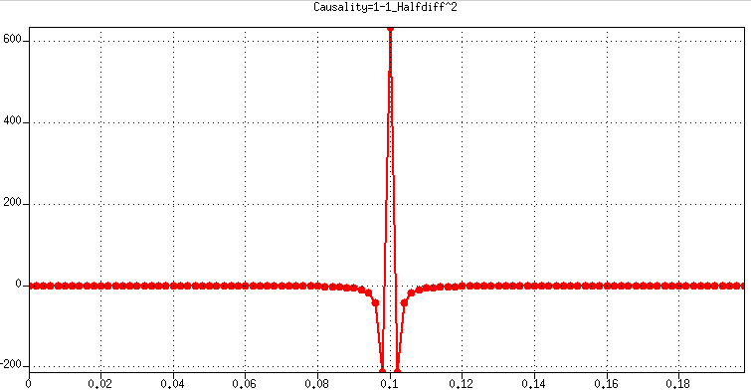

Testing the half-derivative program
Applying causal half derivative twice gives a causal full derivative
Applying anti-causal half derivative twice gives an anti-causal full derivative
Time
Time
Impulse response of an anti-causal half derivative after a causal half derivative
Impulse response of a causal half derivative after an anti-causal half derivative
Time
Time

Slide 42
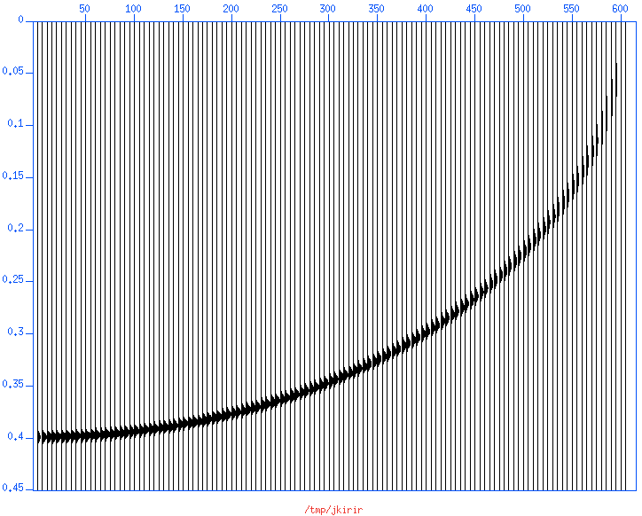
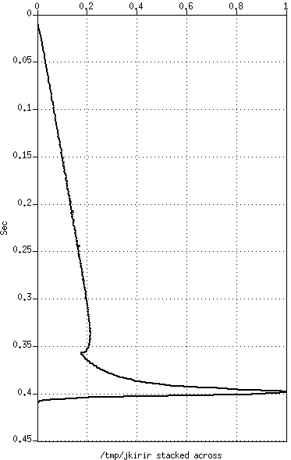
No Half Diff—Not good
Poor-man’s Kirchhoff Impulse Response using NMO
No Half Diff
Summing across to get a Flat Event Response

Slide 43
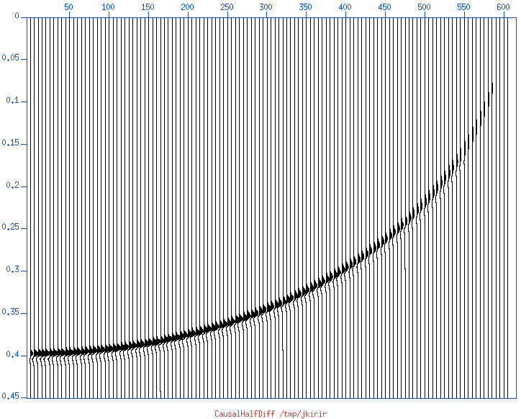
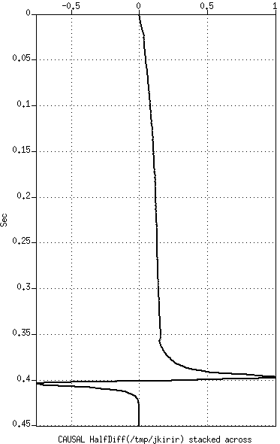
Causal Half Diff—even worse!
Poor-man’s Kirchhoff Impulse Response using NMO
Causal Half Diff
Summing across to get a Flat Event Response

Slide 44
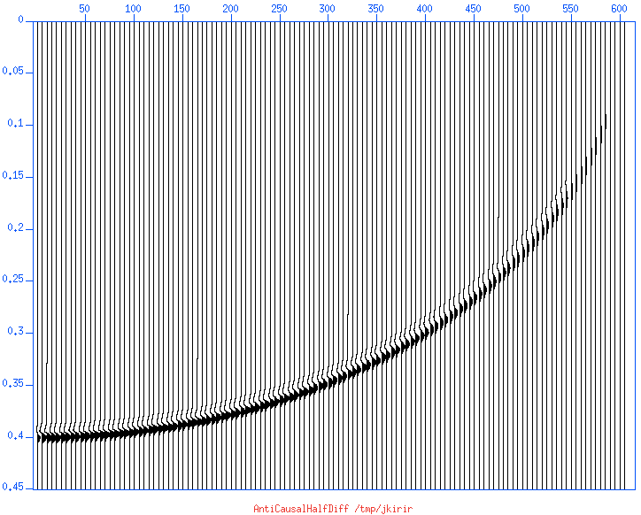

Anti-causal Half Diff—pretty good
Poor-man’s Kirchhoff Impulse Response using NMO
Anti-Causal Half Diff
Summing across to get a Flat Event Response

Slide 45

Comparing the three outputs
The red, which is no half diff has what looks like an anti-causal half integral
The green which is the causal Half Diff is the worst: approximately 45º+45º !
The blue, which is the anti-causal half diff is good
  Not exactly… probably poor approximation of finite differencing half derivative

Slide 46
3D
In 3D, Kirchhoff theory predicts a need for a full time derivative
We will test it with a 3D poor-man’s-Kirchhoff-using—NMO-of-a-flat plane
We will stack across the semispherical impulse response to get the flat event response
  With and without full derivative

Slide 47


1/8th of a sphere (migration impulse response)
Vertical slices movie
Time slices movie

Slide 48




3D Flat event response (sunmo default sscale=1)
Just sum across IR
Sum IR after diff
Sum IR after diff
and flip sign
Sum IR before diff
and flip sign

Slide 49




Flat event responses (sscale=0 in sunmo)
Just sum across IR
Sum IR after diff
Sum IR after diff
and flip sign
Sum IR before diff
and flip sign
Perfect!

Slide 50
Summary so far—significant problem ~solved
Input Flat Event | Gazdag Migration | Kirchhoff Migration
 |  | sscale on |  | sscale off
 |  | Raw | Half Diff | Raw | Half Diff
Perfect!
Good!
Good!

Slide 51
Low frequency imaging
Velocity model building such as FWI benefits from low frequency signal
  Avoiding local minima (“cycle skips”) in fitting the data
Imaging low frequencies should also benefit
  Sub-salt/Sub-basalt/Blocky reservoir model building
But it seems like imaging has a low frequency limit!
  In Kirchhoff there is a stationary phase approximation and a zero divided by zero implied by correcting/pre-empting a half integral by a half derivative: sqrt(iω) / (1/sqrt(iω)
  FK and FD migration methods will also have a problem with very low frequencies for any shallow reflector that is not flat

Slide 52

Spiral plots for Ultra Low Frequency
With maximum migration aperture of 4km they do not converge at 0.5 Hz
With up to 4 km aperture, we will not be able to image 1Hz even if we had 1Hz sources and receivers
0.5 Hz
1 Hz
2 Hz

Slide 53

Spiral plots for Ultra Low Frequency
With 40 km aperture they converge better
We can image 1 Hz signal if had
  Ultra low frequency sources and receivers
  Ultra long offset
  And are willing to tolerate or fix incomplete convergence
0.5 Hz
1 Hz
2 Hz

Slide 54
Summary
3D Kirchhoff migration requires a time differentiator
  A differentiator is very simple: D(Z) = 1 – Z
  The only slight complication is that it should be anti-causal (if not, the sign is reversed)
  It’s better applied prestack
2D is much more difficult: we need a half differentiator
  A half differentiator is difficult in the time domain (and what would be the causality in the frequency domain?
  It must be anti-causal (if not, it’s a mess)

Slide 55
Appendix: Why all those half-derivatives?
Take the Gazdag phase shift formula, and Fourier transform k_{x} → x (2-D), (k_{x}, k_{y}) → (x, y) (3-D) …. NOT EASY!
This produces “Kirchhoff-Helmholtz” formula (ask any DELPHI student): d/dz (Green’s function).
Downward extrapolate using Kirchhoff-Helmholtz produces sqrt ( iω ) (2-D) or iω (3-D) – these are “high-frequency” limits.

Slide 56
Appendix: Why all those half-derivatives?
Multiply by an extra sqrt ( iω ) to produce iω (2-D), or iω to produce ( iω )^2 (3-D)…. HUH?? We’ll see why.
Integrate across x (2-D) or (x, y) (3-D): 2-D integration produces 1 / ( iω ), 3-D integration produces 1 / ( iω )^2.
BINGO! Image wavelet is the same as input wavelet! Step 4 did the job, same as in slide #31.

Slide 57
Spare slides
Simple Kirchhoff with NMO code
Spiral code
Do we need the Jacobian?
Do we need spherical spreading?
Other snails

Slide 58
Kirchhoff PUSH simulated with NMO
<$gauss sugain qbal=1 scale=0.5 > $flat
@ x = $dx
while ($x < $xmax)
<$gauss sugain qbal=1 | sushw key=offset a=$x >> $flat
@ x += $dx
end
<$flat sunmo smute=1e9 >$kirir
<$flat sunmo smute=1e9 sscale=0 >$kirir.sscale=0
foreach f ($flat $kirir $kirir.sscale=0)
<$f $XWIGB title=$f label1=Sec $X1END &; sleep 1
<$f $XIMAG title=$f label1=Sec $X1END &; sleep 1
<$f sufft | suamp | $XIMAG title=$f label1=Sec legend=1 cmap=hsv8 verbose=1 &; sleep 1
<$f sustack | $XGRAP title="$f stacked across" &; sleep 1
<$f surange
sleep 2
end

Slide 59
Spare slides
Simple Kirchhoff with NMO code
Spiral code
Do we need the Jacobian?
Do we need spherical spreading?
Other snails

Slide 60
Code (reproduced 2020) —comments
/*
This programs follows this 1996 paper: Dealiasing DMO: Good‐pass, bad‐pass, and unconstrained. Ronen, Nichols, Bale, and Ferber
https://doi.org/10.1190/1.1887374
https://library.seg.org/doi/abs/10.1190/1.1887374
The 1996 paper did it for (Kirchhoff) DMO. This program is for (Kirchhoff) Migration. Post stack or Zero Offset Migration
The idea is to calculate a flat event response.
The program sums over a diffraction hyperbola from a point (x0,z0) to a surface point (x,z=0)
t(t0,x0,x) = sqrt (t0^2 + (2*(x-x0)/v)^2
where t0 = 2/v*z0
In General the Kirchhoff integral would be Image(z0,x0) = integral dx C(x) Data(t(t0,x-x0),x)
Because we calibrate a flat event, we can set x0=0 Image(z) = integral dx C(x) Data(t(t0),x)
t(t0,x) = sqrt (t0^2 + (2*x/v)^2
C() is a an operator which is expected to contain a scalar times a half derivative. What we know about C() is that it contains spherical spreading and a Jacobian because the integration is over the hyperbola and not over the horizontal x. For the Jacobian we need dt/dx
t^2 = t0^2 + (2/v)^2 * x^2
2*t*dt = (2/v)^2 * 2*x*dx
dt/dx = (x/t) * (2/v)^2
dl^2 = dt^2 + dx^2
Jacobian = dl/dx = sqrt(1+(x/t*(2/v)^2)^2)
We can do the above in the frequency domain
Image(kz) = integral dx C(x) exp(i*w*t(t0,x) * Data(w,x)
We expect that if we know C() the results would be
Image(z) = delta(z-z0)
Image(kz) = exp(i*kz*z0)
If we don't know C() then the output would be
Image(kz) = C(kz) * exp(i*kz*z0)
We are not interested in exp(i*kz*z0). Only in C() which is complex. We expect sqrt(iw)
*/

Slide 61
Code—before the integration
int main(int ac, char **av)
{
int i, verbose=1, nx=10001;
double f; FGETPAR(1,f,40.0);
double t0; FGETPAR(2,t0,1.0);
double xmax; FGETPAR(3,xmax,12000.0);
int halfdiff; IGETPAR(4,halfdiff,0);
double xmin = 0.0; double v = 1500.0; double dx = (xmax-xmin)/(nx-1);
double w = 2*M_PI*f; // M_PI is defined by <math.h>
double vh = v/2.0; double ovh = 1.0/vh; double z0 = t0*vh; double t0t0 = t0*t0;
if(verbose) {
if(ac==1) fprintf(stderr, "Example:\n%s [freq_in_Hz t0_in_secs xmax halfdiff]\n",av[0]); // Selfdoc
fprintf(stderr,"f=%g w=%g v=%g t0=%g z0=%g nx=%d xmin=%g xmax=%g dx=%g\n",
f,w,v,t0,z0,nx,xmin,xmax,dx);
}
double re = 0.0;
double im = 0.0;
printf("%g %g\n",re,im); // We want the starting point

Slide 62
Code—loop over x
82 for(i=0;i<nx;i++) {
83 double x = xmin + i*dx;
84 double xovh = x/vh;
85 double t = sqrt(t0t0 + xovh*xovh);
86 double jac = sqrt(1.0+xovh*xovh/t/t);
87 double dre = cos(w*(t-t0));
88 double dim = sin(w*(t-t0));
89 if(i==0) { dre *= 0.5; dim *= 0.5; } // We are summing only on positive x
90
91 // Jacobian: Integral dl = jac * dx
92 dre *= jac*dx;
93 dim *= jac*dx;
94
95 // Spherical spreading 1/sqrt(time) in 2D
96 dre /= sqrt(t);
97 dim /= sqrt(t);
98
99 re += dre;
100 im += dim;
101
102 if(halfdiff) printf("%g %g\n",(re+im)*sqrt(w/2),(im-re)*sqrt(w/2));
103 else printf("%g %g\n",re,im);
104 }

Slide 63
Spare slides
Simple Kirchhoff with NMO code
Spiral code
Do we need the Jacobian?
Do we need spherical spreading?
Other snails

Slide 64
Default: Jacobian=YES
Observations
This is the same as one of the previous slides
5 Hz
20 Hz
80 Hz

Slide 65

Jacobian=NO
Observations
Convergence is a bit faster
No big difference—hardly noticeable except the overall scale
5 Hz
20 Hz
80 Hz

Slide 66
Spare slides
Do we need the Jacobian?
Do we need spherical spreading?
  Compare tpow = 1, 0.5 (=default), 0, -1, -4

Slide 67

tpow=1
Observations
Slightly faster convergence
5 Hz
20 Hz
80 Hz

Slide 68
Default: tpow=0.5
Observations
This is the same as two of the previous slides
5 Hz
20 Hz
80 Hz

Slide 69

tpow=0
Observations
Slightly slower convergence
5 Hz
20 Hz
80 Hz

Slide 70

tpow=-1
Observations
Slower convergence
But it still converges—at least down to 5 Hz
5 Hz
20 Hz
80 Hz

Slide 71

tpow=-4
Observations
Low frequency does not converge
High frequencies converge slower
5 Hz
20 Hz
80 Hz

