Slide 1
Thoughts on CO₂ sequestration
Shuki Ronen
June, 2020

Slide 2
Assumptions
We will reduce carbon emissions to reduce global warming
Renewables are s l o w l y replacing fossil fuels
There will be a business model to sequester CO₂
The Oil industry can do it
  Oil companies own the wells and the surface facilities over depleted reservoirs
  Oil companies have the people and processes to manage big projects and risk
  Service companies have the people and the technology to actually do it
  Oilfield service companies can drill and inject it
  Geophysical companies can monitor it
There will be public scrutiny to monitor and verify that
  The CO₂ is not coming back to the surface and released to the atmosphere
  Environmental risks such as induced seismicity and ground water are predicted before they cause harm

Slide 3
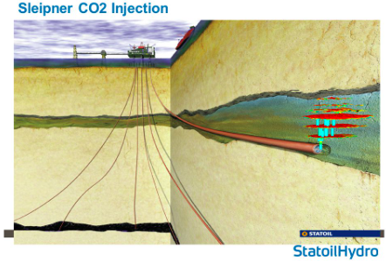
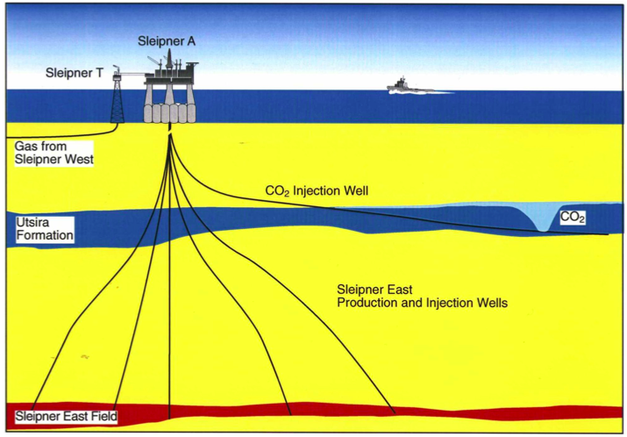
Case History: Sleipner
Offshore Norway near the UK border
StatoilHydro is now Equinor
Injection site away from the platform enabling monitoring with streamers
Specially drilled injection well
Monitored with repeated (4D) streamer surveys done by Geco
https://static.cambridge.org

Slide 4
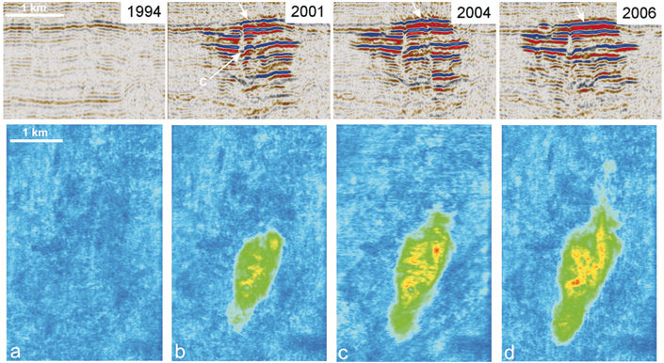
Sleipner seismic monitoring: bright spots
https://www.bgs.ac.uk/science/CO2/home.html

Slide 5
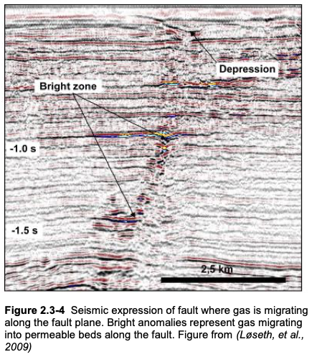
Bright Spots
Natural in-situ gas is the classic bright-spot
Gas coming through the cap rock (gas chimneys)
Gas going up faults →
Gas coming out of solution following production due to pressure drop
Gas going up wells outside the casing

Slide 6
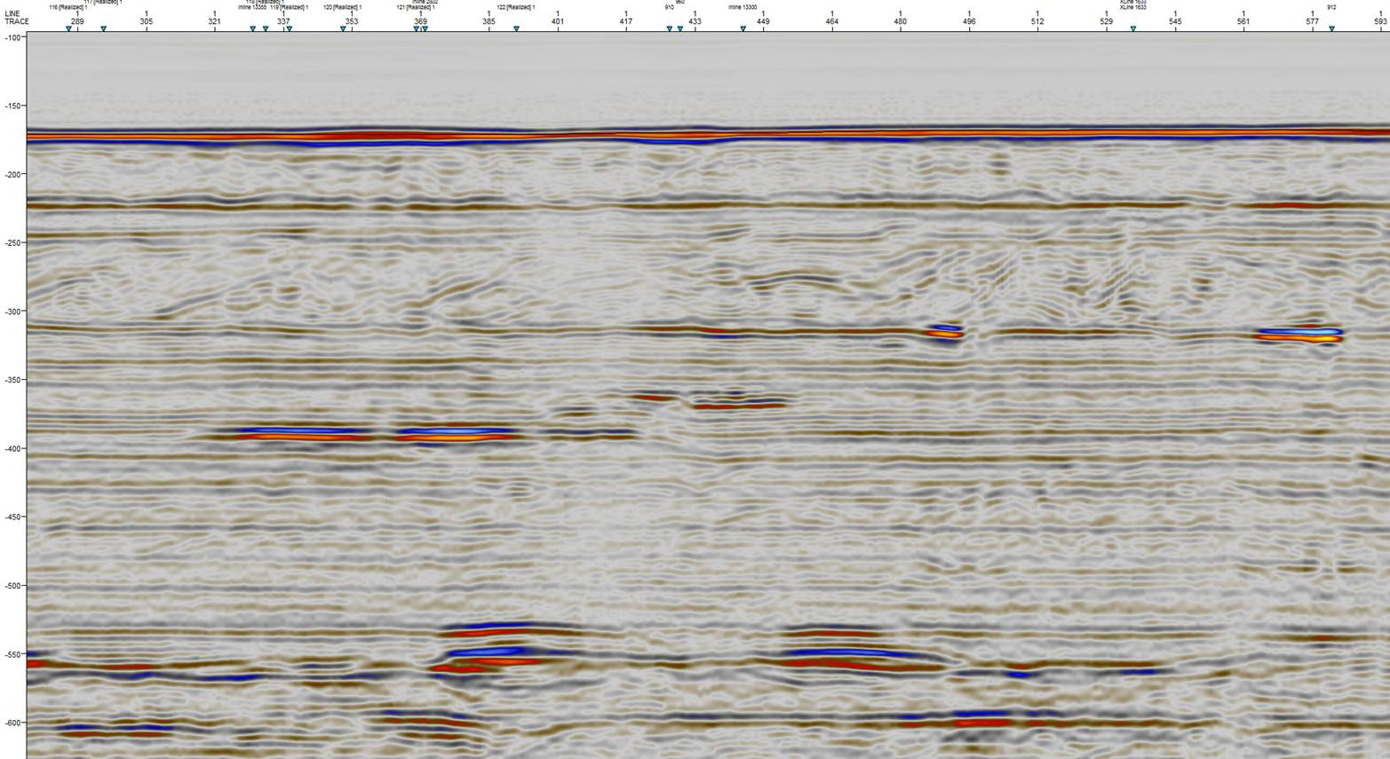
Bright spots: shallow gas
Forties field courtesy of Apache

Slide 7
Environmental risks
Fall et al, 2012
AAPG_Bulletin
96(12):2297-2318
CO₂ escaping to the surface
  through the cap rock
  along non sealing faults
  through wells outside the casings
Chemical reactions with the rock
  Long term
  May cause subsidence of facilities
  May damage the cap rock
Induced seismicity
  Due to pressure changes
https://i0.wp.com/geoera.eu

Slide 8
Reservoir choice
Depleted but not abandoned
  Good sealing cap rock / faults / salt
Characterized
  Good seismic data area
  Lots of logged wells with re-entry
  Predictive reservoir modeling
  Pipelines that can be reversed from produced crude to injected CO2
May be offshore
  on the shelf (not deep water)
http://earthsci.org

Slide 9
Schematic injection site (based on Sleipner)
https://static.cambridge.org

Slide 10
Schematic injection site (based on Sleipner)

Slide 11
Schematic injection site (based on Sleipner)
Sparse ocean bottom seismometers
Seismic monitoring well
Borehole seismometers
CO₂ sniffer well
CO₂ injector

Slide 12
Monitoring program
Deploy [semi]permanent ocean bottom seismometers
Deploy [semi]permanent borehole seismometers
Shoot a baseline shot carpet. Record data.
Perforate the sniffer well. Record data.
Inject CO₂
Continuously record ”passive” data while injecting
Shoot a repeat shot carpet (once a year or so)
Continuously monitor formation pore pressure and fluids in the sniffer well
Occasional cross-well seismic survey?
Loop back to 5

Slide 13
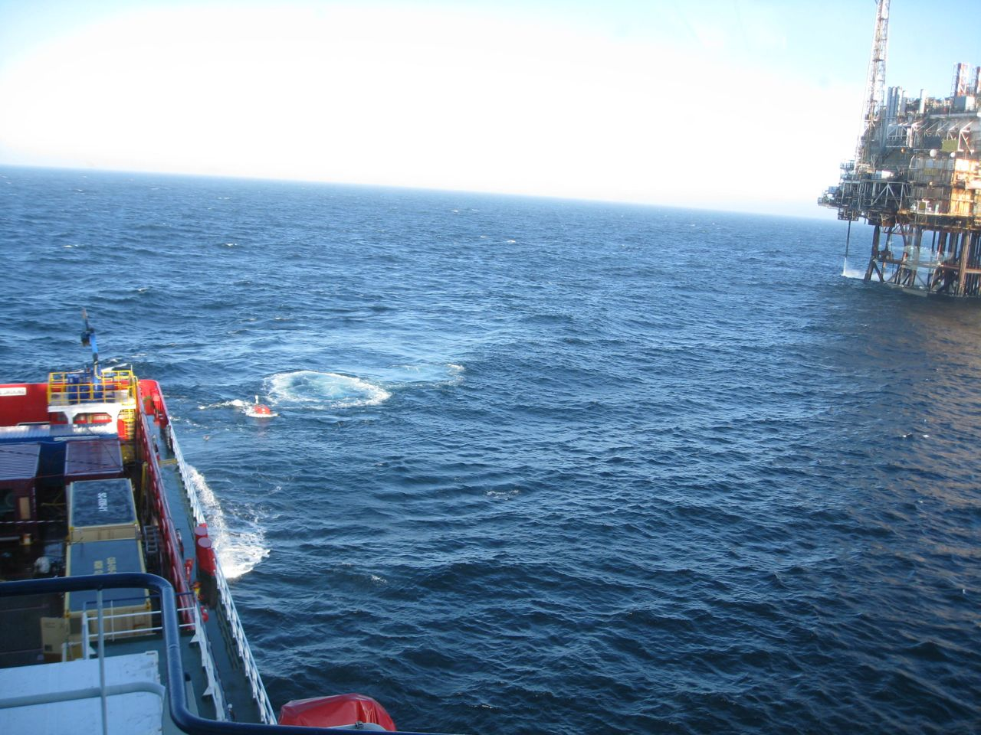
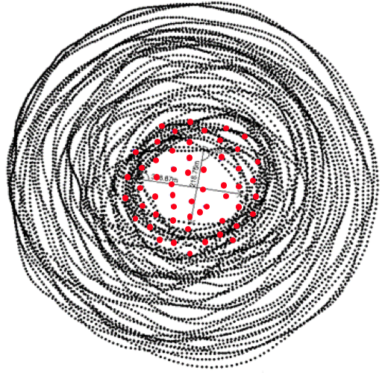
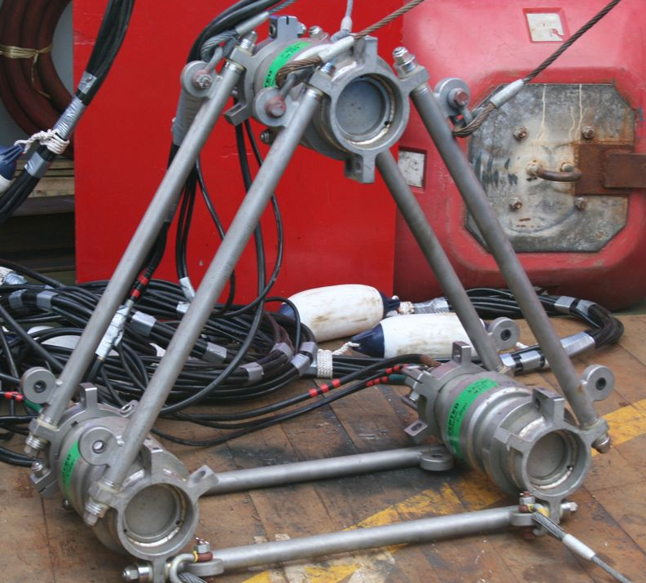
Apache Forties: spiral shot carpet, sparse nodes
• Sparse nodes • Dense shot carpet • Small source

