Slide 1
Vp and Vs (gas)
Sand
Brian Russell and Dan Hampson, CSEG Recorder December 2006. The old and the new in seismic inversion.
https://csegrecorder.com/articles/view/the-old-and-the-new-in-seismic-inversion
https://csegrecorder.com/assets/images/articles/2006-12-old-and-new-fig01.jpg

Slide 2
Density is simple

Slide 3
Vp & Vs as a function of gas saturation
porosity= 0.3
rho0 = 2500
rho1 = rho0*(1.0-porosity)
vsref = 1400
muref = rho0*vsref*vsref
lamda0 = muref*2
lamda1 = muref/2
fl = 50.0
i = 0
for i in range(n):
sg[i] = on*i
rho[i] = rho0 + (rho1-rho0)*sg[i]
lamda[i] = lamda1 + (lamda0-lamda1)*math.exp(-sg[i]*fl)
mu[i] = muref
vs[i] = math.sqrt(mu[i]/rho[i])
vp[i] = math.sqrt((lamda[i]+2*mu[i])/rho[i])
vpvsr[i] = vp[i]/vs[i]

Slide 4
Rock Physics paper on CO2 (in carbonates)
Wang, Cates, and Langan, Geophysics 1998. Seismic monitoring of a CO2 flood in a carbonate reservoir: A rock physics study. https://library.seg.org/doi/pdf/10.1190/1.1444457
Berryman, J (2009), Origins of Gassmann's equations, 2009, Geophysics
https://library.seg.org/doi/pdf/10.1190/1.1444667
https://www.osti.gov/servlets/purl/1241154.

Slide 5
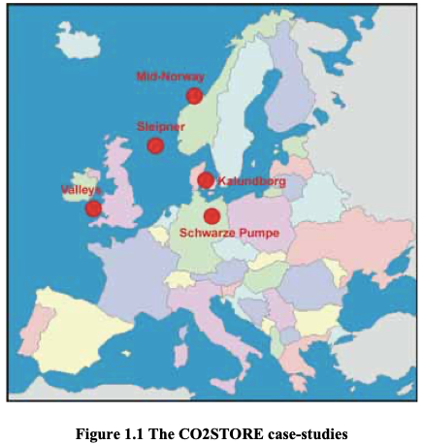
BEST PRACTICE FOR THE STORAGE OF CO2 IN SALINE AQUIFERS
Observations and guidelines from the SACS and CO2STORE projects
273 page report of EU funded CO2STORE studies 1998-2006
https://www.ngu.no/FileArchive/91/CO2STORE_BPM_final_small.pdf

Slide 6
