Slide 1
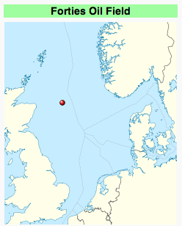
Forties Field
The Forties Oil Field is the largest oil field in the North Sea, 110 miles east of Aberdeen. It was discovered in 1970 and first produced oil in 1975 under ownership of BP.
About 5 billion barrels in place
Production from the field peaked in 1979 at 500 thousand barrels per day, and was down to just over 30 thousand barrels per day in 2003
BP sold the field to Apache in 2003

Slide 2
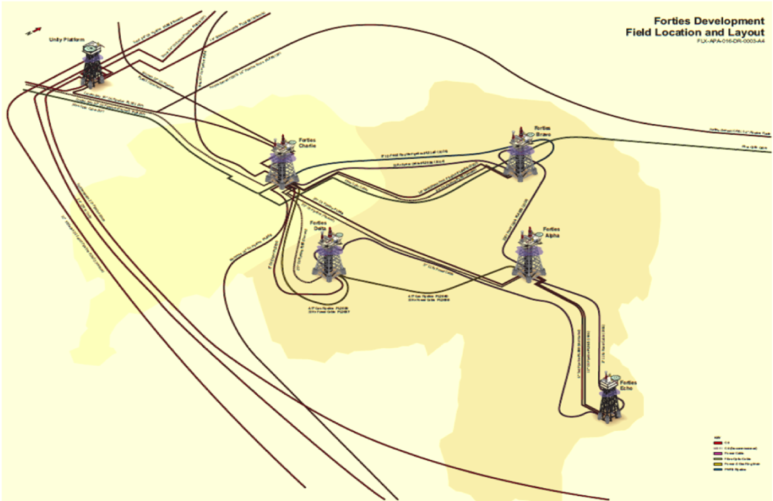
Forties Field (North Sea)
2.6 billion barrels already produced
2009 Production 73K barrels/day
Highest since 1999
Drilling hazards:
Past blowouts
Gas in overburden
Bright spots
Streamers off platforms
High Resolution 2D
Streamer 4D with platform undershoots
Node undershoots
April 2010

Slide 3
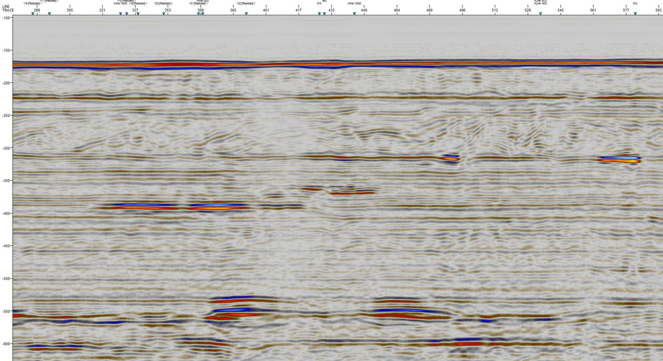
2D high resolution site survey
Risky zone is upper 500m within a radius of 100m from the platforms

Slide 4
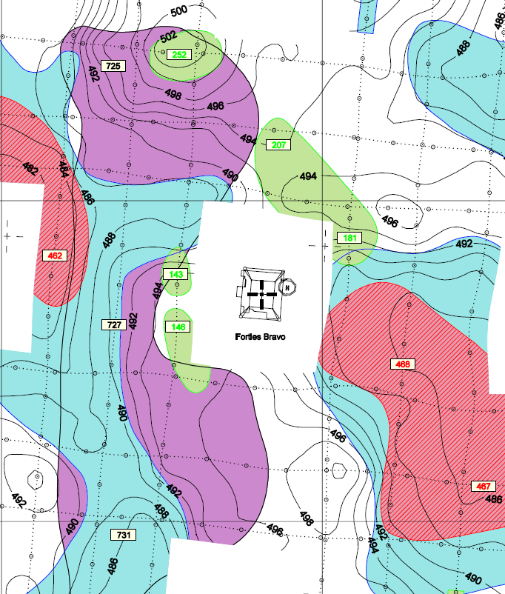
No image underneath platforms from the 2D
2D high resolution site survey
100x100m grid
But 300x300m hole around platform
Risky zone is from seabed (100m) to Basin Sands (500m) inside the no-data zone
Significant amount of drilling planned in 2nd half of 2010 and 2011
Failure to image the gas => Safety and drilling cost issues
Bravo
Bravo
200m

Slide 5
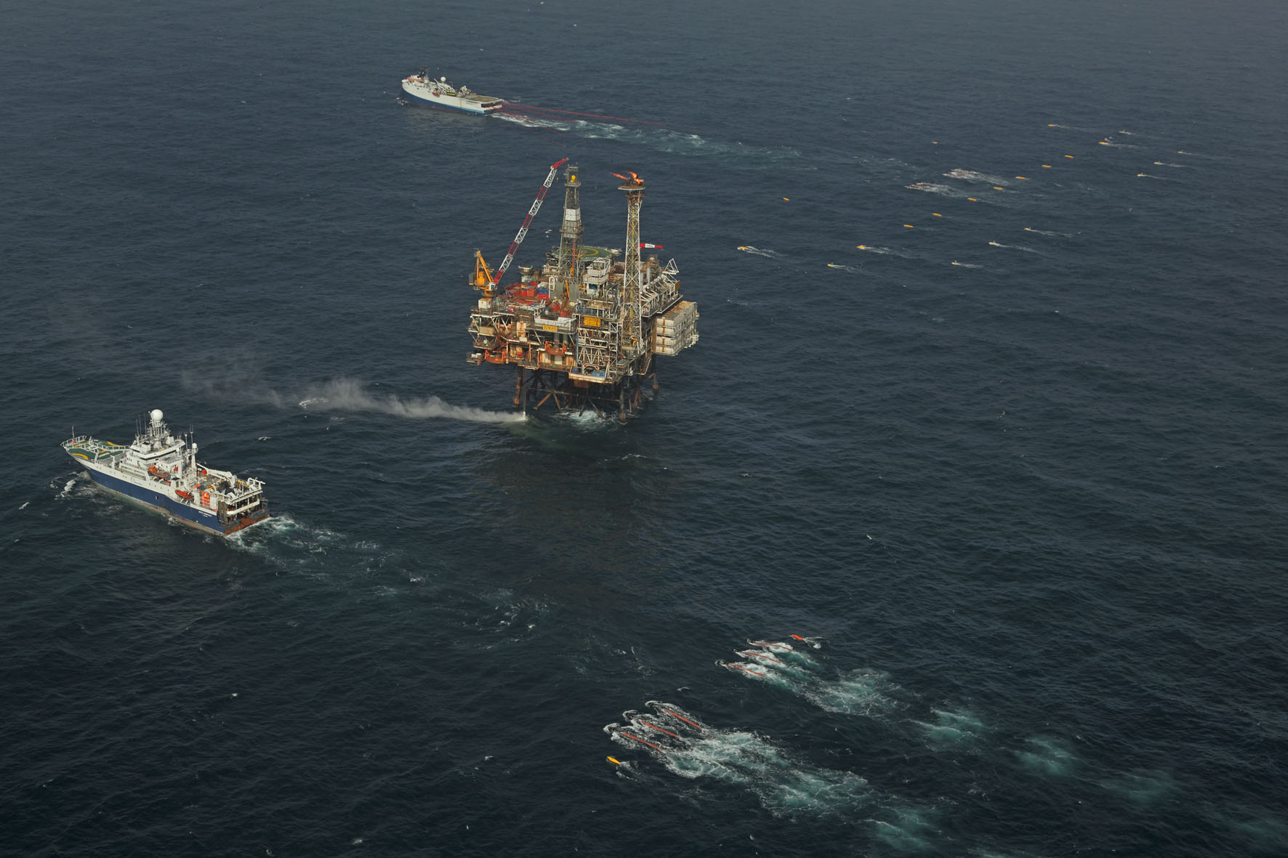

Slide 6
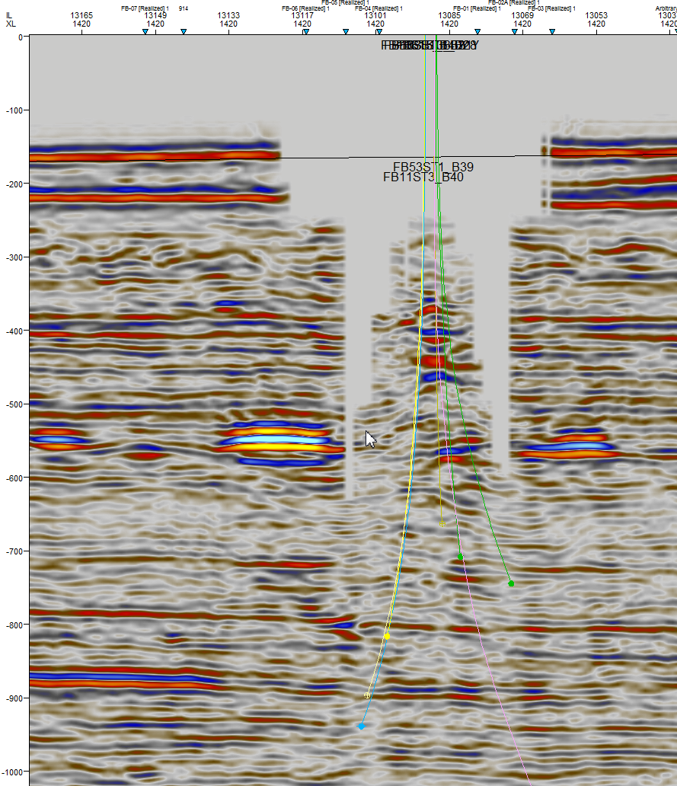
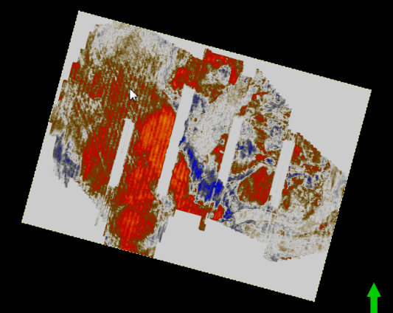
No image underneath platforms from undershoot
Bravo
400m
2010 (and 2000 vintage) 3D data provides excellent image of the hazards everywhere, except above 700m in 400m strip around platforms
Risky zone is from seabed (100m) to Basin Sands (500m) within a radius of 100m from platform inside the no-data zone
Problem requires a new approach to seismic data acquisition.

Slide 7
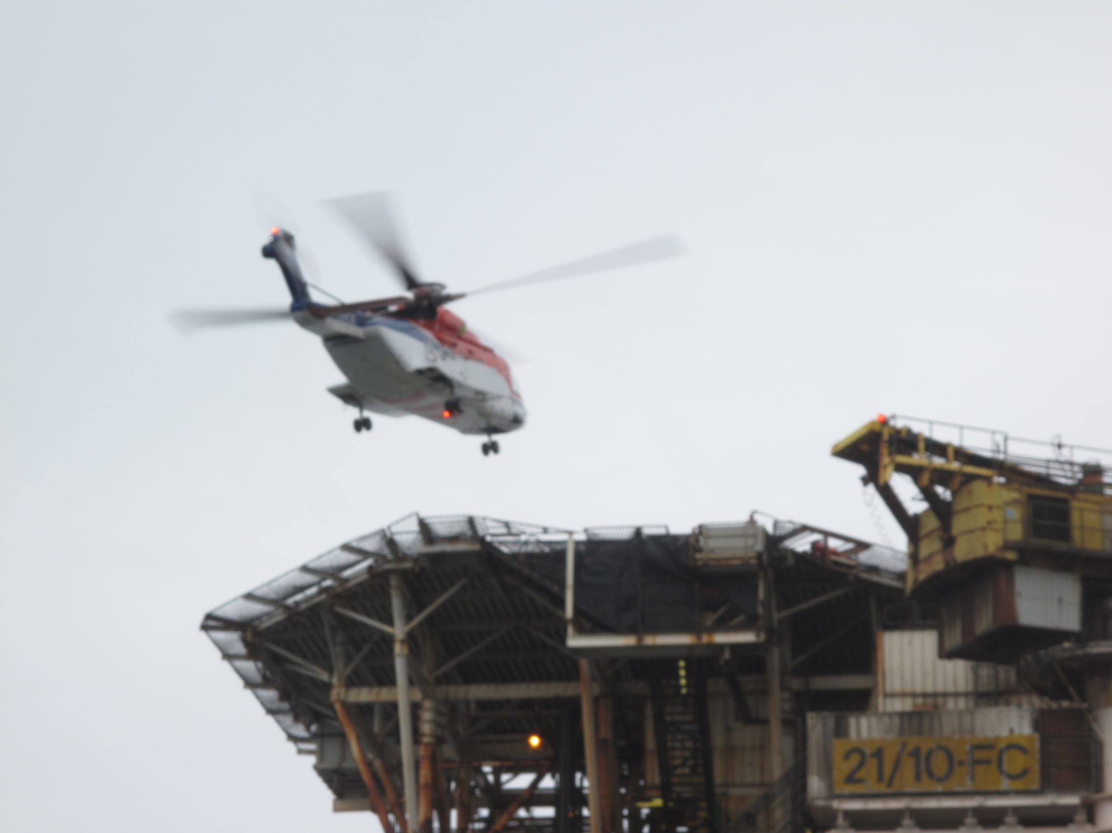

Slide 8
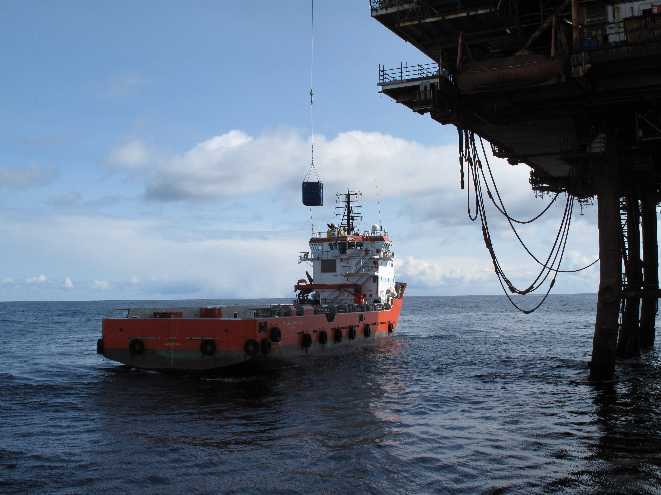

Slide 9
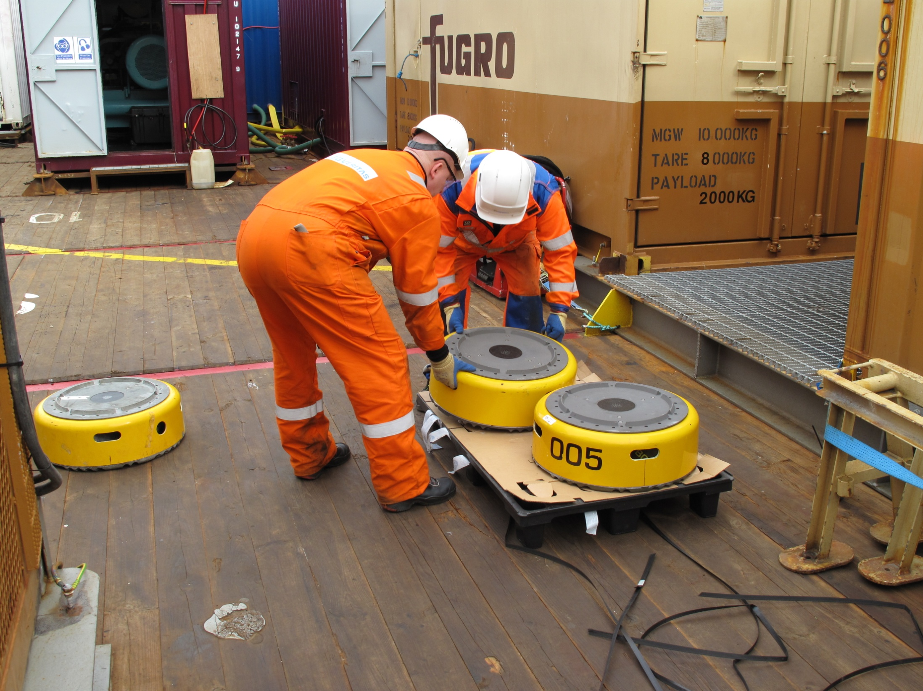

Slide 10
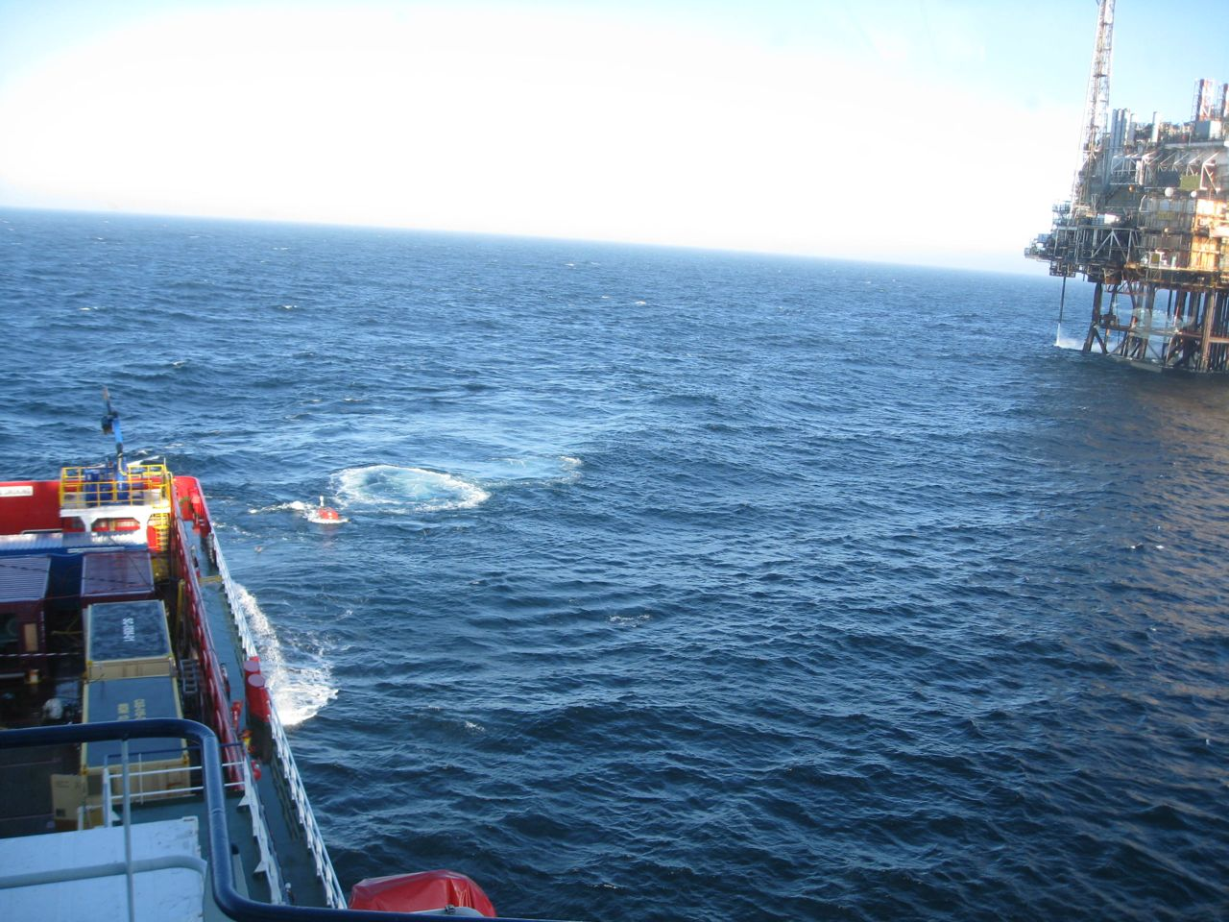
Shooting

Slide 11
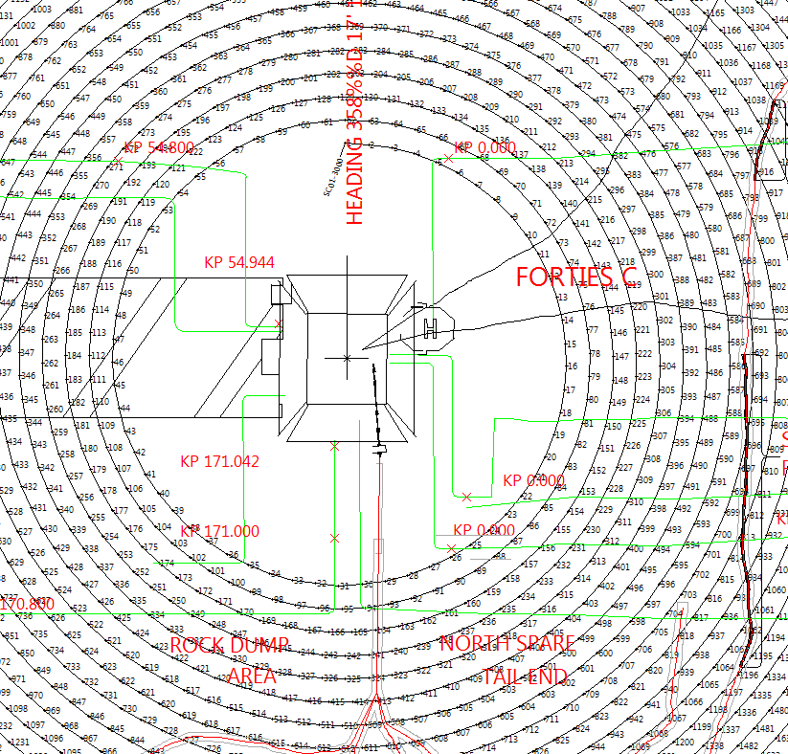
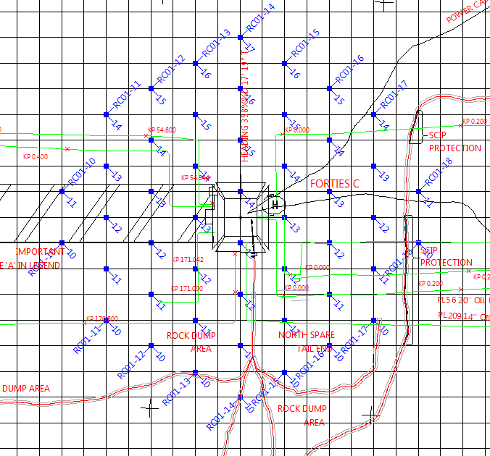
Preplot geometry
Spiral source
Hexagonal receivers
50m
150m

Slide 12
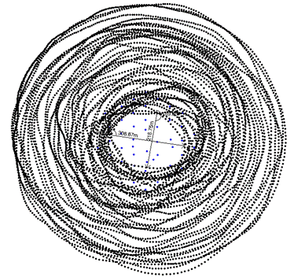
Postplot geometry
Node geometry—nominally hexagonal with offsets for seabed obstructions
Shot geometry: close to desired spiral, but exact shot positioning was not required for coverage.

Slide 13
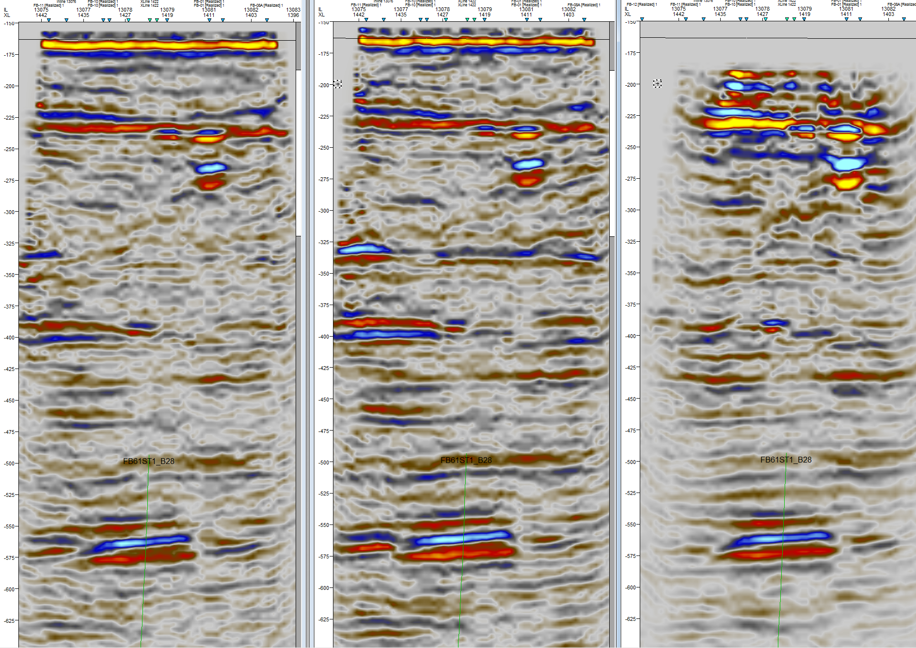
Up-going
Mirror
Mirror+Demultiple

Slide 14
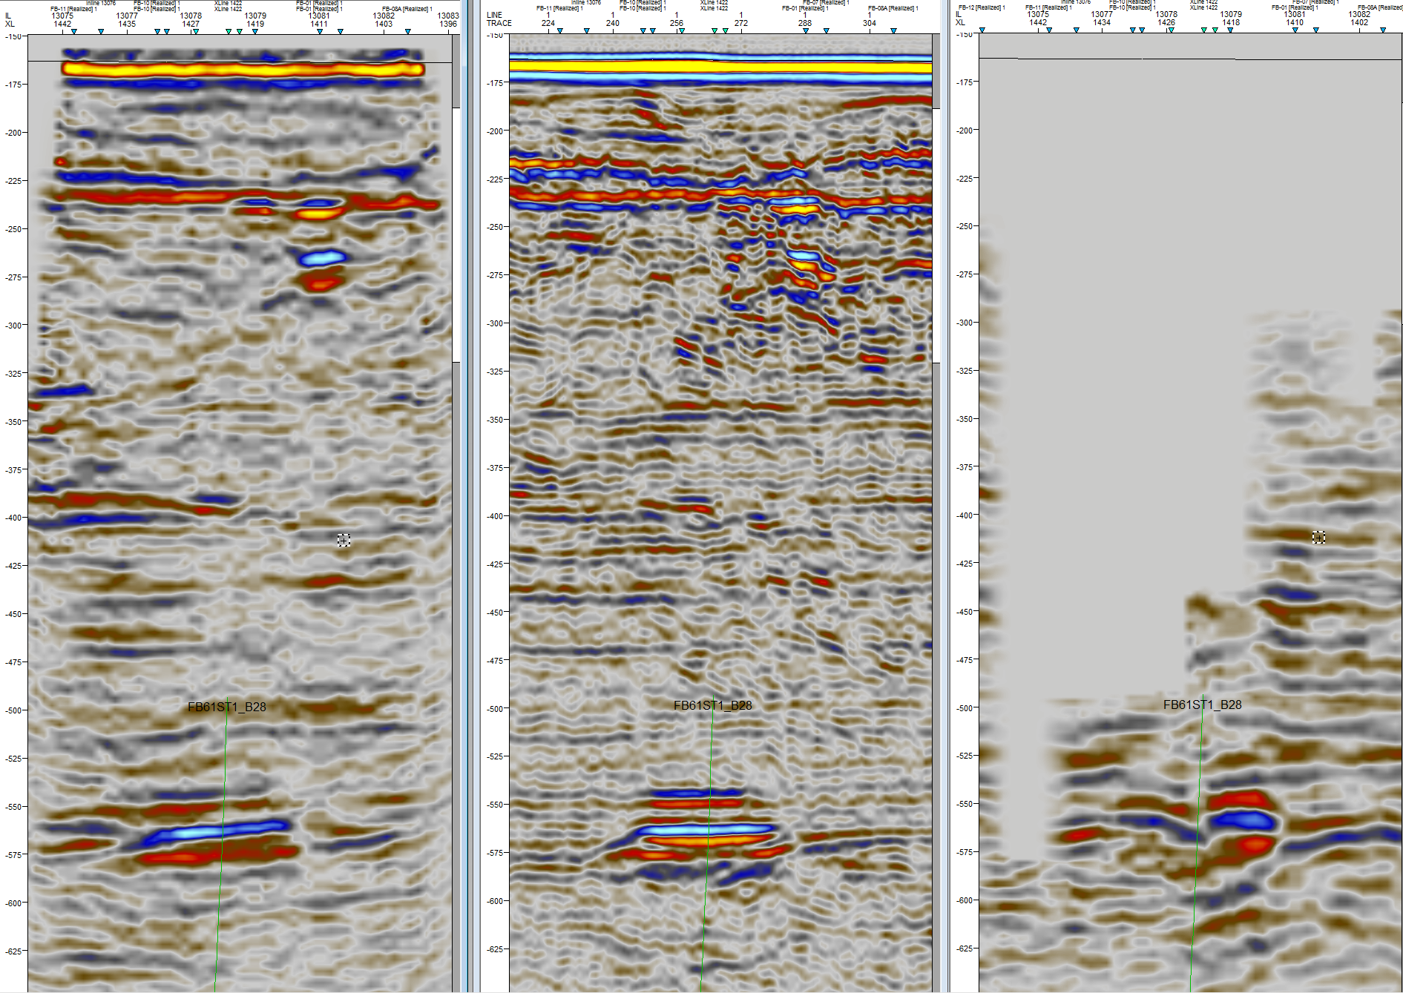
Cross section away from the platform (on a site survey line)
Ocean Bottom Nodes
2D Streamer
3D Streamers
Bright spots indicating gas (drilling hazards)
Multiple
Away from the platform: Consistent image of 2D site survey and 3D nodes (except the multiples)
Only the nodes provide shallow image under the platform

Slide 15
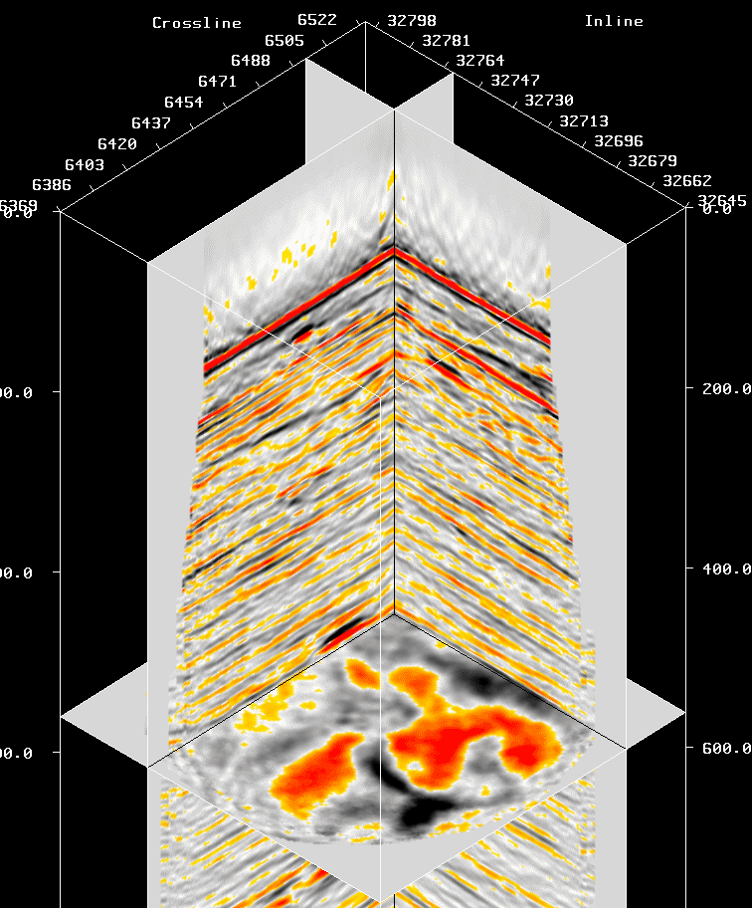
Imaging
Processing
On schedule
Good results!
Preprocessing
Mirror Imaging
Attenuation of higher order multiples

Slide 16
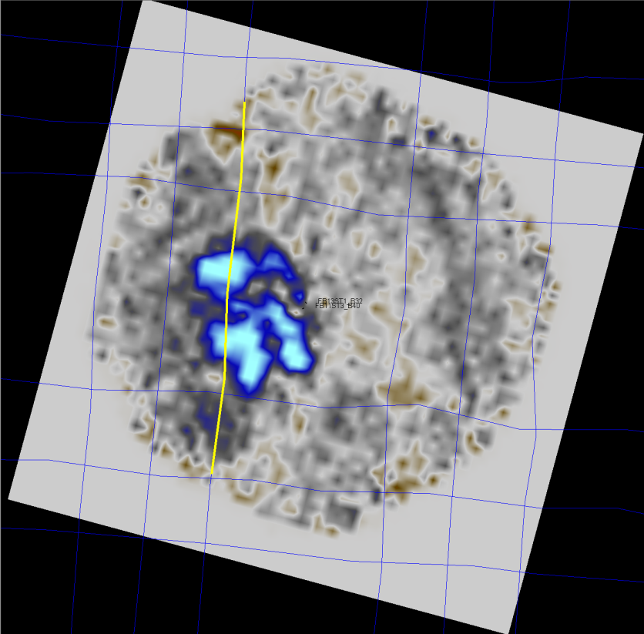

Slide 17
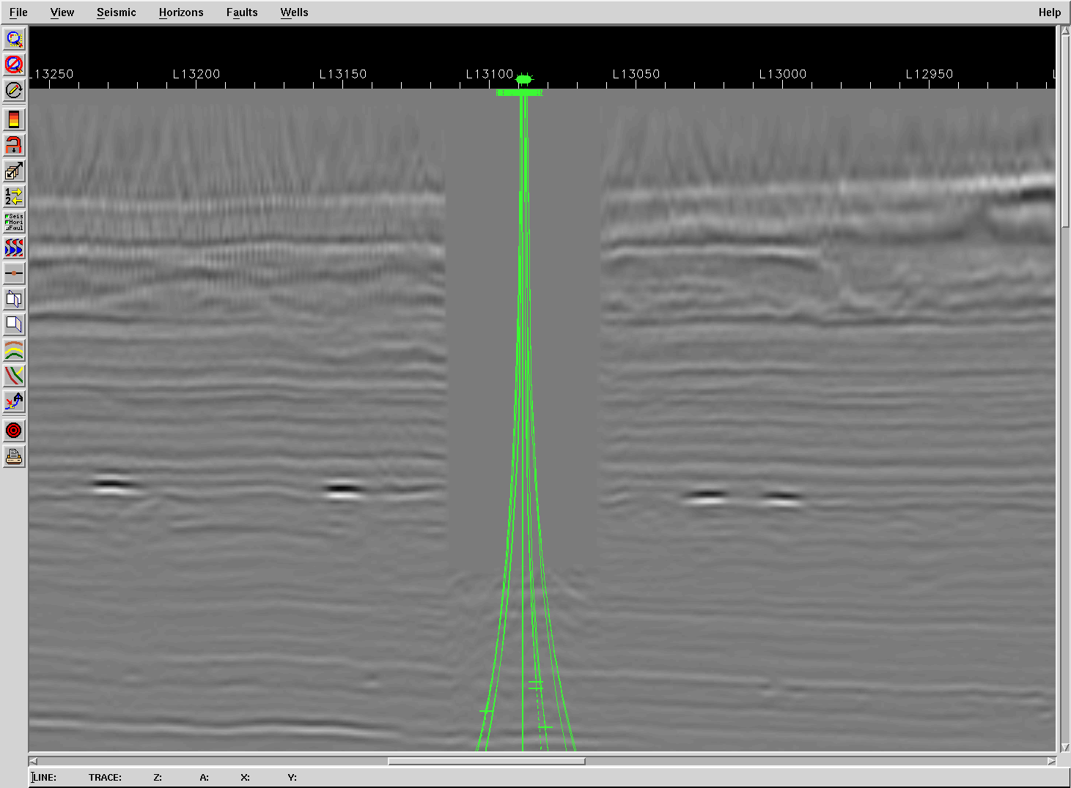
Streamer 3D data
Note the gas bright spots

Slide 18
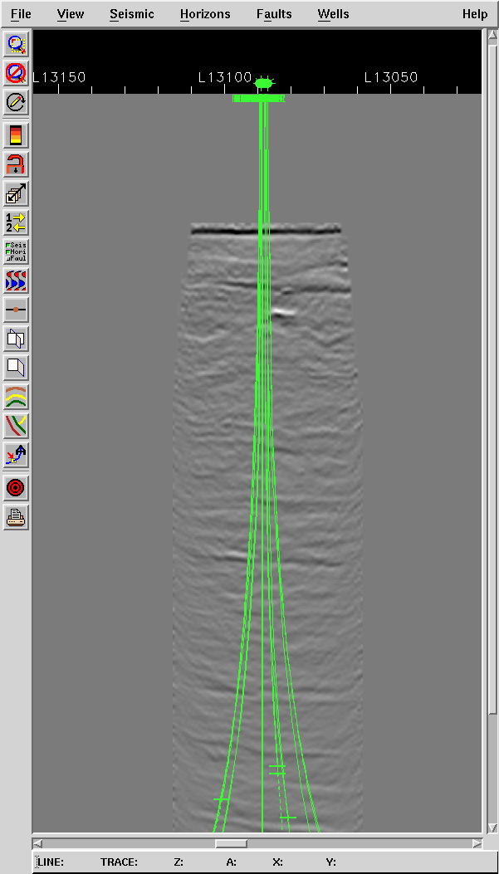
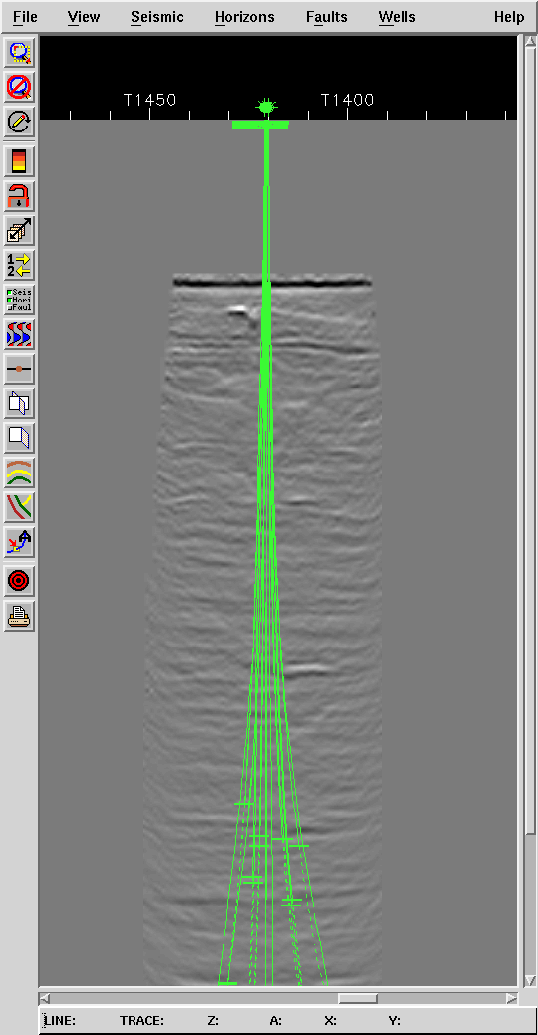
Platform Node survey
Inline and crossline at platform location

Slide 19
Nomination by Klaas Koster — Apache North Sea
The acquisition crew delivered the survey safely and on time, overcoming many challenges that included mobilization on a vessel of opportunity, improvised heliportable mobilization (because of a volcanic eruption), working on a vessel where they were “last on the food chain” (in the instrument room and in the cabins), bad weather, and improvising around some minor equipment failures that otherwise could have brought down the crew.
The Processing team kept their eyes on the ball and delivered good results on time, overcoming many challenges that included delayed delivery of final data, and last and least geophysical challenges in imaging with multiples.

Slide 20
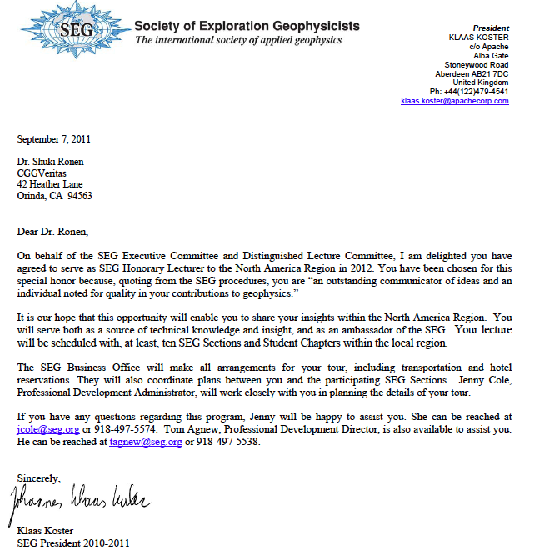
Nomination
by Klaas Koster — SEG President

Slide 21
A long list of Firsts
First special node survey for drilling hazards
First survey designed for Mirror Imaging
First seismic survey mobilized on field work ROV vessel—cost reduction and HSE advantage
First airborne node delivery offshore
First commercial node survey with clock synchronization on the seabed
First multi-node uploading per each ROV docking
First node survey with spiral source geometry
First data drop via a production platform

