Slide 1


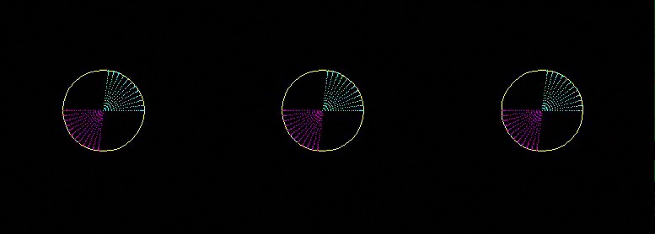
Chapter 3: Wave-mode separation in the continuous wavelet
domain using combined translational and rotational data
Vertical component
P waves
Notes:
Hello, my name is Ohad, and this talk is about wave-mode separation of multicomponent seismic data.
We use a polarization filtering scheme in the the continuous wavelet domain to carry out this wave mode separation.
An example of what I mean by wave mode separation can be seen in this vertical geophone receiver gather:
here is a wave mode that obscures our desired P-wave reflections.
You can see that is has been removed here, and the P-wave reflections are now visible.

Slide 2
Current state of the art
Data components:
Hydrophone
Vertical
Radial
Transverse
“Coherent noise” /
“Source generated noise”
Wave modes:
P-waves
S-waves
Surface waves
“ground roll”
“Vz noise”

Slide 3
Wave-mode selectivity using translational + rotational data
Data components:
Hydrophone
Vertical
Radial
Transverse
Yaw
Roll
Pitch
…
Wave modes:
P-waves
S-waves
Rayleigh
Love
….

Slide 4
Agenda
Current coherent noise removal methods

Slide 5
Agenda
Current coherent noise removal methods
Polarization template matching
  Continuous Wavelet Transform (CWT)
  Singular Value Decomposition (SVD)

Slide 6
Agenda
Current coherent noise removal methods
Polarization template matching
  Continuous Wavelet Transform (CWT)
  Singular Value Decomposition (SVD)
Kettleman six-component survey

Slide 7
Agenda
Current coherent noise removal methods
Polarization template matching
  Continuous Wavelet Transform (CWT)
  Singular Value Decomposition (SVD)
Kettleman six-component survey
Polarization-based wave mode separation

Slide 8
Coherent Noise
Waves generated by the seismic source that do not contain information about the deep subsurface
Typically surface waves
Much stronger than the P-wave reflection data
Introduction / Polarization, CWT, SVD / Kettleman 6C survey / Polarization-based wave-mode separation

Slide 9
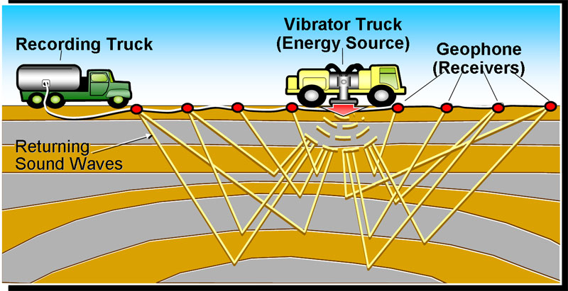
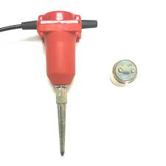
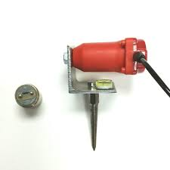
Ground roll / Rayleigh / Surface waves
Introduction / Polarization, CWT, SVD / Kettleman 6C survey / Polarization-based wave-mode separation

Slide 10
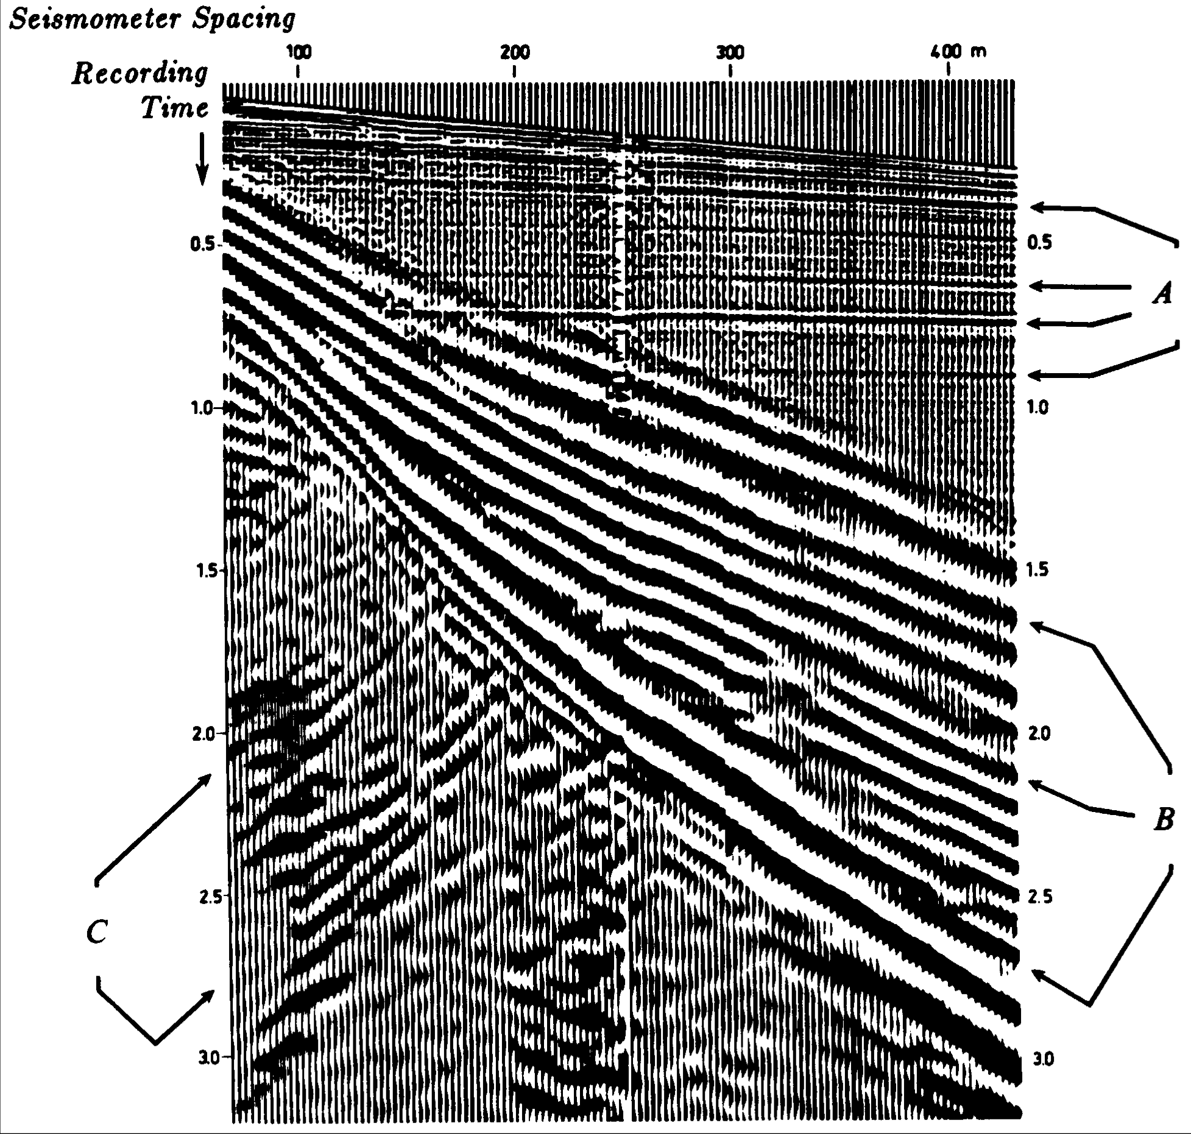
Ground roll / Rayleigh / Surface waves
Data courtesy of Shell
Introduction / Polarization, CWT, SVD / Kettleman 6C survey / Polarization-based wave-mode separation

Slide 11
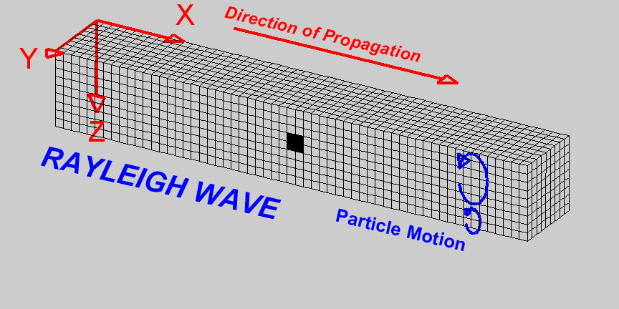
Ground roll / Rayleigh / Surface waves
Data courtesy of Shell
Introduction / Polarization, CWT, SVD / Kettleman 6C survey / Polarization-based wave-mode separation

Slide 12
Ground roll suppression: Mute
Data courtesy of Shell
Introduction / Polarization, CWT, SVD / Kettleman 6C survey / Polarization-based wave-mode separation

Slide 13
Ground roll suppression with F-K
Receivers spaced at 2m intervals
Courtesy of Gustavo Alves
Introduction / Polarization, CWT, SVD / Kettleman 6C survey / Polarization-based wave-mode separation

Slide 14
Ground roll suppression with F-K
Receivers spaced at 8m intervals
Courtesy of Gustavo Alves
Introduction / Polarization, CWT, SVD / Kettleman 6C survey / Polarization-based wave-mode separation

Slide 15
Ground roll suppression with polarization analysis
Multicomponent data (2C or 3C geophone)
Analysis of signal attributes of each multicomponent trace
Threshholding based on signal attributes to identify and separate noise from data
Introduction / Polarization, CWT, SVD / Kettleman 6C survey / Polarization-based wave-mode separation

Slide 16
Ground roll suppression with polarization analysis
Multicomponent data (2C or 3C geophone)
Analysis of signal attributes of each multicomponent trace
Threshholding based on signal attributes to identify and separate noise from data
Not applicable to single component data
Introduction / Polarization, CWT, SVD / Kettleman 6C survey / Polarization-based wave-mode separation

Slide 17
Ground roll suppression with polarization analysis
Multicomponent data (2C or 3C geophone)
Analysis of signal attributes of each multicomponent trace
Threshholding based on signal attributes to identify and separate noise from data
Can operate on spatially aliased data (3D surveys)
Insensitive to statics
Introduction / Polarization, CWT, SVD / Kettleman 6C survey / Polarization-based wave-mode separation

Slide 18
Ground roll suppression with polarization analysis
Multicomponent data (2C or 3C geophone)
Analysis of signal attributes of each multicomponent trace
Threshholding based on signal attributes to identify and separate noise from data
Need to have some prior model of data or noise signal attributes
Introduction / Polarization, CWT, SVD / Kettleman 6C survey / Polarization-based wave-mode separation

Slide 19
Ground roll suppression with polarization analysis
Vidale, 1986: Eigenvalue decomposition of covariance matrix of analytic signal
Kendall et al., 2005: First polarization vector from singular value decomposition of data covariance matrix after low-pass filter
de Meersman et al., 2006: Similar to Kendall et al., but with better noise weighting
Diallo et al. 2006: analytic signal of data after continuous wavelet transform
Introduction / Polarization, CWT, SVD / Kettleman 6C survey / Polarization-based wave-mode separation

Slide 20
Ground roll suppression with polarization analysis
Diallo et al., 2006
Introduction / Polarization, CWT, SVD / Kettleman 6C survey / Polarization-based wave-mode separation

Slide 21
Frequency-dependent polarization template matching
Extract multiple attributes of input multicomponent signal
Insensitive to spatial aliasing
Frequency is an attribute
Data comprise translations and rotations
No prior model for noise. Noise model is learned directly from the data.
Introduction / Polarization, CWT, SVD / Kettleman 6C survey / Polarization-based wave-mode separation

Slide 22
Agenda
Current coherent noise removal methods
Polarization template matching
  Continuous Wavelet Transform (CWT)
  Singular Value Decomposition (SVD)
Kettleman six-component survey
Polarization-based wave mode separation

Slide 23
Singular Value Decomposition (SVD)
Introduction / Polarization, CWT, SVD / Kettleman 6C survey / Polarization-based wave-mode separation

Slide 24
Singular Value Decomposition (SVD)
Scaled singular vectors
Introduction / Polarization, CWT, SVD / Kettleman 6C survey / Polarization-based wave-mode separation

Slide 25
Singular Value Decomposition (SVD)
Polarization vectors
Introduction / Polarization, CWT, SVD / Kettleman 6C survey / Polarization-based wave-mode separation

Slide 26
Singular Value Decomposition (SVD)
Polarization vectors
Data1 |  | Comp 1 | Comp 2
 | Sample 1 | 1 | 0
 | Sample 2 | -0.2 | 0
Data2
 | Sample 1 | 0 | 0.2
 | Sample 2 | 0 | 0.6
Data3
 | Sample 1 | 1 | 0.2
 | Sample 2 | -0.2 | 0.6
Introduction / Polarization, CWT, SVD / Kettleman 6C survey / Polarization-based wave-mode separation

Slide 27
Singular Value Decomposition (SVD)
Polarization vectors
Data1 |  | Comp 1 | Comp 2
 | Sample 1 | 1 | 0
 | Sample 2 | -0.2 | 0
Data2
 | Sample 1 | 0 | 0.2
 | Sample 2 | 0 | 0.6
Data3
 | Sample 1 | 1 | 0.2
 | Sample 2 | -0.2 | 0.6
Introduction / Polarization, CWT, SVD / Kettleman 6C survey / Polarization-based wave-mode separation

Slide 28
Singular Value Decomposition (SVD)
Polarization vectors
Data1 |  | Comp 1 | Comp 2
 | Sample 1 | 1 | 0
 | Sample 2 | -0.2 | 0
Data2
 | Sample 1 | 0 | 0.2
 | Sample 2 | 0 | 0.6
Data3
 | Sample 1 | 1 | 0.2
 | Sample 2 | -0.2 | 0.6
Introduction / Polarization, CWT, SVD / Kettleman 6C survey / Polarization-based wave-mode separation

Slide 29
Continuous Wavelet Transform
data
mother wavelet (Morlet)
daughter wavelet
dilation
time delay
Introduction / Polarization, CWT, SVD / Kettleman 6C survey / Polarization-based wave-mode separation

Slide 30
Continuous Wavelet Transform
data
mother wavelet (Morlet)
daughter wavelet
dilation
time delay
Introduction / Polarization, CWT, SVD / Kettleman 6C survey / Polarization-based wave-mode separation

Slide 31
Continuous Wavelet Transform
64
16
4
1
32
8
2
Introduction / Polarization, CWT, SVD / Kettleman 6C survey / Polarization-based wave-mode separation

Slide 32
Agenda
Current coherent noise removal methods
Polarization template matching
  Continuous Wavelet Transform (CWT)
  Singular Value Decomposition (SVD)
Kettleman six-component survey
Polarization-based wave mode separation

Slide 33
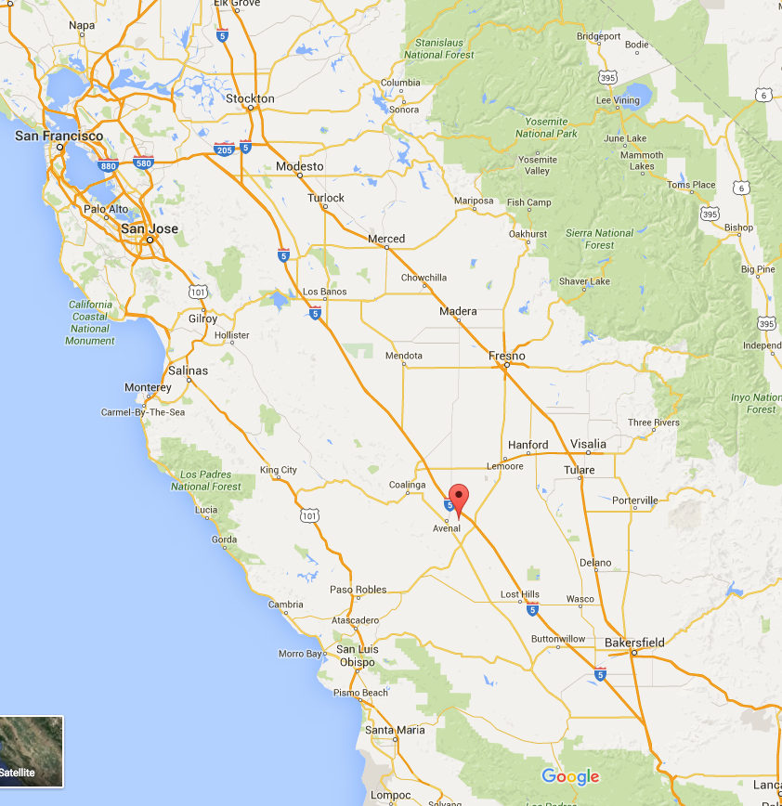
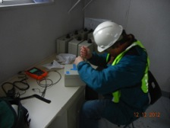
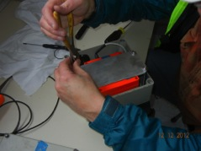
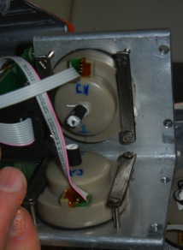
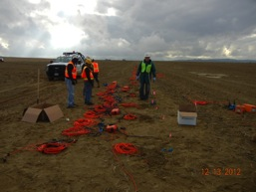
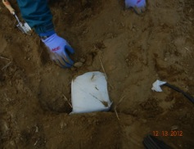
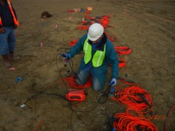
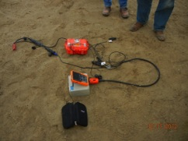
Chevron’s six-component Kettleman survey
Introduction / Polarization, CWT, SVD / Kettleman 6C survey / Polarization-based wave-mode separation

Slide 34
Chevron’s six-component Kettleman survey
1 survey line
Maximum offset = 1600 m
3C MEMS accelerometers at 2 m intervals
3C electrokinetic rotation sensors
4 different source types:
  Accelerated weight-drop
  Vibroseis
  Dynamite at depth = 25 m
  Dynamite at depth = 50 m
Introduction / Polarization, CWT, SVD / Kettleman 6C survey / Polarization-based wave-mode separation

Slide 35



Accelerated weight-drop source
Shot interval 6.25 m
Vertical
Radial
Transverse
Data courtesy of Chevron
Yaw
Roll
Pitch
Notes:
AWD, clip=93%

Slide 36
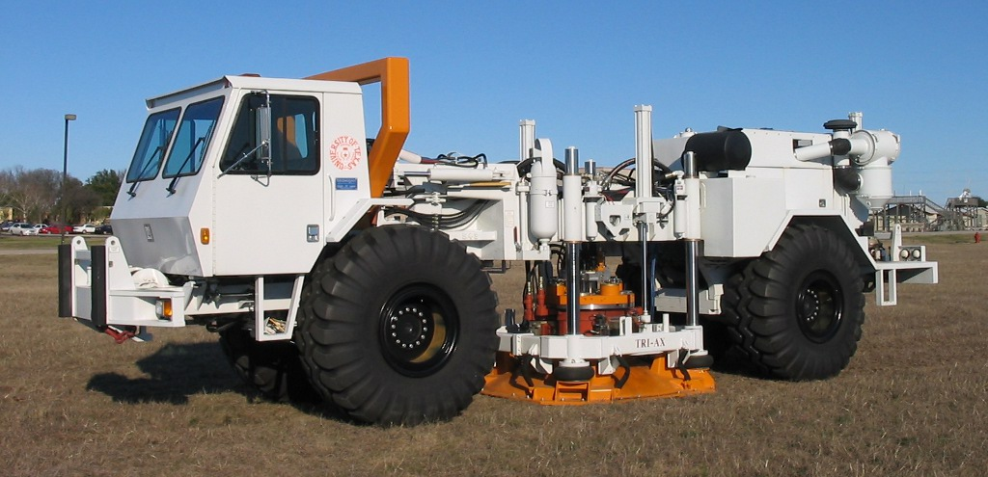
Vibroseis source
Shot interval 25 m
Vertical
Radial
Transverse
Data courtesy of Chevron
Yaw
Roll
Pitch
Notes:
Vibroseis, clip=93%

Slide 37
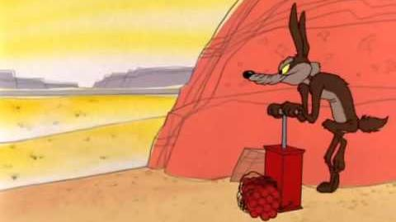
Dynamite source at depth = 25 m
Shot interval 25 m
Vertical
Radial
Transverse
Data courtesy of Chevron
Yaw
Roll
Pitch
Notes:
Dynamite 25, clip=93%

Slide 38
Dynamite source at depth = 50 m
Shot interval 25 m
Vertical
Radial
Transverse
Data courtesy of Chevron
Yaw
Roll
Pitch
Notes:
Dynamite 50, clip=93%

Slide 39
Rotations from geophone differencing on a free surface
Dynamite source
1
d
2
Pitch
r-sensor
Pitch
geo-diff
Data courtesy of Chevron
Introduction / Polarization, CWT, SVD / Kettleman 6C survey / Polarization-based wave-mode separation

Slide 40
Rotations from geophone differencing on a free surface
3 components:
Vertical
Radial
Pitch
Dynamite source
Pitch
r-sensor
Pitch
geo-diff
Data courtesy of Chevron
Introduction / Polarization, CWT, SVD / Kettleman 6C survey / Polarization-based wave-mode separation

Slide 41
Vibroseis source after NMO
Data courtesy of Chevron
Vertical
Radial
Pitch
Introduction / Polarization, CWT, SVD / Kettleman 6C survey / Polarization-based wave-mode separation

Slide 42
Dynamite source at depth=25m after NMO
Data courtesy of Chevron
Vertical
Radial
Pitch
Introduction / Polarization, CWT, SVD / Kettleman 6C survey / Polarization-based wave-mode separation

Slide 43
Dynamite source at depth=50m after NMO
Data courtesy of Chevron
Vertical
Radial
Pitch
Introduction / Polarization, CWT, SVD / Kettleman 6C survey / Polarization-based wave-mode separation

Slide 44
Objectives
Pitch
Separate undesired wave modes from all data components
Insensitive to spatial aliasing
Does not rely on an a priori model of the noise
Radial
Vertical
Data courtesy of Chevron
Introduction / Polarization, CWT, SVD / Kettleman 6C survey / Polarization-based wave-mode separation

Slide 45
Attributes that distinguish between wave modes
Rayleigh wave appearance on each component
Rayleigh wave frequency
Incorporate a time-frequency dependence into polarization analysis
Polarization in the continuous wavelet domain
Learn noise polarization from the data
Pitch
Radial
Vertical
Data courtesy of Chevron
Introduction / Polarization, CWT, SVD / Kettleman 6C survey / Polarization-based wave-mode separation

Slide 46
Agenda
Current coherent noise removal methods
Polarization template matching
  Continuous Wavelet Transform (CWT)
  Singular Value Decomposition (SVD)
Kettleman six-component survey
Polarization-based wave mode separation

Slide 47
Dynamite source at 50 m depth before removal of shear-induced wave
Vertical
Radial
Pitch
Introduction / Polarization, CWT, SVD / Kettleman 6C survey / Polarization-based wave-mode separation

Slide 48
Dynamite source at 50 m depth after removal of shear-induced wave
Vertical
Radial
Pitch
Introduction / Polarization, CWT, SVD / Kettleman 6C survey / Polarization-based wave-mode separation

Slide 49
3C data in the continuous wavelet domain
Pitch
Radial
Vertical
CWT
Introduction / Polarization, CWT, SVD / Kettleman 6C survey / Polarization-based wave-mode separation

Slide 50
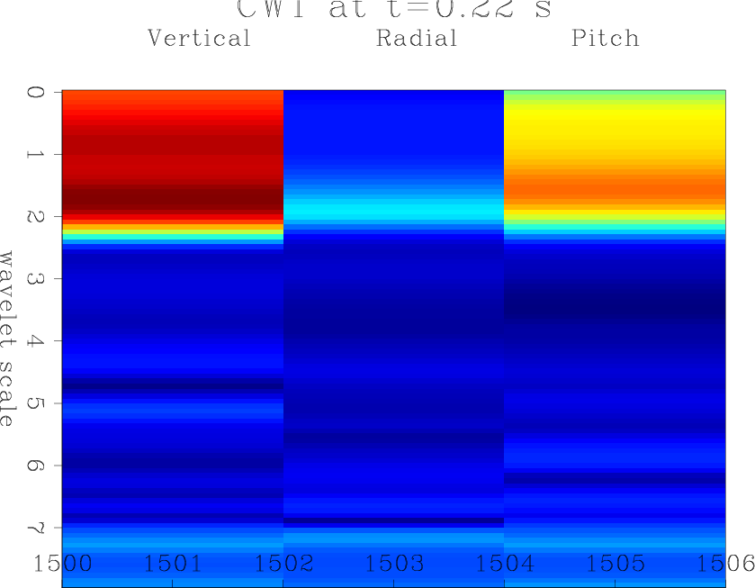
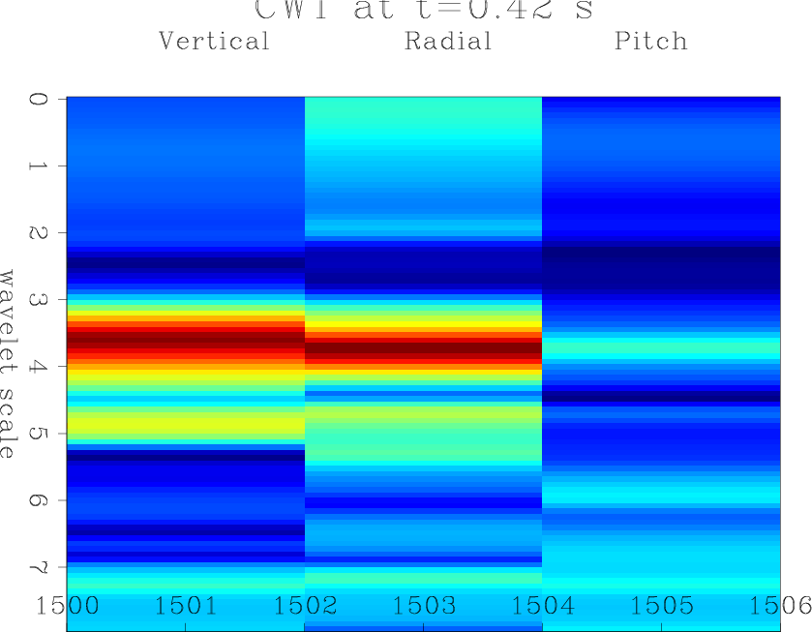
3C data in the continuous wavelet domain
component
frequency
time
Introduction / Polarization, CWT, SVD / Kettleman 6C survey / Polarization-based wave-mode separation

Slide 51
CWT polarization
1st
2nd
S-wave CWT
P-wave CWT
Scaled singular vectors =
polarizations
3rd
Singular value decomposition
Introduction / Polarization, CWT, SVD / Kettleman 6C survey / Polarization-based wave-mode separation

Slide 52
CWT polarization
1st
S-wave CWT
Scaled singular vectors =
polarizations
V_{z}
R_{y}
V_{x}
Introduction / Polarization, CWT, SVD / Kettleman 6C survey / Polarization-based wave-mode separation

Slide 53
CWT polarization
S-wave CWT
P-wave CWT
S-wave polarization
P-wave polarization
Introduction / Polarization, CWT, SVD / Kettleman 6C survey / Polarization-based wave-mode separation

Slide 54
Polarization template
V_{z}
weight
S-wave polarization template
1
0
R_{y}
V_{x}
Introduction / Polarization, CWT, SVD / Kettleman 6C survey / Polarization-based wave-mode separation

Slide 55
Polarization template
V_{z}
weight
Some other arrival’s polarization
1
0
R_{y}
V_{x}
Introduction / Polarization, CWT, SVD / Kettleman 6C survey / Polarization-based wave-mode separation

Slide 56
Weighting function
Introduction / Polarization, CWT, SVD / Kettleman 6C survey / Polarization-based wave-mode separation

Slide 57
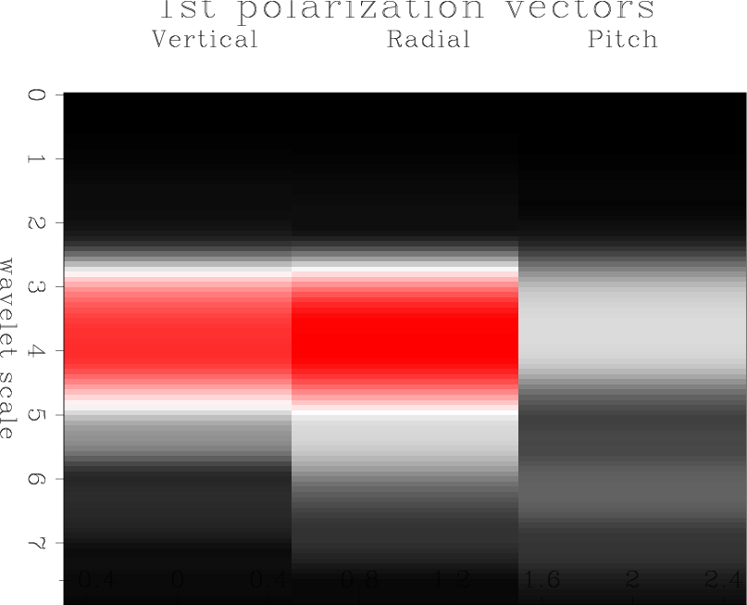
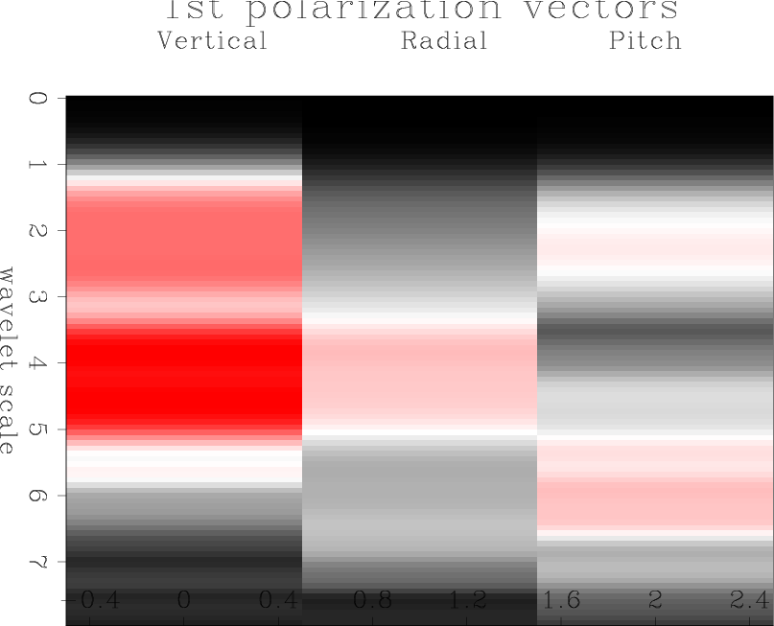
Continuous wavelet domain polarization filtering flow
polarization template
Weighting function
CWT
SVD
CWT⁻¹
CWT+SVD
Introduction / Polarization, CWT, SVD / Kettleman 6C survey / Polarization-based wave-mode separation

Slide 58
Dynamite source at 50 m depth before removal of shear-induced wave
Vertical
Radial
Pitch
Introduction / Polarization, CWT, SVD / Kettleman 6C survey / Polarization-based wave-mode separation

Slide 59
Dynamite source at 50 m depth after removal of shear-induced wave
Vertical
Radial
Pitch
Introduction / Polarization, CWT, SVD / Kettleman 6C survey / Polarization-based wave-mode separation

Slide 60
Polarization filter vs frequency filter
Input data
Polarization filter
High-pass filter
Introduction / Polarization, CWT, SVD / Kettleman 6C survey / Polarization-based wave-mode separation

Slide 61
Dynamite source at 25 m depth before removal of shear-induced wave
Vertical
Radial
Pitch
Introduction / Polarization, CWT, SVD / Kettleman 6C survey / Polarization-based wave-mode separation

Slide 62
Dynamite source at 25 m depth after removal of shear-induced wave
Vertical
Radial
Pitch
Introduction / Polarization, CWT, SVD / Kettleman 6C survey / Polarization-based wave-mode separation

Slide 63
Vibroseis source before removal of Rayleigh waves
Vertical
Radial
Pitch
Introduction / Polarization, CWT, SVD / Kettleman 6C survey / Polarization-based wave-mode separation

Slide 64
Vibroseis source after removal of Rayleigh waves
Vertical
Radial
Pitch
Introduction / Polarization, CWT, SVD / Kettleman 6C survey / Polarization-based wave-mode separation

Slide 65
Vibroseis source before removal of Rayleigh waves
Vertical
Introduction / Polarization, CWT, SVD / Kettleman 6C survey / Polarization-based wave-mode separation

Slide 66
Vibroseis source after removal of Rayleigh waves
Vertical
Introduction / Polarization, CWT, SVD / Kettleman 6C survey / Polarization-based wave-mode separation

Slide 67
Summary
Frequency-dependent polarization filtering using CWT and SVD
Matching wavelet-domain polarization template of an undesired wave-mode
Multicomponent translational + rotational field data
No spatial sampling requirement
Assumption of stationarity of undesired wave-mode

Slide 68
Summary
Frequency-dependent polarization filtering using CWT and SVD
Matching wavelet-domain polarization template of an undesired wave-mode
Multicomponent translational + rotational field data
No spatial sampling requirement
Assumption of stationarity of undesired wave-mode
Chapter 4: Automatic wave-mode identification with machine learning

Slide 69
Machine-learning classification at station 337
Training: Class 1=
Slow ground roll
Training: Class 1=
Fast ground roll
Training: Class 1=
Slow+fast ground roll
Class 1
Class 0
Class 1
Class 0
Class 1
Class 0
Data courtesy of Chevron
Manual wave-mode identification / Support Vector Machines / Automatic wave-mode identification

Slide 70
Acknowledgements
Fred Herkenhoff and Ranjan Dash (Chevron)
Robert Brune (Geokinetics)
Everhard Muyzert (Schlumberger)
Notes:
Hello, my name is Ohad, and this talk is about wave-mode separation of multicomponent seismic data.
We use a polarization filtering scheme in the the continuous wavelet domain to carry out this wave mode separation.
An example of what I mean by wave mode separation can be seen in this vertical geophone receiver gather:
here is a wave mode that obscures our desired P-wave reflections.
You can see that is has been removed here, and the P-wave reflections are now visible.

Slide 71
Spare slides

Slide 72
Comparison of weighting function with different components
C₁
Cone
C₃
C₂
Introduction / Polarization, CWT, SVD / Kettleman 6C survey / Polarization-based wave-mode separation

Slide 73
Comparison of weighting function with different components
Six components in Kettleman dataset:
Vertical
Radial
Transverse
Yaw
Roll
Pitch
Introduction / Polarization, CWT, SVD / Kettleman 6C survey / Polarization-based wave-mode separation

Slide 74
Comparison of weighting function with different components
Compare filtering using:
Vertical
Radial
Transverse
Vertical
Radial
Transverse
+ Pitch
vs
Introduction / Polarization, CWT, SVD / Kettleman 6C survey / Polarization-based wave-mode separation

Slide 75
Comparison of weighting function with different components
C₁
C₃
C₂
Introduction / Polarization, CWT, SVD / Kettleman 6C survey / Polarization-based wave-mode separation

Slide 76
Comparison of weighting function with different components
C₁
C₃
C₂
Introduction / Polarization, CWT, SVD / Kettleman 6C survey / Polarization-based wave-mode separation

Slide 77
Comparison of weighting function with different components
C₁
Slice
C₃
C₂
Introduction / Polarization, CWT, SVD / Kettleman 6C survey / Polarization-based wave-mode separation

Slide 78
Comparison of weighting function with different components
C₁
Wedge
C₃
C₂
Introduction / Polarization, CWT, SVD / Kettleman 6C survey / Polarization-based wave-mode separation

Slide 79
Comparison of weighting function with different components
C₁
Cone
C₃
C₂
Introduction / Polarization, CWT, SVD / Kettleman 6C survey / Polarization-based wave-mode separation

Slide 80
Comparison of weighting function with different components
C₁
Cone
C₄
C₂
Introduction / Polarization, CWT, SVD / Kettleman 6C survey / Polarization-based wave-mode separation

Slide 81
Comparison of weighting function with different components
Compare filtering using:
Vertical
Radial
Transverse
Vertical
Radial
Pitch
vs
Introduction / Polarization, CWT, SVD / Kettleman 6C survey / Polarization-based wave-mode separation

Slide 82
Transverse vs Pitch component, dynamite 25 m
Vertical
Radial
Transverse
Introduction / Polarization, CWT, SVD / Kettleman 6C survey / Polarization-based wave-mode separation

Slide 83
Transverse vs Pitch component, dynamite 25 m
Vertical
Radial
Pitch
Introduction / Polarization, CWT, SVD / Kettleman 6C survey / Polarization-based wave-mode separation

Slide 84
Before removal of shear-induced wave, dynamite 25 m
Vertical
Radial
Transverse
Pitch
Introduction / Polarization, CWT, SVD / Kettleman 6C survey / Polarization-based wave-mode separation

Slide 85
After removal of shear-induced wave with vertical, radial, transverse
Vertical
Radial
Transverse
Pitch
Introduction / Polarization, CWT, SVD / Kettleman 6C survey / Polarization-based wave-mode separation

Slide 86
After removal of shear-induced wave with vertical, radial, pitch
Vertical
Radial
Transverse
Pitch
Introduction / Polarization, CWT, SVD / Kettleman 6C survey / Polarization-based wave-mode separation

Slide 87
Before removal of slow ground roll, vibroseis
Vertical
Radial
Transverse
Pitch
Introduction / Polarization, CWT, SVD / Kettleman 6C survey / Polarization-based wave-mode separation

Slide 88
After removal of slow ground roll with vertical, radial, transverse
Vertical
Radial
Transverse
Pitch
Introduction / Polarization, CWT, SVD / Kettleman 6C survey / Polarization-based wave-mode separation

Slide 89
After removal of slow ground roll with vertical, radial, pitch
Vertical
Radial
Transverse
Pitch
Introduction / Polarization, CWT, SVD / Kettleman 6C survey / Polarization-based wave-mode separation

Slide 90
Before removal of shear-induced wave, dynamite 50 m
Vertical
Radial
Transverse
Pitch
Introduction / Polarization, CWT, SVD / Kettleman 6C survey / Polarization-based wave-mode separation

Slide 91
After removal of shear-induced wave with vertical, radial, transverse
Vertical
Radial
Transverse
Pitch
Introduction / Polarization, CWT, SVD / Kettleman 6C survey / Polarization-based wave-mode separation

Slide 92
After removal of shear-induced wave with vertical, radial, pitch
Vertical
Radial
Transverse
Pitch
Introduction / Polarization, CWT, SVD / Kettleman 6C survey / Polarization-based wave-mode separation

Slide 93
Ground roll suppression with Stack-Array
(Morse and Hildebrandt, 1989)
Introduction / Polarization, CWT, SVD / Kettleman 6C survey / Polarization-based wave-mode separation

Slide 94
Ground roll suppression with Stack-Array
(Morse and Hildebrandt, 1989)
Introduction / Polarization, CWT, SVD / Kettleman 6C survey / Polarization-based wave-mode separation

Slide 95
Ground roll suppression with Stack-Array
Topography (Statics correction)
Assumption of surface wave velocity
Large scale 3D acquisition?
Acquisition design focused on noise suppression
(Morse and Hildebrandt, 1989)
Introduction / Polarization, CWT, SVD / Kettleman 6C survey / Polarization-based wave-mode separation

Slide 96
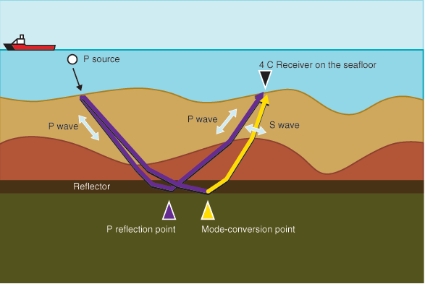
Vz noise in ocean bottom node data
Introduction / Polarization, CWT, SVD / Kettleman 6C survey / Polarization-based wave-mode separation

Slide 97
Upgoing and downgoing wavefields
Downgoing
Upgoing
(M. Wong, 2014)
Introduction / Polarization, CWT, SVD / Kettleman 6C survey / Polarization-based wave-mode separation

Slide 98
Upgoing and downgoing wavefields
Downgoing
Upgoing
PZ summation:
Combine Hydrophone and vertical geophone to separate upgoing data from downgoing data
(M. Wong, 2014)
Introduction / Polarization, CWT, SVD / Kettleman 6C survey / Polarization-based wave-mode separation

Slide 99
Vz noise in ocean bottom node data
Hydrophone
Vertical with Vz noise
(Zhou et al., 2011)
Introduction / Polarization, CWT, SVD / Kettleman 6C survey / Polarization-based wave-mode separation

Slide 100
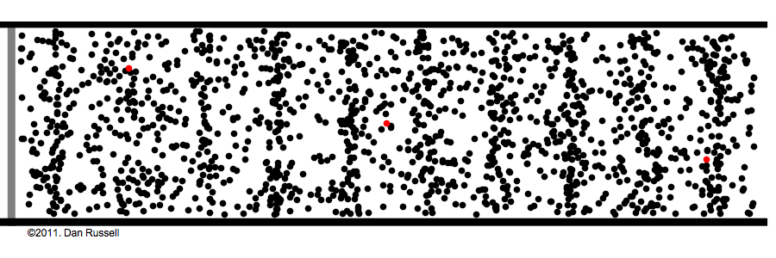
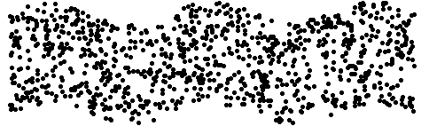
Vz noise in ocean bottom node data
P wave
S wave
Hydrophone
Vertical with Vz noise
(Zhou et al., 2011)
Introduction / Polarization, CWT, SVD / Kettleman 6C survey / Polarization-based wave-mode separation

Slide 101
Vz noise suppression with match filtering
Hydrophone
Vertical with Vz noise
(Zhou et al., 2011)
Introduction / Polarization, CWT, SVD / Kettleman 6C survey / Polarization-based wave-mode separation

Slide 102
Vz noise suppression with match filtering
Hydrophone
Vertical with Vz noise
Vertical after Vz noise suppression
(Zhou et al., 2011)
Introduction / Polarization, CWT, SVD / Kettleman 6C survey / Polarization-based wave-mode separation

Slide 103
Vz noise suppression with match filtering
Extension of the data dimensions to a domain where noise is separable from data
Requires an input model of “clean” data
Spatial transforms that rely on sufficient spatial sampling of the wavefield
Hydrophone
(Zhou et al., 2011)
Introduction / Polarization, CWT, SVD / Kettleman 6C survey / Polarization-based wave-mode separation

Slide 104
Ground roll suppression with adaptive subtraction
(Edme et al., 2014)
Introduction / Polarization, CWT, SVD / Kettleman 6C survey / Polarization-based wave-mode separation

Slide 105
Ground roll suppression with adaptive subtraction
No spatial sampling requirements
Requires a model of the noise
Assumption that noise appears only on particular data components
(Edme et al., 2014)
Introduction / Polarization, CWT, SVD / Kettleman 6C survey / Polarization-based wave-mode separation

Slide 106

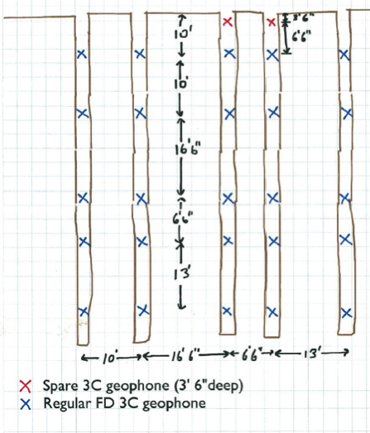

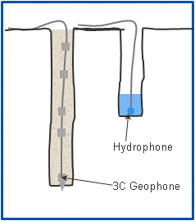
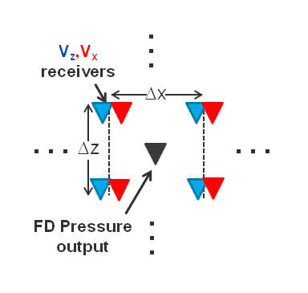
“FD Pressure” Idea
-Put the FD Stencil in the Earth-
(Courtesy of Fred Herkenhoff)

Slide 107
Thanks for listening
1C
3C
6C
email: ohad@sep.stanford.edu
Notes:
Seisballs are a derivation from Bob’s idea of using the BMW symbol

